Slide 1


Education Moment
10 Things That Require Zero Talent
Notes:
You may have seen a graphic floating around social media titled, “10 Things That Require Zero Talent.”
They are: Being on Time, Work Ethic, Effort, Body Language, Energy, Attitude, Passion, Being Coachable, Doing Extra & Being Prepared.
What they are simple characteristics that, anyone, highly skilled or not can apply to their life and business to improve the perception others have of you.
All of these can be connected to the core values of BNI and I will share these today:

Slide 2

1. Being On Time
Notes:
1. Being on time – It’s not about you, it is all about respecting the time of others.

Slide 3

2. Work Ethic
Notes:
2. Work Ethic – Think about it, would you hire or recommend someone with a poor Work Ethic?

Slide 4
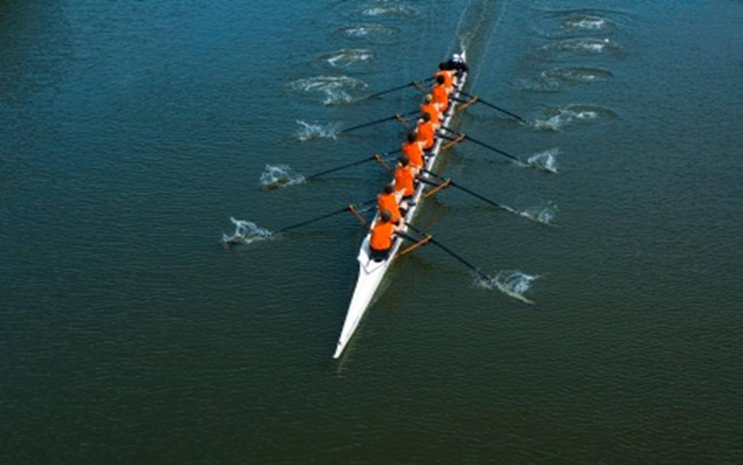
3. Effort
Notes:
3. Effort – You get out of something what you put into it.

Slide 5

4. Body Language
Notes:
4. Body Language –People will make their perceptions of you and your business by how you act.

Slide 6

5. Energy
Notes:
5. Energy – Approach every meeting you have, with high-energy, ready to make a contribution.

Slide 7

6. Attitude
Notes:
6. Attitude – It is your attitude, more than your aptitude, that will determine your altitude.

Slide 8

7. Passion
Notes:
7. Passion – People who are passionate about what they do, are way easier to refer.

Slide 9

8. Being Coachable
Notes:
8. Being Coachable – Engage yourself in a culture of learning, we can always learn more.

Slide 10

9. Doing Extra
Notes:
9. Doing Extra – Go the extra mile for all of your BNI referrals, people will be more likely to refer you on to
others.

Slide 11

10. Being Prepared
Notes:
10. Being Prepared – Prepare for all your BNI Meetings as you were about to prepare to meet you
biggest client.

Slide 12
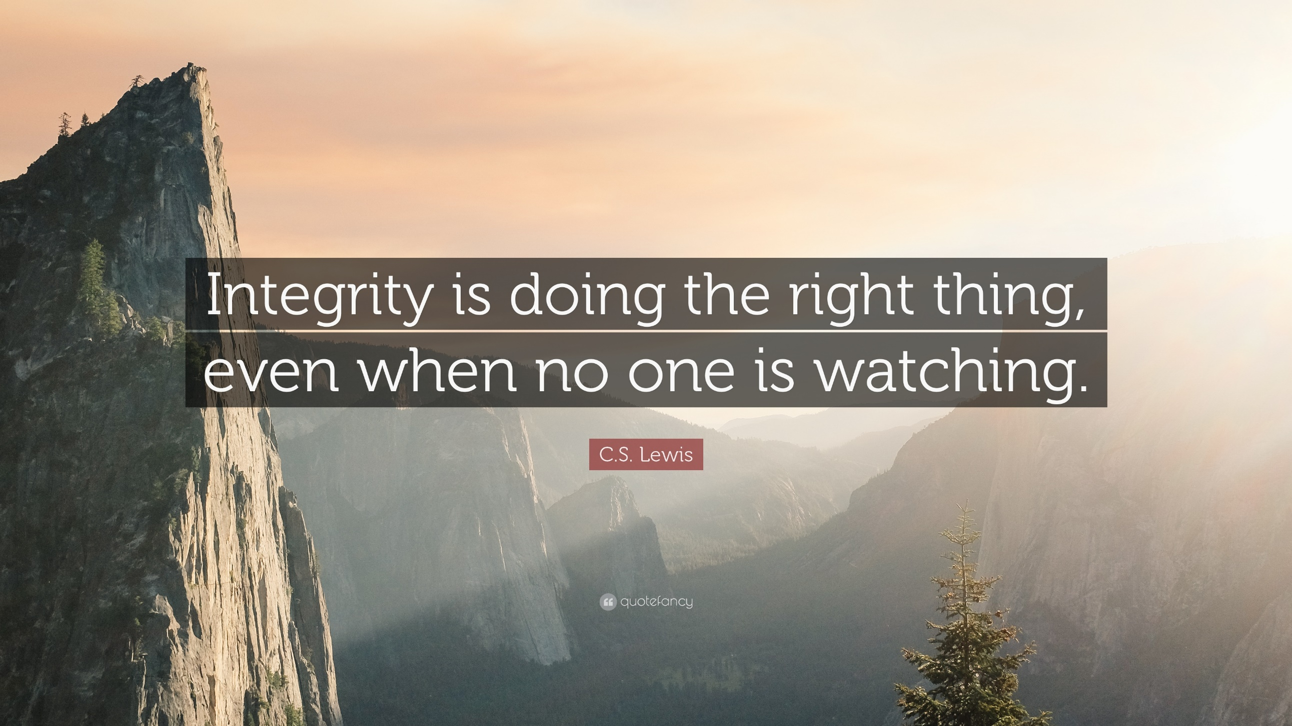
Notes:
These do require absolutely no talent, but the results in your business networking efforts will pay off handsomely by keeping these traits in mind.
Can you suggest any others? Get some suggestions (2 or 3) from the group
Remember, do what is right, not just what is easy- even if no one is looking

