Slide 1


Education Moment
Know Your 20%

Slide 2
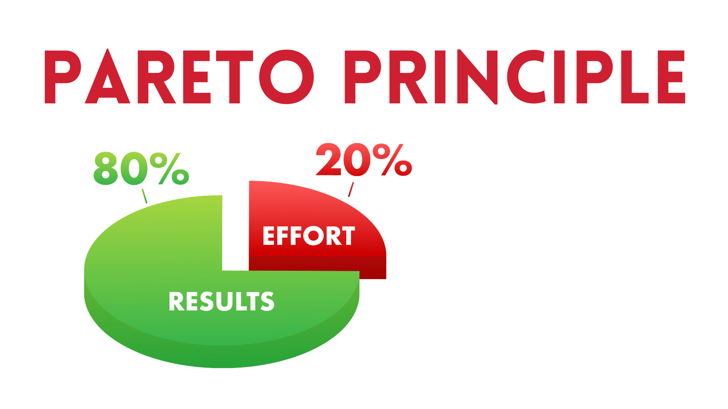
For many outcomes,
roughly 80% of consequences
come from 20% of causes

Slide 3

What are the
Income Producing Activities
(IPAs)
for your business?

Slide 4

Networking!
Fostering Collaborations
Getting Referrals
Keeping In Touch
Being A Guest Star
Going To Events
Marketing With A Goal
Testimonials & Case Studies
Creating Packaged Services
Producing Pro Proposals
Consult Calls
Following Up Potential Leads
Upselling Existing Clients
Contacting Past Clients
Cold Contacting
Delivering On Client Commitment

