Slide 1

Education Moment
Dissecting Your Traffic Lights

Slide 2
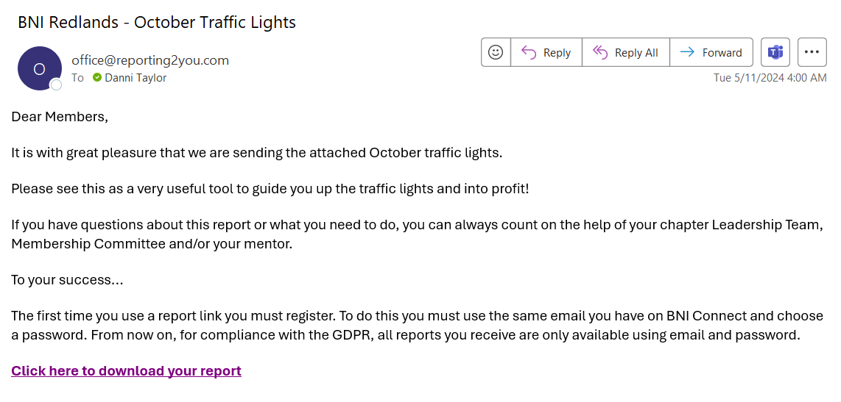

Slide 3
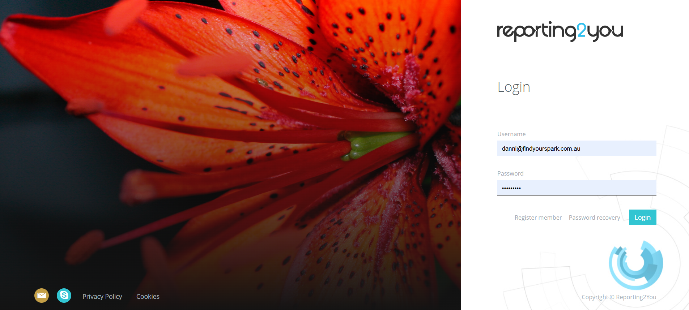


Slide 4
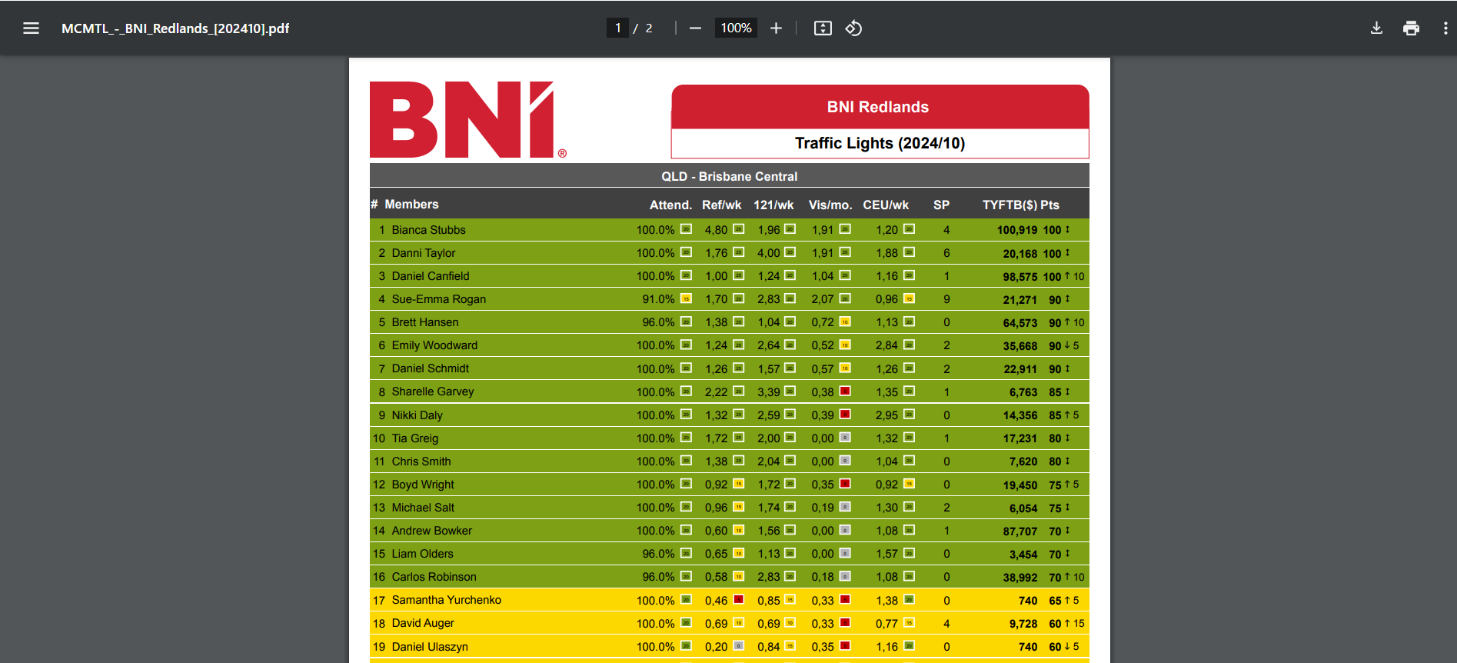

Slide 5
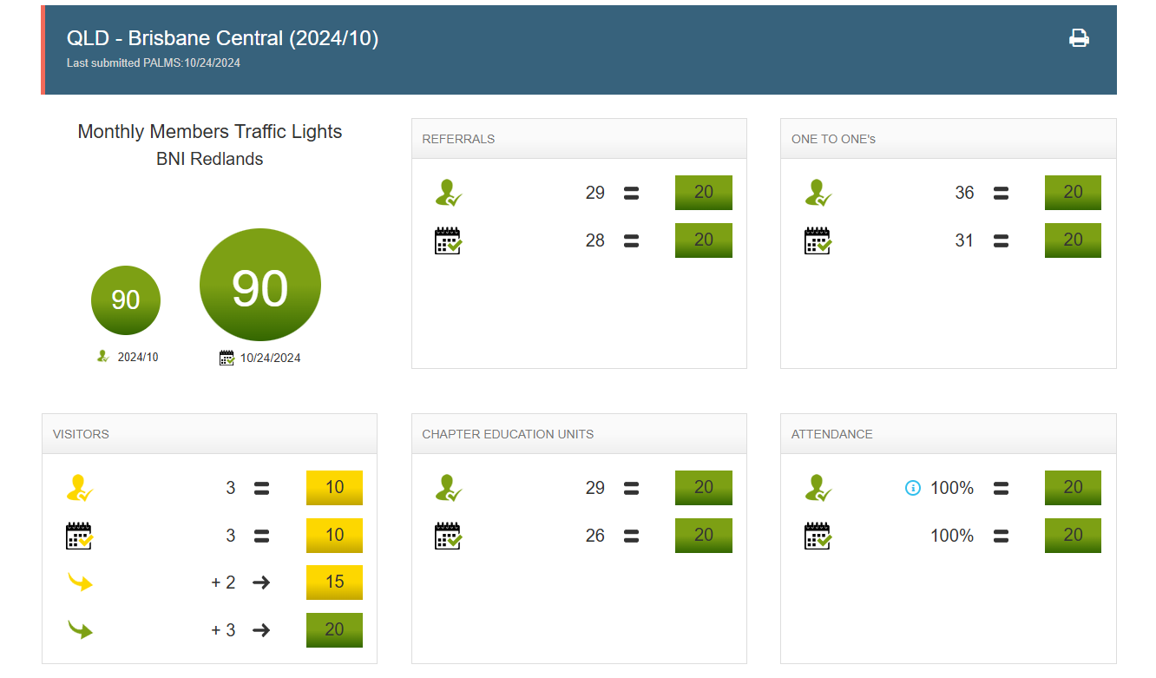

Latest PALMS Report
Latest Traffic Lights
Needed to stay YELLOW
Needed to get to GREEN

Slide 6
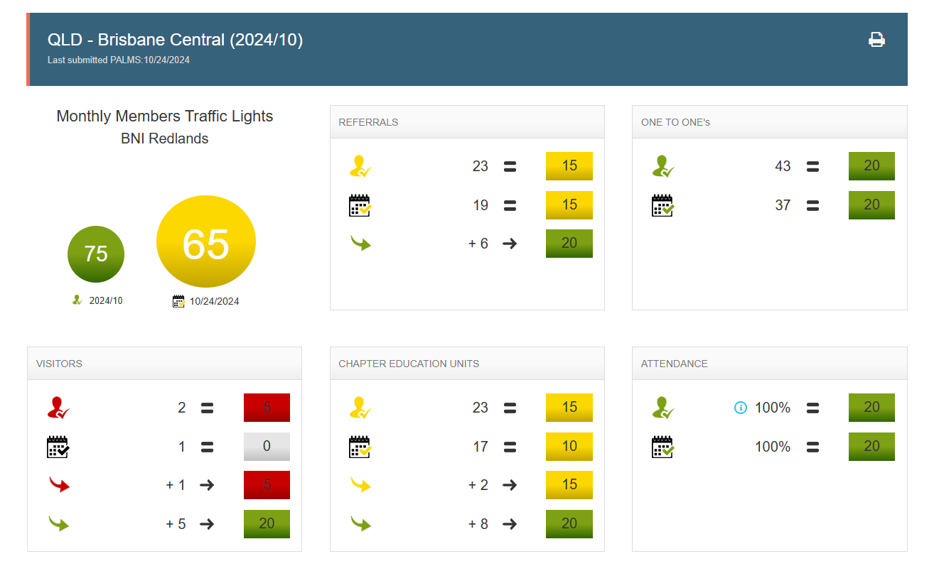
Latest PALMS Report
Latest Traffic Lights
Needed to get to GREEN
At time of report,
member was sitting on RED
Currently sitting on GREY
Needed to get to RED
Needed to get to GREEN

Slide 7
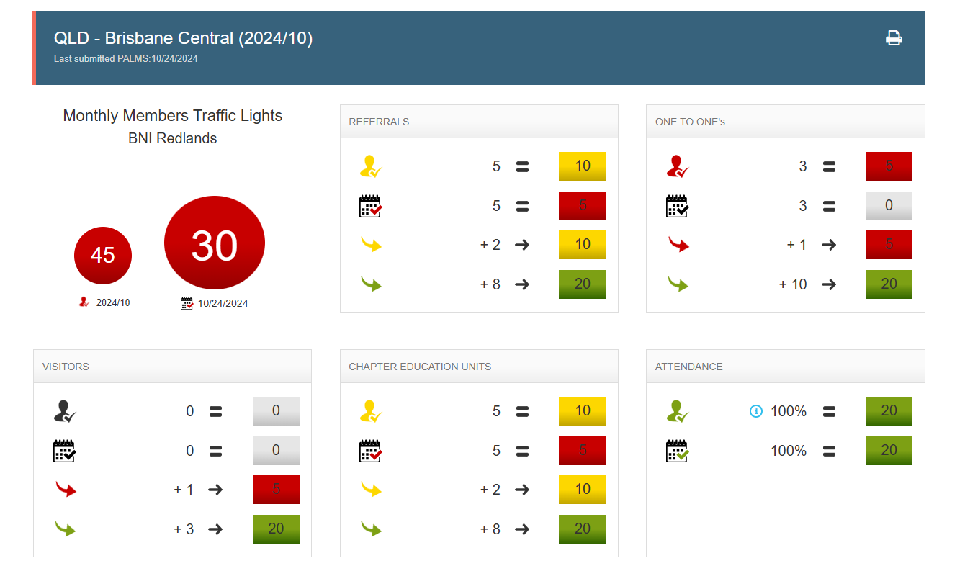

Slide 8


