Slide 1


Education Moment
How Hot Is This Referral?

Slide 2
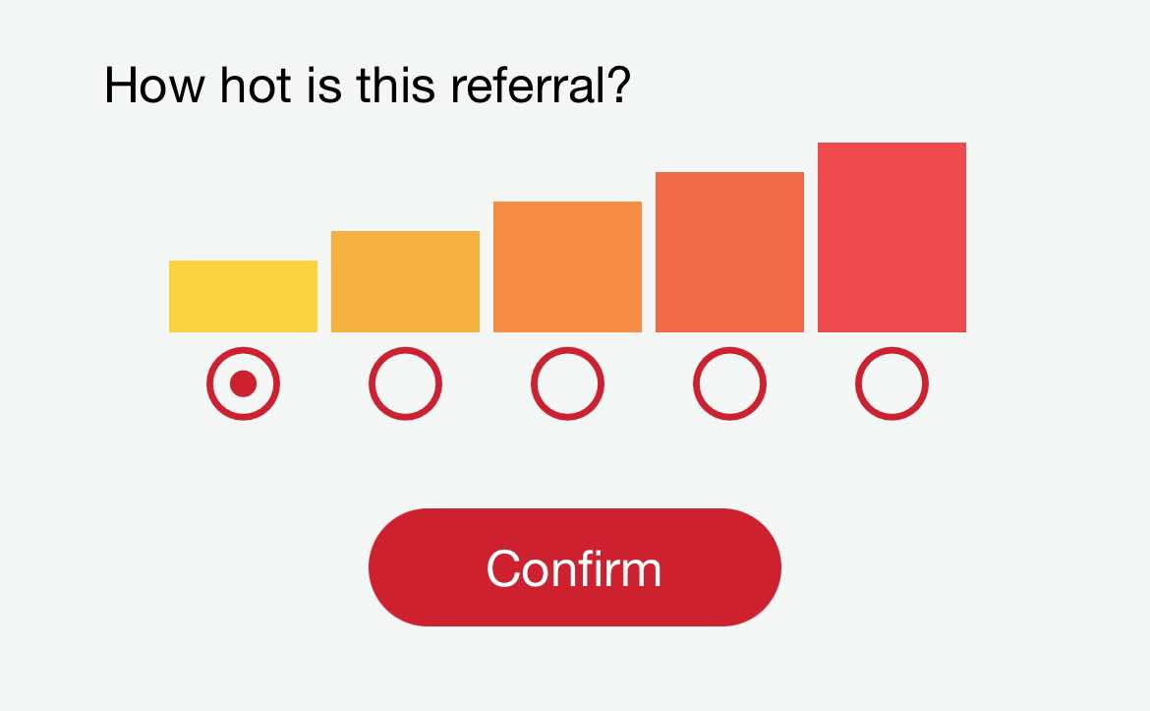

Slide 3
Referrals come in different shades.
The more time and effort your referral partner puts in to …
QUALIFYING
EDUCATING
ENCOURAGING
… your prospect
– before you become involved –
the higher the quality
AND
level of that referral

Slide 4

LEVEL 1
NAME & CONTACT INFORMATION
Recommendation made
Contact information given to prospect
Phone number / Address / Email received
Prospect knows you might contact them
EXPECTING YOUR CALL = BETTER THAN A COLD CALL

Slide 5

LEVEL 2
SUPPLEMENTARY MATERIAL
As Above
Marketing Literature / Website Information or
Other Content for Prospect to Review
ADDITIONAL INFORMATION MAY POSITIVELY INFLUENCE

Slide 6

LEVEL 3
SHARE EXPERIENCE
Mostly As Above
Effort Is Required
Written Testimonial Provided or Strong Verbal Recommendation
Time Spent Talking About Your Experience
Background Information + Description of Product / Service
THE ELEMENT OF PROMOTION INCREASES EFFECTIVENESS

Slide 7

LEVEL 4
INTRODUCTION & / or
ARRANGE MEETING
Mostly As Above
Personal Phone Call or Arrange Phone Call / Meeting
Move Beyond Role of Promoter > Become Master Connector
BEING A FACILITATOR SHOW COMMITMENT & EFFORT

Slide 8

LEVEL 5
IN-PERSON INTRODUCTION
& PROMOTION
Serious Time & Energy Commitment
Arrange AND Participate In The Meeting
Done The Pre-Qualifying So Member Can Tailor Product / Service
Member May Need To Answer Questions, Deliver Product
& Take Payment
PRACTICALLY A “CLOSED DEAL”

Slide 9
What Level Of
REFERRAL
TEMPERATURE
Would You Prefer?

