Slide 1
BNI Aurora
Working with
Power Teams

Slide 2
Contact Sphere vs Power Teams
Aspect | Contact Sphere | Power Team
Purpose | Natural referral potential | High‑intent collaboration
Size | Broad group | Small, focused subset
Client type | Similar | Identical
Referral style | Opportunistic | Strategic, guided, proactive
Interaction | Occasional | Regular, structured, intentional
Trust level | General | Deep, operational

Slide 3
Why Power Teams?
Increased Collaborations = more business
For the chapter = impacts Retention ☺
Increased focused visitors to complete Power Teams.
Helps Chapter Growth.

Slide 4

My Power Team
It is not about being in the same industry.
It is all about serving the SAME TARGET MARKET.

Slide 5
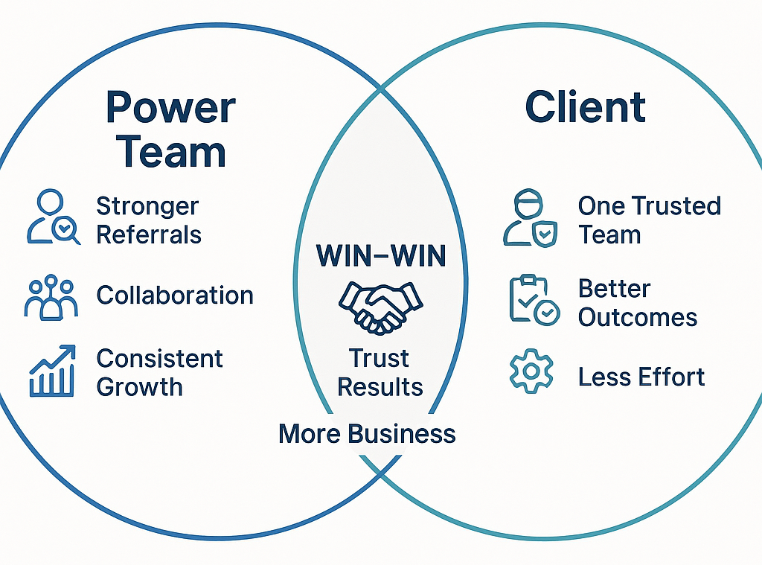
Concept of a Power Team
Keep it Small!
Collaboration
Joint Projects
GROWTH

Slide 6
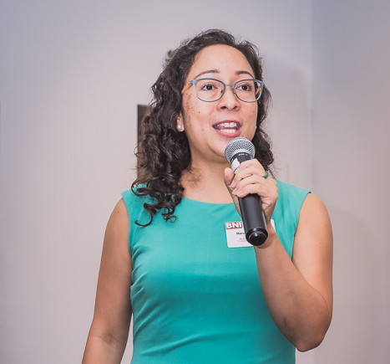

Creative Power Team
Our Story
It all started with a 1-2-1

Slide 7
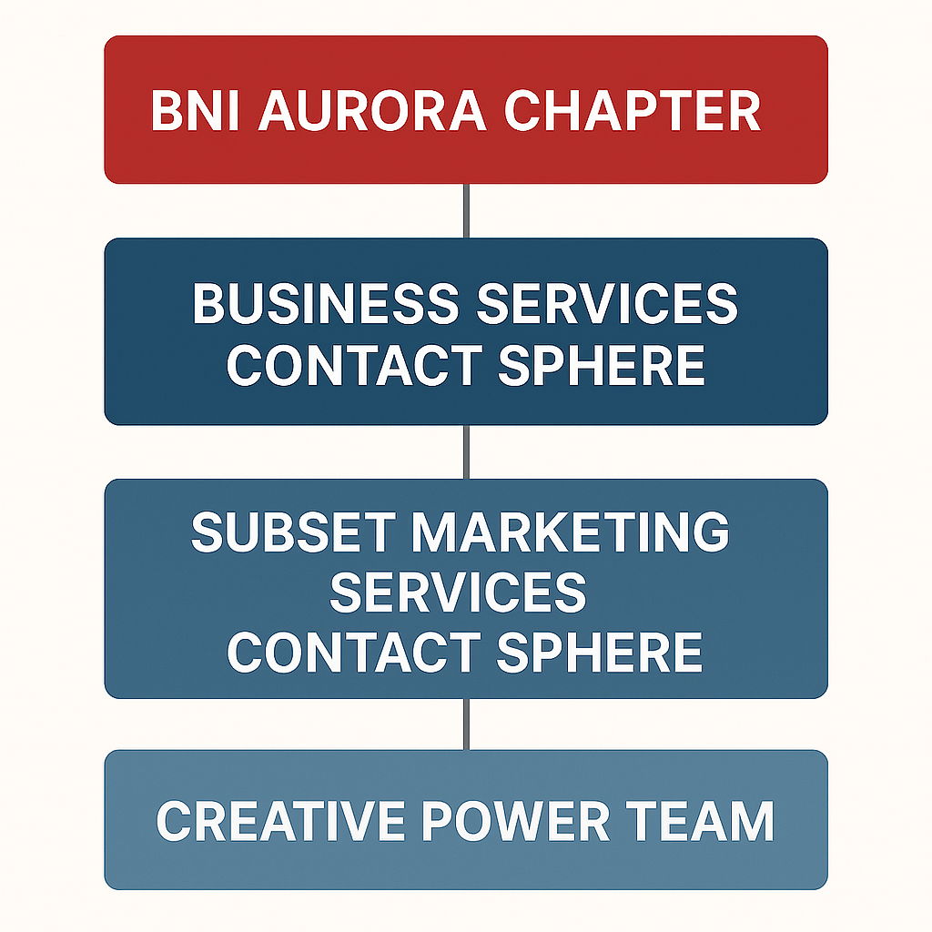
How it works

Slide 8
Who fits in my Power Team
Marcela
Marilyn
Rob Buchel
Jason Leembruggen
Chris Watkins
Kara Baker
Missing = Potential Visitors
Graphic Designer
Printer

Slide 9
Focus on Power Teams
Growth Coordinator or appointed person works with Power Team Leaders
Every Power Team has a Leader (and Deputy where possible)
Meet weekly to coordinate ongoing projects
Monthly off-site meetings with agenda
Monthly meetings are focused and structured on bringing more business

Slide 10
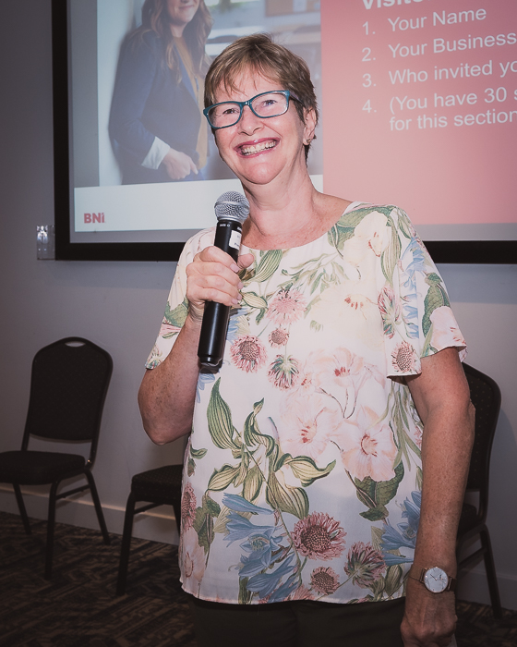
Ready to build your
Power Team?

