Slide 1

Education Moments

Slide 2
Lead vs Referral:
What’s the Difference?
Notes:
This Week’s Education: Leads vs Referrals – Turning Contact into Connection
Most Members want better referrals- but what many don’t realise is that unclear asks, vague 60-second presentations, and casual 1-2-1s often result in leads, not true referrals.
This week’s Education Moment, created by Monique Bradley (BNI New Zealand’s National Trainer), explores the key differences between a lead and a referral- and how to improve the quality of what you receive.
It’s a practical mindset reset: instead of asking “Why am I not getting the right referrals?”, flip the question to “Am I giving people the right tools to refer me well?
Encourage your Members to reflect on their messaging and 1-2-1 approach—and walk away with simple, actionable changes they can implement this week.
As always, please don’t read the Education Moment word-for-word. Prepare ahead, bring your energy and personal flair, and deliver it in a way that connects with your Chapter.
Enjoy!

Slide 3
The Power of a Real Referral
Turning Contact into Connection​
Notes:
Let’s talk about something that can make or break your success:
Do you know the difference between a lead and a referral?
If you’ve ever been handed a name with little to no context and felt unsure about the next step- you’re not alone. Today, we’re drawing a clear line between a maybe and a meaningful opportunity—and helping you move from uncertainty to clarity in your referral strategy.

Slide 4
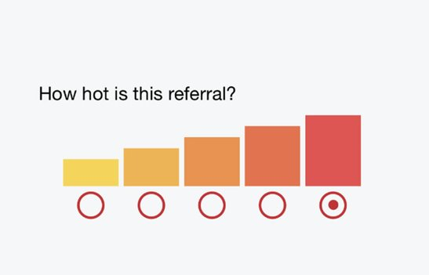
The Referral Thermometer
Notes:
Not all referrals are created equal. That’s why the BNI Referral Slip in your app includes a scale—it helps clarify the level of connection and expectation.
It’s important to check in with your fellow Chapter Member about how much information you can share. For example:
Level 1 (YELLOW): You may use my name.
Level 3 (ORANGE): They know you’ll be calling and are interested.
Level 5 (RED): They are ready to buy—I’ve recommended you.
The hotter the referral, the stronger the connection—and the easier your job becomes.

Slide 5
Contact details only. The person knows you may contact them, but little else has been done.
"Here's John's number. I told him you might call."
🔵 1 – Cold
The prospect has also been given your website, brochure or some information about you.
"I've emailed John your website and told him what you do."
🟢 2 – Warm
The referrer has personally recommended you and explained why they trust you.
I told John how u helped my business & why he should speak with you."
🟡 3 – Good
The referrer has arranged a phone call, Zoom or meeting between you and the prospect.
"I've organised a call for both of you next Tuesday."
🟠 4 – V Warm
The referrer personally introduces you & often attends the meeting or makes a live introduction. The prospect already understands the value you provide and wants to meet.
Let's all catch up together—I think Rob is exactly who u need."
🔴 5 – Hot

Slide 6
The amount of work the referrer has done positions’ you for success.
It's not simply how likely the sale is to close.
The more effort the referrer has invested, the "hotter" the referral.

Slide 7
THE REFERRAL STARTS WITH YOU
Notes:
Still getting leads instead of strong referrals? Ask yourself:
Is your Weekly Presentation and Feature Presentation specific?
Is your call to action specific enough to act on?
Are you educating your referral partners during 1-2-1s?
Your results are a direct reflection of the clarity of your message and the strength of your relationships.

Slide 8
THE TAKEAWAY
Want stronger referrals?
Become a stronger communicator.
Notes:
Want stronger referrals? Work on your communication clarity.
Upgrade your weekly presentation.
Refresh your 1-2-1s so they are building trust.
Make your call to action specific, visual, and repeatable.
When your Chapter clearly understands what you do best, referrals don’t have to be forced—they flow naturally.

Slide 9
A simple way to remember
🔵 1 = Contact
🟢 2 = Contact + Information
🟡 3 = Contact + Recommendation
🟠 4 = Contact + Introduction
🔴 5 = Contact + Personal Endorsement + Facilitated Meeting
Notes:
Want stronger referrals? Work on your communication clarity.
Upgrade your weekly presentation.
Refresh your 1-2-1s so they are building trust.
Make your call to action specific, visual, and repeatable.
When your Chapter clearly understands what you do best, referrals don’t have to be forced—they flow naturally.

Slide 10
QUOTE
“The best lead is not as good as the worst referral.” ​
– Dr. Ivan Misner​
Notes:
This week:
Ask for a warm referral.
Review your last few referrals—how warm were they, really?
Level up your communication—and see what comes back.

