Slide 1

Education Moments

Slide 2
Why Invite Visitors?

Slide 3
The Most Expensive Chair in the Room
"Because of who isn't sitting in it."

Slide 4
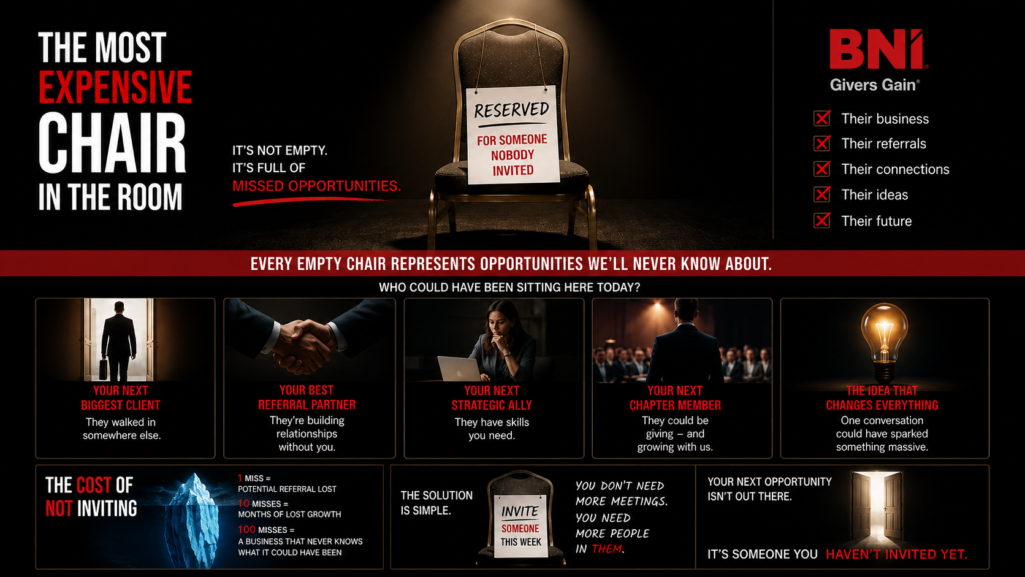

Slide 5
That person could have been...
My next client.
Your next referral partner.
Next strategic ally
Our next member.
Or the person with the idea that changes everything
We'll never know.
Because nobody invited them.

Slide 6
Have a look around.
Every single person sitting here, was once sitting in that chair.
If someone hadn't invited them...
They wouldn't be here.
And none of us would have received a single referral from them.

Slide 7
THE MINDSET SHIFT
I think we make one mistake
We invite people because we hope they'll join BNI.
Don't. Invite people because u want to introduce them to this room
"If they join..." Fantastic.
"If they become my client..." Fantastic.
"If they become someone else's client..." Even better.
"That's Givers Gain at work.”

Slide 8
So here's the challenge.
Don't think..
WHO SHOULD I INVITE TO BNI?
Think...
WHO DESERVES TO MEET MY NETWORK?

Slide 9
This chair isn't empty. It's full of opportunities that never happened.

Slide 10
Next week, whose opportunity will be sitting here?
Do they deserve this network?

