Slide 1
Education Moments
Email Last Invoice

Slide 2
Quick Steps
From the home screen, click your name in the upper right corner
1. Click MY ACCOUNT
2. Under PROFESSIONAL DETAILS click EDIT
3. EMAIL LAST INVOICE in the bottom left side
4.The email will be sent to the email address on your profile
NOTE: If EMAIL LAST INVOICE is not available, your regional office has disabled this function. Please contact your Managing or Executive Director or Regional Admin team for further assistance. You can find their contact information by clicking on REGIONAL WEBSITE from the home screen.

Slide 3
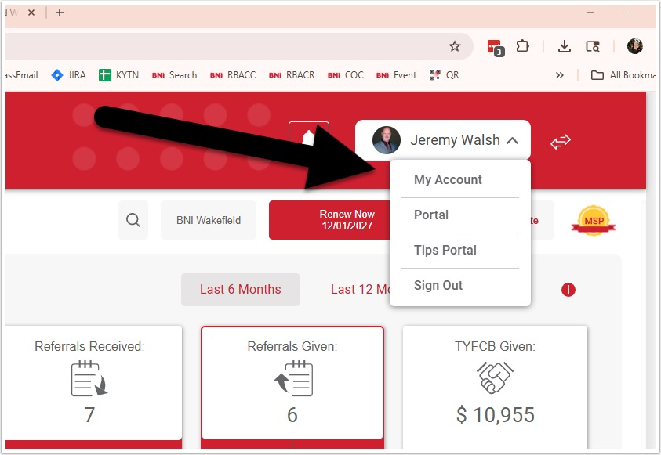
Visual Walk Through

Slide 4
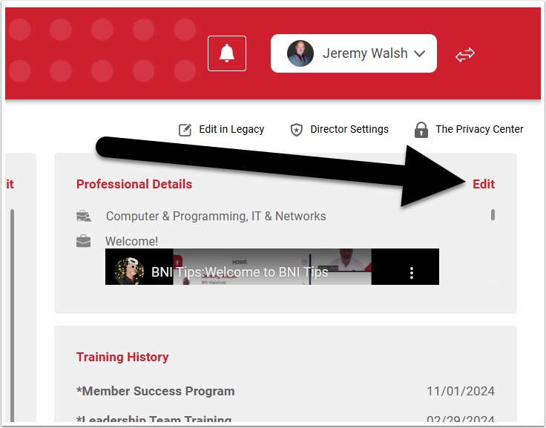

Slide 5
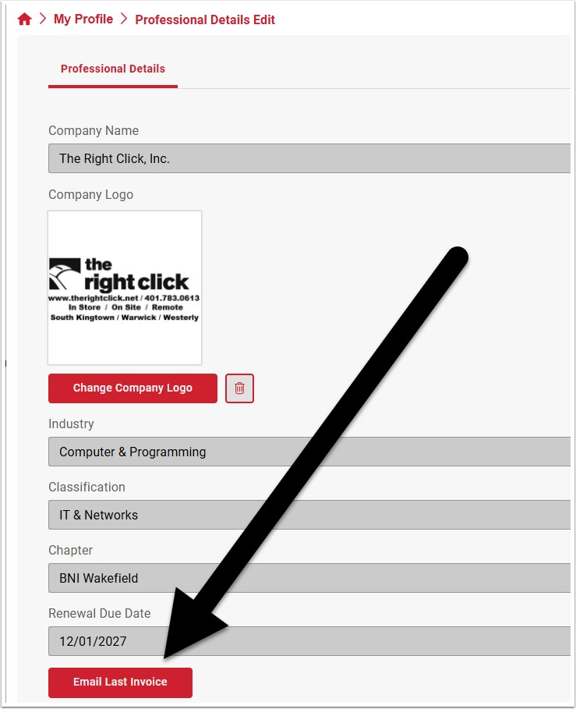

Slide 6
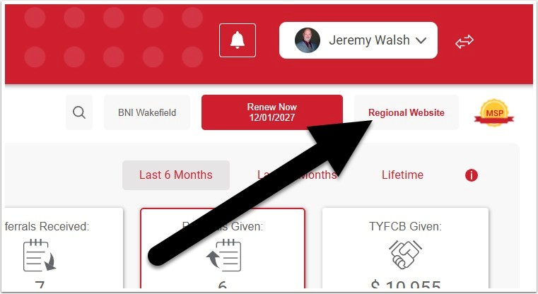

Slide 7
If the EMAIL LAST INVOICE button is not there, contact your regional office directly. Go to the home screen and click on REGIONAL WEBSITE to find their contact information

