Slide 1

Networking Education

Slide 2


Slide 3


Slide 4


Slide 5
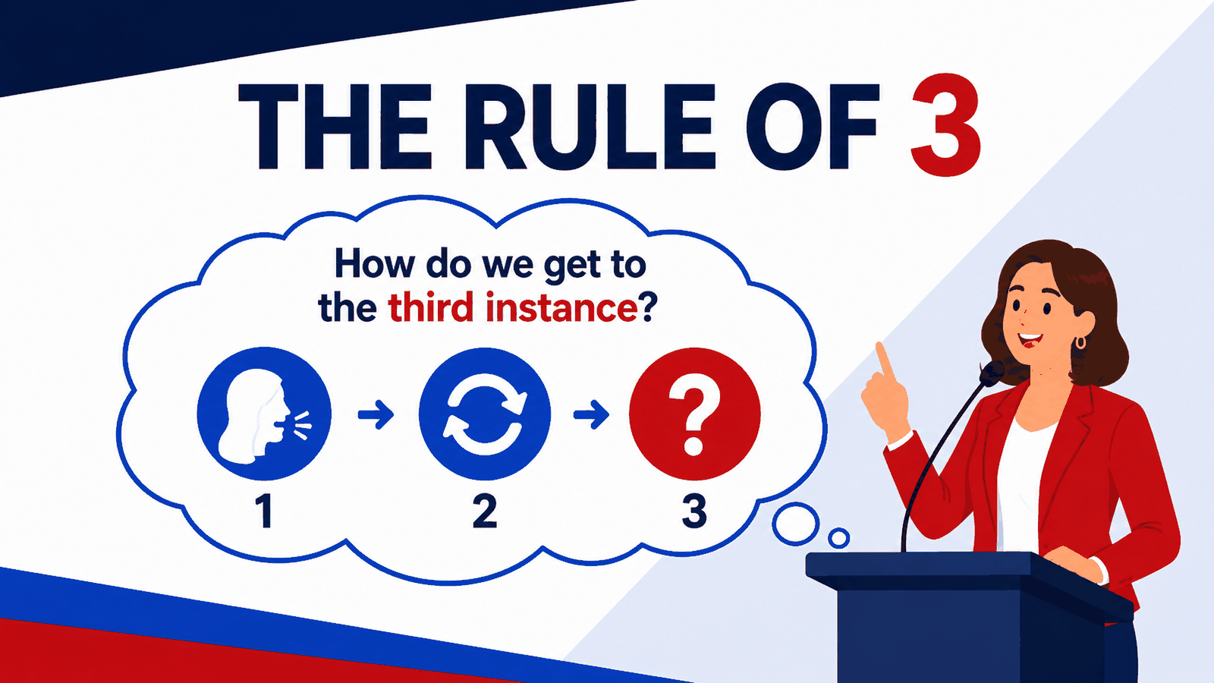

Slide 6

v

Slide 7

v

Slide 8

v

Slide 9

v

