Slide 1
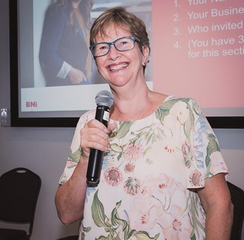
BNI Aurora
Education Moment
Sherree Price – an effective feature presentation

Slide 2
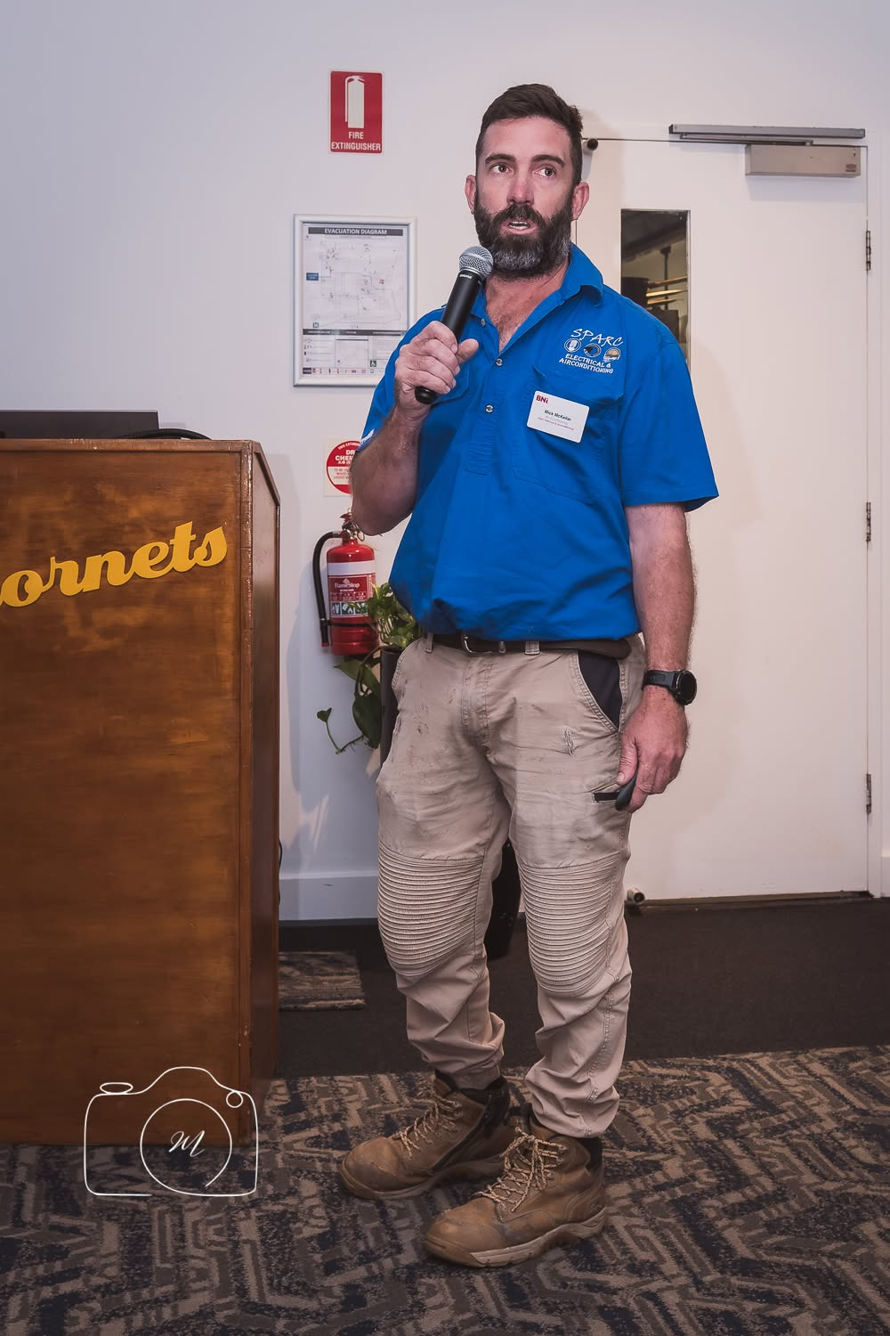
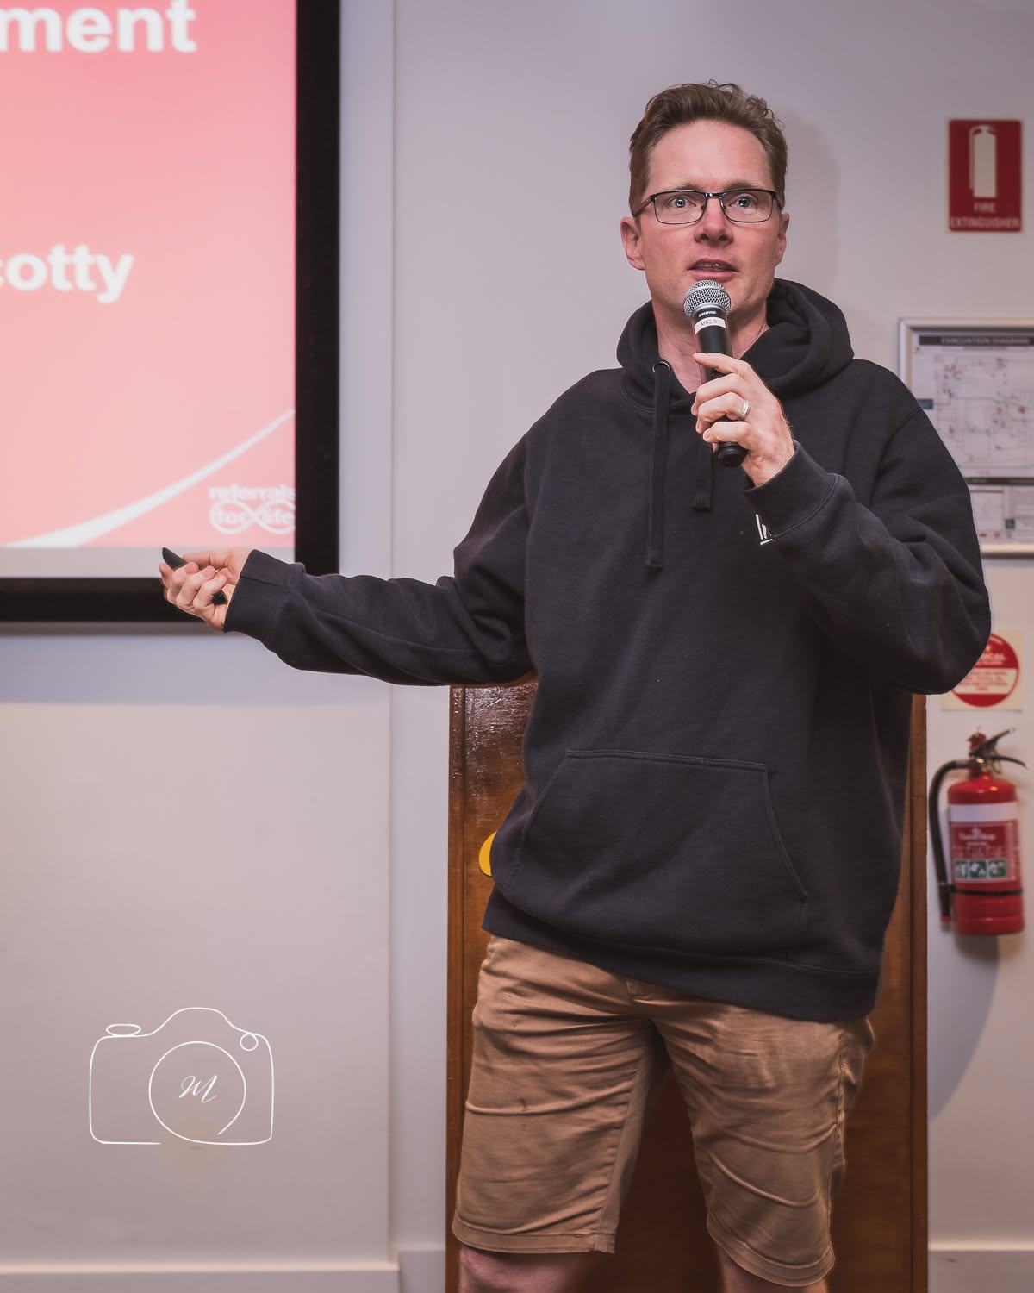
Feature presentation
your opportunity to educate the audience and gain more referrals
your opportunity to make an impression – polished, professional, compelling
I know you, I like you, I trust you

Slide 3
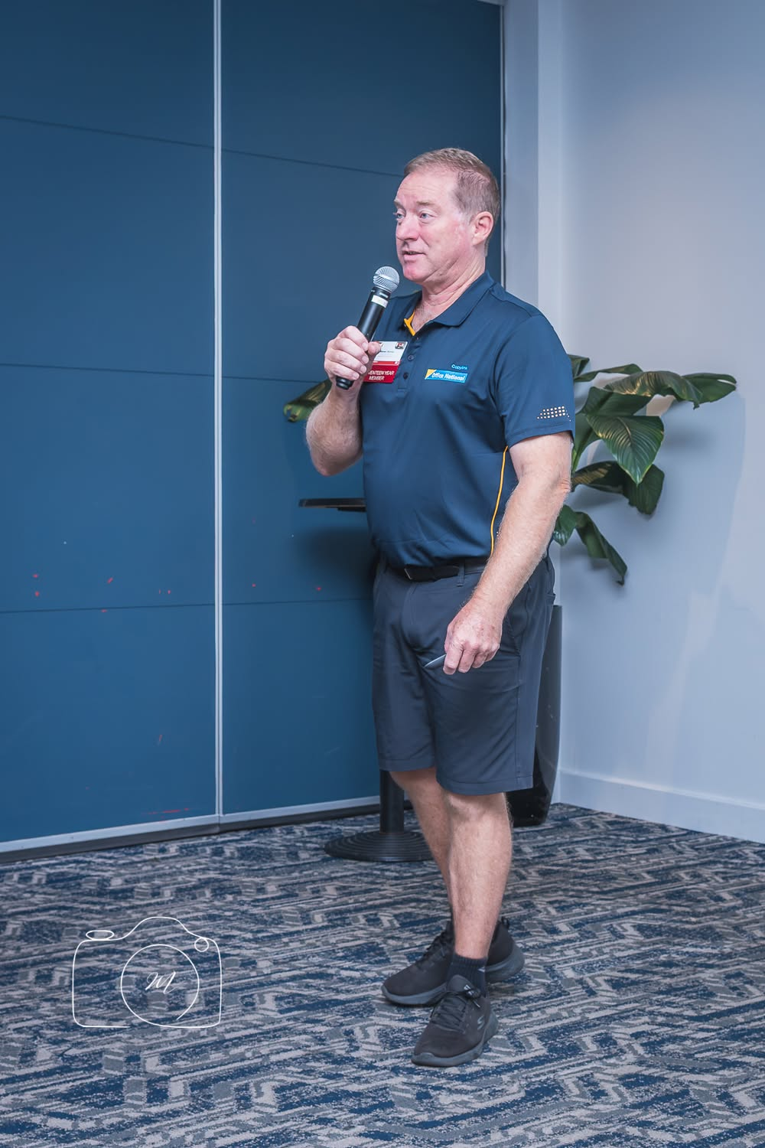
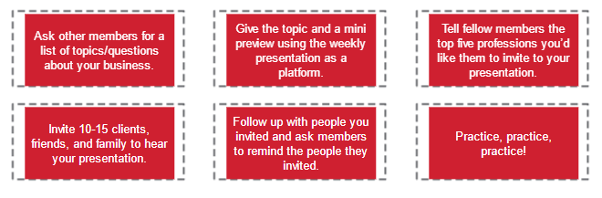
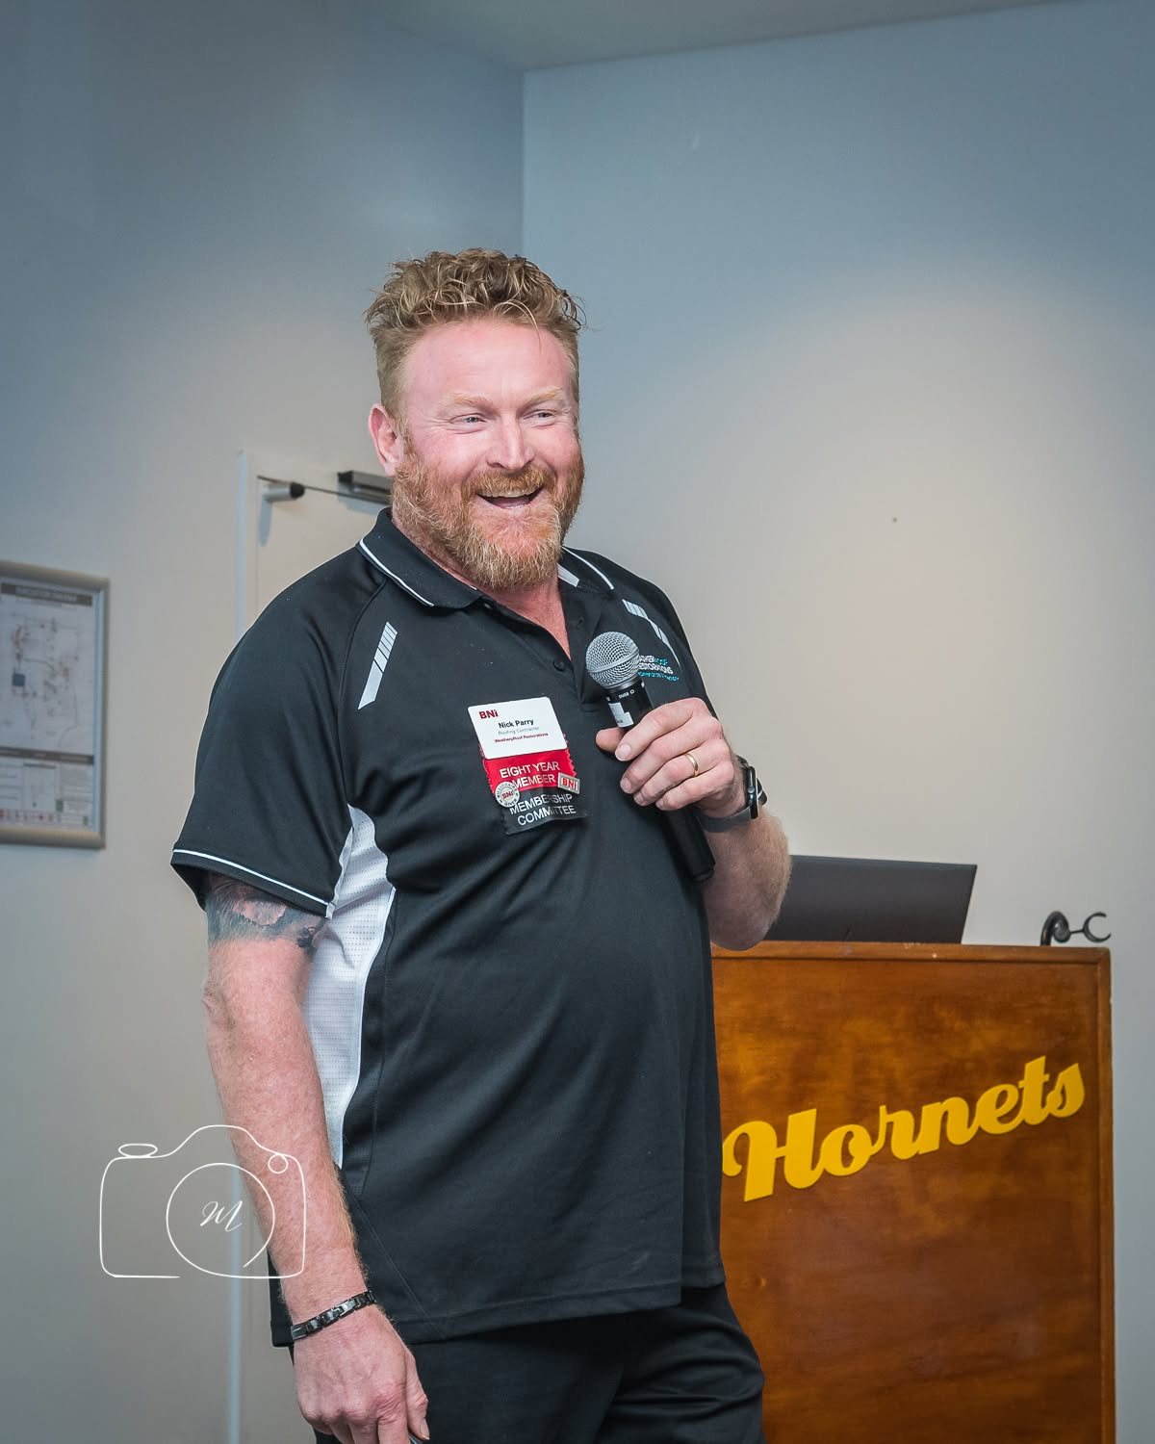
Preparation
Source: MyBNI/BNI Academy/Feature Presentation

Slide 4
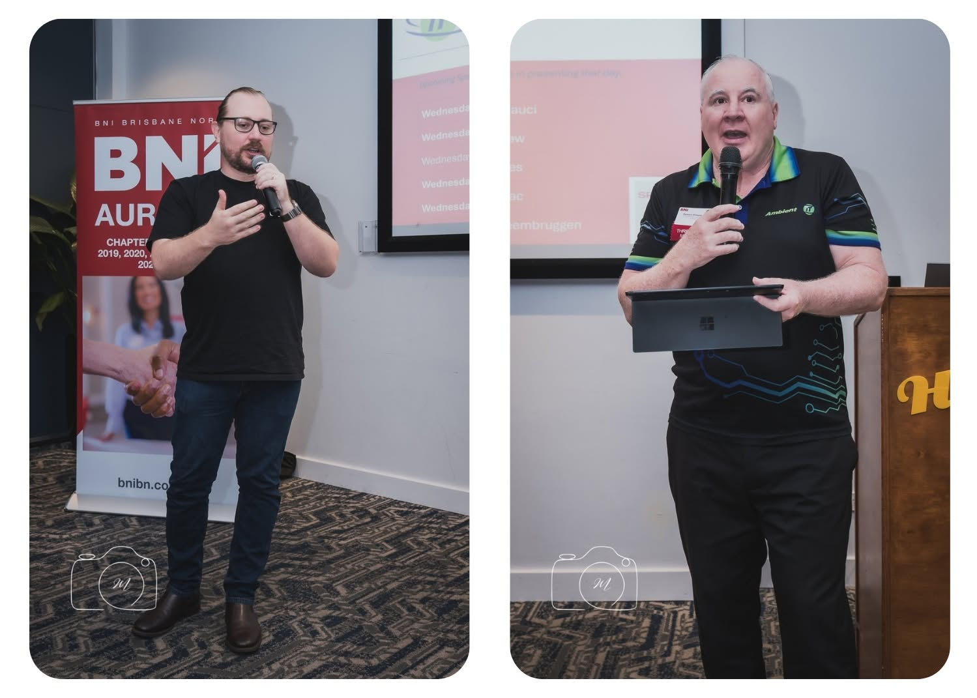
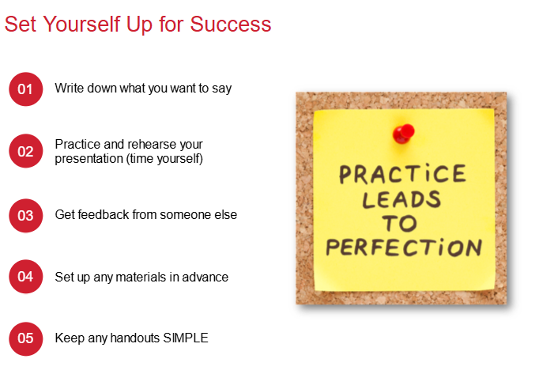
More Preparation

Slide 5
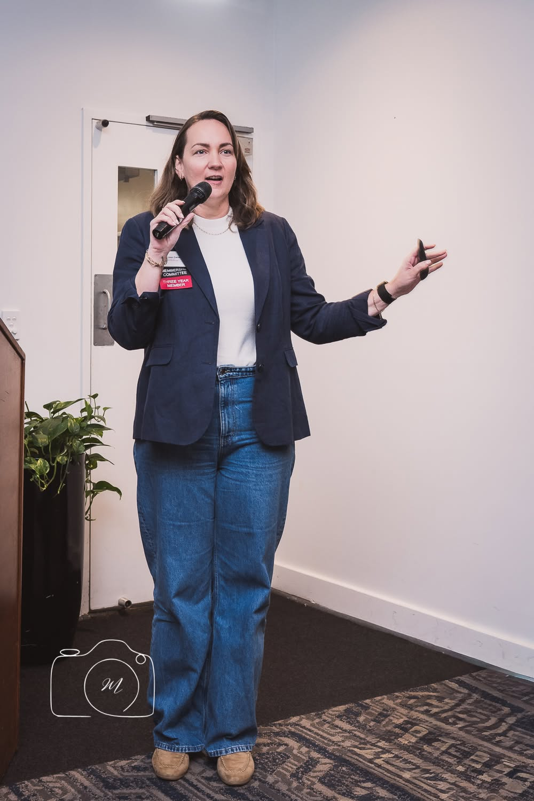
Structure of your presentation
Introduction - 1 minute
Connect to the audience – your why, unique characteristics/benefits of your business
Body – 3 minutes
Include a problem a client had that you solved
Or types of referrals you are seeking and why
Or things members can listen and look for
Or what members can say to bring you and your product/service into the conversation

Slide 6
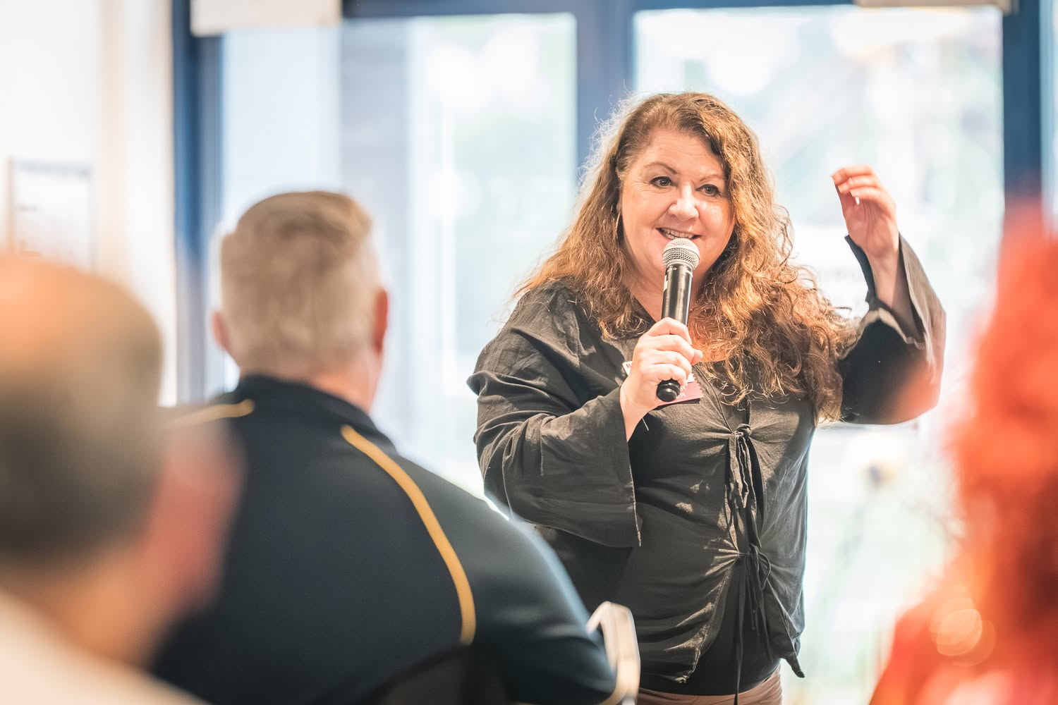
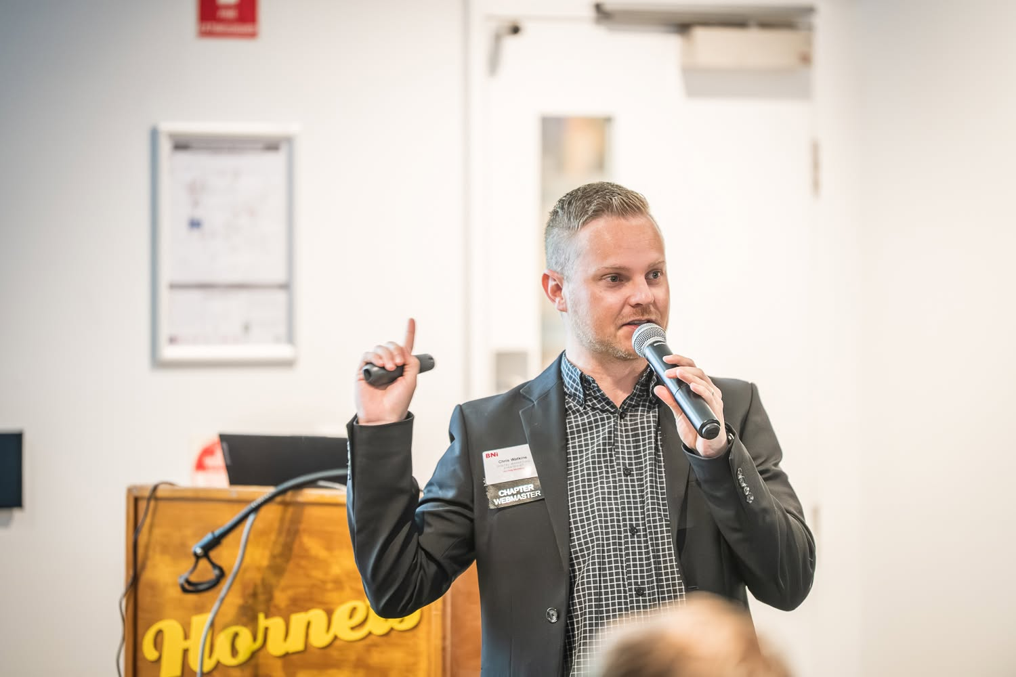
Structure of your presentation
Conclusion - 1 minute
Consider your call to action
have a 121 with me to discuss my
business further
ideal referrals
Remember you are not selling to
your fellow members – you are selling
through them

Slide 7
