Slide 1
BNI Aurora
Education Moments
Sherree Price

Slide 2
Why giving testimonials matters
Who here has given a testimonial for another member in the past month?
Who received one and saw a boost in confidence, credibility, or business?

Slide 3
1. Build Credibility Fast
When you share a real result you’ve had with a member’s service, you fast-track trust.
It’s a third-party endorsement—far more powerful than someone praising themselves.
2. Strengthen the Chapter’s Brand
Public testimonials (on socials or websites) supports our chapter as a thriving, connected business community.
It shows that we actually refer and support each other.
3. Make Referrals Easier
A testimonial gives you a “success story” to share with prospects:
EG “I referred Sarah to a client and she doubled their conversions—don’t take my word for it, check this testimonial I wrote.”
4. Good Testimonials = More Business
Clients shop with their eyes. They check Google, Facebook, LinkedIn, your websites.
BNI members look at testimonials on your BNI profile
Let’s fill those spaces with real results from real members.

Slide 4
Where to Leave Testimonials
✅ Google Reviews
– Search for the member’s business name, and leave a public 5-star review.
– Helps their SEO and builds trust with total strangers.
✅ BNI profile
– You don’t know how many national and international BNI member is searching for your service. A testimonial on your profile build trust.
✅ LinkedIn Recommendations
– Especially for B2B or professional services. A written LinkedIn rec can be a game-changer.
✅ Facebook Page Reviews
– If the business is active on Facebook, leave a positive review with a quick story.
✅ Instagram & Facebook Shout-Outs
– Snap a pic of the result, or just do a “Member Spotlight” tag on stories or reels.
– Share what they did for you or your client. Tag them and the chapter.
✅ Personal Website Testimonials
– Offer to write a blurb they can post on their website. Better yet, let them quote your name and business. It adds weight.

Slide 5
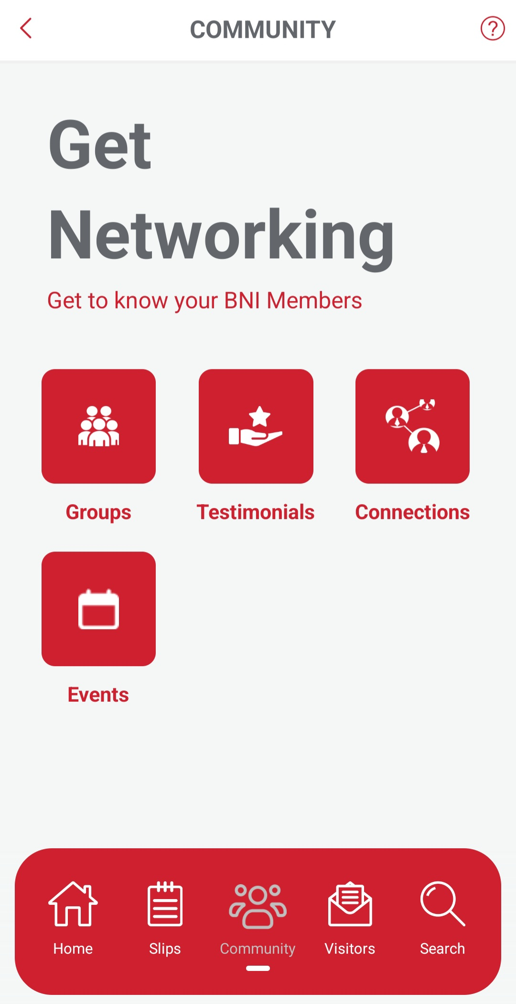
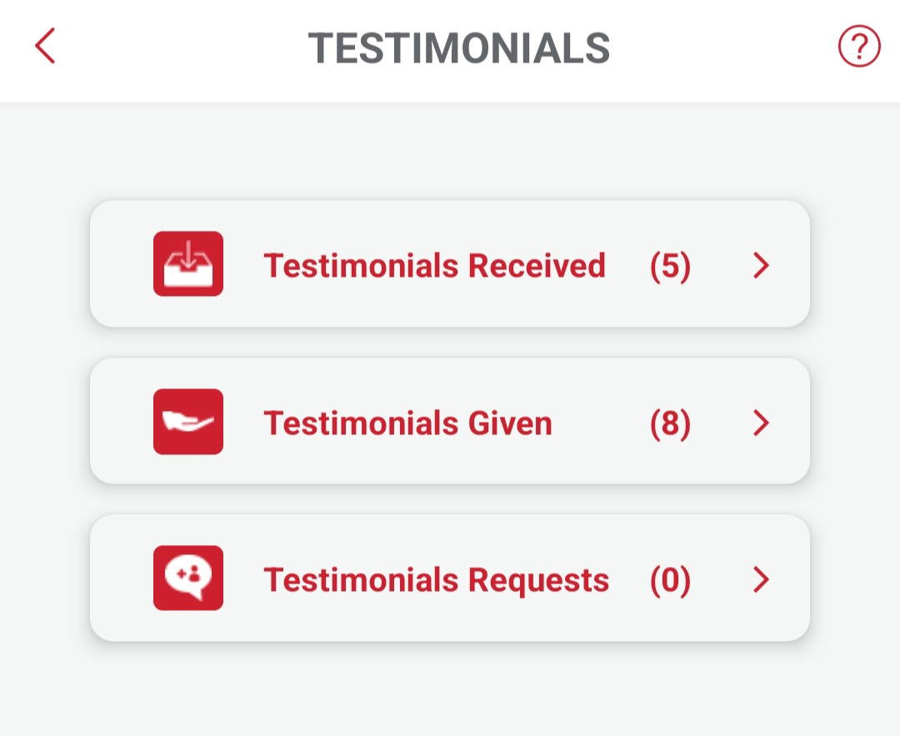
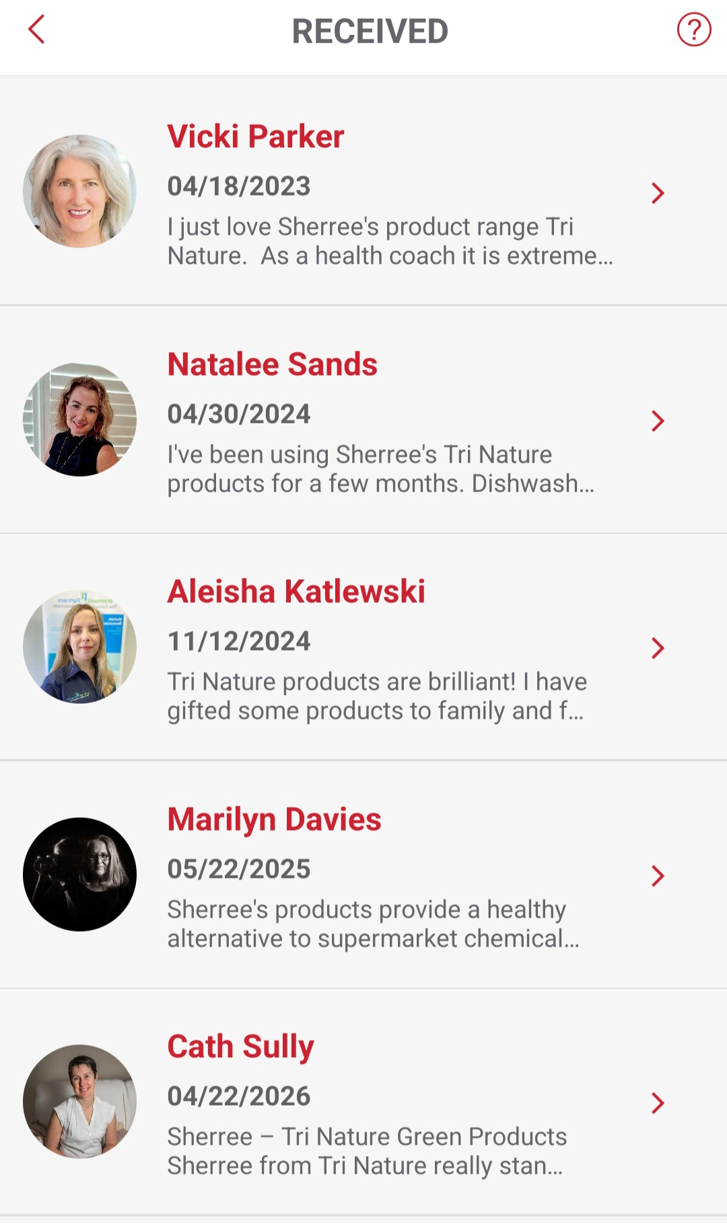


Slide 6
Call to Action
1. Pick one member today you’ve worked with—and leave them a testimonial on any public platform this week.
2. Tag our chapter if posting on social media. Let’s build our BNI brand together.
3. Track results—if a testimonial generates business, speak with the person who wrote it about a possible referral and closed business.

Slide 7
Testimonials aren't just feel-good moments they're powerful marketing tools for each other and for our chapter’s reputation.
That is why they matter

