Slide 1

12 Weeks of
BNI Fundamentals
BNI
Changing the Way the World Does Business
WEEK 3
Tier 1, Tier 2 and
Tier 3 Referrals
How trust grows beyond the BNI room
8-minute Education Moment
Notes:
Good morning everyone. Today I have brought three envelopes labelled Tier 1, Tier 2 and Tier 3. They represent three different ways business can grow through BNI. The higher the tier, the further trust has travelled beyond this room. By the end of today, I want each of us to recognise the three tiers and know how to create more Tier 2 and Tier 3 referrals.

Slide 2



12 Weeks of
BNI Fundamentals
BNI
Changing the Way the World Does Business
The three referral tiers
TIER 1
TIER 2
TIER 3
A BNI member buys from you
Someone outside BNI buys from you
That customer refers you again
Inside referral
Outside referral
Referral from a referral
Each tier expands your circle of trust
2
Notes:
Here is the simple definition used in our BNI Fundamentals series. Tier 1 is an inside referral. A fellow BNI member pays for your product or service. Tier 2 is an outside referral. A member introduces someone outside BNI who then becomes your customer. Tier 3 happens when that Tier 2 customer refers you to someone else. Each tier expands the circle of people who know and trust you.

Slide 3
12 Weeks of
BNI Fundamentals
BNI
Changing the Way the World Does Business
Tier 1: business inside the chapter
A fellow BNI member becomes your customer
They know you from the chapter and trust you enough to buy.
Example
A chapter member hires your business directly.
The work you deliver can become proof for future referrals.
3
Notes:
Tier 1 starts inside our chapter. One BNI member buys directly from another. This matters for more than the sale. When we experience a member's service ourselves, we gain first-hand confidence in their professionalism. A strong Tier 1 experience gives us a genuine story to tell when we recommend that member outside the chapter.

Slide 4

12 Weeks of
BNI Fundamentals
BNI
Changing the Way the World Does Business
Tier 2: business outside the chapter
A member introduces someone outside BNI
The introduction leads to paid work.
The referrer transfers their confidence in you to a client, friend or business contact.
These are the referrals we work towards
4
Notes:
Tier 2 takes us beyond the chapter. A member recognises an opportunity, explains why they trust us and introduces us to someone outside BNI. If that person purchases, it becomes a Tier 2 referral. These are the referrals we really want because they show that chapter members feel confident enough to open their own networks to us.

Slide 5
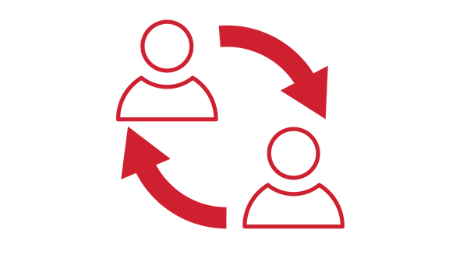
12 Weeks of
BNI Fundamentals
BNI
Changing the Way the World Does Business
Tier 3: the referral keeps travelling
A Tier 2 customer refers you to someone else
Your BNI member opened the first door.
Your work earned the next introduction.
Tier 3 shows that trust has moved beyond the original relationship.
5
Notes:
Tier 3 is where referral marketing starts to multiply. A Tier 2 customer has now experienced your work and refers you to someone else. The original BNI member opened the first door, but your service earned the next introduction. This is powerful because trust has travelled beyond the original relationship and started creating its own momentum.

Slide 6

12 Weeks of
BNI Fundamentals
BNI
Changing the Way the World Does Business
How confidence grows
Professionalism in every chapter activity
Members notice how you communicate, contribute and follow through.
A visible Givers Gain attitude
Help others consistently without keeping score.
Clear referral education
Teach members and customers who you want to meet and what to listen for.
6
Notes:
How do we build enough confidence to receive Tier 2 referrals? We demonstrate professionalism and show a genuine Givers Gain attitude in our chapter activities, weekly meetings and dealings with other members. How do we create Tier 3 referrals? We teach our Tier 2 customers how to refer us. Make sure customers know what a good referral looks like, the problems you solve and the type of person or business you can help.

Slide 7

12 Weeks of
BNI Fundamentals
BNI
Changing the Way the World Does Business
Chapter activity: move it up a tier
Choose one recent referral
1
Which tier was it?
2
What could move it up one tier?
3
What must the customer know to refer you again?
Discuss with the person beside you for 60 seconds
7
Notes:
Let us make this practical. Turn to the person beside you and choose one referral you have given or received recently. Decide which tier it was. Then answer two questions. What could have moved it up one tier? What would that customer need to know to refer the business again? You have 60 seconds. After the discussion, ask one or two members to share their answer.

Slide 8

12 Weeks of
BNI Fundamentals
BNI
Changing the Way the World Does Business
This week’s challenge
Ask one customer for a referral
Explain who you want to meet
Describe the problem you solve
Make the introduction easy
Don’t think small. Givers Gain is a bigger game than most of us realise.
8
Notes:
Here is your homework. Ask at least one customer for a referral this week. Explain who you want to meet, the problem you solve and how they can introduce you. See whether you can generate a Tier 2 or Tier 3 referral from your own clientele. Tier 1 begins inside the chapter. Tier 2 takes us outside. Tier 3 proves the referral can keep travelling. Do not think small. Givers Gain is a bigger game than most of us realise. Thank you.

