Slide 1
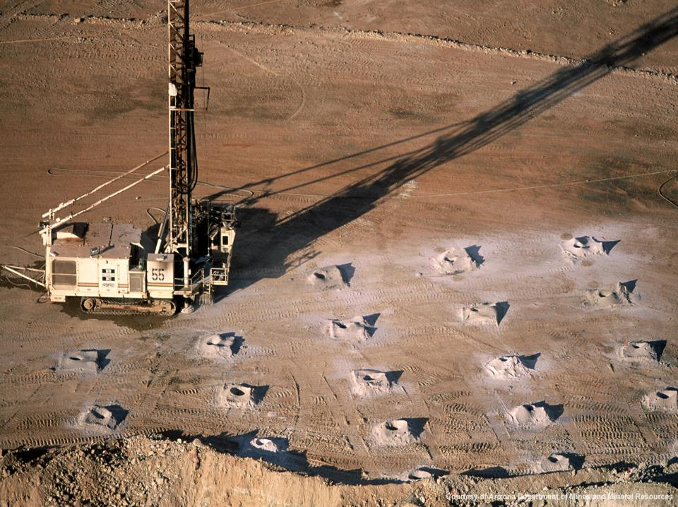

MineExcellence Drilling Platform
Get more from your drilling data…

Slide 2
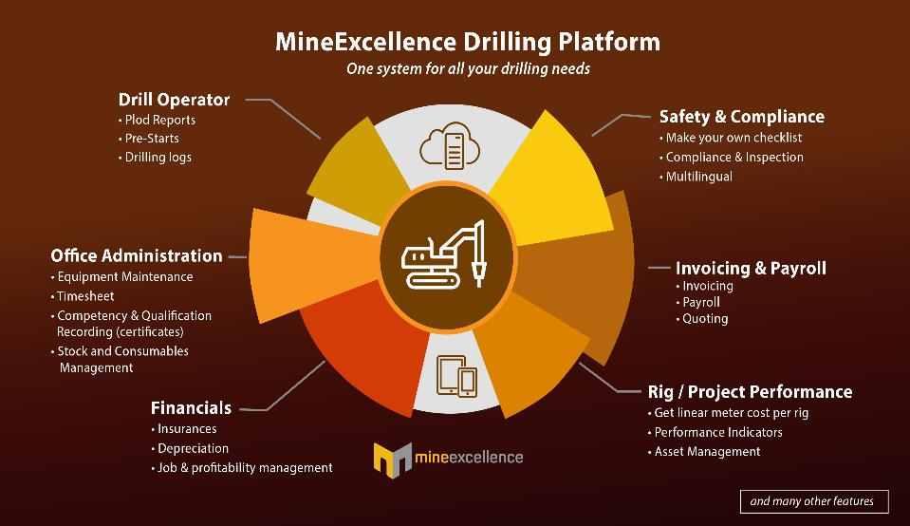

Slide 3
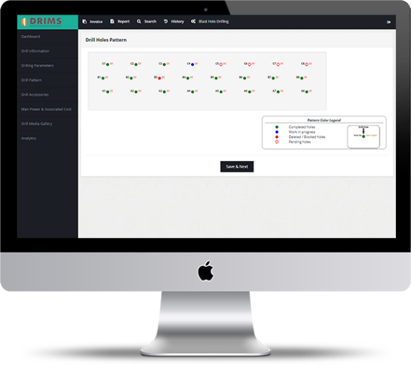
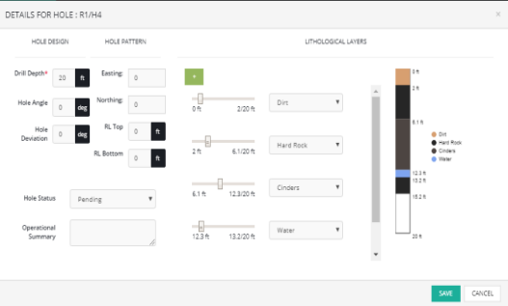
Drill Information Management System (DRIMS)
Drill Information Management System (BIMS) helps to collect drilling information & provides data to meet the strategic and operational needs for planning, controlling and decision making for optimizing mining operations.
Some of the key features of DRIMS incudes –
Daily Electronic Plod Reports / Daily Activity
Pre-Start Checklist
Drill Logs
Safety Checklists
Basic Payroll
Invoicing
Asset Management
Price/ Insurances
Maintenance
Bills / Expenses
Summary Costs
Drill Performance Report
Live Drill Rig Tracking
Notes:
International Mining's August 2017:Blasting represents less than 4% of total mine cost, but it can positively impact 60% of the cost, through improved fragmentation, vibration, increased throw etc.(By Orica)
https://view.joomag.com/im-2017-august-17/0791217001501582550?utm_source=IM+August17+Password+PDF+Circ+list&utm_campaign=IM+August+17+Password+PDF+circ&utm_medium=email
Password: EJsp21wH
Please read pages about explosives and blasting 50-55
Blasting/Explosive industry is XXX with the major players of Orica & Incitec Pivot HQ in Melbourne.
Blasting is mainly in Construction industry especially the cement industry and mineral mining industry

Slide 4
Collaboration via Cloud and mobile
Share data to all the stakeholders to increase collaboration.
Drilling platform is hosted in a secure online cloud environment, makes collaboration with stakeholders simple. Whether taking decisions to improve operational planning, accounting, monitoring daily activities or capturing drill logs.
The mobile version also accepts information in offline mode and synchronizes with online web version to produce real time analytics and pattern visualization.

Slide 5
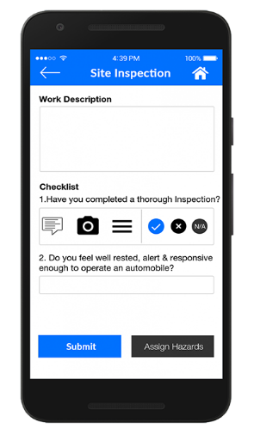
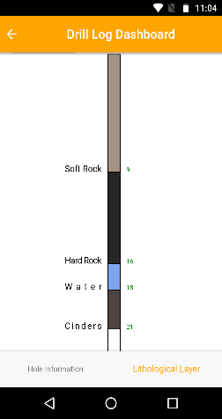
Drill Logs
Update the different strata and loading information at different depths via mobile and tablet.

Slide 6
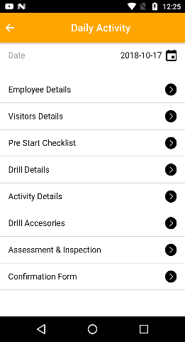
Plod Reports/ Daily Activity
SMART DRILL PLOD Data Capture and Control allows for:
Auto generation of drilling pattern reports; performance measurement & analysis
Advanced analytics related to drill penetration rates, tools, and operator performance
Advanced analytics related to cost, downtime, maintenance, by operation, rig, client, etc.
Connection of activity to payroll, invoicing, supply requirements, etc.

Slide 7
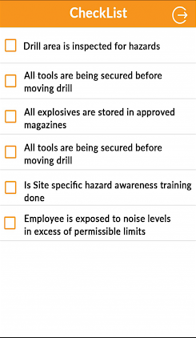
Check list and Inspection
Create your custom checklist and inspections forms based on your site operation.
Few scenarios that you may think for…
  1. Daily Machine Prestart Checklist
  2. Safe work method form
  3. Inspection forms
  4. Permit forms
  5. Auditing

Slide 8
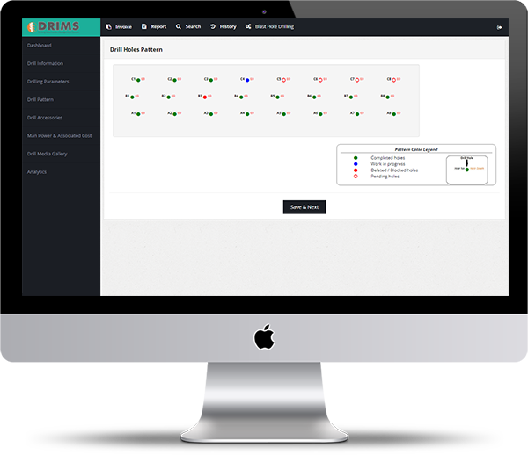
Drill Design Pattern

Slide 9

Real Time Dashboard

Slide 10
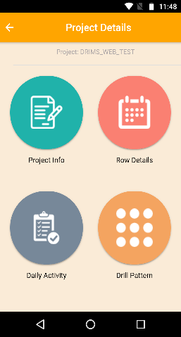
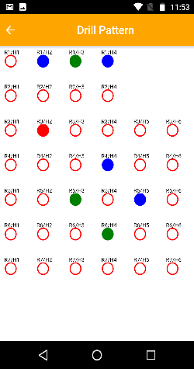
Mobile App

Slide 11
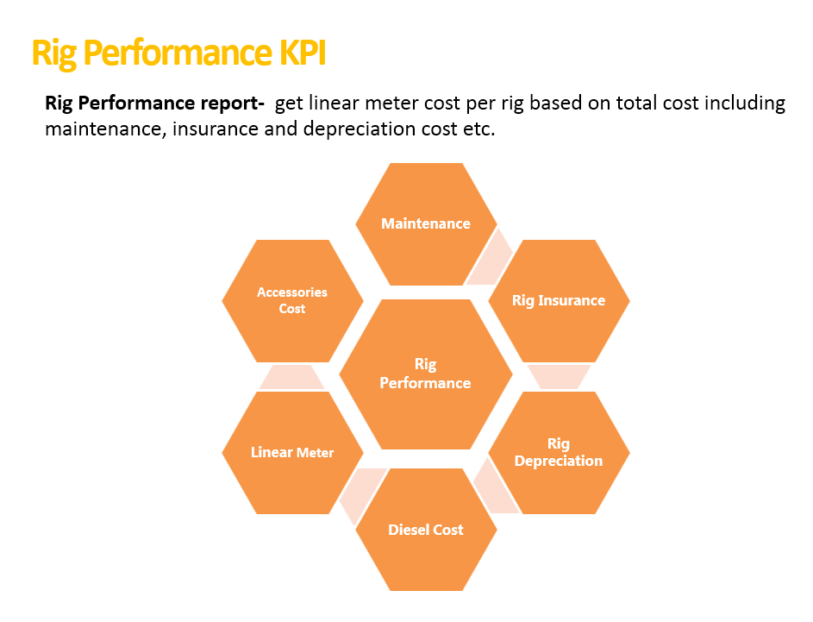
Features in Basic vs. Enterprise DRIMS

Slide 12
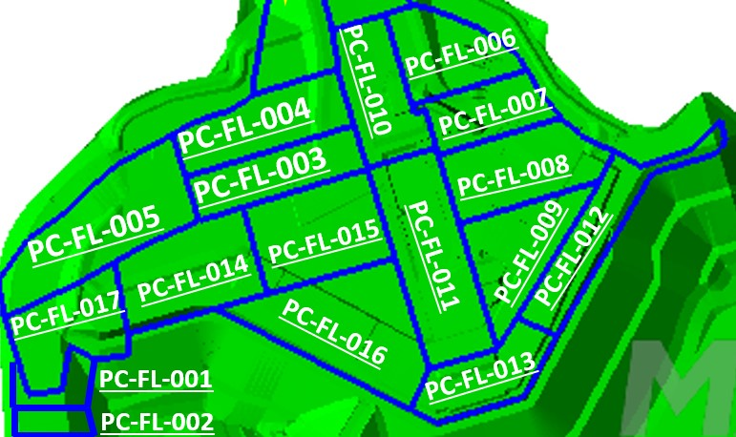
Ability to See Drill Zones in the field Directly
Real time collaboration with drill zones on maps, the progress on current drilling & which rigs and other vehicles are allotted to that zone and for how long they have been there.

Slide 13
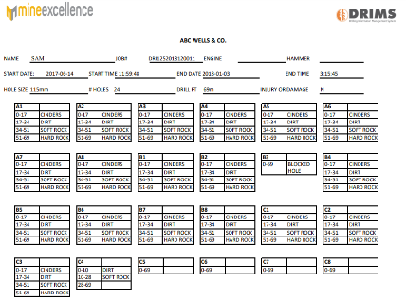
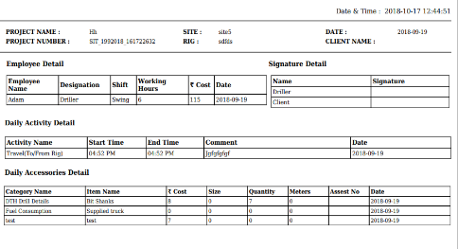
Reports

Slide 14
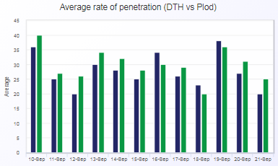
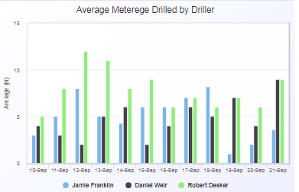
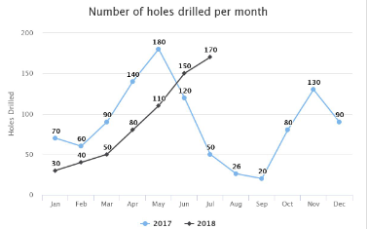
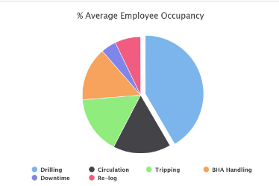
Analytics

Slide 15


Benefits To A Mining Company
Greater visibility to meterage drilled etc.
Visibility of shift utilisation
Reducing Human Error in drilling
Ability to automate, verify and correct crucial process
Visibility
Productivity
Better production and more revenue due to better drilling.
Automation in Drilling Process
Transparency
Ability to cross verify, audit and prevent idle times in drilling process.
Integration with Blast Design Software in Real Time to optimize drill and blast.

Slide 16


Benefits to Drilling Contractor
Real time tracking of Drill Rig.
Visibility of total drilling time, idle time, maintenance time etc.
Prevent revenue loss due to un-invoiced work.
Prevent disputes with customers with a common system.
Automation
Compliance
Measure drill rig & operator efficiency and delays in drilling on block.
Digitization
Ability to link drilling to individual blasts accessible in an online portal.

Slide 17
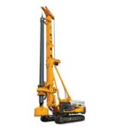
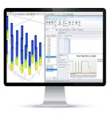
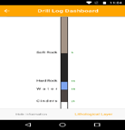
High Level Flow diagram of Drilling Automation
2
Drilling sheet from blast designer is fed into drilling equipment
1
DRILL EQUIPMENT
Actual drilling data is fed into DRIMS
1.BLAST DESIGNER
Drilling data is fed into designer to do reconciliation of deviation and charging design
3
MineExcellence Modules
2.DRILL INFORMATION MANAGEMENT SYSTEM
Drilling
Equipments

Slide 18

Drilling Shift time management
Drilling start
Drilling End
Dec 2018: 00:54:22
Mar 2019: 00:43:55
Dec 2018: 00:40:20
Mar 2019: 00:20:46
Variance: 19%
Variance: 49%
Difference: 00:10:27
Difference: 00:19:34
Start of Shift
Last Ignition
End of Shift
1st Ignition
Dec 2018: 01:36:49
Mar 2019: 01:14:40
Dec 2018: 00:48:21
Mar 2019: 00:40:22
Variance: 23%
Variance: 17%
Difference:00:22:10
Difference:00:07:49
Optimise pre and post shift routines
Easily identify areas of difference and areas for improvement
Set targets for operational delays

Slide 19
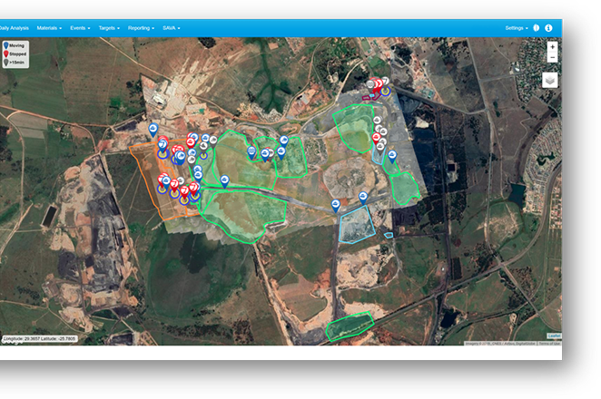
Live dashboard/ tracking of all your drill rigs globally
Asset filtering to drilldown on an asset level
Layer management to maintain updated geographical data
Asset search to quickly find assets
Geofencing to easily identify areas of the mine

Slide 20
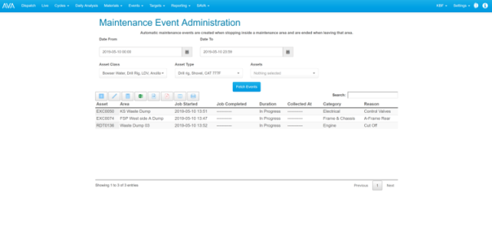
Maintenance event capturing
Ability to edit and add maintenance events to ensure accuracy in reporting
Asset & date filtering to easily locate and modify maintenance events
View of all events within above selection to obtain a accurate view of maintenance
Automated maintenance events on workshop entry

Slide 21
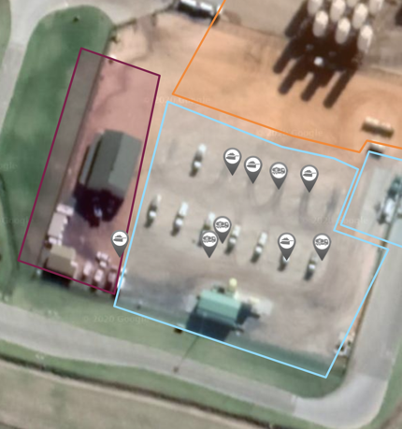
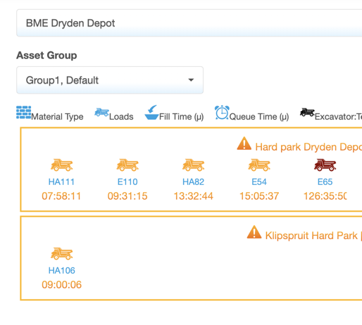
Exact live location of all Drill Rigs
Summarised live view into location and duration on dashboard
ABC
DEF
Know the real-time location and activity of every vehicle

Slide 22
Record all delays creating comprehensive Explosive Charging / blasting time model
Delay Events
Time KPI’s
KPI categories | Unit of measurement
1. Utilisation
Operational breakdown events | Amount
Operational downtime per event | Hours
Traveling speed | Km/hour
First hole drilled | Time stamp
Last hole drilled | Time stamp
Drilling hours (equivalent to DOH) | Hours
2. Availability
Ignition on | Time stamp
Ignition off | Time stamp
Breakdown events | Amount
Downtime per event | Hours
Planned maintenance downtime | Hours
Equipment availability | %
Plant availability | %
3. Safety and Efficiencies
Cycle time | Hours
Cycle distance | Km
Travelling speed (instantaneous and trending) | Km/hour
KPI categories | Unit of measurement
4. Time at block
Arrival time at block | Time stamp
Departure time from block | Time stamp
Time spent on block | Hour
Charging time (Pump hours) | Hour
5 Travel time
Travel distance: Empty | Km
Travel speed: Empty | Km/hour
Travel time: Empty | Hour
Travel distance: Full | Km
Travel speed: Full | Km/hour
Travel time: Full | Hour
Safety: Speeding incidents | Amount
Safety: Harsh braking incidents | Amount
Type of delay
WL | Wait to ignite
FUN | Fill up diesel
FUE | Set up drill bit
PI | Pre-shift inspection
WT | Wash rig
ED | Engineering downtime
SYN | Synchronize delays
WC | Wait for drill sheet
DR | Drill
TT | Travel time
CT | Change tyre

Slide 23
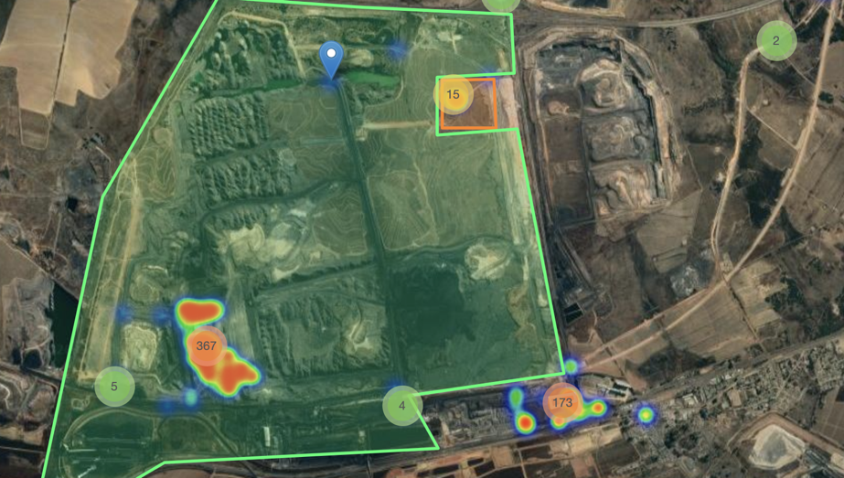
Visualise events on heatmap to understand relative duration and impact on the operation

Slide 24
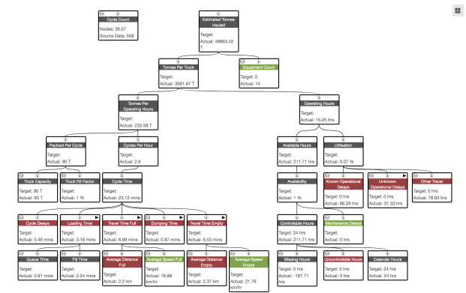
Collaboration Between Maintenance & Production - OEE
Tracking and ability to drill down on every production and maintenance activity

