Slide 1

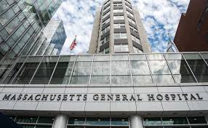

Massachusetts General Hospital Trauma Center
Haytham Kaafarani, MD
Professor of Surgery, Harvard Medical School Medical Director, Hospital Quality & Safety Medical Director, Trauma Center

Slide 2
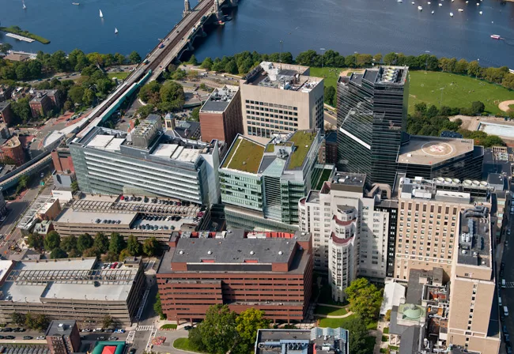
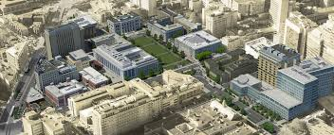
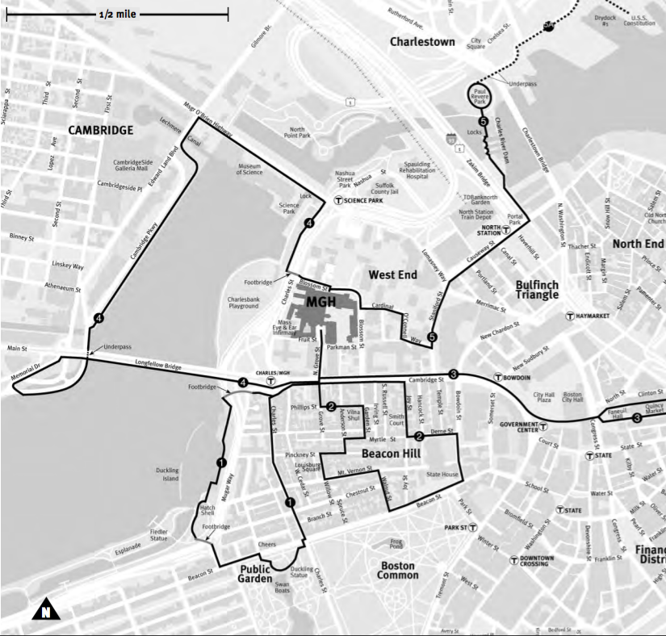
Massachusetts General Hospital, Massachusetts
Harvard Medical School, Boston
Notes:
Very centralised system

Slide 3
The Massachusetts General Hospital Trauma Center
The Mass General Trauma Center treats patients with the most critical injuries and is a major referral center in New England for patients of all ages. We offer exceptional 24-hours-a-day on-site trauma specialists, and our state-of-the-art facility is fully equipped to handle any medical or surgical emergency. Each year, we have more than 2,500 trauma admissions—the highest in Massachusetts.
The Mass General Trauma Center is verified as a Level 1 Adult Trauma Center and Level 1 Pediatric Trauma Center by the American College of Surgeons. The Sumner Redstone Burn Center at Mass General, which coordinates seamlessly with the Trauma Center, is one of the few American Burn Association-verified burn centres in New England.

Slide 4
The Massachusetts General Hospital Trauma Center
Our multidisciplinary team includes highly trained trauma surgeons, trauma psychiatrists, rehabilitation physicians, injury prevention specialists, trauma nurse practitioners, and occupational and physical therapists. We work closely with specialists across various disciplines at Mass General to provide optimal care to patients for every aspect of injury and recovery:
Anaesthesia, Critical Care and Pain Medicine
Burn, Acute and Critical Care Program
Emergency Medicine
Neurosurgery
Oral and Maxillofacial Surgery
Orthopaedic Trauma Service
Paediatric Trauma Center
Physical Medicine and Rehabilitation
Plastic and Reconstructive Surgery
Psychiatry Service
Radiology
Trauma, Emergency Surgery and Surgical Critical Care
Trauma Injury Prevention and Outreach Program

Slide 5
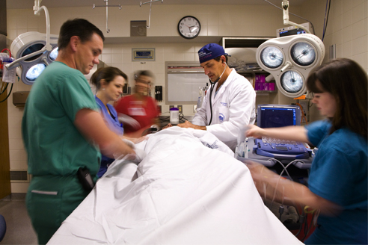
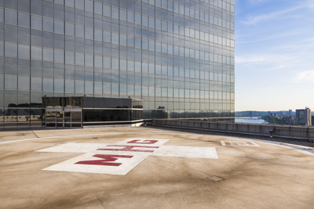
Trauma The Mass General Trauma Center treats patients with the most critical injuries. Each year they provide care to an average of 2,500 trauma patients - the highest in Massachusetts
The division works with:
Department of Orthopaedic Surgery
Department of Oral and Maxillofacial Surgery
Neurosurgery
Division of Plastic and Reconstructive Surgery
Imaging
Mass General for Children
Department of Anaesthesia, Critical Care and Pain Medicine
Department of Emergency Medicine

Slide 6
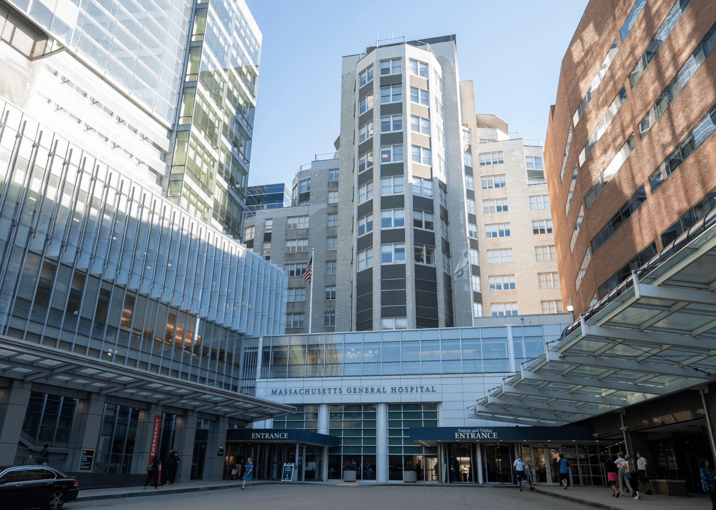
The Division of Trauma, Emergency Surgery and Surgical Critical Care
The Division of Trauma, Emergency Surgery and Surgical Critical Care (TESSCC) at Massachusetts General Hospital offers general emergency surgery for all types of traumatic and non-traumatic injuries
Trauma
Emegency Surgery
Surgical Critical Care
Notes:
Heavy duty in Meilahti. A bit lighter, minimally invasive, day surgery in Jorvi.

Slide 7
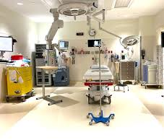
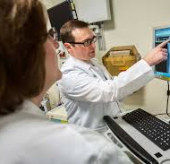
What make us stand out:
Continuous coverage: Our team of surgeons offers 24-hours-a-day in-house coverage and is always available to handle any general surgical emergency
Multidisciplinary approach: We work closely with Mass General Trauma Center specialists across a variety of disciplines, and our team includes trauma psychiatrists, rehabilitation physicians, injury prevention specialists, occupational and physical therapists, and speech-language pathologists
Leading-edge facilities: Our Emergency Department features the latest technology for treating patients, including two new-generation helical CT scanners and one MRI machine. A new, state-of-the-art emergency room opened in 2011
An eye toward the future: We are committed to discovering new methods of treating critically ill trauma and emergency patients through laboratory, outcomes and clinical research programs. In addition, we host an intense educational program and other opportunities to prepare the next generation of surgeons
Notes:
EGS on call system (if there is time)

