Slide 1




Healthier Together NENC
Age < 1 years
Alex Battersby
Healthier Together Clinical Lead

Slide 2

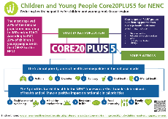
Network delivery and reach
Delivery Areas
- CYP Transformation programme, Integration and CEW pilots (NHSE)
  - Asthma, Epilepsy, Transition and Diabetes focus & Mental Health Champions and
  Paediatric Early Warning (PEW)
  - 2 Clinics for Excessive Weight pilots established
  - Integration Centre 3-year pilot – supportive environment to test and learn
- Delivered the Tackling Inequalities in Children Programme (NHS Charities Together)
  - Youth MH First Aid, Poverty Proofing, South Tees ARts (STAR), Digital Apprenticeship
- NENC specific CYP Core20PLUS5 Toolkit developed and launched (NHSE & H&F)
  - Work with Healthier and Fairer delivering the national framework oversight
  - Asylum seeking health work focus
- Developed a Sustainability Resource on Child Health
- Delivered an Interactive film on Mental Health and Young Parents
Notes:
Deliver the CYP Transformation & Integration programme (NHSE)
Asthma, Epilepsy, Transition and Diabetes focus
Mental Health Champions and Paediatric Early Warning (PEW)
2 CEW Clinic pilots established
13 schools accredited as Beat Asthma Friendly
Healthier Together - over 7,000 children registered
VCSE partnership model to embed initiatives into our most underserved communities – over 43 organisations involved (and 58 Education settings)
Asthma - Primary Care to Secondary Care and Secondary Care to Tertiary Care pathway downloaded 2918 times & L1 and L2 Elearning for Health Asthma Training accessed by 1261 people
NENC specific CYP Core20 Toolkit developed and launched (NHSE H&F)
Work with Healthier and Fairer delivering the national framework oversight
Asylum seeking health work focus
Delivered the Tackling Inequalities in Children Programme (NHS Charities Together)
Over 500 trained in Youth MH First Aid
Over 1000 children been part of STAR initiative
Supported Poverty Proofing in 8 settings including dental and oral health
Delivered a Sustainability Resource on Child Health
Delivered an Interactive film on MH and Young Parents

Slide 3
Outline
Common conditions/presentations in pre-school children
Red flags for common presentations
When to refer on
How the Healthier Together website and mobile app can support professionals and parents with this
Q and A

Slide 4
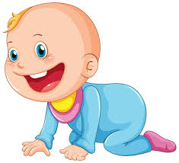
Breathing
Staying Healthy
Feeding
Vomiting
Crying

Slide 5
Conditions
Acute
  Bronchiolitis
  Diarrhoea and Vomiting
Chronic
  CMPA
  GORD
  The Unsettled Baby

Slide 6
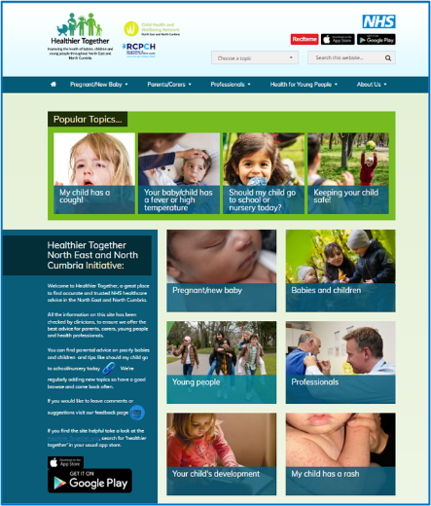
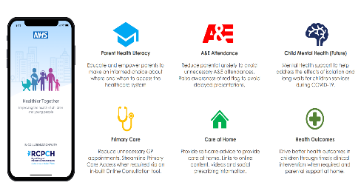
Healthier Together Website and Mobile App
Valued by both professionals and families alike as a platform to share information consistently across the whole healthcare system

Slide 7
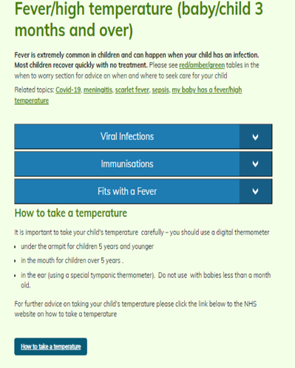
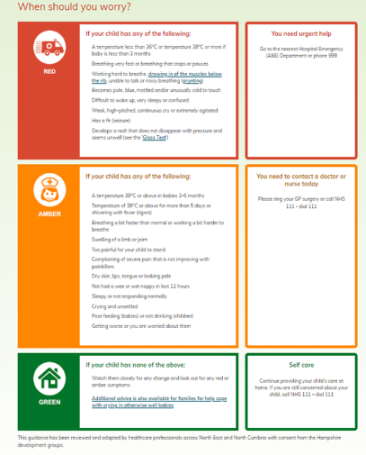
Traffic light system
Notes:
Reassure/empower parents
Reduce unnecessary PED attendance and encourage prompt attendance of sick children

Slide 8
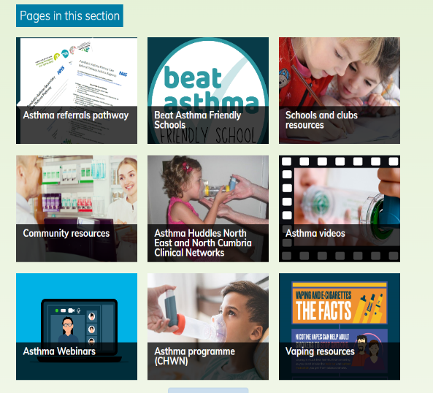
Professional Resources
Professional resources
Community resources
Webinars
Referral Pathways

Slide 9
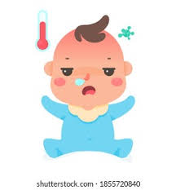
Case Study
3 days of runny nose and cough
1 day worsening breathing
Breathing faster than normal
Poor feeding, 5 ounces since this morning
No vomiting, reduced wet nappies
?temp at home

Slide 10




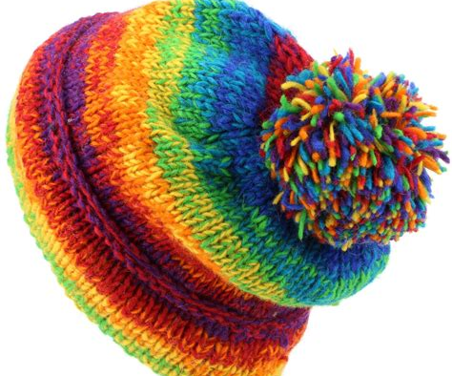
BRONCHIOLITIS

Slide 11
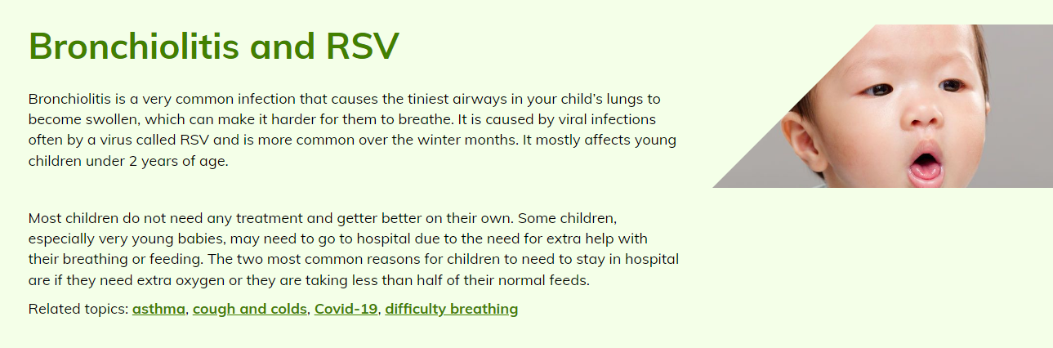
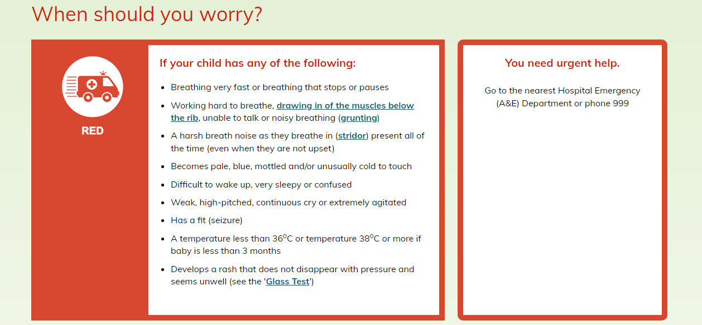
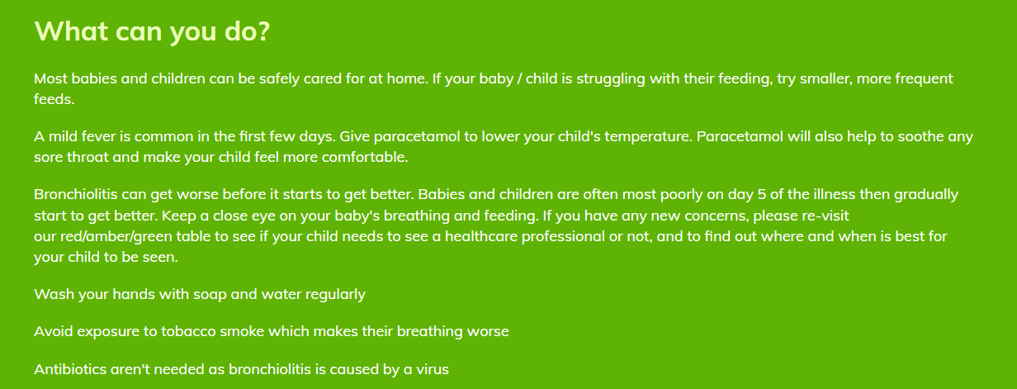
Healthier Together | NHS | Bronchiolitis (nenc-healthiertogether.nhs.uk)

Slide 12
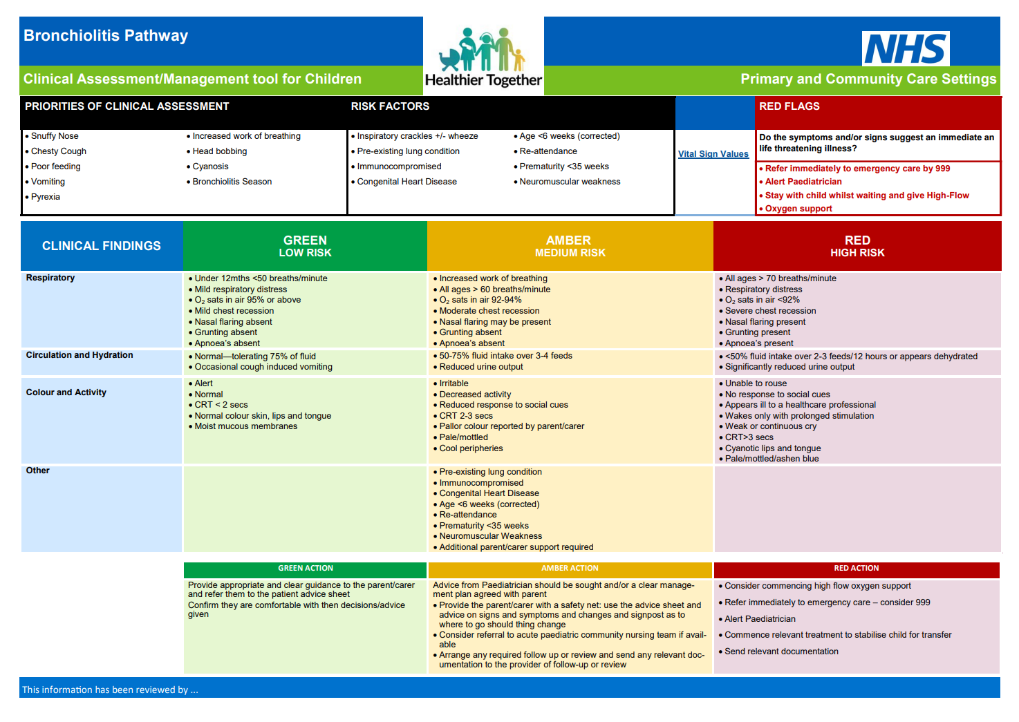

Slide 13
Treatment
Respiratory Support
Oxygen → admission
High Flow ?
PICU
Feeding Support
Little and often
NG → admission
IV fluids
Time and good safety net advice

Slide 14

What doesn’t work?
  Bronchodilators
  Steroids
  Antibiotics
  Hypertonic saline

Slide 15
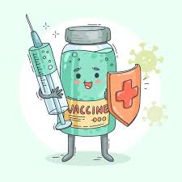
Prevention
Palivizumab
  For high risk babies with strict criteria
Pregnancy
  28 weeks and onwards
  Protects for first 6 months
Notes:
Palivizumab
humanised monoclonal antibody
provides a form of passive immunisation, providing short-term protection against Respiratory Syncytial Virus (RSV).
Given once a month during ‘RSV season’
Indications.
High Risk due to Bronchopulmonary dysplasia (BPD) – (also known as chronic lung disease)
Pre-term infants who have moderate or severe BPD.
Infants with respiratory diseases who remain in oxygen may include those with conditions including:
● pulmonary hypoplasia due to congenital diaphragmatic hernia
● other congenital lung abnormalities
● interstitial lung disease and including those receiving long term ventilation
High Risk due to Congenital Heart Disease (CHD)
Preterm infants with haemodynamically significant, acyanotic CHD Cyanotic or acyanotic CHD plus significant co-morbidities particularly if multiple organ systems are involved.
Children less than 24 months of age with Severe Combined Immunodeficiency Syndrome (SCID)

Slide 16
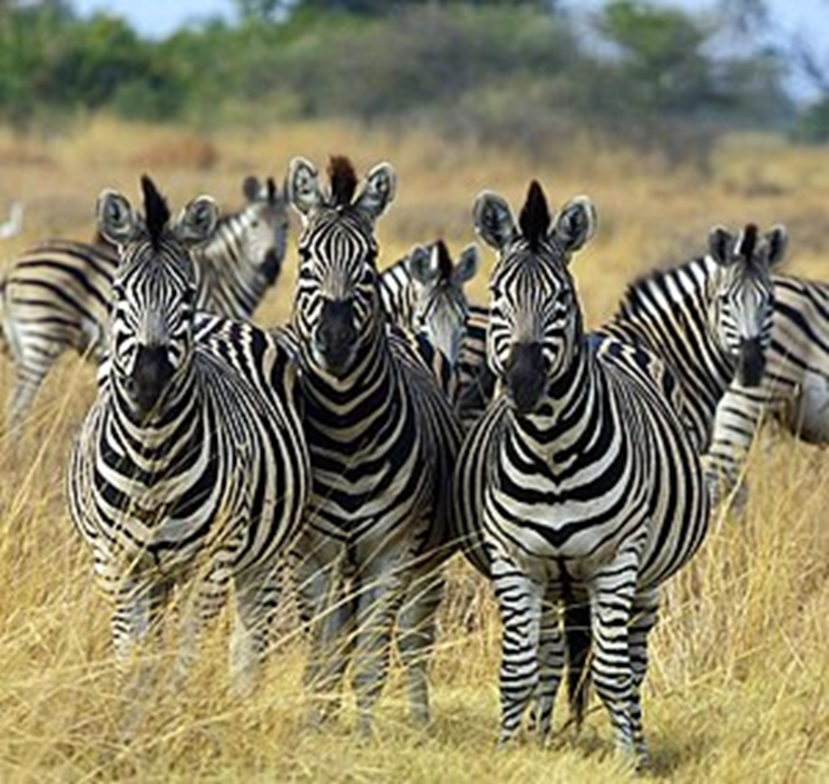
But what if it’s not bronchiolitis???

Slide 17
Case Study
3 days of runny nose and cough
Always seem to be breathing fast
Poor feeding, 5 ounces since this morning
Breathless when feeding for a while
Noisey breathing

Slide 18

Case 1: Always seems breathless……
Seen in ED and diagnosed with LRTI +/- laryngomalacia
Represented with worsening respiratory distress
Significant intercostal and subcostal recession
History was over 2-3 months more breathless with feeds
No wheeze
Notes:
Key Features: Long history, no coryza

Slide 19
Case Study
3 days of runny nose and cough
1-2 days breathing faster
Poor feeding, 5 ounces since this morning
Multiple episodes of bronchiolitis
Poor weight gain

Slide 20
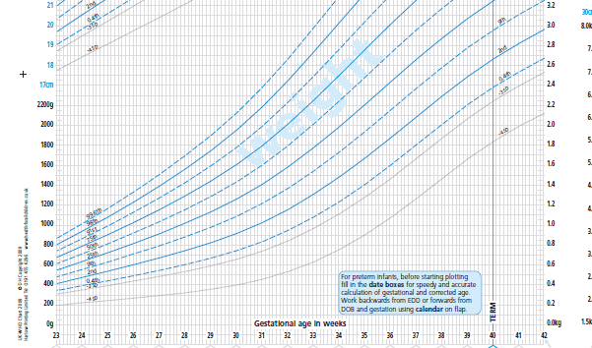
Case 2: Not like his twin…….
Twin
3 x presentations with ‘bronchiolitis’
CXR changes on 2 occasions
Never completely right
Mum’s concern that he wasn’t thriving like his sister
But normal saturations and felt well enough to be at home
Notes:
The maternal concern and clear growth faltering warrant a bit more thinking

Slide 21
 | Birth | Bronchiolitis Admission 1 | Bronchiolitis Admission 3
Hb | 217 | 113 | 98
Plat | 270 | 322 | 285
Neut | 2.4 | 2.56 | 2.06
Lymph | 0.29 | 0.1 | 0.09

Slide 22
Red flags for Primary Immune Deficiency
Eight or more new ear infections within 1 year
Two or more serious infections within 1 year
Two or more months on antibiotics with little effect
Two or more episodes of pneumonia within 1 year
Failure of an infant to gain weight or grow normally
Recurrent deep skin or organ abscesses
Need for intravenous antibiotics to clear infections
Persistent thrush in mouth or fungal infection on skin
Two or more deep seated infections e.g. sepsis, meningitis
A family history of PID
Arkwright/Gennery 2011

Slide 23

Differential
Cardiac
Immune Deficiency
Other Respiratory

Slide 24
Differential
Cardiac
  History – longer duration, feeding, absence of coryza
  Examination – murmurs, liver, femorals, absence of snot
Immunodeficiency
  History – not typical course, no recovery, faltering growth, other features, family history
  Exam – growth, skin, prolonged course
Respiratory
  History – not typical time pattern
  Exam – not crackles/wheeze, persistent unilateral signs

Slide 25
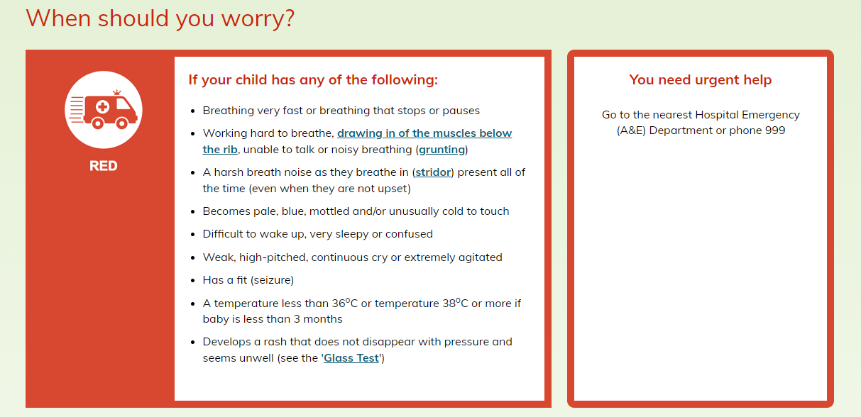
Outcome
Discharge with advice
https://www.nenc-healthiertogether.nhs.uk/parentscarers/worried-your-child-unwell/fever-high-temperature

Slide 26

Diarrhoea and Vomiting

Slide 27
Red Flags
Alternative diagnosis
Systemically unwell
Bilious vomiting
High Fever

Slide 28
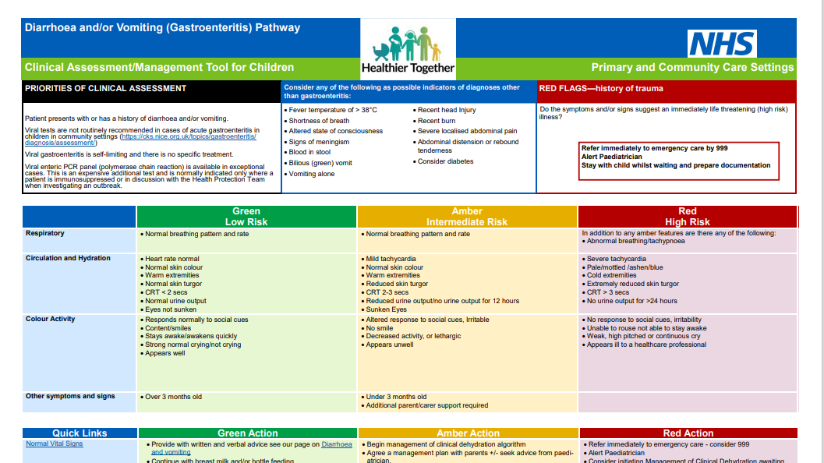

Slide 29
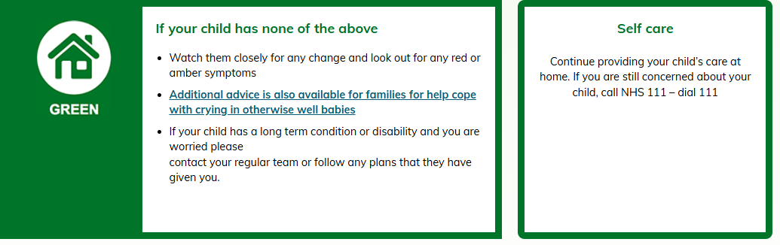

Slide 30
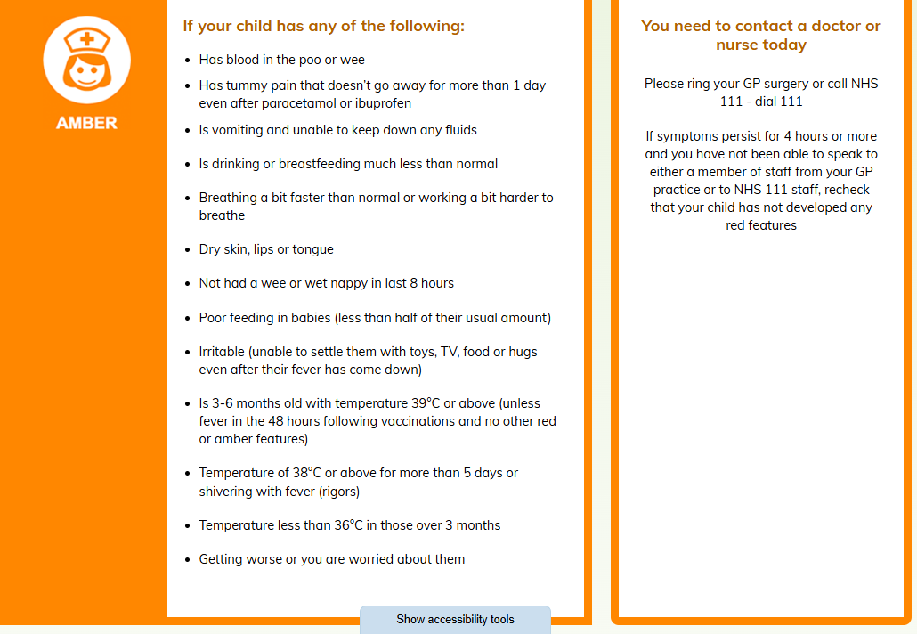

Slide 31
Feeding
CMPA
GORD
Weight

Slide 32
Case Study
Bottle fed baby
Unsettled baby
‘Diarrhoea’, mucous stools, some blood
Vomiting
Skin – non specific rash

Slide 33

Cow’s Milk Protein Allergy
Red Flags
  Immediate reaction suggestive of IgE
  Faltering growth
  Ongoing blood in stool
  Severe atopic Dermatitits
  FPIES
    Profuse vomiting with collapse
    Collapse

Slide 34
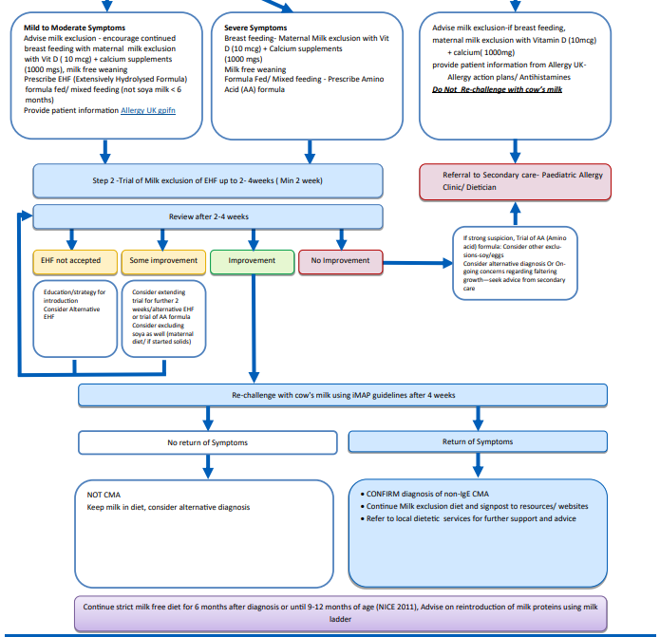

Slide 35
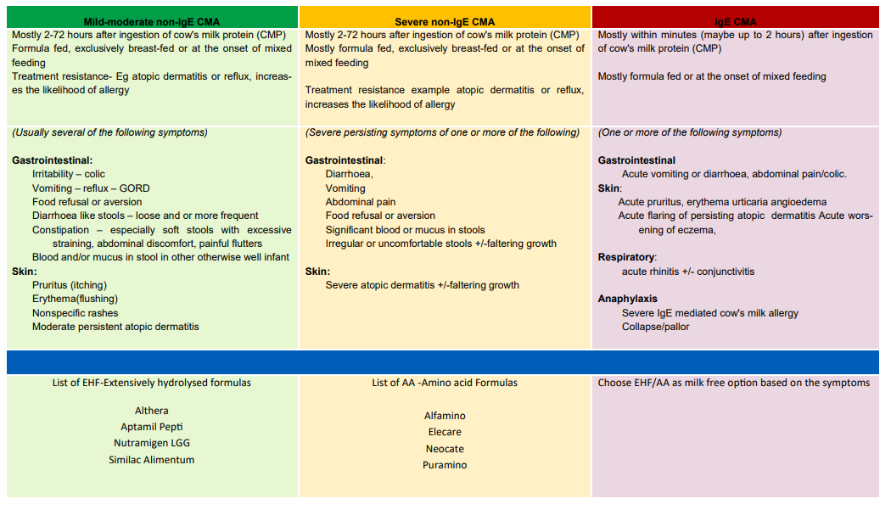

Slide 36
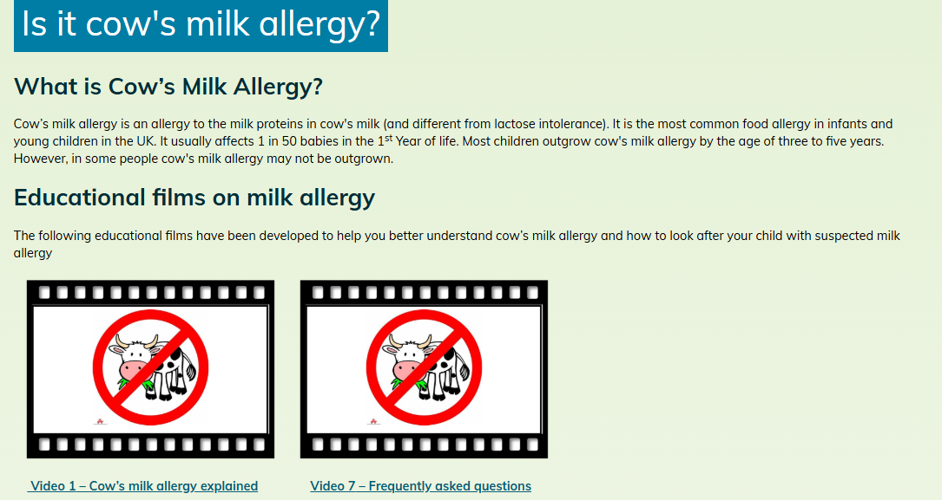
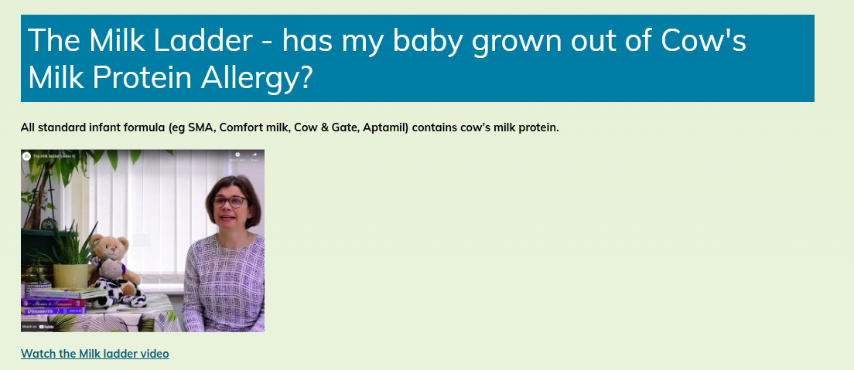
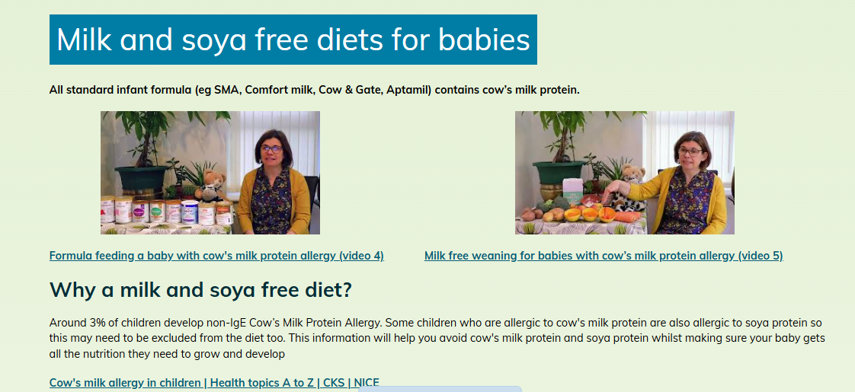
Information for Parents

Slide 37
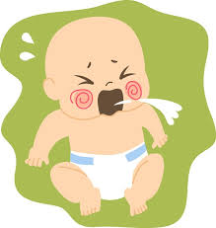
Gastro-Oesophageal Reflux
  Red Flags
    Bile-stained vomit
    Frequent forceful (projectile)
    Blood in vomit or stool (red or brown)
    Faltering growth
    Abdominal distention/chronic
    Unwell child/fever/altered responsiveness
    Bulging fontanelle/rapidly increasing head circumference
    Late onset (after 6 months)

Slide 38
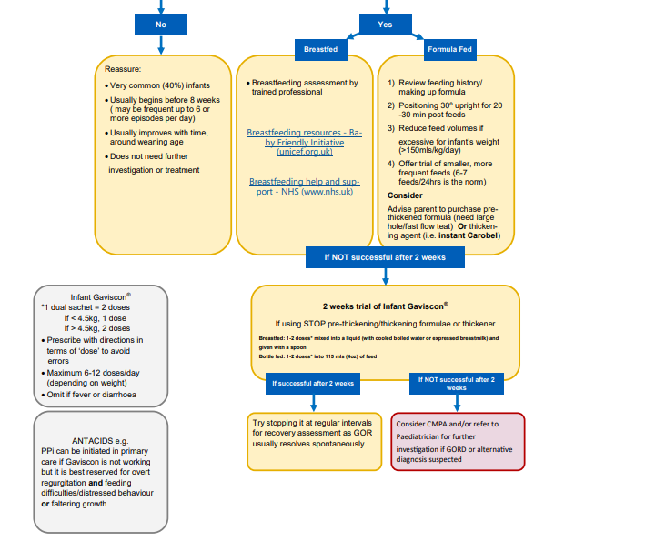

Slide 39
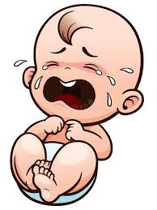
Unsettled Baby

Slide 40
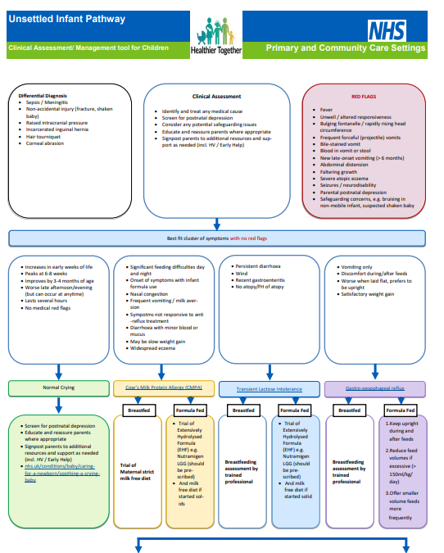

Slide 41
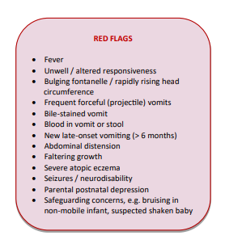

Slide 42
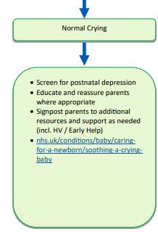

Slide 43

Staying Healthy

Slide 44
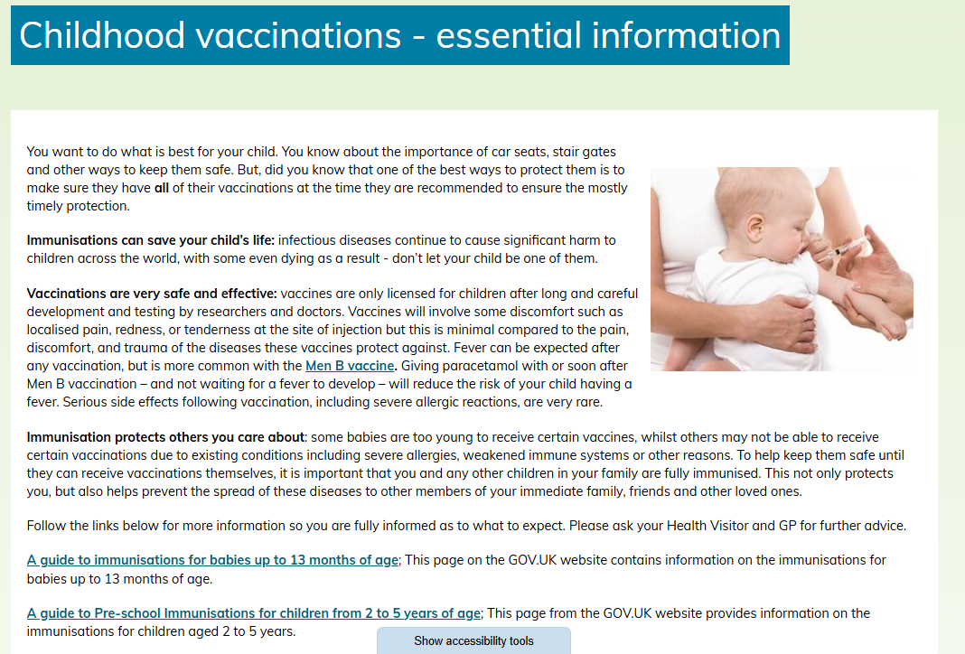

Slide 45
Any questions?

