Slide 1

Making the Case: Strengthening Curriculum Adoptions
for Multilingual Learner Equity
Note: This slide deck is a template for any presenter to use as appropriate for their context. The slides focus on why the quality of instructional materials matters for all students, with a focus on multilingual learners. The presenter does not have to use all slides, nor use slides in the current sequence, in order to put together a meaningful rationale for strengthening curriculum adoptions to be (1) of high quality, and (2) attentive to the linguistic and instructional needs of multilingual learners.

Slide 2


Instructional materials matter for the 1.1 million+ MLLs in California public schools
Notes:
Instructional materials matter for the the over 1 million multilingual students in our schools. 19% of CA students are ELs. 82% of ELs speak Spanish. The performance outcomes suggest that achievement for our multilingual students is unacceptably and persistently below grade-level proficiency.
Source: California Department of Education

Slide 3

What do teachers say about how well their materials support MLLs?
70%
do not feel prepared to teach multilingual learners
64%
do not regularly use district or school-provided materials
80%
can’t rely on their materials to support them in practices that improve outcomes for multilingual learner
Source: Wynn, L. & Zahner, B. (2022). Raising Teachers’ Voices: What do teachers say about how well their instructional materials support English Learners?
Notes:
One problem that needs to be solved for is that there is a mismatch between the instructional materials that districts buy and what teachers use. This is a mismatch related to quality of materials and appropriateness for students.
What would teachers in your district or county say?
What does your student achievement data say?

Slide 4
Research shows that choosing a quality curriculum can have an impact on student achievement. We also know that core curriculum that integrates the language needs of multilingual learners is more effective than add-on interventions.
This means that a curriculum adoption process is a pivotal point in which education leaders can make decisions about materials that will greatly benefit multilingual learners.
What can we do to make sure teachers have the materials they need?
Notes:
What does this all mean? Materials matter even more when multilingual learners are involved. The linguistic and instructional needs of these students have to be part of the materials adoption criteria in order for high-quality materials to matter for everyone.
Adopting better instructional materials that meet the needs of multilingual learners is an important strategy that schools and districts can use to improve learning for all learners. So, what can we do to make sure teachers have the materials they need?

Slide 5
What does research say about the role of materials in supporting high quality instruction?
1
2
3
“In terms of achievement impacts, our findings suggest non-trivial gains in student achievement are attainable simply by choosing more effective curriculum materials.”
Koedel, C and Polikoff, M, 2017
“more grade-appropriate assignments, stronger instruction, deeper engagement, and higher expectations, the gap …began to narrow substantially.”
The Opportunity Myth, TNTP, 2018
“Switching to a higher quality curriculum has a huge ROI relative to other educational policies. The average cost-effectiveness ratio of switching curriculum was almost 40 times that of class-size reduction in a well-known randomized experiment.”
Boser, U, Chingos, M, and Straus, C, 2015
Notes:
One problem that needs to be solved for is that there is a mismatch between what districts buy and what teachers use. This is a mismatch related to quality of materials and appropriateness to students.

Slide 6
Educators often face a set of common obstacles when leading curriculum adoptions that impact multilingual learners:
Districts may not prioritize the inclusion of MLLs in their curriculum adoption process because they either assume good materials do not exist or don't see the significant impact that adoptions have on MLLs.
Adoption committees may not include professionals and stakeholders who may be most knowledgeable about the needs of MLLs in their community due to a lack of awareness or collaboration.
Adoption committees may lack resources, time and training in order to know how to review instructional materials and assess their quality specifically for MLLs.
Adoption committees do not have access to evaluation tools or rubrics that include criteria that address research-based practices for supporting MLLs in content learning.
Meetings with publishers lack sufficient guidance about how to use materials with MLLs.
Final decision makers may not necessarily be informed about the strengths and weaknesses of finalist programs for MLLs.
Notes:
Data show that multilingual learners haven’t been well-served in CA.These are some of the common obstacles. Each click reveals a bullet point. Talk through each one briefly.

Slide 7
Inclusive Curriculum Adoptions for Multilingual Learners: A New Way Forward
Educators need a new way forward for an inclusive curriculum adoption process that focuses on serving multilingual learners. When the needs of multilingual learners are included as criteria for selecting materials, schools and districts consider whether materials are well suited to support the needs of their specific multilingual learners and select the best possible instructional materials for their teachers and students.
Is your curriculum adoption process responding to the needs of your multilingual learners?
Notes:
The obstacles listed in the earlier slide don’t have to stop us from including the needs of multilingual learners in our adoption processes. There are new tools and resources to help guide adoption decisions – there is a new way forward

Slide 8
Shifts toward Culturally and Linguistically Responsive Adoption of Instructional Materials
From Selecting only for Standards Alignment
Assuming standards alignment is sufficient to address the needs of historically marginalized students.
To Selecting Language-Affirming Materials
Looking for and placing value on culturally and linguistically responsive practices in materials.
From No Criteria
Little to no criteria for supporting multilingual learners; criteria list supports as superficial add-ons in materials.
To Language-Focused Embedded Criteria
High-impact, research-based, integrated indicators call for the simultaneous development of language and content learning.
From Silos & Compliance
A small group of language specialists consulted on instructional materials.
To Shared Responsibility and Inclusion
All educators are trained to look for multilingual learner supports in materials and those most knowledgeable about multilingual communities are included in adoption decisions.
From Bureaucratic Process
Fast-paced decision-making process.
To Professional Learning
Using adoption as a professional learning and consensus-building opportunity.
Notes:
1 min.
Facilitator:
Inclusive curriculum adoptions involve the following shifts to address the assets and needs of multilingual learners: [talk through the shifts]
The new way forward can be seen in current shifts now occurring in adoption beliefs and practices throughout California – from the old “one size fits all” to intentional selections based on multiple student needs.
Our hope is that this learning session is one step for your organization to move towards the more desirable conditions on the right.

Slide 9
Which of these reasons resonate most?
How might your district strengthen curriculum adoption for your multilingual learners?
✓Multilingual learners are the fastest growing student population in the country for the foreseeable future. In CA, the 1.1 million multilingual learners are a critical part of the future of the state. Teachers want instructional materials that are culturally and linguistically responsive and help multilingual learners thrive academically.
✓ Selecting high-quality instructional materials at the start provides teachers with a strong foundational set of standards-aligned and engaging content that can be enhanced and adapted in response to multilingual learners’ assets and needs.
✓English Language Development (ELD) classes and add-on supplements are insufficient to meet the needs of multilingual learners. Teachers need subject-specific instructional materials that integrate language and literacy development simultaneously with content area learning.
✓Schools and districts need to develop educator’s understanding of how to assess the quality of instructional materials for multilingual learners specifically and know what to look for as they select and prepare to launch a program.
✓ The selection of high-quality instructional materials that are responsive to multilingual learners is an important step toward instructional equity.
Notes:
These are all reasons why districts would want to invest in instructional materials that address the needs of multilingual learners.They are all good, compelling reasons, but a few of them may speak more directly to your own district and its needs.

Slide 10
Ask yourself two important questions
1 | How are your current core content instructional materials meeting the needs of your multilingual learners?
2 | To what extent do teachers in your school or district report confidence in using the core curriculum materials with multilingual learners?
Notes:
What would tell you that the instructional materials you are now using are meeting the needs of multilingual learners? What would give teachers in your district a sense of confidence or a lack of confidence about using these materials with multilingual learners?.

Slide 11
Through partnerships with states and districts throughout the country, ELSF has found that states and districts typically choose between two main pathways in incorporating multilingual learner-specific criteria into their curriculum adoption reviews. Both pathways can be effective depending on your context with advantages and considerations for each.
Pathways for Using the Multilingual Learner Review Criteria in Curriculum Adoption
Pathway 1 Incorporate select Multilingual Learner Review Criteria and indicators into district criteria to conduct one integrated materials review |  | Pathway 2 Conduct a stand-alone review of materials using all of the Multilingual Learner Review Criteria and indicators
Which of these pathways would work best in your context to include multilingual learners in your adoption process?
Notes:
There isn’t just one way to conduct an inclusive adoption process. Pathway 1 is an integrated process using all criteria together, and Pathway 2 is for a materials review focusing solely on the Multilingual Learner Review Criteria. There are advantages and considerations for each pathway

Slide 12
You can lead the change - here’s how to do it.
Materials Adoption Process Steps |  | Desired State
Step 1 | Review the current landscape and data on multilingual learner achievement and experiences | District instructional vision and mission includes specific goals for multilingual learners. Achievement data for multilingual learners are analyzed or interpreted to diagnose root causes and areas of need in system improvement.
Step 2 | Strengthen adoption criteria using the Multilingual Learner Review Criteria | Multilingual learner criteria are included and reflect research-based practices to promote language and literacy development and content learning simultaneously. Evidence from multilingual learner criteria provides intentional analysis of strengths and weaknesses in instructional materials. Existing reviews of materials address multilingual learners in depth.
Step 3 | Select and prepare an Inclusive Adoption Committee & Review Team | Those who are most knowledgeable about multilingual learners are included in the review process. Adoption committee members have had sufficient practice in looking for evidence of multilingual learner criteria.
Step 4 | Conduct the materials review and make decisions | Pilots have a way to assess impact on student experience for multilingual learners. Final decision makers are informed about the strengths and weaknesses of programs for multilingual learners.
Step 5 | Plan for Launch and Implementation | Teachers and schools are prepared to enhance and adapt the selected materials during launch and implementation. The progress of multilingual learners is monitored separately from all students. The effectiveness of the materials related to multilingual support is monitored to determine impact on both content learning and language and literacy development
Notes:
Now that you have delved into the shifts that reflect an inclusive adoption process, it’s time to think about the materials adoption process. ELSF has outlined a process that addresses the common obstacles educators face when leading curriculum adoptions that impact multilingual learners and reflects the needed shifts toward culturally and linguistically responsive materials adoption processes. ELSF has resources to support communities with each of these five steps of an adoption process inclusive of MLLs.

Slide 13
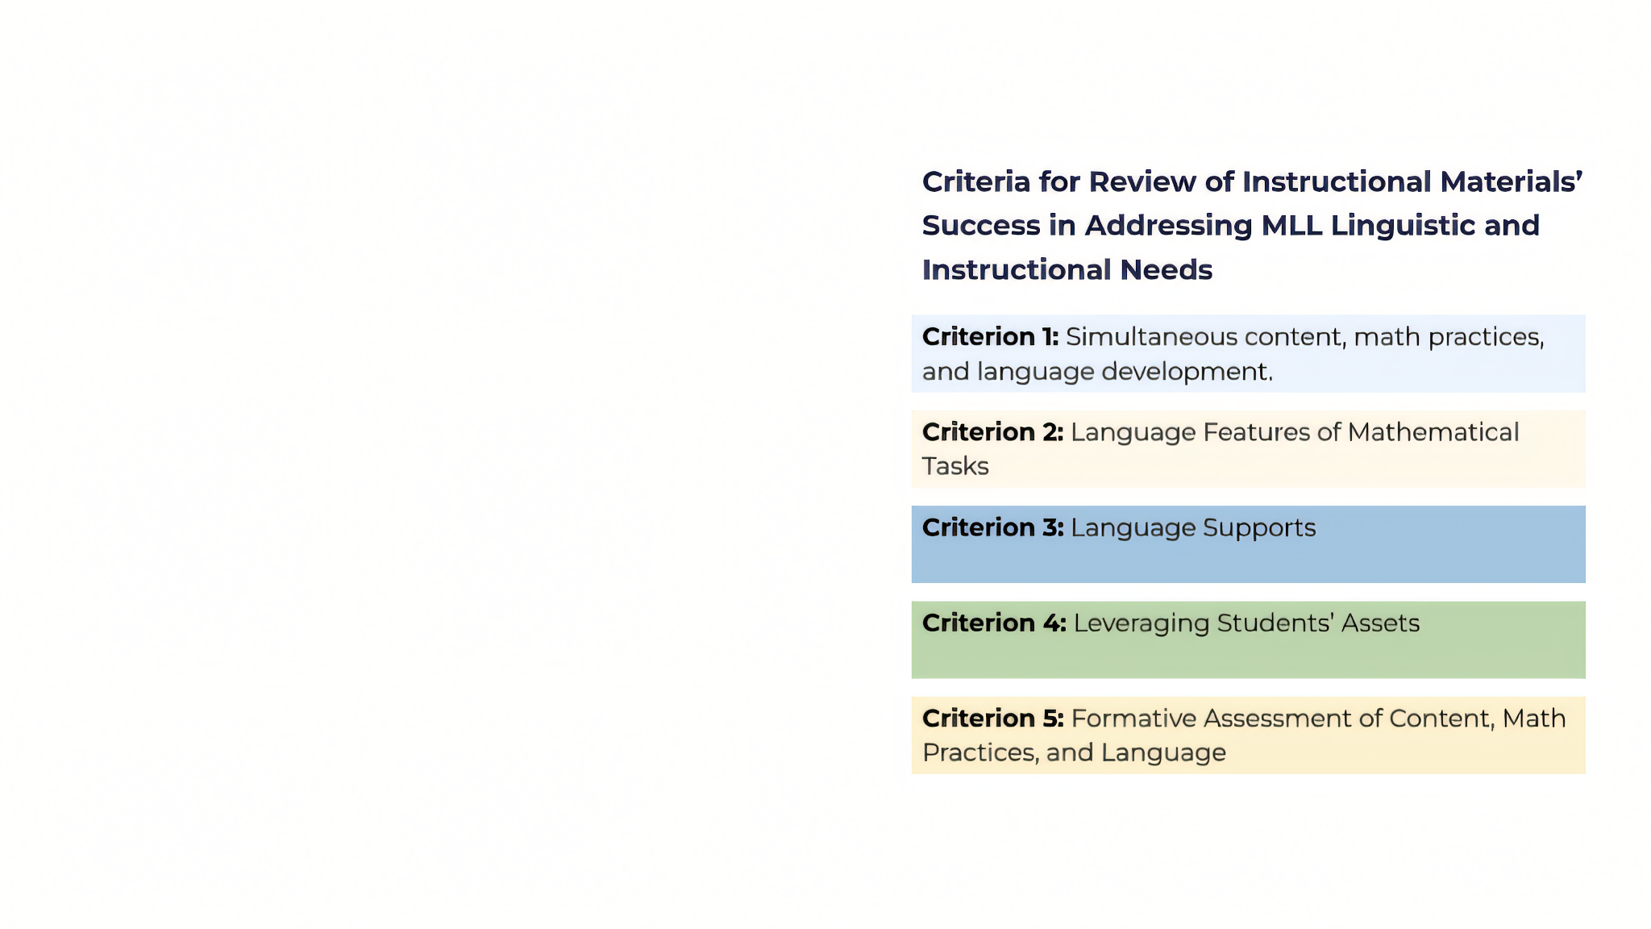
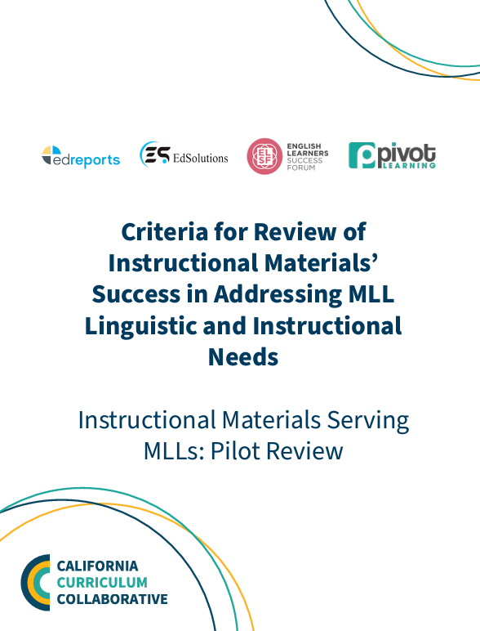
Tool to Assess the Quality of Materials for MLLs
Notes:
The Multilingual Learner Review Criteria provide a clear set of indicators grounded in research-based practices to support multilingual learners in core content learning. The criteria can be used for core K-12 math materials. It synthesizes the research-backed practices into five key areas that effectively support multilingual learners –and all students–when included in core materials. By using these criteria, adoption committees are better set up to know how to review instructional materials.
National organizations and organizations within California have been working together to identify what the criteria should be for adoptions that address the needs of multilingual learners. These criteria have been used in a pilot with California districts in mathematics, and form the basis of the resources of the ELSF toolkit.

Slide 14
Adoption committees need research-based and quality indicators to evaluate instructional materials with the needs of multilingual learners in mind. The criteria should have specificity and include specific language supports they should look for.
Ask yourself:
What criteria do your adoption committee use to select materials?
Do these criteria address the assets and needs of multilingual learners?

Slide 15
Take the next steps to ensure your materials are responsive to multilingual learner needs.
Make a mindset shift by planning your upcoming curriculum adoption with multilingual learners in mind.
Use criteria that includes multilingual learners, such as the Multilingual Learner Review Criteria, to guide your adoption process.
Reach out to the multilingual learner professionals and leaders in your district to discuss how they can be part of the adoption process. Leverage their expertise to ensure your adoption committee knows what instructional materials should have to support multilingual learners.
Use resources to guide you each step of the process, such as the ELSF Multilingual Learner Curriculum Adoption Toolkit, which offers a comprehensive and detailed set of resources with examples and tools specific to multilingual learners.
Notes:
If the information in this slidedeck has made sense to you, you do not have to work alone in trying to figure out how to be sure that your materials meet the needs of multilingual learners. Information presented here has been about the “why” – ELSF has resources in the form of a Guidance and Toolkit to show the “how.” When a district is committed to making this shift toward inclusive instructional materials, it then deserves the resources to be able to do it well.

Slide 16
Recommendations for the Instructional Quality Commission, County Offices, and the California Department of Education
Recommendations for local
education agencies
Ensure that the review of materials for the state adopted list includes vetting for supports that address the needs of multilingual learners.
Include multilingual learner review criteria when providing guidance and resources to districts and schools on curriculum adoptions.
Train all teachers involved in the review process to know how to evaluate the efficacy of instructional materials for multilingual learners.
Ensure English Language Development professionals are a part of the review process.
Notes:
The state and districts both have responsibilities in making it possible for inclusive materials adoptions – they can work in tandem to make it happen

Slide 17
An adoption process that is inclusive, language-focused and language-affirming towards multilingual learners will get you one step closer to ensuring teachers have the materials they need to support multilingual learners. Choosing high-quality materials that support multilingual learners can also lead to a more effective launch of new materials, and subsequent, ongoing professional learning to meet the needs of multilingual learners.
We hope this resource is helpful to you and your organization to create more equitable and culturally and linguistically responsive educational experiences for your multilingual learners.
Ready to learn more?
Visit www.elsuccessforum.org
Notes:
Again, it is clear that materials matter – and that high-quality materials matter even more. And an inclusive materials review process, such as the one described here, makes sure that the needs of all students, including multilingual learners, are prioritized in the review.

