Slide 1

TPS Group Holdings, LLC 2026 Plan Highlights Get to know your Harvard Pilgrim plan benefits

Slide 2
Welcome to Harvard Pilgrim’s Open Enrollment
Let’s discuss:
About Harvard Pilgrim Health Care
2026 Plan Highlights: What’s new
Provider Network: Finding Care
Health Engagement & Wellness Programs
Member Support & Experience
Additional Programs

Slide 3
Medical Plans

Slide 4




Plan Overview
 | HMO: In-Network Only
Annual Deductible
Individual | $1,500
Family | $3,000
Annual Out-of-Pocket Maximum
Individual | $3,000
Family | $6,000
Annual Physical (preventive) | $0, covered in full
Office Visit | $25 copayment
Specialist Visit | $50 copayment
Diagnostic X-Ray/Lab Tests | No charge
Inpatient Hospital (including maternity) | Deductible + 20% coinsurance
Outpatient Hospital | Deductible + 20% coinsurance
Inpatient Mental Health | Deductible + 20% coinsurance
Outpatient Mental Health | $25 copayment
Emergency Room Visit (waived if admitted) | $250 copayment
Physical Therapy (60 visits per plan year limit combined with Occupational Therapy) | Deductible + 20% coinsurance
HMO Best Buy $1500
In-network coverage only
You must select a primary care physician (PCP)
Your PCP coordinates your overall care, including referral to specialist when needed
When traveling outside the service area, you're covered for emergencies and unforeseen care

Slide 5

 | PPO*
 | In-Network | Out-of-Network
Annual Deductible
Individual | $2,000 $4,000
Family
Annual Out-of-Pocket Maximum
Individual | $5,000 $10,000
Family
Annual Physical (preventive) | $0, covered in full | Deductible + 20% coinsurance
Office Visit | $25 copayment | Deductible + 20% coinsurance
Specialist Visit | $50 copayment | Deductible + 20% coinsurance
Diagnostic X-Ray/Lab Tests | $25 copayment | Deductible + 20% coinsurance
Inpatient Hospital (including maternity) | Deductible + 20% coinsurance | Deductible + 40% coinsurance
Outpatient Hospital | Deductible + 20% coinsurance | Deductible + 40% coinsurance
Inpatient Mental Health | Deductible + 20% coinsurance | Deductible + 40% coinsurance
Outpatient Mental Health | $25 copayment | Deductible + 20% coinsurance
Emergency Room Visit (waived if admitted) | $250 copayment
Physical Therapy (60 visits per plan year limit combined with Occupational Therapy) | Deductible + 20% coinsurance | Deductible + 40% coinsurance
Plan Overview
PPO Best Buy $2000
Covers in-network and out-of-network providers
Referral to specialist not required
You’ll typically pay less for in-network coverage

Slide 6

 | HSA-Eligible PPO*
 | In-Network | Out-of-Network
Annual Deductible
Individual | $2,500 $5,000
Family
Annual Out-of-Pocket Maximum
Individual | $5,000 $10,000
Family
Annual Physical (preventive) | $0, covered in full | Deductible + 20% coinsurance
Office Visit | Deductible + 20% coinsurance | Deductible + 40% coinsurance
Specialist Visit | Deductible + 20% coinsurance | Deductible + 40% coinsurance
Diagnostic X-Ray/Lab Tests | Deductible + 20% coinsurance | Deductible + 40% coinsurance
Inpatient Hospital (including maternity) | Deductible + 20% coinsurance | Deductible + 40% coinsurance
Outpatient Hospital | Deductible + 20% coinsurance | Deductible + 40% coinsurance
Inpatient Mental Health | Deductible + 20% coinsurance | Deductible + 40% coinsurance
Outpatient Mental Health | Deductible + 20% coinsurance | Deductible + 40% coinsurance
Emergency Room Visit | Deductible + 20% coinsurance
Physical Therapy (60 visits per plan year limit combined with Occupational Therapy) | Deductible + 20% coinsurance | Deductible + 40% coinsurance
Plan Overview
PPO HSA $2500
Covers in-network and out-of-network providers
Referral to specialist not required
Services subject to deductible, then coinsurance
Eligible to open a Health Savings Account (HSA) through Fidelity

Slide 7
Provider Search & Accessing Care

Slide 8


Nationwide Access to High-Quality Care
74,000+ doctors and other clinicians and 152 hospitals across Harvard Pilgrim’s network
RI
Access to the largest national network in the USA with 950,000+ providers and 4,300 hospitals provided by UnitedHealthcare
PPO:
Available to all employees nationwide
Employees outside of MA, ME, NH, RI and VT are required to enroll in this plan
No PCP required
No referral necessary
Can access in or out-of-network* services
.
HMO:
Only available to employees in MA, ME, NH, RI & VT
Must select a PCP from our network
Referrals required for most specialty care
Need to receive care from plan providers
Emergency services are covered worldwide
*OON services may be subject to balance billing

Slide 9

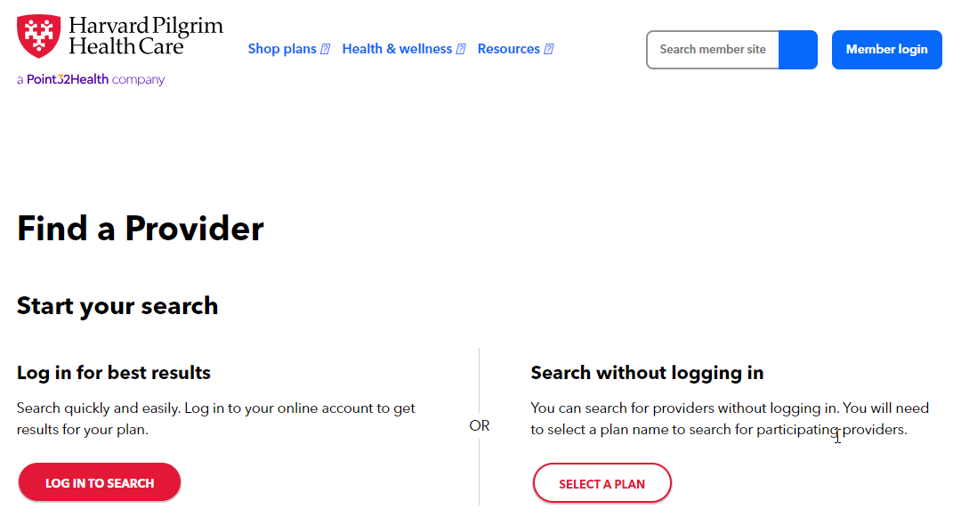
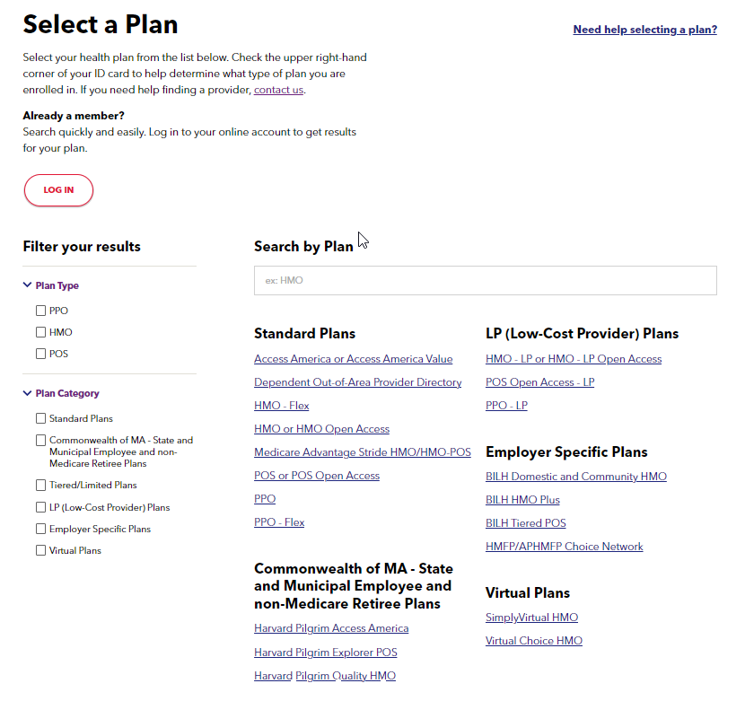
Provider Search: How to Find Doctors & Care
1
2
3
Visit harvardpilgrim.org
Member Tip: For a personalized experience, log in to your secure member account. The provider search tool will automatically recognize your plan and present available providers.

Slide 10
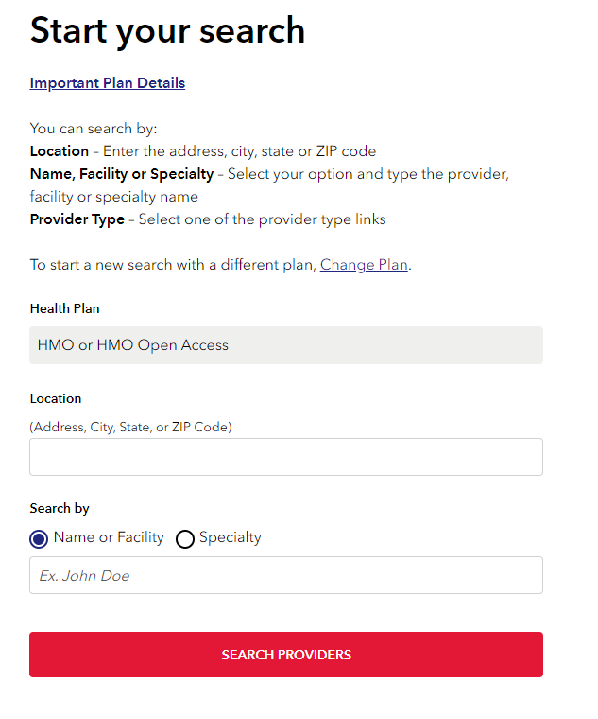
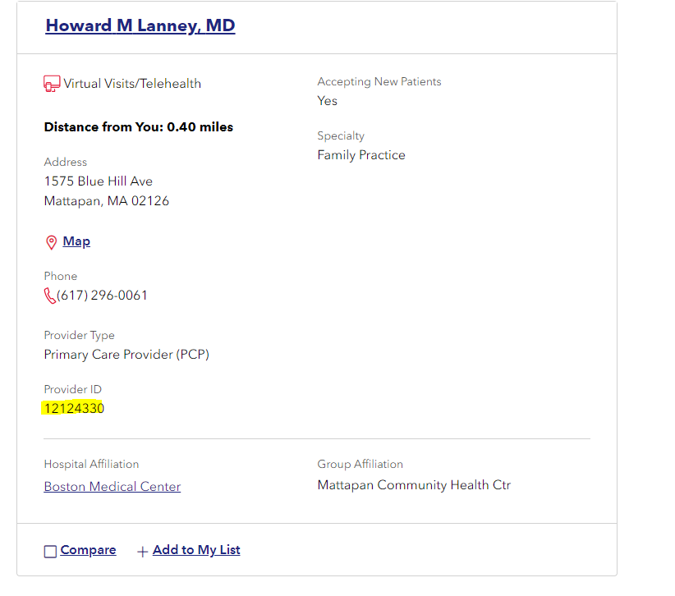
Easily Find Doctors & Specialists Online
Visit harvardpilgrim.org
4
5
Note: Primary Care Providers have a Provider ID number.

Slide 11





Know Your Care Options
$
$
$
$$
$$$
Your PCP
Virtual Care
Retail Clinic
Urgent Care Clinic
Emergency Room (ER)
Visit your PCP for:
Annual check-ups, physicals & child well visits
Preventive screenings & immunizations
Urgent care needs, if offered
Many PCPs offer virtual health care services for added convenience.
With Doctor On Demand, you can request a virtual visit with a U.S.-based doctor 24/7 for non-emergency conditions like:
Colds, upper respiratory infections
Upset stomach
Skin rash
Confidential mental health support
CVS MinuteClinic® and Walgreens Healthcare Clinic offer are good options when you have an ear infection or skin condition like poison ivy, and you want a health professional to check it out without an appointment.
If your PCP doesn’t offer urgent care, consider a local clinic for immediate treatment and care that is not considered life-threatening, such as
Minor burns
Cuts that may require stitches
For medical emergencies that require immediate attention such as:
Severe chest or abdominal pain
Severe trouble with breathing or vision
Serious injuries from falls, cuts or accidents
Broken limbs
If you think you’re having a medical emergency, call 911 or go to the nearest emergency room.

Slide 12
Your Prescription Drug Benefit: NEW Select Formulary for 1/1/26

Slide 13
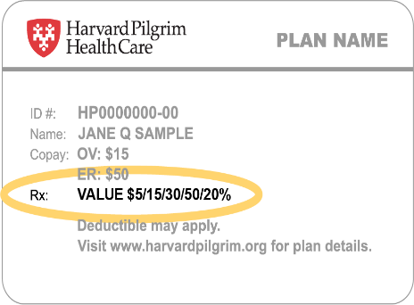

Prescription Drug Benefits: Select 5-Tier Overview HMO and PPO plans
Is a prescription covered?
How the drug tiers work
Find the tier on member ID Card
SELECT 5-TIER | VALUE 5-TIER
Tier 1: $5 retail / $10 mail | Low-cost generic drugs and certain OTC medications
Tier 2: $45 retail / $90 mail | High-cost generic drugs
Tier 3: $60 retail / $120 mail | Preferred brand-name drugs and some high-cost generic drugs
Tier 4: $100 retail / $300 mail | Preferred specialty and non-preferred brand-name drugs
Tier 5: $200 retail / $600 mail | Non-preferred specialty drugs and other high-cost brand-name and generic drugs
Plan type
Plan tiers
Easy to use: Online Drug Tier Look-up
HarvardPilgrim.org/rx
(The 2026 formulary for your plan is posted on Harvard Pilgrim’s public website, no login required)
Please keep in mind drug lists and coverage can vary year to year so it’s a good idea to check your benefits each year

Slide 14
Prescription Drug Benefits: Select 5-Tier Overview PPO HSA plan: RX copayments apply after deductible
Is a prescription covered?
How the drug tiers work
Find the tier on member ID Card
SELECT 5-TIER | VALUE 5-TIER
Tier 1: $5 retail / $10 mail | Low-cost generic drugs and certain OTC medications
Tier 2: $45 retail / $90 mail | High-cost generic drugs
Tier 3: $60 retail / $120 mail | Preferred brand-name drugs and some high-cost generic drugs
Tier 4: $100 retail / $300 mail | Preferred specialty and non-preferred brand-name drugs
Tier 5: $200 retail / $600 mail | Non-preferred specialty drugs and other high-cost brand-name and generic drugs
Plan type
Plan tiers
Easy to use: Online Drug Tier Look-up
HarvardPilgrim.org/rx
(The 2026 formulary for your plan is posted on Harvard Pilgrim’s public website; no login required)
Please keep in mind drug lists and coverage can vary year to year so it’s a good idea to check your benefits each year

Slide 15

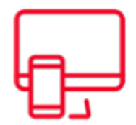




Understanding Your Pharmacy Benefits
Log in or register for your secure online member account Visit harvardpilgrim.org to get started. | Plan ahead if you take maintenance medication Check your medication expiration date, refill amount and coverage under Harvard Pilgrim. If your medication is not covered, talk to your doctor about switching to an alternate maintenance medication that is covered.
Look up your prescriptions We cover thousands of different medications, but if your current prescription isn’t on our list (formulary), talk to your doctor about switching to a covered medication. | Save money with mail order service Mail order service provides the convenience of home delivery instead of going to a retail pharmacy. On some plans, your medication may be less expensive if you buy a 90-day supply through this service
Check if your prescription has special requirements If there is a “PA,” “STPA,” “QL” or “SP” after any of your prescriptions, talk to your provider. Refer to the “Key Terms“ section of this Member Guide for full “special requirements” definitions.
Member Tip
Please keep in mind drug lists and coverage can vary year to year, so it’s a good idea to check your benefits each year.

Slide 16
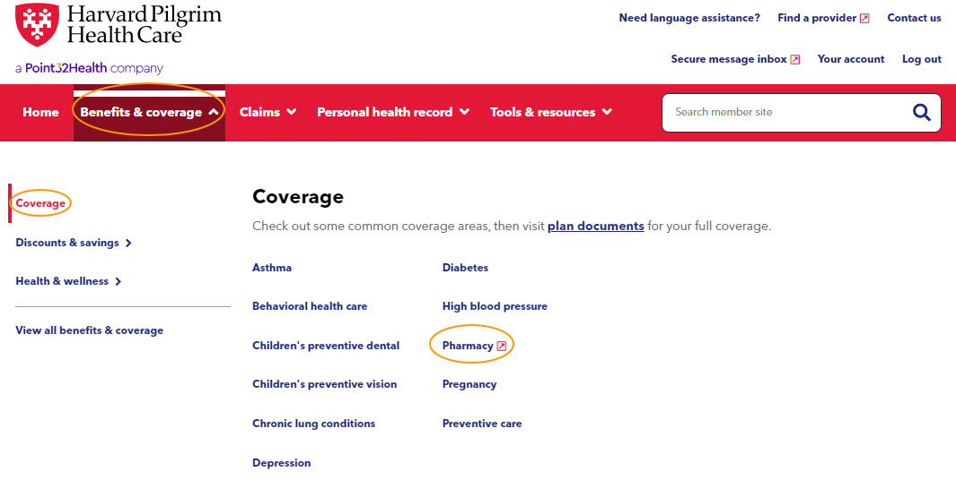
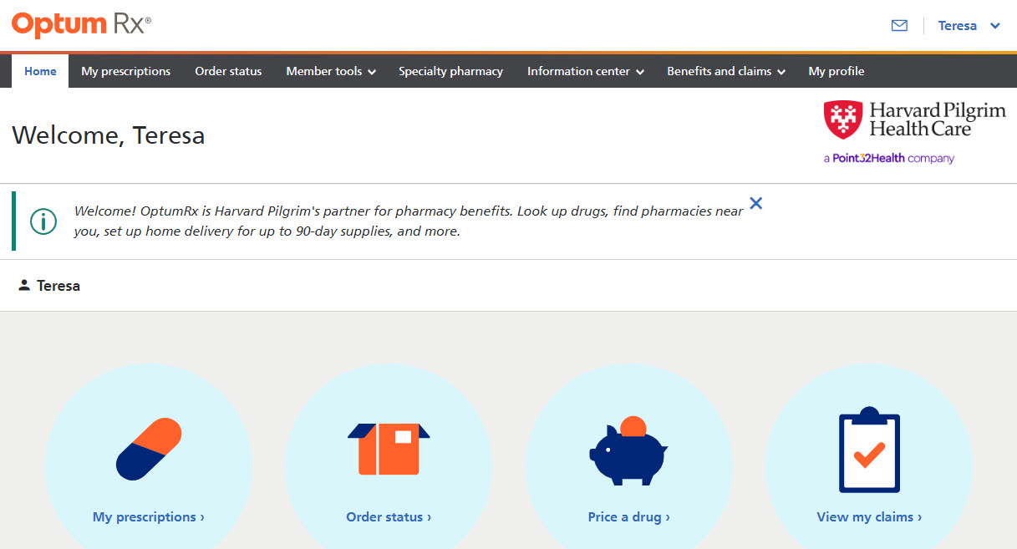
Access Your Pharmacy Information Online
1
From your member dashboard, click “Benefits & Coverage” then “Coverage” then “Pharmacy”
2
Through the Optum Rx, site, use the drug lookup, see your current prescriptions, view your claims, plan documents and more
Member Tip: For a personalized experience, log in to your secure member account at harvardpilgrim.org, after your new plan is effective

Slide 17
Behavioral Health: Connecting You to Whole Person Care

Slide 18
Behavioral Health: Core Programs & Services
Designed to ensure timely, personalized support across the full spectrum of behavioral health
Digital Therapy
Easily accessible tools designed to enhance daily well-being and foster emotional growth, including self-care activities, coping strategies, guided meditation and biofeedback, these programs offer accessible, evidence-based support anytime, anywhere.
AbleTo Self Care
InStride Health
Meru Health
Virtual Therapy
Convenient, flexible access to licensed therapists and psychiatrists
for a wide range of behavioral health needs. Members can connect from home, receiving personalized care that fits their schedule.
AbleTo
Doctor On Demand
Grow Therapy
Valera Health
Substance Use Treatment
Harvard Pilgrim offers access to a network of trusted providers delivering comprehensive substance use disorder care. From detoxification to ongoing recovery support, our programs integrate medical, behavioral, and community-based services to support your whole-person recovery journey.
Providers include Better Life Partners and Spectrum Health
Our Addiction Recovery Care Management Team
If you’re experiencing a crisis or emergency, you should always call 911 or go to the nearest emergency room.

Slide 19










Behavioral Health Service Navigation Member Journey
1
Member calls Integrated Member Services Team for behavioral and physical health inquiries
2
Member services representative addresses member’s behavioral health inquiries and connects member with specialized behavioral health service navigation team
3
Behavioral health service navigation team connects member to the right service or resource at the right time
Behavioral health service navigation staff works with member to discuss personalized behavioral health support options
Member receives follow-up outreach from behavioral health team to ensure needs are met
4
5

Slide 20
Health Engagement & Wellness Programs

Slide 21

Wellness Programs & Services
Living Well Online Portal
Holistic well-being program
Variety of wellbeing activities & monthly challenges
Syncs to wearable devices
Mobile & app accessible
Opportunity to earn rewards
Reimbursement Programs
Wellness/Fitness
Weight Management
Childbirth Classes
Mindfulness
Guided mindfulness sessions led by our team of expert instructors
Living Well at Home
Free, virtual fitness and wellness classes, including cardio dance, strength training, yoga and more
Wellness webinars
Private Facebook group
Family Wellness
Ovia Health: Family and women’s health resources
Wellthy: Support for caregivers
LGBTQ+ support and resources
Exclusive Member Discounts & Savings
Exclusive savings on a wide range of programs, products and services to support your health and well-being

Slide 22


Up to $300 in Wellness Reimbursement
You can qualify to receive:
Individual | Family (up to 2 members)
$150 | $300
Qualifying fees include:
Fitness facility monthly fees
Virtual fitness class subscriptions
Monthly fees at studios or facilities for dance, gymnastics, swimming or martial arts
Select nutrition and mindfulness meditation apps
Cardiovascular and strength training equipment
Athletic fees
More details: Visit our Wellness Reimbursement page.
There is a $300 maximum per family contract for up to two members per calendar year. Must be currently enrolled in Harvard Pilgrim at the time of reimbursement for at least four months within a calendar year. Restrictions apply. Reimbursement may be considered taxable income. Members should consult their employer or tax advisor.

Slide 23

Childbirth Education Class Reimbursement
What types of classes qualify?
Qualifying classes are offered through your local hospital, birthing center, physician’s office or childbirth education organization.
Led by a trained childbirth educator, classes typically address labor and birth, pain relief and coping management, birthing options, postpartum care, and the basics of caring for your newborn baby
Tinyhood’s virtual program, which includes on-demand pregnancy and parenting classes, also qualifies
More details: https://www.harvardpilgrim.org/public/childbirth-class-reimbursement
You must be currently enrolled in Harvard Pilgrim at the time of reimbursement. Restrictions apply, and reimbursement is not available to all members. Reimbursement may be considered taxable income. For tax information, consult your employer or tax advisor.

Slide 24





Exclusive Member Discounts & Savings
A wide range of healthy savings opportunities
Fitness, personal training, yoga virtual programs or products
Daily Burn
Expect*
Marathon Sports
ProSourceFit
Holistic Wellness
Ompractice
The Center for Mindfulness at UMass Memorial Health
DharmaCrafts
Happier
Ivy Child
Magic Weighted Blanket
Mighty Well
Sana Health
Healthy Eating
Savory Living
The Dinner Daily
Eat Right Now
Family & Senior Care
Tinyhood**
Be Safer at Home
Lively
Life Cycle Transitions
Home Instead Senior Care
Vigorous Mind
Smoking Cessation
Craving to Quit
QuitSmart
* Also eligible for reimbursement under Harvard Pilgrim’s Wellness and Fitness Reimbursement programs.
** Also eligible for reimbursement under Harvard Pilgrim’s Childbirth Class Reimbursement program.

Slide 25






Healthy Weight Program
A virtual program to help members improve their health through food
Delivers personalized, one-on-one coaching with a registered dietitian
Provides access to a digital app for additional support and curated information
Live webinars available for participants
Manage weight in a nutrition-focused way
Fit healthy eating into a budget
Reduce the risk of diet-related chronic diseases
Incorporate physical activity
Support for members prescribed weight loss medication
(e.g. GLPs)
Optimize nutrition for a healthy pregnancy and post-partum
harvardpilgrim.org/public/good-measures-healthy-weight-program
Coaching can be provided in English and Spanish with in-app communications translated into Spanish.

Slide 26



Tinyhood
Virtual on-demand learning option eligible for childbirth class reimbursement
On-line childbirth classes
Bite-size video lessons
Watch anytime, anywhere, from any device and refer back at anytime
Instruction from certified experts
Downloadable class handouts, cheat-sheets and guides for quick reference
tinyhood.com/partner/harvardpilgrim
Notes:
Updated 2/2025
SME: Jennifer Rollo
Employer, broker, and member-facing slide
Standalone slide for additional information if a group asks about Tinyhood when you are reviewing the Childbirth Reimbursement program or the Discount program.
Talking Points:
Tinyhood is our virtual vendor for Childbirth Class Reimbursement (ie: members with the Childbirth Class Reimbursement can get reimbursed)
It offers a variety of on-line classes and video lessons with instruction from certified experts.
Harvard Pilgrim members can also receive a discount on Tinyhood through our Member Discounts & Savings program.
As of 2/2025, Tinyhood’s Ultimate Collection will be offered to members with an initial trial period and be priced at $116 (reg. $155) per year, 25% discount.

Slide 27


Expect
Virtual on-demand fitness platform for pregnancy and postpartum
200+ OB-GYN approved workouts from cardio and dance, to strength and yoga
Trimester-specific workout plans
Expert support from a team of medical professionals
Comprehensive resources
25% off monthly or annual subscription for Harvard Pilgrim members
Eligible for Harvard Pilgrim fitness and wellness reimbursement
expect.fit/partners/harvard-pilgrim
Notes:
Updated 3/2025
SME: Jennifer Rollo
Employer, broker, and member-facing slide
Talking Points:
Be sure to check with your health care provider before you start any workout program.
Doctor-endorsed workouts
From pre-pregnancy to postpartum, exercises evolve with the member through trimesters, all approved by practicing OB-GYNs from top medical systems for peace of mind
Also includes
Pelvic floor series (expert designed) to improve pelvic floor strength and recovery with routines created by a physical therapist & approved by a board-certified urogynecologist
Mindfulness and well-being to nurture mental health alongside physical fitness
Nausea-friendly workouts for those tough first trimester days and low-energy options when feeling fatigued
On-demand sessions range from 10 to 30+ minutes

Slide 28
Family & Maternal Health Support

Slide 29
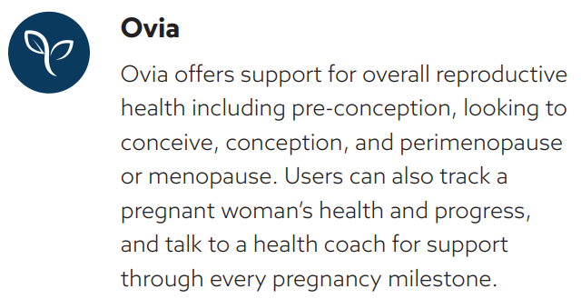
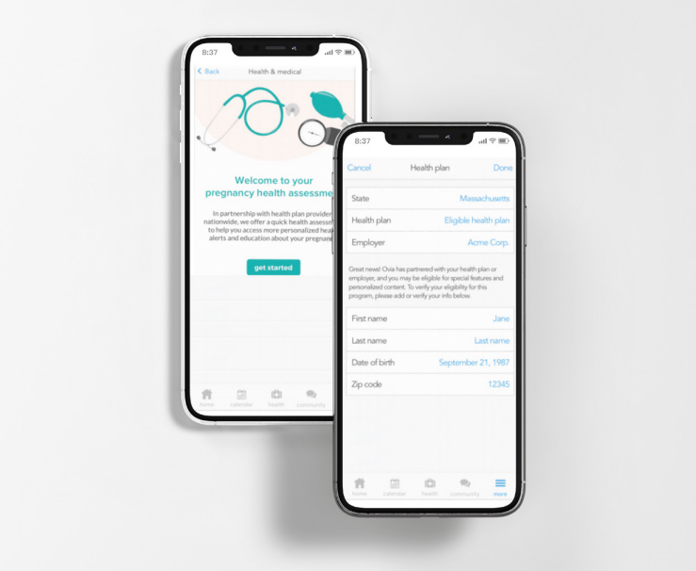
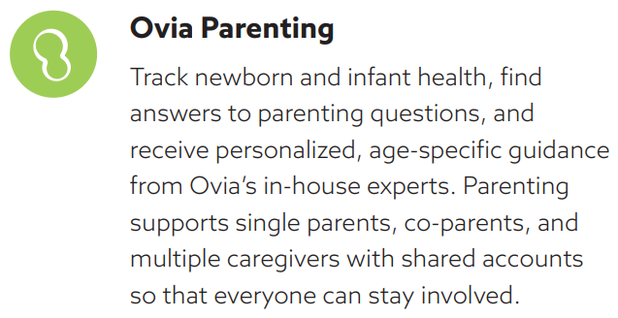
Ovia Health: Support Through Life’s Biggest Transitions

Slide 30




Wellthy: Hands-on Support for Caregivers
Wellthy helps members tackle the logistical and administrative tasks of caring for the ones they love, including themselves – across a wide array of needs.
Care Dashboard
Helping families plan and learn
Aging
Childcare Needs
Mental Health
Health Concerns
Financial Hardship
Veteran Support
Care Concierge
Helping families get things done
Dedicated, hands-on support from experts who get to know each family and tackle their to-dos
Care Dashboard
Helping families plan and learn
Comprehensive care planning tools and resources in one centralized, accessible place
Wellthy Community
Helping families feel less alone
Peer-to-peer platform where family caregivers can find support and exchange knowledge

Slide 31
Member Experience & Support

Slide 32

SmartStart Is At Your Service – for NEW members
Pre-Enrollment Guidance
Dedicated, pre-enrollment support to make switching health plans worry-free
96%
overall program satisfaction rate
Connect with clinical experts about your health care concerns
Discuss your new benefits and get immediate answers to your questions
Get help with finding providers and managing care
Ask about your current medications
Learn about continuity of care to keep your health on track
Support for transitions of care (e.g., provider coordination, ongoing treatments, upcoming procedures and medication approvals).
How to reach us:
Email SmartStart@harvardpilgrim.org
Call (866) 874-0817

Slide 33
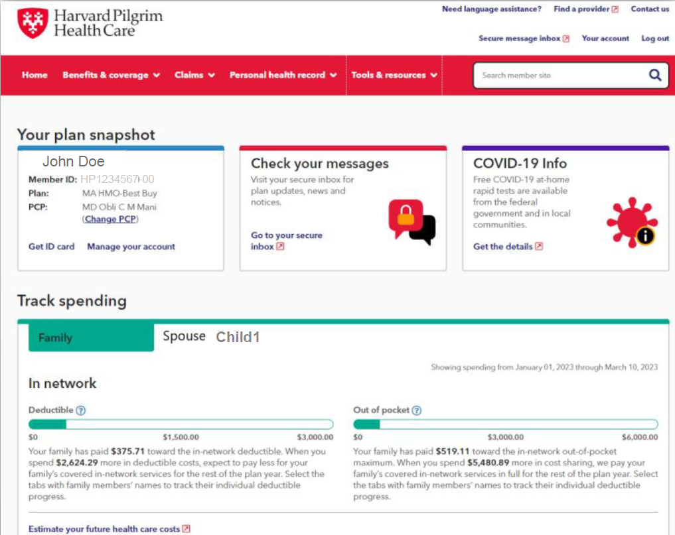
Member Tools
Your Secure Member Account
Visit harvardpilgrim.org and select “Member login”
Key features of your member account
Search for in-network providers
Review your plan documents and claims
Look up the costs and tiers of your medications
Learn about cost-effective alternatives to the Emergency Room
Submit your reimbursements
Print your member ID card or add your ID card to your Apple Wallet or Google Pay
Communicate (via email) with our Member Advocates

Slide 34
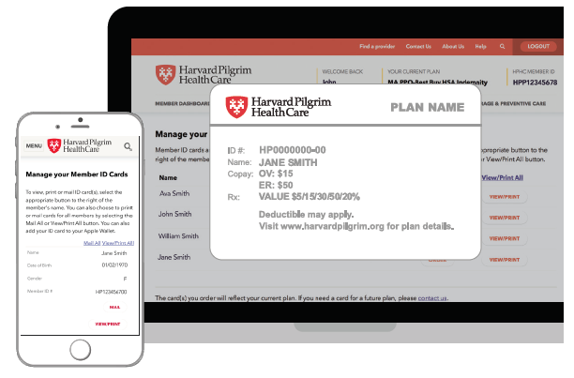
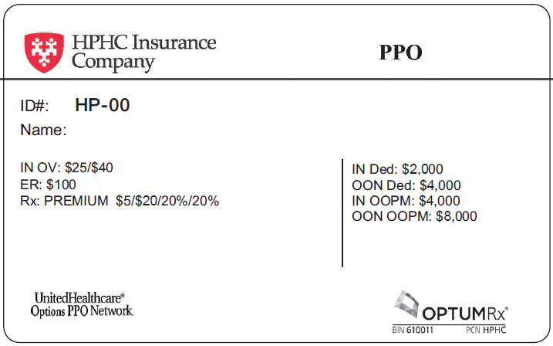
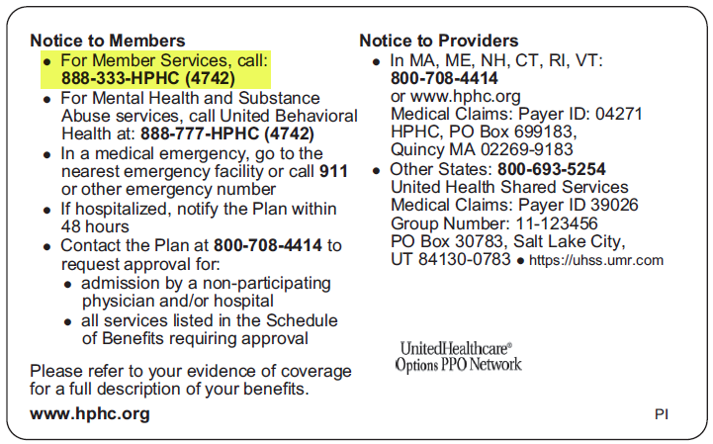
Your Member ID Card
Member Tools
Arrives in the mail before your plan effective date – and available through your secure member account
Digital Member ID Card
Sample ID card (front and back)
Access through mobile app or secure member account at harvardpilgrim.org
Apple Wallet compatible, Android users save as a PDF
Member ID card is dynamic – updates in real time

Slide 35
Digital Tools & Support Overview
Member Experience
Get the most out of your Harvard Pilgrim plan with these tools
Secure Member Account and Mobile App
Log in or activate your secure online account at harvardpilgrim.com/create or download the Harvard Pilgrim mobile app to access your health plan benefits information
Find a doctor or hospital
Log in to your secure account to find a convenient location near you. Search for doctors or hospitals by name or location, find doctors accepting new patients, and view doctors by specialty
Estimate My Cost
Log in to your secure account to estimate your out-of-pocket costs and find a provider that will save you money
Reduce My Costs
Connect with a nurse at 855-772-8366 when you shop for a wide range of outpatient tests and procedures, including lab work and diagnostic imaging, and earn cash rewards when you select high-quality, cost-effective providers.
Telehealth provided by Doctor On Demand
Access a Doctor on Demand provider 24/7, by phone or mobile app worldwide for everyday care and confidential therapy. Set up your account at doctorondemand.com/harvard-pilgrim.

Slide 36





Member Experience
How to stay connected and informed
Member Newsletter
Our digital member newsletter shares current health topics and benefit highlights including tips to manage your health, recipes and discounts on wellness services. Delivered to your email inbox and posted on our public website.
Member Communications
Receive valuable information about your benefits, discount options, new programs, and health and well-being opportunities – via email, secure message or postal mail.
.
Website
The member section of our website is a great place to learn more about the resources, wellness options, care management programs, and additional member benefits to keep you and your family healthy. Bookmark the site for easy access harvardpilgrim.org
Social Media
Follow our social feeds to keep up with the latest news, tips and stories.
Harvard Pilgrim continues to focus on digital communications wherever possible –
for efficiency, timely distribution and added convenience

Slide 37
Cost-saving Programs

Slide 38
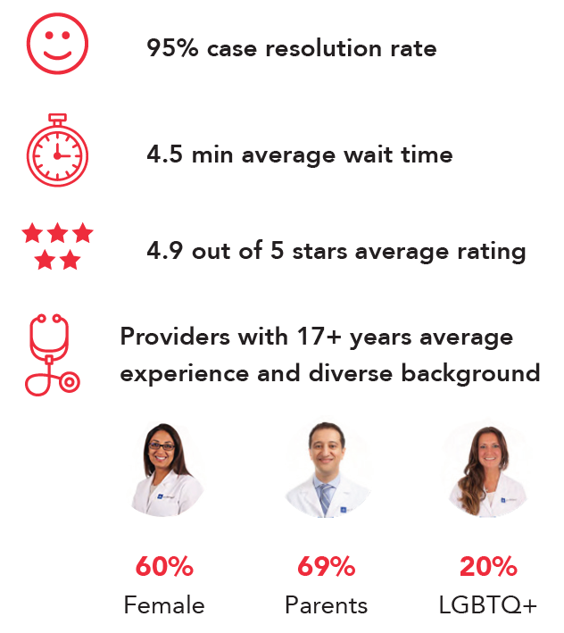
Telehealth options: Doctor On Demand
Non-emergency virtual care 24/7
Connect with a U.S. board-certified physician in less than 15 minutes from your smartphone, tablet or computer
Get care for concerns such as bronchitis, sinus issues, pink eye, UTIs, or skin rashes
What members are saying
Confidential behavioral health therapy
Licensed providers can help with anxiety, depression, grief, family issues, trauma or PTSD
Choose from a variety of therapists with different backgrounds and specialties, and build a relationship with the provider who best meets your needs
Providers can order prescriptions* at the member’s local pharmacy when medically necessary
* Doctor On Demand physicians do not prescribe controlled substances and may elect not to treat or prescribe other medications based on what is clinically appropriate.

Slide 39
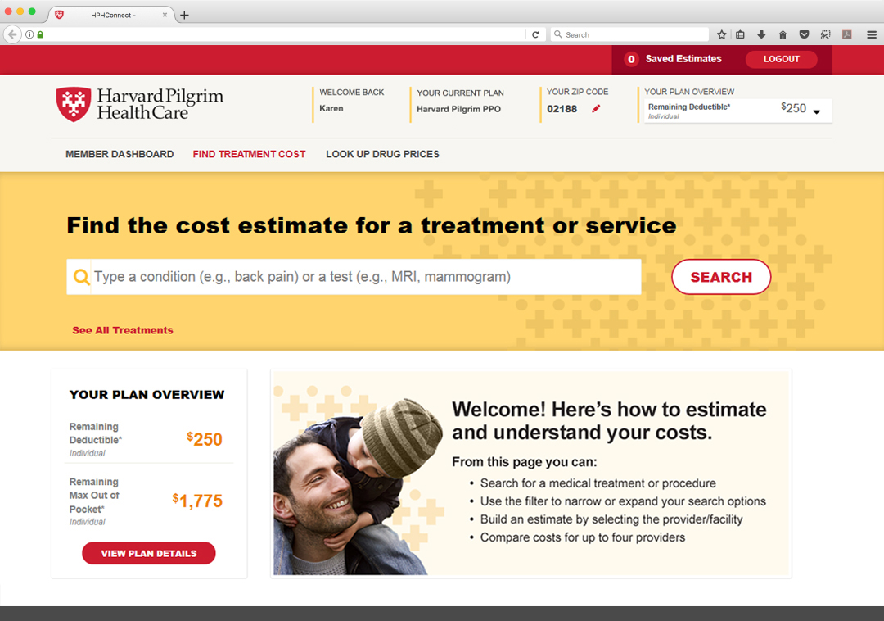
Estimate My Cost: A Simple Way to Estimate Your Out-of-Pocket Expenses
Our easy, online medical cost transparency tool empowers you to:
Plan ahead for out-of-pocket costs
Be more engaged in your health plan
Make informed decisions

Slide 40

Reduce My Costs: Shop, Save & Earn
Connect with a nurse to help you find high-quality, cost-effective providers near you
Quick and easy access:
Available via phone, email, or live chat
The nurse can assist with appointment scheduling or required authorizations, if needed.
Save on most outpatient tests and procedures, such as lab work, MRIs, colonoscopy, mammograms and more.³
Rewards range from Rewards range from $10 to $75 depending on savings and service.²
If you’re already seeing a cost-effective provider for a service that meets the minimum savings threshold, you’ll receive a $10 reward – just for trying Reduce My Costs!
Potential Savings
Service Type | Cost Range¹ | Potential Savings
Screening colonoscopy | $1,600-$3,000+ | $1,500+
MRI lower extremity | $500-$3000+ | $200-$1,500+
Common labs | $250-750 | $125 - $500+
Call 855-772-8366 or scan the QR code to get started
¹ Ranges are based on Harvard Pilgrim’s data,actual service prices vary by provider type and location. The figures represent 1Q2024.
² Cash rewards comes in an e-gift card format that is emailed directly to the member. Rewards are offered on services that meet minimum savings threshold. Rewards are considered taxable income; please consult with your tax advisor. Rewards vary based on plan and state.
³ Your health plan may require a referral and/or prior authorization before you receive services. To ensure the services will be covered, please refer to your plan documents or contact Harvard Pilgrim at 888-333-4742.
11
Confidential. Please do not distribute.

Slide 41

Questions?

