Slide 1
Guidance for using this deck
The deck has two parts:
Overview of the bid profession, roles opportunities etc.
Activities / materials you can use to engage your audience (virtual or in person)
What you need to do (before using)
Things to consider when running your session
Review the deck and personalise where appropriate (e.g., Intro slide)
Check if the language and materials are audience age appropriate, for example, Year 9s (13 – 14) will need different language and messaging vs. undergraduates / post-graduates (20+)
Work out how much time you have and therefore what you want to include / hide. Some content is mandatory (check the notes)
Careful with jargon!
Q&As often take longer than you think, and can go off at tangents
Try to make the session engaging and interactive – think of them as your customers
Don’t forget to hide this slide!
If you have another activity idea, please create it and share with the APMP community
Notes:
DON’T FORGET TO HIDE THIS SLIDE!

Slide 2
Bid and Proposal Profession
What is it, and why should I care?
Notes:
MANDATORY

Slide 3

Quick introductions
Who am I?
What do I do?
Why am I here?
Why is this of interest to you?
Notes:
MANDATORY
explain who you are, what you do and something interesting about you to get their attention

Slide 4
Icebreaker
Notes:
OPTIONAL
If you have time you may want to do an icebreaker + an activity. If time is limited suggest just doing an activity
Use your favourite or select from the Supporting Materials (Slide 20 onwards)

Slide 5
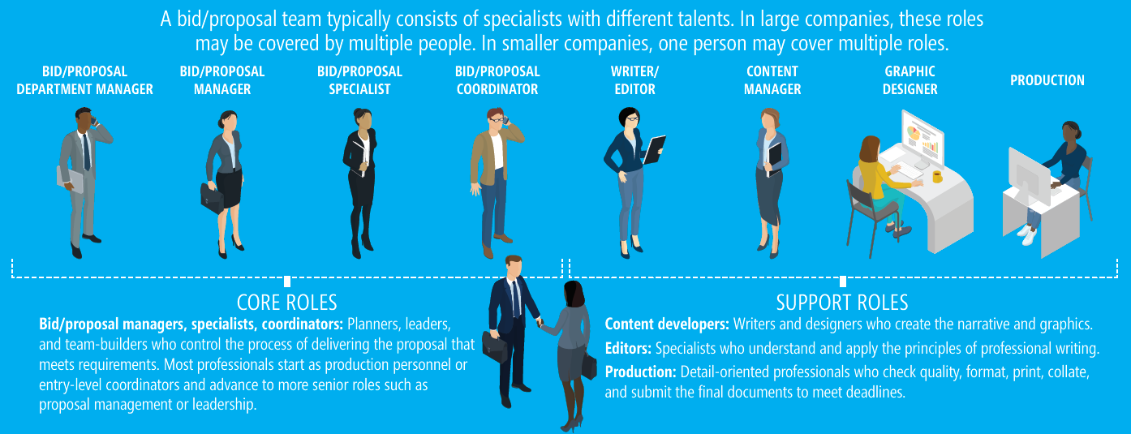
What do I do?
My passion, mission, profession and vocation
Notes:
MANDATORY
Brief overview of your role and those you work with (bid colleagues)
Type of company you work for / market area
How you got in to the profession
NOTE: Careful not to use too much bid speak (if they don’t know what bids are it won’t make much sense)
Potential to use ‘pick-up cards’ on in the examples from slide 21
Bring out the importance of soft skills as much as hard skills

Slide 6
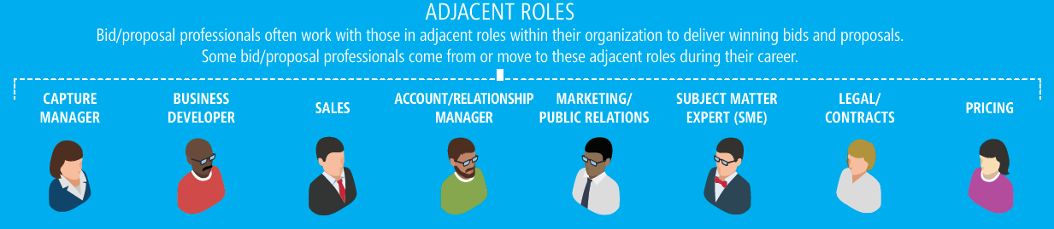
Who do I work with?
I am part of a team of specialists with different skills
We work with experts across our organisations to deliver winning bids and proposals, and some of us move to these adjacent roles during their career
Notes:
MANDATORY
Reinforce that in bidding you get access to multiple people, skills, experiences from your organisation (and others you may collaborate with)
About connecting, respecting other people’s subject matter expertise
Bidding is a team sport

Slide 7




































Tell me about you
What are your interests?
Notes:
MANDATORY
Aim here is to introduce a bit of conversation and engagement with the group. The importance is to focus on both hard and soft skills.
By highlighting what they like / are interested in (both personally but also in their studies) will do two things:
Show that we’re all unique in our skills and interests
Take what interests them and why, and explain how their interest / likes can be applied in a bidding context
Open to interpretation, but images here include:
Sports
Travel
Winning / being successful
Reading / Research / Creative thinking/writing
Design
Hobbies such as cars, cooking/baking, DIY, gaming, music, films
Travel and exploring
Sustainability initiatives
Spending time with friends

Slide 8
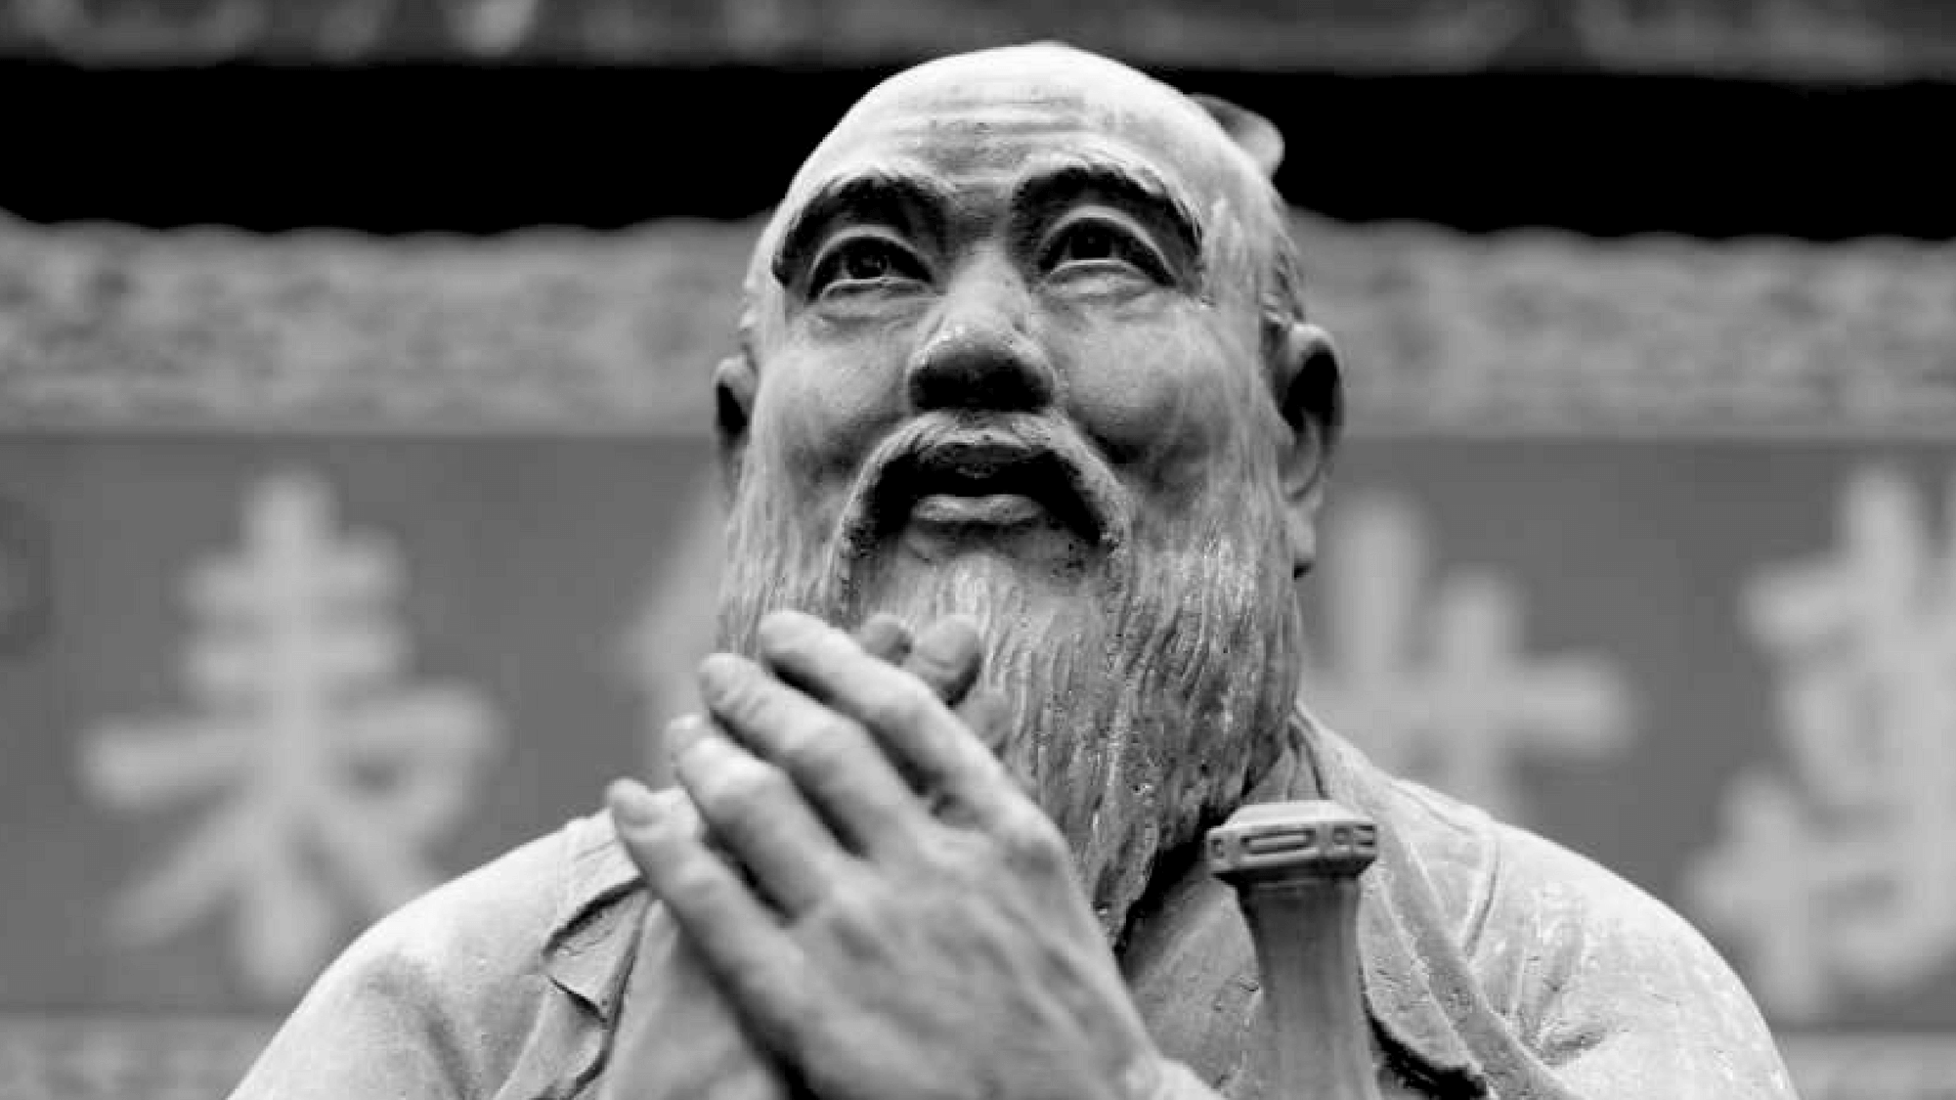
BID, PROPOSAL and BD ASSOCIATION
Satisfaction
“Choose a job you love,
And you will never have to
work a day in your life.”
Fame
Happiness
Security
Money
Respect in society
Other?
Confucius
Notes:
MANDATORY
Prompt audience to think about what their motivators are

Slide 9
what you LOVE
Ikigai: The Japanese Secret to a Joyful Life
A passion that gives value and joy to life.
Passion
Mission
what
you are GOOD
AT
what
the World NEEDS
ikigai
Profession
Vocation
what you can be PAID FOR
Venn diagram based on design by Hector Garcia, author of Ikigai: The Japanese Secret to a Long and Happy Life
Notes:
MANDATORY
Maybe talk about your experience and what your Passion, Mission, Profession and Vocation are
Invite your host (teacher / lecturer) to do the same
Ask them to think about what there’s might be, and how it might inform where they go next (they don’t have to tell you or share)

Slide 10
Activity
Notes:
MANDATORY
See activities from Slide 20 onwards and choose based on audience, circumstance, and time available
Feel free to create your own

Slide 11
Everyone’s journey is unique
Meet some of my peers and their experiences
Notes:
MANDETORY
Play video of other bid professionals talking about how they got into bidding, their roles etc. (Need to get some content from APMP UK to embed (Marti))

Slide 12
Questions
Anything you want to ask or know more about?
How can you get involved Work experience, internships, placement
Think about your study / career next steps
Post GCSE, A Level, Degree, what to study
Where to find more information
APMP Student Membership
Notes:
MANDATORY
Close of session and takeaway for audience
Add links to LinkedIn, APMP website, your contact details (optional)

Slide 13
Notes:
Add this section if appropriate to your audience, you want to focus on sales, and/or you have time

Slide 14

The role of Bid and Proposal in Sales
Bid and Proposals is a part of the sales job family

Slide 15




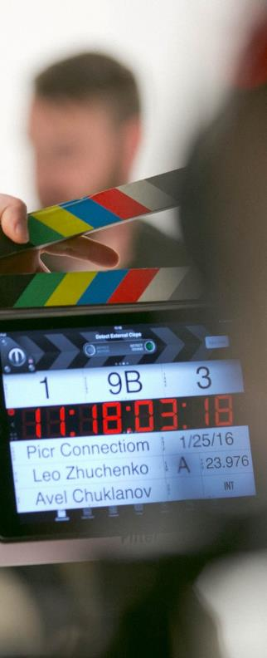

Some well-known professions
Doctor
Engineer
Lawyer
Teacher
Actor
Accountant

Slide 16





What about some less well known jobs?
Finance and Procurement
Sales and marketing
Human Resources
Project management
Operations
Notes:
Animation will highlight Sales and Marketing

Slide 17


What is Sales and marketing?
VS.
B2C
B2B
B2B stands for business-to-business, referring to a type of transaction that takes place between one business and another. B2C stands for business-to-consumer, as in a transaction that takes place between a business and an individual as the end customer.
Notes:
Explain difference B2C and B2B and how we focus pre-dominently in B2B space for our career

Slide 18
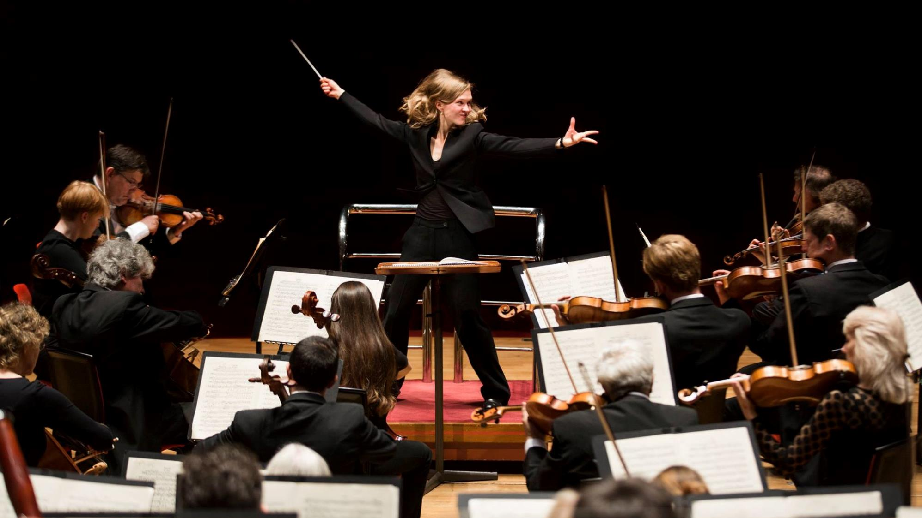


B2B Selling
Bid and Proposal professional!
Notes:
Do you know what profession this picture depicts?
Would you like to be like her in a corporate world?
This is synonymous with the Bid and Proposal Profession where the bid manager like an orchestrator makes people play on her command…

Slide 19
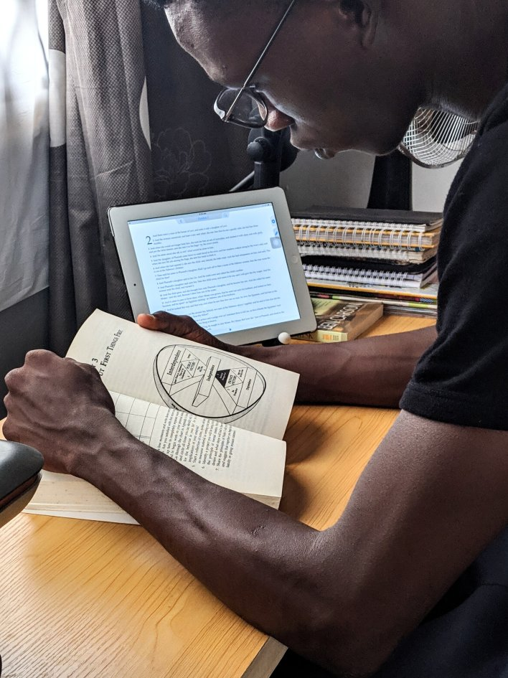
What do you need?
1
Ability to grasp and understand business
2
Strong oral and written communication skills
3
Strong analytical abilities
4
Ability to lead teams towards a goal
5
Win, Win, and Win!
Notes:
Do you want to be one? You will need to develop…

Slide 20
Supporting Materials
Activity-based materials to support your session
Notes:
Selection of resources that you can use for the Icebreaker / activities, or create your own

Slide 21












Stakeholder
engagement
Plan and
Organise to
meet
deadlines
Research / Fact finding
Run workshops
and meetings
Work with others
Understand the customer
Storytelling / Build Compelling narratives
Contract/Commercials
Present
Design & graphics
Pricing
Develop Win Strategies
Notes:
OPTIONAL (Either Slide 21 or Slide 22)
Can show this slide, animate it (like pick-up cards), or run as a physical activity (pick-up cards)
Other areas to highlight might include:
Understand the customer: Review and analyse the client’s requirements / tender documents
Plan and Organise: Build proposal plan, manage strict deadlines, produce final documents
Develop win strategy: Determine key messaging (win themes)
Storytelling: Write original content, edit, proof-read,
Design and Graphics: Page layouts and design, artwork for covers / dividers, presentation materials
Work with others: Departments, partners, consortium members, supply chain etc.

Slide 22
Stakeholder
engagement
Plan and
Organise to
meet
deadlines
Research / Fact finding
Run workshops
and meetings
BID, PROPOSAL and BD ASSOCIATION
BID, PROPOSAL and BD ASSOCIATION
BID, PROPOSAL and BD ASSOCIATION
BID, PROPOSAL and BD ASSOCIATION
Work with others
Understand the customer
Storytelling / Build Compelling narratives
Contract/Commercials
BID, PROPOSAL and BD ASSOCIATION
BID, PROPOSAL and BD ASSOCIATION
BID, PROPOSAL and BD ASSOCIATION
BID, PROPOSAL and BD ASSOCIATION
Present
Design & graphics
Pricing
Develop Win Strategies
BID, PROPOSAL and BD ASSOCIATION
BID, PROPOSAL and BD ASSOCIATION
BID, PROPOSAL and BD ASSOCIATION
BID, PROPOSAL and BD ASSOCIATION
Notes:
OPTIONAL (As Digital Pick-up cards)
Can show this slide which is animated for virtual session
Other areas to highlight might include:
Understand the customer: Review and analyse the client’s requirements / tender documents
Plan and Organise: Build proposal plan, manage strict deadlines, produce final documents
Develop win strategy: Determine key messaging (win themes)
Storytelling: Write original content, edit, proof-read,
Design and Graphics: Page layouts and design, artwork for covers / dividers, presentation materials
Work with others: Departments, partners, consortium members, supply chain etc.

Slide 23

Quiz
What do you think ‘hot buttons’ are?
What might a ‘Pre-Qualification Questionnaire’ be?
What is storyboarding?
Do we use colours, animals, food, or names to describe the reviews? And how many do you think there might be?
How might you describe a Telegraph Heading?
What is a Kick-off, and what might happen there?
What is a CQ?
Put the following in the right order (Red Review / Proof-read / Preferred Bidder / Kick-off / Storyboard / Submission / Presentation)
Describe what shredding is?
Which of these is not a bid role: (Proposal Manager, Director, Writer, Hat Master, Cost Modeller, Subject Matter Expert, Designer)
What is capture management?
What evidence might we use to convince the customer we can do the job?
What is an ‘action caption’?
Notes:
OPTIONAL
Using a quiz to explain / start a discussion about elements of the bid process
Select a series of questions to ask (factoring in the time you have available to you)
Assume the audience will not know the answers so keep it light and have some fun with what they’ve written / said and what the answers are.
Make sure to include some that will generate fun responses (hot buttons / action captions)
Feel free to add your own questions and responses

Slide 24

Project plan
Create a bid process flow (from Initiation through to Contract Sign), include:
  Key milestones (Approval to Bid, Kick-off, Approval to Submit, Submission, Client Decision, Contract Award)
  Reviews (Pink, Red, Gold, White, other)
  Writing, pricing and commercial elements
  Capture / Proposal / Presentation / Clarifications (maybe dialogue)
Break it up into pieces and put in folder / envelope
Put audience into groups (3 – 4)
  Give an envelope (with the pieces) to each group
  Set time limit for the group to piece together what they think the order of the bid plan is
  Maybe include 2 / 3 query cards to check / ask a query
Once time’s up get groups to talk through their process and thinking behind it (see if other groups did the same / something different)
Discuss against a ‘traditional’ bid process and provide an explanation as to ‘why’
Notes:
OPTIONAL
Use an APMP one from the BOK, or you might have one that your companies use

Slide 25
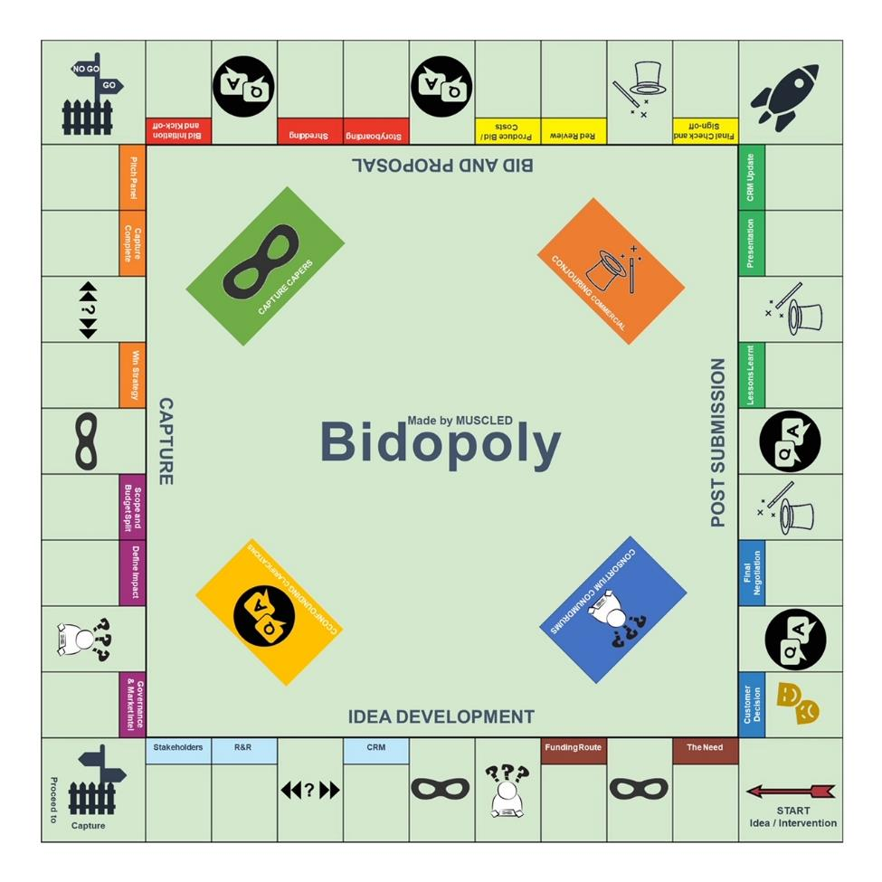
BIDOPOLY
Create a simple Bidopoly game of the process
Play the game and use squares, pick-up cards and activities to learn about the process
Notes:
OPTIONAL
A few options here:
Create your own (like this one above)
Depending on time / whether your session is a one-off or you’re doing multiple sessions you may want to co-create with your group
Create one and then use it as a training / education aid with your group

Slide 26

Belinda Bid and Peter Proposals quest for the winning marks
Give the group(s) a client question, the evaluation criteria, and some written text.
Ask them to:
  Read all the information
  Compare the response to the question – does it answer the question? If not, what’s missing
  Compare the response to the evaluation criteria – what would they score it, and why?
How might the writer be able to improve their answer to get a higher score?
Notes:
OPTIONAL
Select some text that you have from your company (and old bid)
Make sure it’s age appropriate
Provide each group with the question, evaluation criteria, and the draft response (maybe something that’s around 4 pages long)

Slide 27

A picture paints a thousand words
Give the group(s) a page of text
Ask them to turn it into a graphic with an ‘Action Caption’
Share their graphics with the group, what they did, why, and does it make sense to the others?
Notes:
OPTIONAL
Maybe use and Exec Summary or Introduction Text
Have paper / pens etc. or a Miro / Jam / Mural Board for them to collaborate on (if doing remotely)
Again, remember to make it age appropriate

