Slide 1


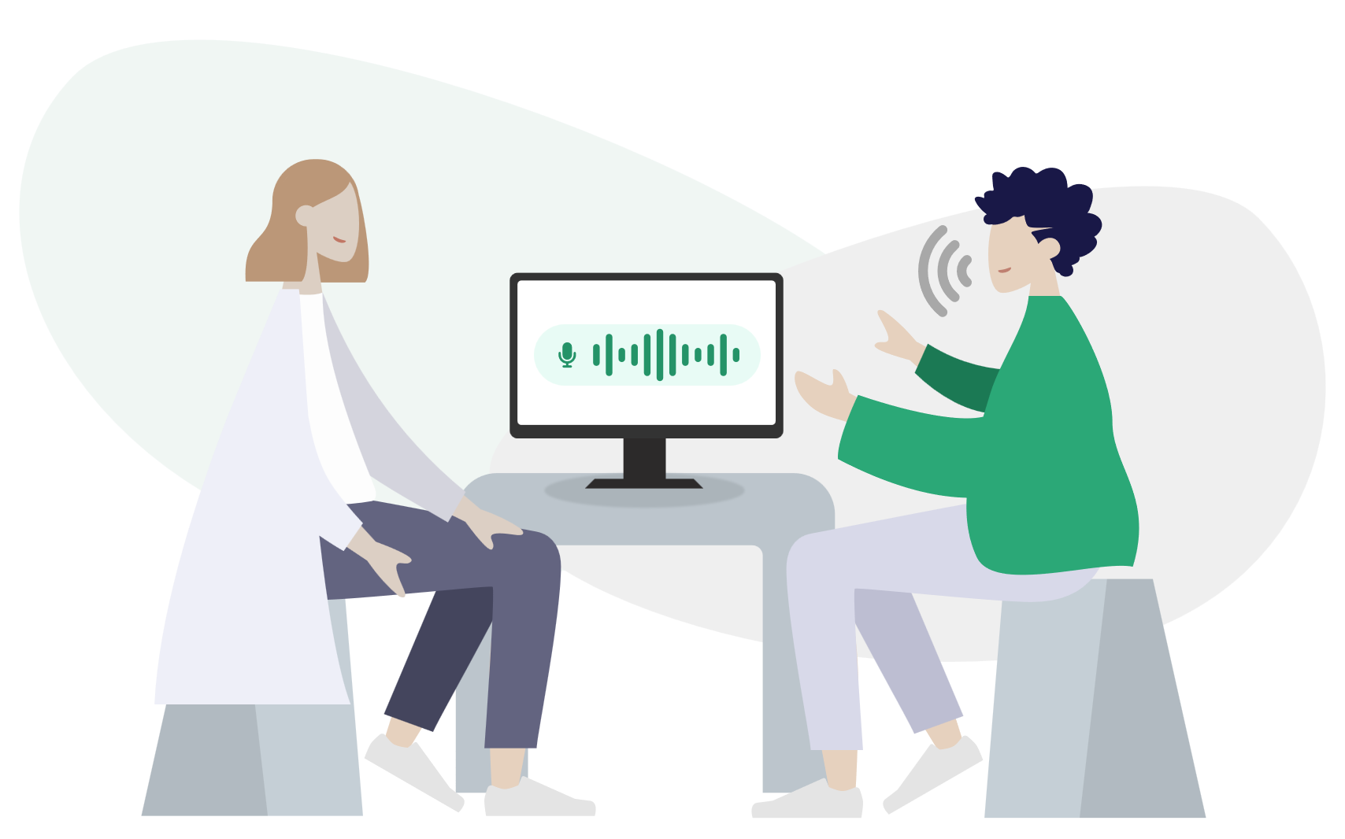
Dear Patient
In our practise, we use Seranote - an ambient transcription tool that helps us document the visits in efficient way. The conversation between you and your doctor is recorded and transcribed, which allows the doctor focus entirely on you and and conducting proper examination. The audio files and transcriptions are stored securely with full respect for your privacy and in compliance with GDPR policy. If you wish to opt out of audio recording, please inform your doctor before the consultation starts.

Slide 2
How do you benefit from Seranote as a patient?
01
More time for conversation
The doctor can spend more time to listen and examine you, since documentation takes less time and does not require manual note-taking.
02
The consultation will look the same as usual - nothing changes for you as a patient.
Uncompromised treatment quality
03
All of the patient data collected during consultation is processed anonymously and stored securely in compliance with GDPR policy.
Secure patient information

Slide 3

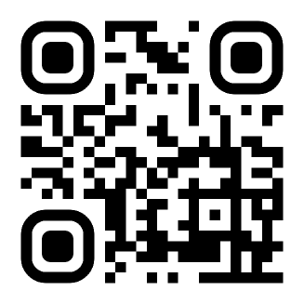
Do you need more information?
Scan QR code to read more on Seranote, or visit our website at https://seranote.dk/

