Slide 1
Charting New Paths in Precision Immunotherapies
Investors Deck / 2025 01 30
Giuseppe Pantaleo input dated Jan 21, 2025

Slide 2
Table of contents
Investors Deck
The Market Opportunity
The Company & the Data
The Roadmap & Funding

Slide 3

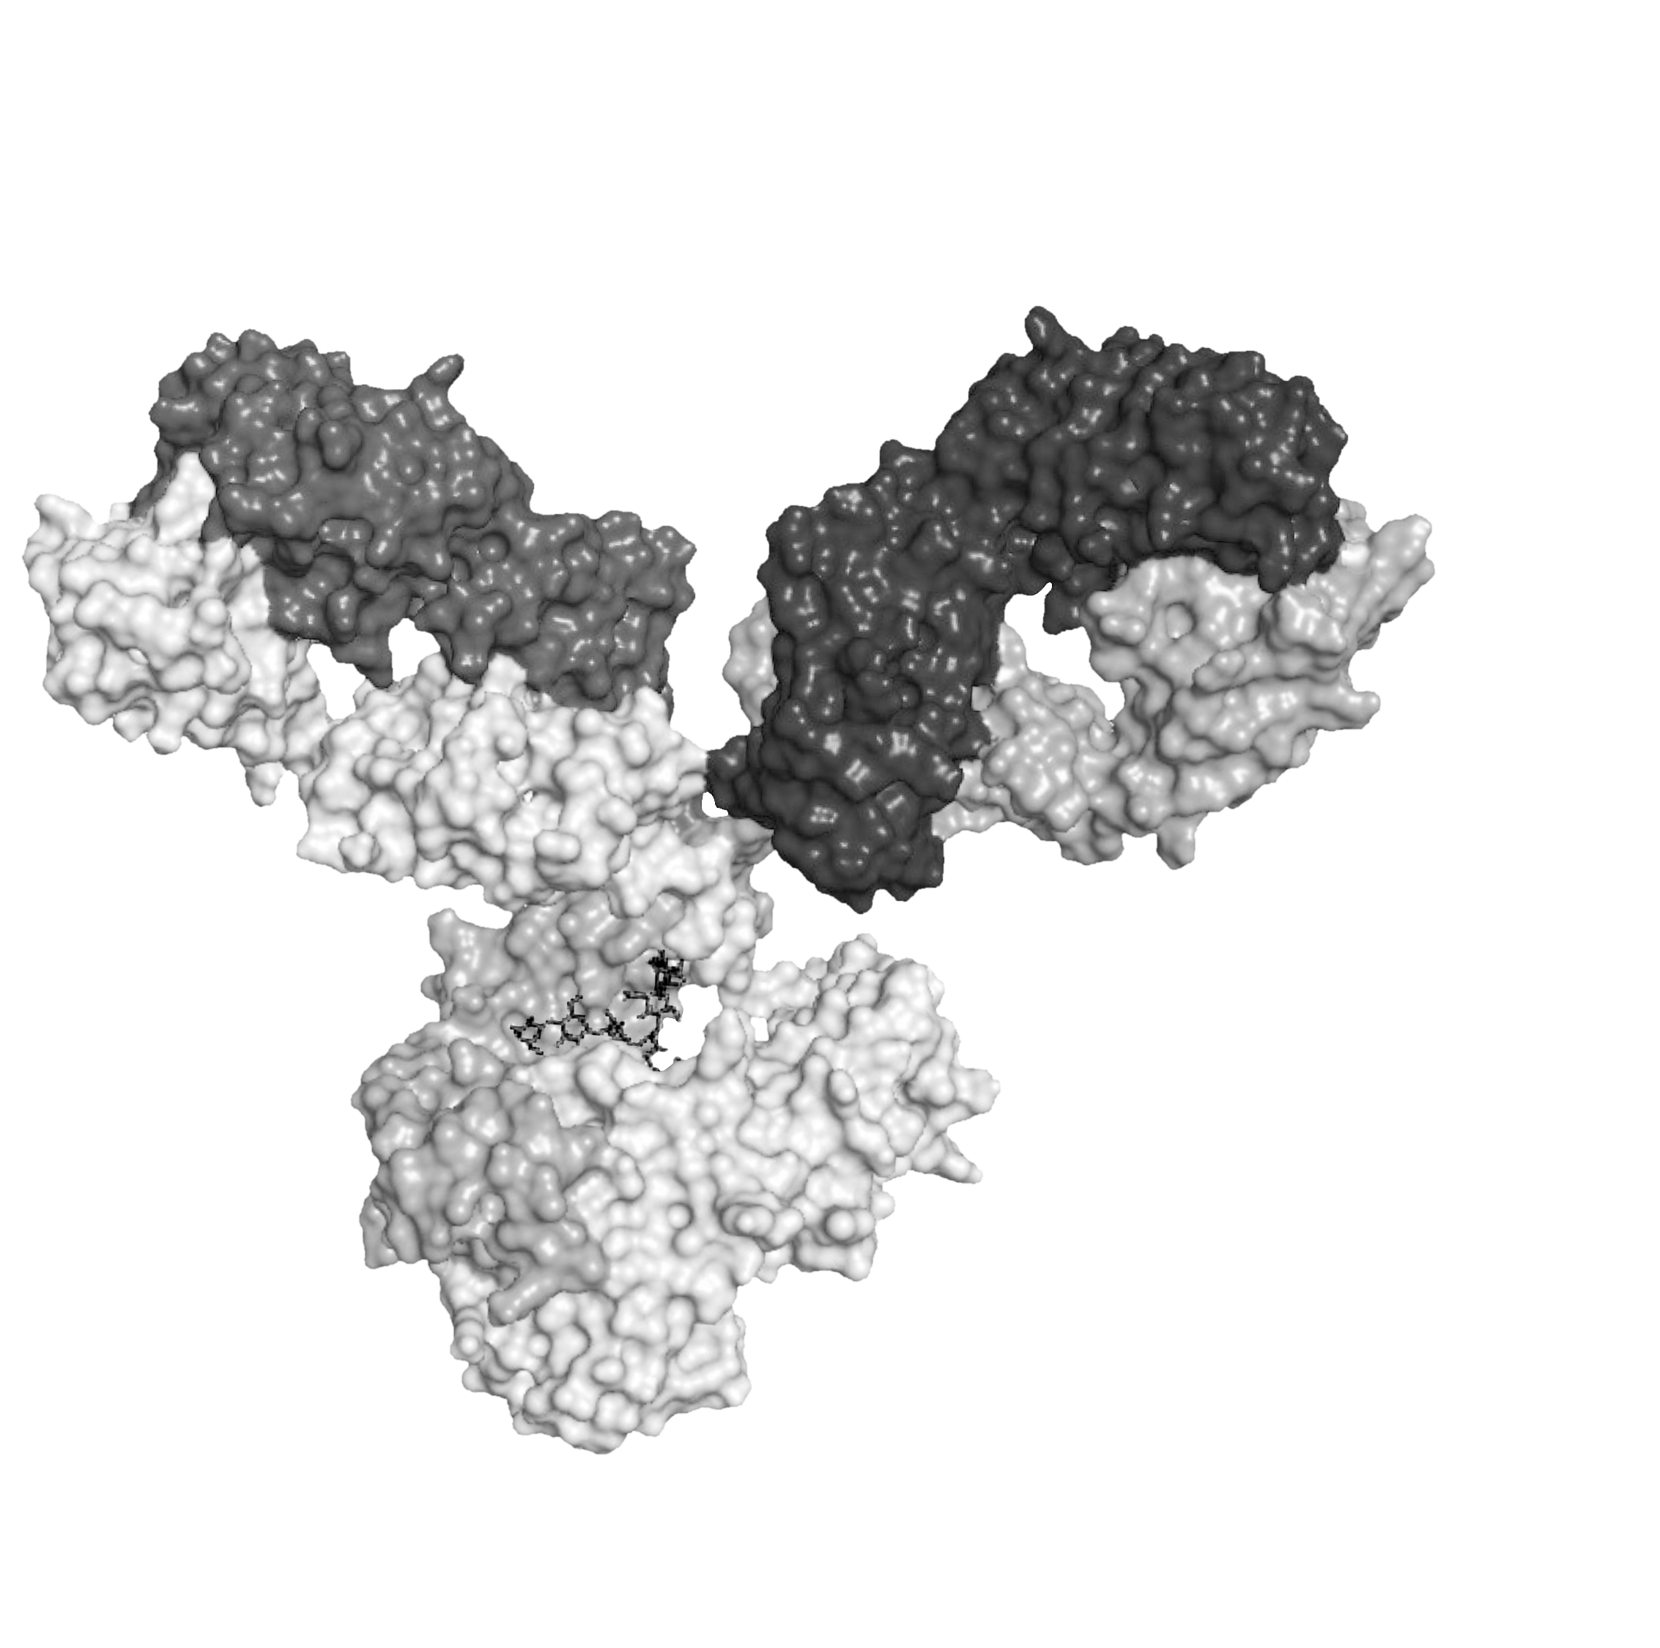


Introduction to MabQuest Therapeutics
The Company & the data
MabQuest Therapeutics is a Swiss-based biopharmaceutical company dedicated to developing novel monoclonal antibodies, with an initial focus on oncology.
Headquartered in Lausanne, MabQuest Therapeutics was founded on strong background of medical and pharmaceutical expertise, united by a mission to create potent, targeted immunotherapies with improved safety profiles.
Privately financed, the company has a Phase I clinical asset (MAQ-001) and a second asset (MAQ-002) in pre-clinical validation. Its asset-centric approach has enabled progression to Phase I with a lean team of highly experienced professionals specializing in immunology, immune-based therapies, T-cell function, and clinical development.

Slide 4


MabQuest Allosteric Anti-PD-1 Therapy
To Address Unmet Needs
The Market Opportunity
Unmet Needs
Limited Efficacy: Only a subset of patients achieve durable responses with the current authorized orthosteric anti-PD-1 antibodies, exemplified by Keytruda and Opdivo.
Resistance Mechanisms: Diverse mechanisms of anti-PD-1 resistance (low PD-L1 expression for orthosteric anti-PD-1/PD-L1 antibodies, T-cell activation defects, immune dysfunction, neoantigen loss, and altered tumor metabolism) ¹⁻²
Expanding PD-1 approvals to
more tumor types
Combination therapies to improve objective clinical outcomes (CheckMate and KEYNOTE trials)
Biomarkers: Expanding range of positive biomarkers (e.g. PD-L1 expression, tumor mutational burden, microsatellite instability /mismatch repair deficiency, TILs, IFNγ related gene signature, strong neoantigen presentation, favorable Teff/Treg ratio)
Patents expiring on top brands (e.g., Keytruda, Opdivo), or expired (Yerevoy, BMS)
Commercially attractive therapeutic sector and a growing patient base with high access potential
The Opportunity Ahead: Innovative strategies like allosteric PD-1 modulation have the potential to overcome these resistance mechanisms. Addressing resistant tumors and non-responding patient groups is critical
1. Sun, JY., Zhang, D., Wu, S. et al. Resistance to PD-1/PD-L1 blockade cancer immunotherapy: mechanisms, predictive factors, and future perspectives. Biomark Res 8, 35 (2020). https://doi.org/10.1186/s40364-020-00212-5
2. Zou, R., Wang, Y., Ye, F. et al. Mechanisms of primary and acquired resistance to PD-1/PD-L1 blockade and the emerging role of gut microbiome. Clin Transl Oncol 23, 2237–2252 (2021). https://doi.org/10.1007/s12094-021-02637-2

Slide 5
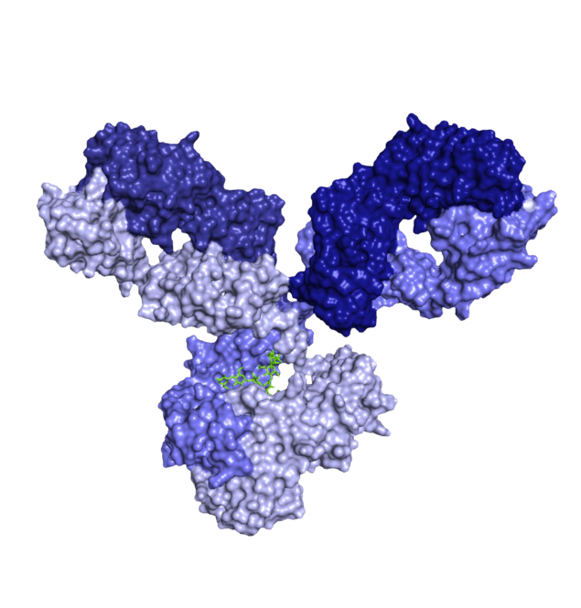
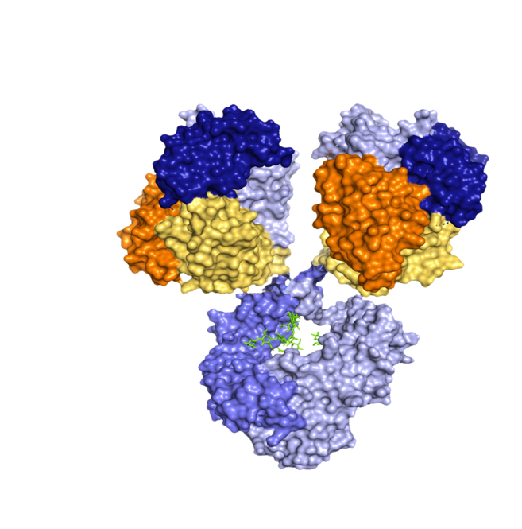
MabQuest Oncology Pipeline Offers Novel Therapeutic Opportunities
The Company & the data
Anti-PD-1
Anti-PD-1
MAQ-001 has a novel mode of action relative to standard of care anti-PD-1 mAbs.
MAQ-001 modulates PD-1 activity without interfering with PD-L1 and functions via the NFκB pathway, enhancing the activity of tumor-specific CD8 T cells.
MAQ-00X is a Novel Bispecific Tetravalent DART-Fc (Dual-Affinity Re-Targeting) that ensures each arm of the antibody can simultaneously bind a distinct antigen, PD-1 and a second target, with high specificity.
The DART fusion with an antibody Fc domain helps to ensure that the drug candidate has good in vitro CMC and in vivo PK properties.
Anti-PD-1 binding regions of both MAQ-001 and MAQ-00X target the same allosteric site.
MAQ-001
Frontrunner Allosteric
Anti-PD1 IgG4 Antibody
CLASSICAL
Antibody
Phase I clinical trials
Anti-PD-1
Anti-PD-1
MAQ-002
Bispecific Tetravalent
Anti-PD-1 / second target DART-Fc
NEW
Antibody design
Pre-clinical
Second target
Second target

Slide 6










Introducing MabQuest’s Allosteric Anti-PD-1 Approach: Addressing Critical Gaps
The Company & the data
Allosteric vs Orthosteric:
A new Approach
Conventional orthosteric anti-PD-1 antibodies (Abs) block the PD-1/PD-L1 interaction and activate both the NFAT and NFκB signalling pathways.
Allosteric (non-blocking) MAQ-001 antibody modulates PD-1 activity without blocking PD-L1 and acts only through the NFκB pathway, potentially reducing the Risk of Immune-Related Adverse Events (irAEs).
Relieves tumor-specific CD8 T cells from exhaustion and restores T cell functional activity.
Superior Potency with Allosteric Targeting
MAQ-001 belongs to the family of allosteric antibodies, such as Insulin receptor and Epidermal Growth Factor Receptor (EGFR) targeting Abs, which have shown strong therapeutic potential.
Allosteric anti-EGFR Abs have demonstrated greater potency than FDA-approved orthosteric Abs: cetuximab (Head and Neck cancer, Eli Lilly), panitumumab (Colorectal cancer, Amgen), necitumumab (NSCLC, Ely Lilly).¹⁻²
Unlocking Combination
Potential and improving Safety
MAQ-001’s distinct mechanism of action allows for potential synergy with authorized orthosteric anti-PD-1 antibodies.
Potential to improve clinical responses and durability compared to SoC in responding tumours and to address unmet needs in poorly responding tumours.
The differences in the signaling pathways between the two classes of antibodies may result in better safety profile.
1. H. Issafras et al. J (2014) Diabetes Science and Technology, 8:865-873 2. Léxane Fournier et al (2024) Discovery of potent allosteric antibodies inhibiting EGFR, mAbs, 16:1

Slide 7
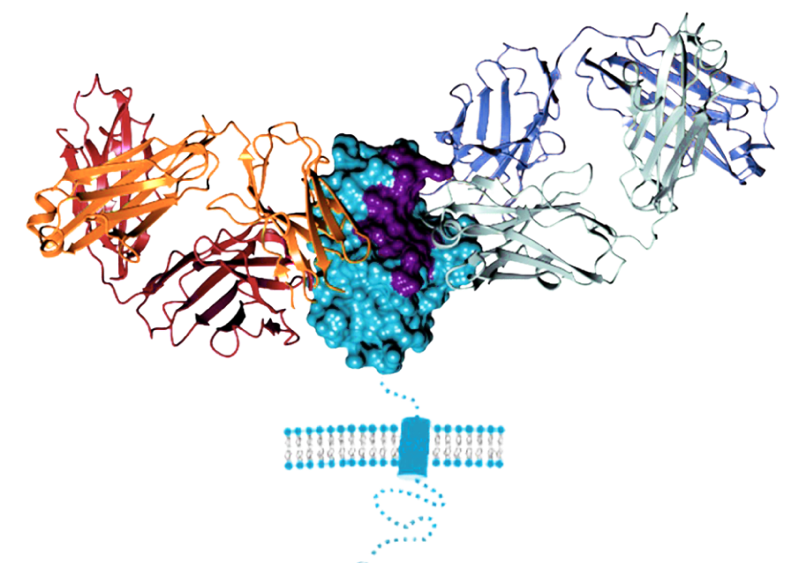
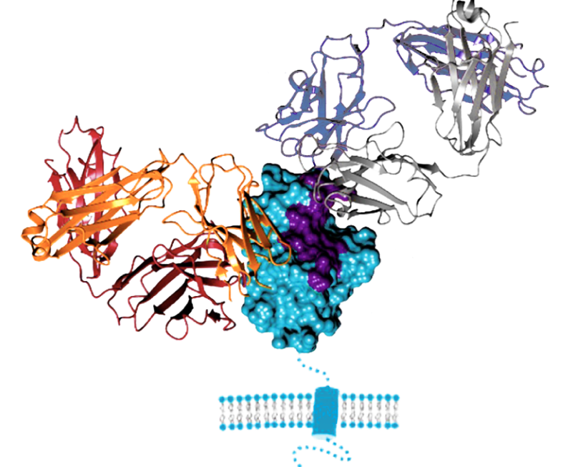
MAQ-001 Mechanism of Action:
Unlocking New Combination Potential
The Company & the data
Structural models of the MAQ-001 Frontrunner Allosteric Anti-PD-1 Immune Checkpoint inhibitor shows that its binding to PD-1 does not overlap with the PD-L1 binding site (purple residues) and does not interfere with orthosteric pembrolizumab (Keytruda) or nivolumab (Opdivo) antibodies. This binding is directly linked to the novel Mode of Action (MoA) for MAQ-001
MAQ-001
+
KEYTRUDA®
MAQ-001
+
OPDIVO®
PD-1
PD-1
MabQuest’s in vitro data show simultaneous binding of orthosteric and allosteric antibodies on PD-1 positive cells. Similarly, the combination of these same antibodies in a mouse tumor model shows improved efficacy, providing strong evidence of non-interference and potential combination strategies between the two anti-PD-1 antibody classes.

Slide 8
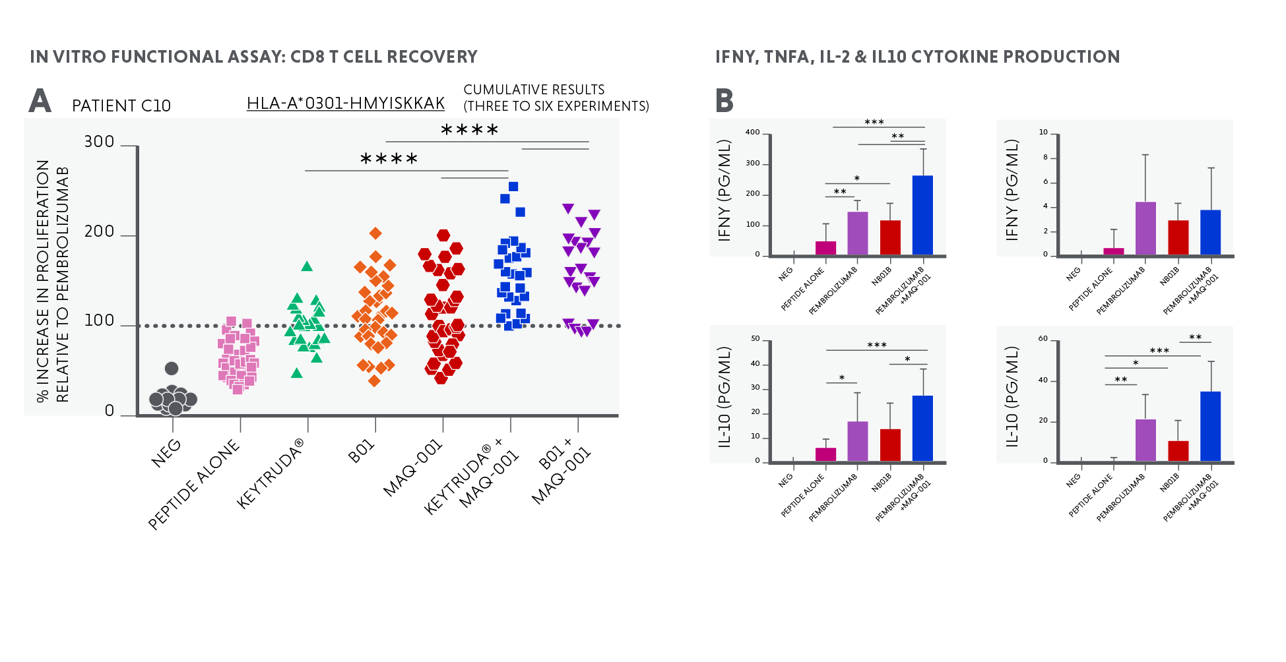

MAQ-001 Preclinical POC: Allosteric MAQ-001 and Orthosteric Keytruda Synergize Recovery of CD8 T Cell Proliferation
The Company & the data
MAQ-001
CLASSICAL Antibody
In Vitro functional Assay: CD8 T Cell recovery
Patient C10
Graph shows % increase in proliferation relative to Keytruda® (pembrolizumab) with cumulative recovery of HIV-specific CD8 T cell proliferation after treatment with single and combination of anti-PD-1 antibodies.
The synergy of the two antibody classes in restoring antigen-specific CD8 T-cell proliferation is consistent with crystal structure data indicating that the two antibodies do not interfere with each other's binding to the PD-1 receptor.
HLA-A*0301-HMYSKKAK
Craig Fenwick, Giuseppe Pantaleo et el. “Tumor suppression of novel anti–PD-1 antibodies mediated through CD28 costimulatory pathway, J Exp Med (2019) 216 (7): 1525–1541.
Note: B01 is an MQ patented orthosteric anti-PD-1 mAb

Slide 9
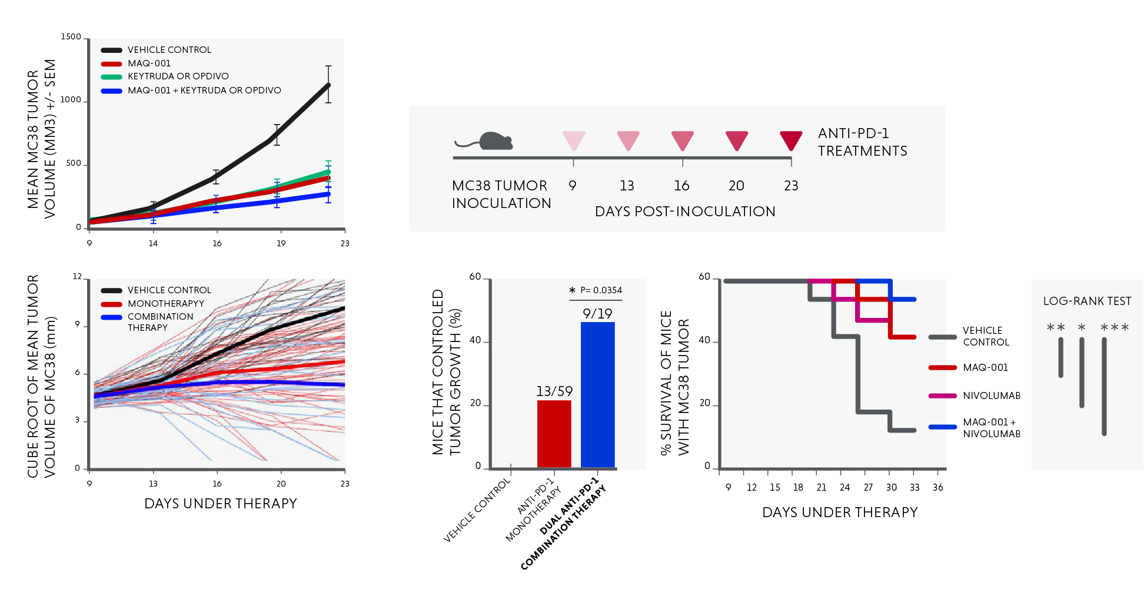
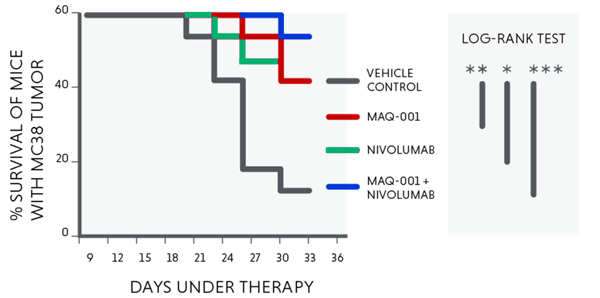
MAQ-001 Shows Potent Preclinical in Vivo Tumor Suppression Efficacy
The Company & the data
MAQ-001
In the immunogenic MC38 mouse tumor model, combining allosteric MAQ-001 with orthosteric Keytruda or Opdivo antibodies significantly reduced tumor growth and prolonged survival
Craig Fenwick, Giuseppe Pantaleo et el. “Tumor suppression of novel anti–PD-1 antibodies mediated through CD28 costimulatory pathway, J Exp Med (2019) 216 (7): 1525–1541.
Notes:
Mark to review color comments

Slide 10
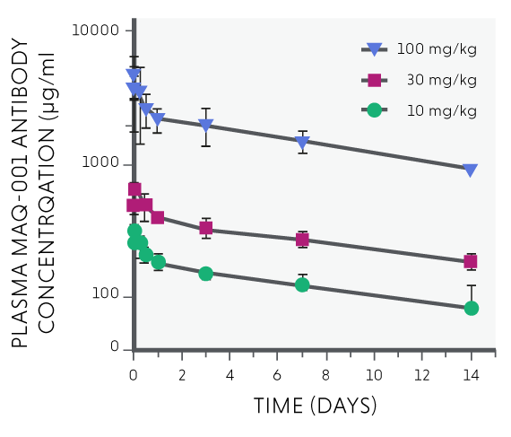
MAQ-001 NHP Preclinical Pharmacokinetics Profile are Comparable to Keytruda (1/2)
The Company & the data
MAQ-001
The mean PK half-life for MAQ-001 was 20 days compared to 10.6 days for Keytruda in a similar NHP study.
Exposure was approximately dose proportional with AUC_{0-last} comparable to a Keytruda NHP study, both dosed at 30 mg/kg.
No gender specific differences in NHP exposure were evident.
The No Observed Adverse Effect Level (NOAEL) for MAQ-001 was determined to be 30 mg/kg based on an 8-week repeat dose followed by a 12-week recovery study.
Ref. Labcorp 2021 Study; 4 cynomolgus monkeys per dosing group (10, 30 and 100 mg/kg)

Slide 11
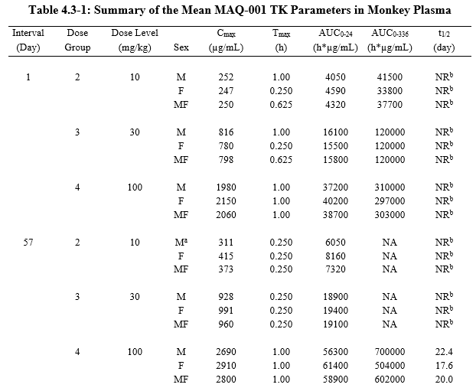
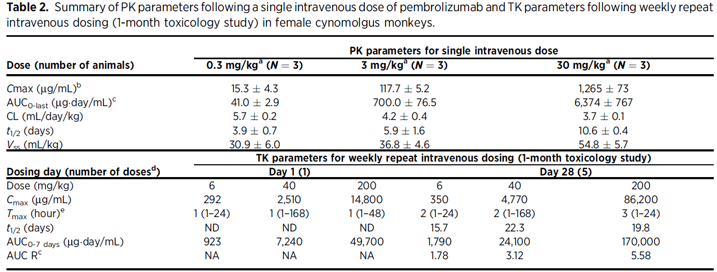
MAQ-001 NHP Preclinical Pharmacokinetics Profile are Comparable to Keytruda (2/2)
The Company & the data
MAQ-001
KEYTRUDA (pembrolizumab)
Hutchins, Molecular Cancer therapeutics, 2020; DOI: 10.1158/1535-7163.MCT-19-0774
and BLA # 125514 KEYTRUDA Pharmacology report
MAQ-001 NHP PK parameters compared to Keytruda pre-clinical studies
Half-life: 20 days MAQ-001
10.6 days Keytruda
AUC_{0-last}: 120000 h*µg/mL MAQ-001 at 30 mg/kg
152976 h*µg/mL Keytruda¹ at 30 mg/kg
Ref. Labcorp 2021 Study; 4 cynomolgus monkeys per dosing group (10, 30 and 100 mg/kg)
1-Note conversion of AUC from µg/day/mL to h*µg/mL

Slide 12
A phase IA/IB study to investigate the safety, tolerability, and pharmacokinetics of intravenous (IV) MAQ-001 as monotherapy and combination immunotherapy in patients with advanced solid tumors
The Company & the data
Protocol Nr: MQ01
EU CT: 2023-507774-41-00
NCT06514651

Slide 13


Phase 1A-1B Objectives
The Company & the data
MAQ-001
Phase IA/IB study Investigates the safety, tolerability, and pharmacokinetics of intravenous (IV) MAQ-001 As monotherapy and combination immunotherapy in patients with advanced solid tumors (target 30 patients) | Phase IA | Phase IB
 | Primary Objectives To define the recommended phase II dose (RP2D) of MAQ-001 for administration as monotherapy in advanced solid tumor patients To establish the safety and tolerability of MAQ-001 as IV monotherapy in patients with advanced solid tumors | Primary Objective To establish the Recommended Phase II Dose (RP2D) of MAQ-001 as combination with ipilimumab (targeting CTLA-4 [Cytotoxic T-Lymphocyte Antigen-4]) in patients with advanced solid tumors To establish the safety and tolerability of MAQ-001 as IV combination with ipilimumab (anti CTLA-4) in patients with advanced solid tumors
 | Secondary Objectives To determine the pharmacokinetic (PK) profile of MAQ-001 as monotherapy and in combination with ipilimumab in patients with advanced solid tumors (Ipilimumab, Yervoy, BMS) Exploratory Objectives To evaluate the anti-tumor activity of MAQ-001 as monotherapy and in combination with ipilimumab in patients with advanced solid tumors To determine PD-L1 expression levels on tumor cells
Craig Fenwick, Giuseppe Pantaleo et el. “Tumor suppression of novel anti–PD-1 antibodies mediated through CD28 costimulatory pathway, J Exp Med (2019) 216 (7): 1525–1541.

Slide 14
Phase 1A-1B Trial Design
The Company & the data
MAQ-001
 | Phase IA | Phase IB
Dose | Cohort 1: 1 mg/kg Cohort 2: 3 mg/kg Cohort 3: 10 mg/kg | Two independent regimens: Regimen 1: MAQ-001 at 1 mg/kg + ipilimumab at 3 mg/kg Regimen 2: MAQ-001 at 3 mg/kg + ipilimumab at 1 mg/kg
Route of Administration | IV Infusion | IV Infusion
Treatment frequency | Every three weeks | Combination every 3 weeks for the first 4 doses, followed by MAQ-001 mono at 3 mg/kg every 3 week
Cohort Size | Rolling 6 design for cohort 1& 2, 3+3 design for cohort 3, (6 -18 patients) | 3+3 design, (6-12 patients)
Patient Population | Patients who have advanced solid tumors or lymphomas for which an anti-PD-1/PD-L1 has been approved as single agent by the EMA Patients with rare tumors for which significant activity of anti-PD1 has been observed (e.g., TLS+ sarcomas, alveolar soft part sarcomas, etc.)
Study Duration | Maximum 2 years/patient, or until disease progression, unacceptable toxicity, death, loss to follow-up or withdrawal of consent if earlier | Up to 8 cycles

Slide 15



MAQ-001 has demonstrated in vivo anti-tumor activity with potency equivalent to Keytruda and the potential to reduce resistance and toxicity
The Roadmap & the Funding
MAQ-001
Allosteric Anti-PD1 inhibitor
Mechanism of Action/Signaling
Demonstrated that MAQ-001 acts through the NFκB pathway while conventional anti-PD-1 antibodies act through both NFκB and NFAT pathways.
Potential for improved safety and reduced risk of autoimmunity and immune-related adverse events (irAEs); may allow the treatment of frailer patients
Activity
Demonstrated that MAQ-001 relieves antigen-specific CD8 T cells from exhaustion and restores T cell function.
Potential for enhanced anti-tumor immunity due to restored CD8+ T-cell function. May be synergetic with other therapies.
In vivo anti-tumoral activity
Demonstrated that allosteric MAQ-001 strongly suppresses tumor growth in vivo and shows equivalent potency as compared to conventional approved Keytruda anti-PD-1 antibody.
May help to address resistance and be a promising patient option for treatment-resistant cancers​

Slide 16


MAQ-001: Three Routes to Success
The Roadmap & the Funding
MAQ-001
Allosteric Anti-PD1 inhibitor
Equivalent efficacy
Equivalent potency to Keytruda (MSD) and/or Opdivo (BMS) in vitro (recovery of CD8 T cell functions) and in vivo (anti-tumor activity) pre-clinical models, acting on PD-1, a highly validated immuno-oncology target, with the added benefit of patent protection until 2036.
Superior Safety
Allosteric anti-PD-1 antibodies may demonstrate equivalent clinical efficacy but with meaningful superiority on safety (phase I studies). The combination of allosteric with orthosteric antibodies may potentially prolong the durability of the clinical response and thus efficacy.
New indications
MAQ-001, alone or in combination with orthosteric anti-PD-1 antibodies, may also enhance therapeutic efficacy in tumors with low PD-L1 expression as it acts through a mechanism independent of PD-1/PD-L1 blockade. Thus, it could provide therapeutic benefits in cases where current anti-PD-1 therapies are less effective or not yet approved.

Slide 17
Strategic Portfolio: From Discovery to Phase I Development
The Roadmap & the Funding
Line of therapy / Indication | Discovery | Pre-clinical | Phase 1
Monotherapy: Solid organ tumors for which an anti-PD-1 /PDL-1 has been approved as single agent by the FDA and EMA
Combination therapy with Yervoy, anti-CTLA-4 antibody: Solid organ tumor and rare tumors for which activity of anti-PD1 has been observed including TLS+ sarcomas
Multivalent antibody: Solid organ tumors, advanced cancers with resistance to standard immunotherapy and chemotherapy
Multivalent antibody: Multiple myeloma
MAQ-001
MAQ-002
MAQ-003

Slide 18
Strategic Roadmap: From Phase I to Phase II Development
The Roadmap & the Funding
MAQ-001
Allosteric Anti-PD1 inhibitor
Phase 1
Phase II
Completion
Review data on safety, tolerability, maximum tolerated dose (MTD) and recommended Phase II dose (RP2D) by June 2025
Evaluate pharmacokinetics (PK) and early biomarkers of immune activation.
Preliminary efficacy signals
Assess with our SAB initial anti-tumor activity through objective response rates (ORR) and disease control rates (DCR).
Monitor biomarkers such as PD-L1 expression, T-cell infiltration, or cytokine levels to identify potential responders
Translational data integration
Analyze biomarker-driven patient subgroups to refine target populations for Phase II.
Integrate mechanistic data on resistance and immune modulation (e.g., PD-L1/PD-1 pathway involvement).
Trial design
Design an expanded, single-arm or randomized trial to evaluate efficacy (e.g., ORR, PFS, OS) and confirm safety at the RP2D.
Target specific tumor types (solid tumors or hematologic malignancies) based on Phase I data.
Implement stratification for biomarker-positive or clinically relevant subgroups.
Consider options on future geography including USA
Regulatory interactions
Engage with regulatory agencies (e.g., EMA and FDA) to discuss Phase I findings and Phase II design, ensuring alignment on endpoints and patient populations.

Slide 19


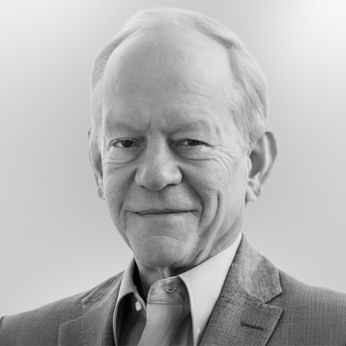
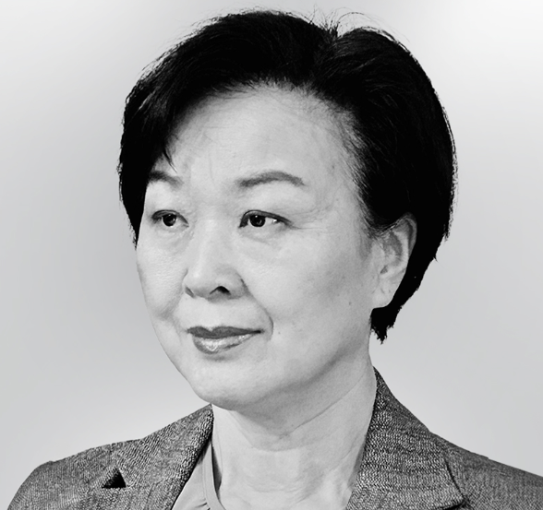

Leadership Team
Leading Minds in Immunology and PD-1 function
The Roadmap & the Funding
Prof. Giuseppe Pantaleo, MD
Co-Founder
  Prof. Pantaleo is a world-renowned immunologist at Lausanne University Hospital, recognized for groundbreaking contributions to HIV/AIDS research, immunotherapy, immune activation, and T-cell exhaustion. He has authored over 400 publications and received numerous awards, including The National Institutes of Health Director Award, The National Institutes of Health Award of Merit, the Pfizer Research Prize in Clinical Research in Infectious Disease, The Foundation Prof. Dr. Max Cloetta Prize, The FBM University of Lausanne Translational Research Award, The FBM University of Lausanne Lifetime Achievement Award.
Dr. Craig Fenwick, PhD
Co-Founder
  Dr. Fenwick, a former Senior Principal Scientist and Group Leader at Boehringer Ingelheim, leads CHUV’s antibody discovery and immune-monitoring platforms. His expertise includes studying immune profiles associated with infectious diseases, cancer, and vaccine responses, with a strong background in cellular immunology, mechanistic studies, assay development and drug discovery.
Prof. John A. Thompson, MD
CMO
  Prof. Thompson is a leading expert in melanoma and kidney cancer, pioneering immunotherapy innovations involving lymphocytes and immune checkpoint inhibitors. He chaired the guidelines committee for management of immunotherapy-related toxicities for the National Comprehensive Cancer Center and participated in similar efforts for ASCO and SITC.
Ms. Song Ding
Head of Clinical Operations
  Song Ding has an extensive background in translational clinical research, operations, and management of multi-center clinical trials in Europe, US and Africa. She has been overseeing and contributing to the implementation and management of close to 20 phase I/II vaccine and antibody trials, especially in product management and regulatory affairs.
Claude Ramoni
Attorney, Legal Council
  Claude Ramoni is a founding partner of the Lausanne-based law firm Libra Law. With over two decades of experience, he notably advises and represents clients in their business activities, in particular companies and entities active in scientific research and health care. In addition to his practice, he serves on boards of various companies and foundations and lectures at institutions such as the University of Lausanne.

Slide 20







Leadership Team
Leading Minds in Immunology and PD-1 function
The Roadmap & the Funding
Prof. Christophe Massard, MD PhD
  Gustave Roussy Cancer Hospital
    Prof. Massard heads the Department of Therapeutic Innovation and Early Clinical Trials (DITEP) at Gustave Roussy in Paris. He specializes in phase 1 trials, genitourinary and central nervous system tumors, focusing on precision medicine and histology agnostic trials. His work includes leading programs like MOSCATO.
Dr. Jim Tartaglia, Ph.D
  Former Head of Life Cycle Management & Vaccine Development, Sanofi
    Dr. Jim Tartaglia is a seasoned development leader with over 30 years of industry experience. He has held prominent roles at Sanofi and previously served as Executive Director of Research at Virogenetics Corporation in Troy, New York. Dr. Tartaglia holds a Ph.D. in Microbiology and Immunology, has authored over 130 publications, and is credited with more than 20 patents.
Prof. Solange Peters, MD PhD
  CHUV University Hospital
    Prof. Peters is Chief of Medical Oncology at the Centre Hospitalier Universitaire Vaudois (CHUV) in Lausanne, Switzerland. She specializes in thoracic malignancies, including lung and pleural cancers, with a focus on immunotherapy and biomarker discovery. A prolific author, she served as President of the European Society for Medical Oncology (ESMO) from 2020 to 2022.
Prof. Arlene Sharpe, MD PhD
Harvard Medical School
    Prof. Sharpe’s pioneering work on the PD-1 immune checkpoint pathway has revolutionized cancer immunotherapy, enabling life-changing treatments like checkpoint inhibitors. Recognized globally, Dr. Sharpe's research on T-cell regulation and immune evasion has positioned her as a driving force in advancing immunology and cancer therapies.
Prof. Rafick-Pierre Sekaly Emory University
    Prof. Sekaly is Vice-Chair of Translational Medicine in the Department of Pathology and Laboratory Medicine at Emory University School of Medicine in Atlanta, Georgia. He has pioneered the use of transcriptomics and bioinformatics to identify predictors/correlates of immune responses that lead to protection from viral infections, disease progression and licensed preventative and therapeutic vaccines.

Slide 21
Why invest in MabQuest?
Proven Innovation, Exceptional Safety, and Strong Foundations for Growth
The Roadmap & the Funding
PATENTED
Allosteric Antibody
  Novel mechanism antibody in a competitive Immune-checkpoint inhibitor market
  MAQ-001 PCT2 Patent natural expiration Jan. 22, 2036
  MAQ-002 later patient expiration (date TBC)
  Pembrolizumab (Keytruda, Merck), and Nivolumab (Opdivo, BMS) expected to lose patent protection 2028
COMPELLING
MAQ-001 Pre-Clinical results
  In vitro demonstration that MAQ-001 and orthosteric pembrolizumab synergize to restore proliferation of exhausted antigen-specific CD8 T cells and enhance cytokine production
  Gold standard immunogenic MC38 mouse tumor model shows that dual anti-PD-1 combination therapy of MAQ-001 and Keytruda suppresses tumor growth in vivo and significantly prolongs mouse survival
EXCELLENT
MAQ-001 Phase I Safety
  Excellent outcomes in terms Adverse Events (AEs) and Serious Adverse Events (SAEs) outcomes across solid tumours combined with compelling early results in anal cancer
Good MANUFACTURABILITY
  Leverage Lonza Biologics’ GS CHO XceedTM Mammalian Expression System
  Proven CHO (Chinese Hamster Ovary) Cell Platform
  High expression yields & streamlined development timelines
  Regulatory Acceptance
A dedicated
ASSET-CENTRIC TEAM
  Swiss based team with an exceptional background of medical and pharmaceutical research expertise, with a track record in immunology, immune-based therapies, and T-cell function
  Ready to advance to the next level.

Slide 22
Our Leadership Team

Slide 23
Prof. Giuseppe Pantaleo
MD, Co-Founder
The Roadmap & the Funding
Prof. Giuseppe Pantaleo, MD, is the Chief of the Service of Immunology and Allergy, and the director of the Department of Laboratory Medicine and Pathology at the Lausanne University Hospital, University of Lausanne, Switzerland. He serves also since 2007 as Executive Director of the Swiss Vaccine Research institute
Giuseppe Pantaleo is a renowned immunologist, recognized for his groundbreaking work in HIV/AIDS research and immunotherapy.
He has contributed significantly to understanding the mechanisms of HIV pathogenesis, particularly to the immune system response to the virus. His research has focused on immune activation, T-cell exhaustion, and the development of therapeutic vaccines and immune-based strategies for controlling HIV infection.
Pantaleo has also played a key role in advancing knowledge on immune responses to vaccines and chronic infections, and his work continues to influence the fields of immunology and virology.
He is based in Switzerland, where he has held prominent academic and research positions, including at the Lausanne University Hospital.

Slide 24
Dr. Craig Fenwick
Co-Founder
The Roadmap & the Funding
Former Senior Principal Scientist in pharmaceutical research at the Boehringer Ingelheim Infectious Disease R&D Centre in Canada. There, he spent 13 years as a Project Leader for the discovery and clinical advancement of a novel allosteric HIV Integrase drug, led exploratory research projects including antibody discovery and served on the management committee of a CRO-led bispecific antibody design project.
Craig Fenwick is now a research scientist at the Lausanne University Hospital, serves as Director of the IAL Antibody Discovery and Clinical Immune Monitoring platforms and contributes to several international research projects, including as the academic lead for the antibody discovery group for the IMI Corona Accelerated R&D in Europe project.
Together with Giuseppe Pantaleo, Craig has discovered therapeutic antibodies against multiple infectious disease and oncology targets with three oncology or infectious diseases antibodies advanced to Phase 1 clinical trials.

Slide 25
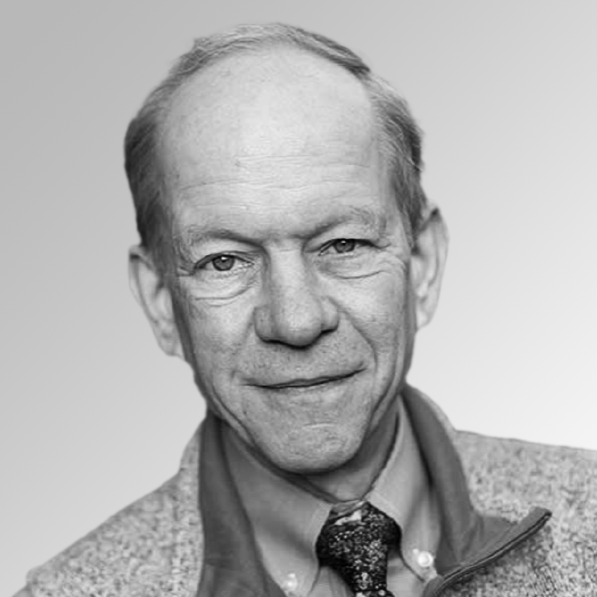
Prof. John A. Thompson, M.D.
Chief Medical Officer
The Roadmap & the Funding
Fred Hutchinson Cancer Center in Seattle in an expert in and Immunotherapy where he has played a major role in advancing innovative immune checkpoint inhibitors.
Professor in the Medical Oncology Division at the University of Washington
Primary clinical and research interests in melanoma and kidney cancer
Work centers on using activated lymphocytes, cytokines, and antibodies to advance immunotherapy approaches, and continues to influence the global oncology community, positioning him as a leader in the integration of cutting-edge therapies into clinical care.

Slide 26
Mrs. Song Ding
Head of Clinical Operations
The Roadmap & the Funding
Dr. Song Ding, Ph.D. serves as Head of Clinical Research Operations
Song has a track record as a researcher affiliated with the EuroVacc Foundation in Lausanne, Switzerland where she worked on clinical trials that assess the efficacy of various vaccine strategies.
Mrs. Ding's research has contributed to the advancement of the understanding of immune responses and on the potency and durability of T and B cell immune responses

