Slide 1


Slide 2
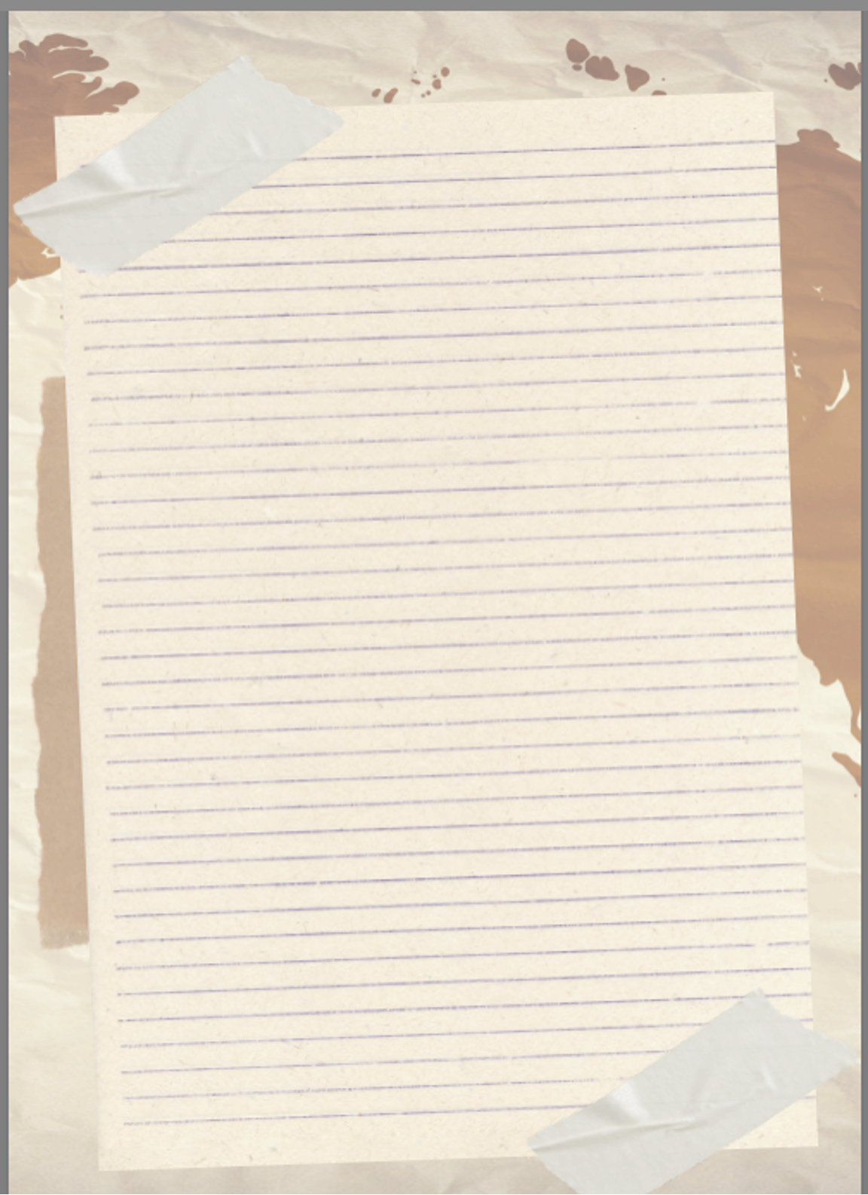


Introduction
The story of the White Rose Resistance reminds us that even in the darkest moments of history, the courage to speak the truth can spark hope. A small group of students armed not with weapons, but with words, dared to stand against injustice. Their leaflets, simple yet powerful, carried ideas strong enough to outlive tyranny. Words are not just ink on a page or sounds in the air-they are vessels of courage, conviction, and change. They can wound or heal, divide or unite, silence or empower.
The White Rose members understood this truth, and so does Anita Pazner in her moving book Words Matter. Her work highlights how language shapes our world, challenges our assumptions and calls us to action.
As we begin this guide, let us remember that resistance begins with expression. To choose words with care is to choose the kind of world we want to create. Like the White Rose, we too can wield language as a force for justice and humanity.

Slide 3
Teacher Guide for Words Matter
Overview and Objectives
Students will:
Analyze the historical context of Nazi Germany and the White Rose Resistance.
Explore the moral and ethical decisions made by Hans and Sophie Scholl.
Examine the power of language and peaceful protest in unjust societies.
Connect historical resistance to current events and their own ability to use words for good.
Novel Themes: Resistance, Fascism, Moral Courage, Propaganda, Power of Words, Social Justice

Slide 4
Teacher Guide for Words Matter
Discussion Questions
BEFORE READING
What does “resistance” mean to you?
Have you ever spoken up for something that was unpopular? What happened?
How can words influence people for good—or for harm?
DURING READING
How does the Scholl family’s environment shape Hans and Sophie’s worldview?
What role does propaganda play in the rise of Hitler? How is it introduced to children?
Why do Hans and Sophie initially join the Hitler Youth? What causes them to question it?
Why do you think the group called themselves the "White Rose"? What symbolism does that name evoke?
How do Hans and Sophie change from the beginning of the story to the end?
AFTER READING
What sacrifices did members of the White Rose Resistance make?
Why did the Nazi regime fear words so much?
How does this story relate to freedom of speech and protest today?
In what ways do you think young people can lead movements for justice?

Slide 5
Lesson: Understanding Propaganda
👀 What Is Propaganda?
Propaganda is information that is spread to shape the way people think, feel, or act.
It often uses emotions (fear, pride, anger, hope) to persuade people.
It can be used for both positive (encouraging recycling, teamwork) and negative (spreading hate, controlling people) purposes.
Governments, companies, and groups have all used propaganda to get people on their side.
🛠️ Common Propaganda Techniques
Bandwagon – “Everyone is doing it, so you should too.”
Fear – Scaring people into action.
Name-Calling – Using negative labels against opponents.
Glittering Generalities – Using fancy words like “freedom” or “justice” without real explanation.
Testimonial – Using a famous person or “expert” to endorse an idea.
Card Stacking – Only showing one side of the story.
Plain Folks – Making leaders seem like they’re “just like you.”
🖼️ Quick Examples
WWII Poster: “Loose Lips Sink Ships” (fear – don’t share secrets).
Commercial: A famous athlete drinks a sports drink and says it made them win (testimonial).
Social Media Ad: “Join millions of people who are already switching to this brand!” (bandwagon).

Slide 6


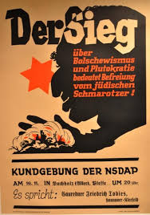
✍️ Student Activity: – Spot the Propaganda!
Analyze the examples (posters, ads, or memes).
Task: Identify which propaganda technique is being used. What is its message? What is its goal?
“Loose Lips Sink Ships” (WWII, U.S.)
Type:
Message.
Goal.
2. Uncle Sam “I Want YOU”
Recruitment Poster (WWI & WWII, U.S.)
Type:
Message:
Goal:
3. Nazi Propaganda Against Jewish People (1930s–1940s, Germany)
Type:
Message:
Goal:
💭 Reflection Question
Why do you think propaganda is powerful? How can we protect ourselves from being tricked by it?

Slide 7

Types of Government
Democracy – A government where the people have the power. Citizens usually vote to choose their leaders and make decisions. Example: the United States.
Monarchy – A government ruled by a king, queen, or emperor. Sometimes they have all the power (absolute monarchy), and sometimes their power is limited by laws (constitutional monarchy). Example: the United Kingdom.
Dictatorship – A government where one leader has total control and does not let people have a real say. Leaders often stay in power through force or fear. Example: North Korea.
Oligarchy – A government ruled by a small group of people, often the rich or powerful families. The average citizen usually has little influence. Example: Russia, Philippines.
Theocracy – A government led by religious leaders or based on religious laws. Example: Iran.
Plutocracy – A government where the wealthy have the most power and influence, often because money controls politics and decisions. Example: Ancient Roman Empire.

Slide 8
🌍 Types of Government – Comparison Chart
Plutocracy | A government where the wealthy have the most power and influence, often because money controls politics and decisions. | No official modern example, but some people argue wealthy elites influence certain governments.
Democracy | A government where the people have the power. Citizens usually vote to choose their leaders and make decisions. | United States
Monarchy | A government ruled by a king, queen, or emperor. Sometimes they have all the power (absolute monarchy), and sometimes their power is limited by laws (constitutional monarchy). | United Kingdom
Dictatorship | A government where one leader has total control and does not let people have a real say. Leaders often stay in power through force or fear. | North Korea
Oligarchy | A government ruled by a small group of people, often the rich or powerful families. The average citizen usually has little influence. | Ancient Sparta
Theocracy | A government led by religious leaders or based on religious laws. | Iran

Slide 9
🌍 Types of Government – Student Chart (Fill-In Version)
👉 Directions: Fill in the chart by writing a simple definition and an example country (or historical example) for each type of government. Try to find examples we haven’t discussed.
Type of Government | Definition | Example
Democracy
Monarchy
Dictatorship
Oligarchy
Theocracy
Plutocracy

Slide 10
🌍 Types of Government Worksheet
Part 1: Vocabulary Match
Match the type of government to the correct description. Write the letter in the blank.
___ Democracy
___ Monarchy
___ Dictatorship
___ Oligarchy
___ Theocracy
Word Bank
A. Rule by a few powerful people or families
B. Rule by a single leader with total control, often through force
C. Rule by the people, who vote to make decisions
D. Rule by religious leaders or laws based on religion
E. Rule by a king, queen, or emperor (power may be limited or absolute)
Part 2: Quick Check
Circle the best answer.
Which type of government gives citizens the MOST power?
a) Dictatorship
b) Democracy
c) Theocracy
d) Monarchy
In which government does religion play the central role?
a) Oligarchy
b) Theocracy
c) Democracy
d) Dictatorship
True or False: In an oligarchy, everyone has an equal voice in government.

Slide 11
🌍 Types of Government Worksheet
Part 3: Critical Thinking
Answer in complete sentences.
Which type of government do you think works best in today’s world? Why?
How might life be different for citizens living under a dictatorship compared to a democracy?

Slide 12
🛑 Lesson: Understanding Censorship
👀 What Is Censorship?
Censorship is when a government, school, company, or group controls or limits what information people can see, read, hear, or share.
Sometimes it’s done to protect people (like blocking violent or harmful content for kids).
Other times, it’s used to silence ideas, control people, or hide the truth.
📚 Quick Examples
A government bans books that criticize its leaders.
A school blocks certain websites on student computers.
A social media app removes posts it thinks break community rules.
🤔 Why Does Censorship Happen?
To protect (children, safety, national secrets).
To control (limit free speech, silence critics, spread only one point of view).
To persuade (show only information that supports one side).
Student Activity – “Censorship Case Studies”
Step 1 – Read These Situations
A country removes all newspapers that criticize the government.
A parent blocks certain TV shows for their children.
A school bans a book because some parents complain it has “bad ideas.”
A website deletes posts with false information about health.
Step 2 – Discussion Questions
Is this censorship? (Yes/No)
Is it fair or unfair? Why?
Who benefits and who is harmed?
Step 3 – Reflection
Write a short paragraph:
👉 “Do you think censorship is more helpful or harmful? Give an example to support your opinion.”

Slide 13
🌍Propaganda and Types of Government Worksheet
✅ Teacher Key (for reference):
Propaganda
📢 Propaganda Examples
1. “Loose Lips Sink Ships” (WWII, U.S.)Type: Fear Message: Posters warned Americans not to talk about military secrets because spies might hear. Goal: Scare people into silence to protect soldiers and keep the enemy from gaining information.
2. Uncle Sam “I Want YOU” Recruitment Poster (WWI & WWII, U.S.)Type: Bandwagon / Emotional Appeal Message: A stern-looking Uncle Sam points directly at the viewer, saying “I want YOU for the U.S. Army. ”Goal: Make individuals feel personally called to serve and join millions of others.
3. Nazi Propaganda Against Jewish People (1930s–1940s, Germany)Type: Name-Calling / Fear Message: Posters and films spread lies portraying Jewish people as dangerous or evil. Goal: Turn public opinion against Jewish people and justify discrimination and violence.
Part 1: 1C, 2E, 3B, 4A, 5D
Part 2: 1B, 2B, 3False

Slide 14
White Rose Resistance – Classroom Activities
Words as Weapons Activity:
Give students a short White Rose leaflet excerpt (or summarize one in kid-friendly language).
Task: Highlight words or phrases that would have inspired or challenged readers.
Extension: Students create their own mini-leaflet about an issue they care about today (school/community/global).
Moral Responsibility
Activity: “Would You Speak Up?” scenarios.
Present students with modern dilemmas (e.g., seeing bullying, overhearing a racist comment, noticing someone cheating).
Task: Students decide: Speak up, stay silent, or take another action. Place students in groups. Direct them to read each scenario individually and then decide which action they would take. Once students have made their decisions, have them share out and discuss with the group.
Connection/Extension: Compare to choices made by the White Rose.
Resistance & Civil Disobedience
Activity: Compare Movements.
Divide students into groups to research different nonviolent resistance movements (White Rose, Gandhi’s Salt March, Civil Rights sit-ins).
Task: Each group makes a short presentation: Who resisted? How? What impact did it have
Extension Option: After presentations, have the class create a “Resistance Wall” where each group posts a short summary of their movement and a key quote/image that represents it.

Slide 15
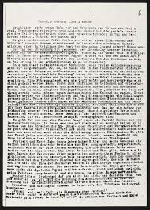
White Rose Resistance – Classroom Activities
Directions: Below is an excerpt of Leaflet 1 of the White Rose. Read and highlight words or phrases that would have inspired or challenged readers. Be prepared to discuss your choices.
I. Leaflet of the White Rose
Nothing is more dishonourable for a civilized people than to let itself be “governed” without resistance by an irresponsible clique of rulers devoted to dark instincts. Is it not true that every honest German today is ashamed of his government? And who among us can sense the dimensions of the dishonor that will lie upon us and our children once the veil has fallen from our eyes and the most horrid and extravagant crimes come to light?
If German people are already so corrupted and spiritually crushed that they do not raise a hand, frivolously trusting in a questionable faith in the lawful order of history; if they surrender man’s highest principle, that which raises him above all other God’s creatures, his free will; if they abandon the determination to take decisive action and turn the wheel of history and thus subject it to their own rational decision; if they are so devoid of all individuality, have already gone so far along the road to turning into a spiritless and cowardly mass – then they clearly deserve their downfall.
Goethe speaks of the Germans as a tragic people, similar to the Jews or the Greeks, but today it would appear rather as a shallow, spineless herd of followers robbed of their core with the marrow sucked out of them, who are now just waiting to be hounded to their destruction. So it seems – but it is not so.
Through gradual, treacherous, systematic violation, every single person has rather been put into a prison of the mind, which he only realizes after finding himself already in chains. Only a few have recognized the impending doom and their heroic warnings have been rewarded with death. The fate of these persons will be spoken of later.
If everyone waits for his neighbour to take the first step, the messengers of the vengeful nemesis will come ever closer, and the very last victim will senselessly be thrown into the throat of the insatiable demon.
Therefore, every individual must be aware of his responsibility as a member of western culture and put up as fierce a fight as possible, he must work against the scourges of mankind, against fascism and any similar system of totalitarianism. Offer resistance – resistance – wherever you may be, stop this atheistic war machine from running on and on, before it is too late; before the last city, like Cologne, lies in ruins; and before the nation’s last young man has bled to death somewhere on the battlefields for the hubris of a subhuman.
Don’t forget that every people deserves the regime it is willing to endure!

Slide 16
Moral Responsibility
Moral Scenarios for Debate
After each scenario
Choose your action.
Be ready to explain why you chose it.
Discuss as a group how different actions could change the outcome.
Scenario 1: The Locker Room
You’re in the locker room after gym class and hear a group of students making fun of someone’s body. The person being talked about doesn’t hear it.
Do you laugh along, stay quiet, or tell them it’s wrong?
What might happen with each choice?
Scenario 2: The Test Answer
During a big test, you notice a friend peeking at someone else’s answers. The teacher doesn’t see it.
Do you say something to your friend, tell the teacher, or ignore it?
How might each choice affect your friend, the class, and yourself?
Scenario 3: The Online Post
A classmate shares a mean meme about another student on social media. Everyone in your group chat is laughing and adding more comments.
Do you join in, say something to stop it, or leave the chat quietly?
How might your choice change the way others see you?
Scenario 4: The Lost Wallet
You find a wallet in the hallway with $40 inside and no name. You could take the money, leave the wallet, or turn it in to the office.
What do you do?
How would you feel about your choice later?
Scenario 5: The Group Project
In a group project, one person doesn’t do any of the work but still expects to get the same grade.
Do you stay silent, talk to your group, or tell the teacher?
How would your choice affect fairness in the group?
Scenario 6: A classmate makes a “joke” about someone’s religion or background. Some students laugh, but you can see it made the other person uncomfortable.
Do you laugh along, stay quiet, or say something? What risks and benefits come with each choice?

Slide 17
Resistance & Civil Disobedience – Group Activity
🎯 Student Directions
Get into groups (your teacher will assign).
Choose one movement (White Rose, Gandhi’s Salt March, or Civil Rights Sit-Ins).
Research your movement using classroom resources or approved websites.
Answer these questions:
  Who resisted? (Who were the leaders/participants?)
  How did they resist? (What nonviolent methods did they use?)
  What impact did it have? (Did it inspire others, change laws, or send a powerful message?)
Create a short presentation (poster, slideshow, skit, or short speech) to teach the class about your movement.
Be ready to answer questions from your classmates!
🌹 The White Rose (Germany, WWII)
The White Rose was a small group of college students in Nazi Germany, including siblings Hans and Sophie Scholl. They resisted Hitler by secretly writing and handing out leaflets that spoke out against the Nazi government. Even though they were caught and executed, their bravery showed that young people could stand up for justice with words instead of weapons. Their story still inspires people today.
🧂 Gandhi’s Salt March (India, 1930)
India was ruled by Britain, and one unfair law forced Indians to only buy salt from the British, who taxed it heavily. Mahatma Gandhi led thousands of people on a 240-mile march to the sea to make their own salt as a protest. This was peaceful but powerful. The march inspired millions of Indians to resist British rule without violence and became a turning point in India’s fight for independence.
🍽️ Civil Rights Sit-Ins (United States, 1960s)
In the U.S. South, segregation laws kept Black and white people separate in public places. In 1960, four African American college students sat down at a “whites-only” lunch counter in Greensboro, North Carolina. When they were refused service, they didn’t leave—they stayed seated quietly. Soon, thousands joined sit-ins across the South. These peaceful protests gained national attention and helped push the Civil Rights Movement forward, leading to new laws for equality.

Slide 18
Lesson: Understanding Censorship
👀 What Is Censorship?
Censorship is when a government, school, company, or group controls or limits what information people can see, read, hear, or share.
Sometimes it’s done to protect people (like blocking violent or harmful content for kids).
Other times, it’s used to silence ideas, control people, or hide the truth.
📚 Quick Examples
A government bans books that criticize its leaders.
A school blocks certain websites on student computers.
A social media app removes posts it thinks break community rules.
🤔 Why Does Censorship Happen?
To protect (children, safety, national secrets).
To control (limit free speech, silence critics, spread only one point of view).
To persuade (show only information that supports one side).
✍️ Student Activity – “Censorship Case Studies”
Step 1 – Read These Situations
A country removes all newspapers that criticize the government.
A parent blocks certain TV shows for their children.
A school bans a book because some parents complain it has “bad ideas.”
A website deletes posts with false information about health.
Step 2 – Discussion Questions
Is this censorship? (Yes/No)
Is it fair or unfair? Why?
Who benefits and who is harmed?
Step 3 – Reflection
Write a short paragraph:
👉 “Do you think censorship is more helpful or harmful? Give an example to support your opinion.”

Slide 19
