Slide 1












About Getnet
A 100% santander owned paytech providing customers with a one-stop shop for innovative payments and integrated solutions.
Created in late 2020 as a global payments platform to innovatively bring together all of Santander Group´s payment solutions under one umbrella, building over Getnet´s, established franchise
Cloud-native platform that process x-border B2B Account to Account pay-outs and FX
Merchant payments services including processing, acquiring and value-added solutions
GLOBAL BUSINESS BREAKDOWN
1
2
3
4
5
Retail & Commercial
Digital Consumer bank
Payments
Corporate & Inverstment banking
Wealth management & insurance
A new Global business integrating our retail and commercial banking activities
A single model across our markets for our consumer and auto finance business for OpenBank
Single infrastructures for our payment solutions
Our global platform to support corporates and institutions
Common service models for our private banking, asset management and insurance business
Five global business have become the new primary segments for the group, in this new model, global heads will define the common business and operating model, which will be based on global platforms.

Slide 2














We keep widening our presence in the payments industry
In diverse and abundant competition landscape Getnet stands 10th among merchant acquirers but...
... there aren´t many players backed by a leading financial institution with a global reach like Santander´s
47,457
47,457
47,033
9,889
45,913
9,639
40,704
9,066
24.538
8,820
16.800
8,329
14,316
7,978
13,450
4,578
10,697
9,889
RANK 1
RANK 2
Nilson Report Issue 1272, October 2024. Ranked by domestic purchase transactions (in Millions). Considering only publicity traded companies
own source based on Nilson Report Issue 2023 only selecting Top 10 international players backed by global banks

Slide 3
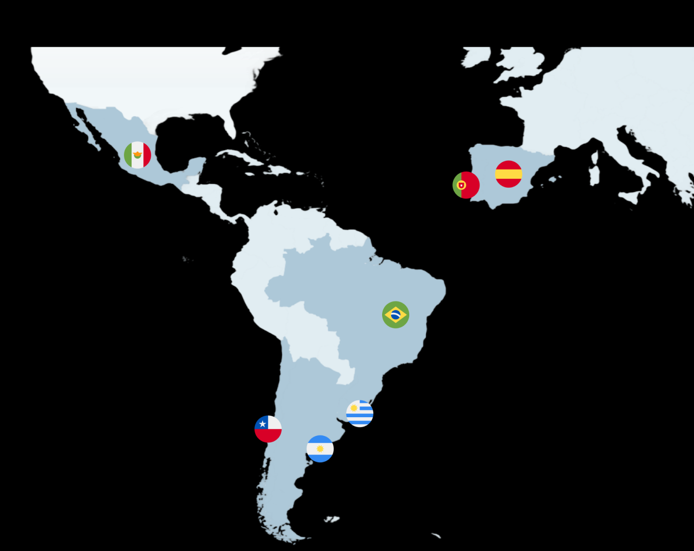













Strong geographical footprint in Iberia and LatAm
Getnet has been providing merchant payment services for more than 10 years in Brazil, Mexico, Spain and Portugal and in the south cone Getnet´s been present - 5 years but has scaled quickly achieving relevant market shares
>220 €Bn
c. 10 Bn
Total payments volume
Processed Transactions
1.3 Mn
>5,000
Active merchants
Employees

