Slide 1

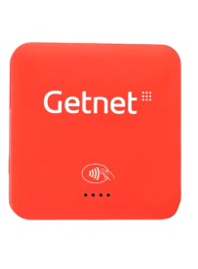

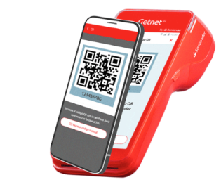






Our History
Argentina
In Argentina, Getnet was launched in 2020 with a focus on small businesses, initially offering Aparato and Payment Link as acceptance solutions. In this first stage, the model relied on Geopagos as a payment facilitator, allowing for a quick market entry. Subsequently, the operation evolved into a scheme supported by Getnet's own platform, expanding its offering with digital integrations, interoperable QR, and Smart POS terminals to serve both SMEs and larger companies.
2020
2021
2022
2023
2024
2025
Launch
API Checkout and virtual integrations
QR Code
We launched the Get Smart POS terminals
The evolution continues!
Open Sales Subscriptions
Launch of Getnet in Argentina with Aparatito and Payment Link
We were among the first to adopt QR interoperability for PCT.
Implementation of interoperable QR, Immediate Payment, and SEP.
Launch of Installment to Installment and new sales models.
Expansion into e-commerce solutions and digital payments.
Advanced solutions aimed at SMEs and businesses.

Slide 2












Our History
Brasil
2003
2009
2010
2014
2015
Innovation in Payment and Recharge Media
Strategic Alliance with Santander
Acquiring Market
Certified Excellence and Security
Complete Coverage
We are the first company in the sector to enter the acquiring market.
We are the first company to operate with all card brands on our terminals.
Founded in Rio Grande do Sul, it operates with payment solutions and mobile phone recharge technology.
We have become a joint venture with Santander.
ISO 27001 and PCI DSS - V3 Certifications.
2016
2021
2022
2023
2024
Sustainability and Compliance
Stock Market Listing
Pioneers in Sustainable Technology
Two Decades of Regional Leadership
Financial Strength and Market Growth
Getnet became an independent company, publicly listed on B3 and Nasdaq.
We achieved carbon neutrality certification as a payment institution from the Central Bank.
We introduced the first eco-friendly payment terminals in Latin America, made from recycled materials.
We celebrate 20 years as the third largest acquirer in Latin America.
We reached 567,500 clients and recorded a net profit of R$592 million.

Slide 3
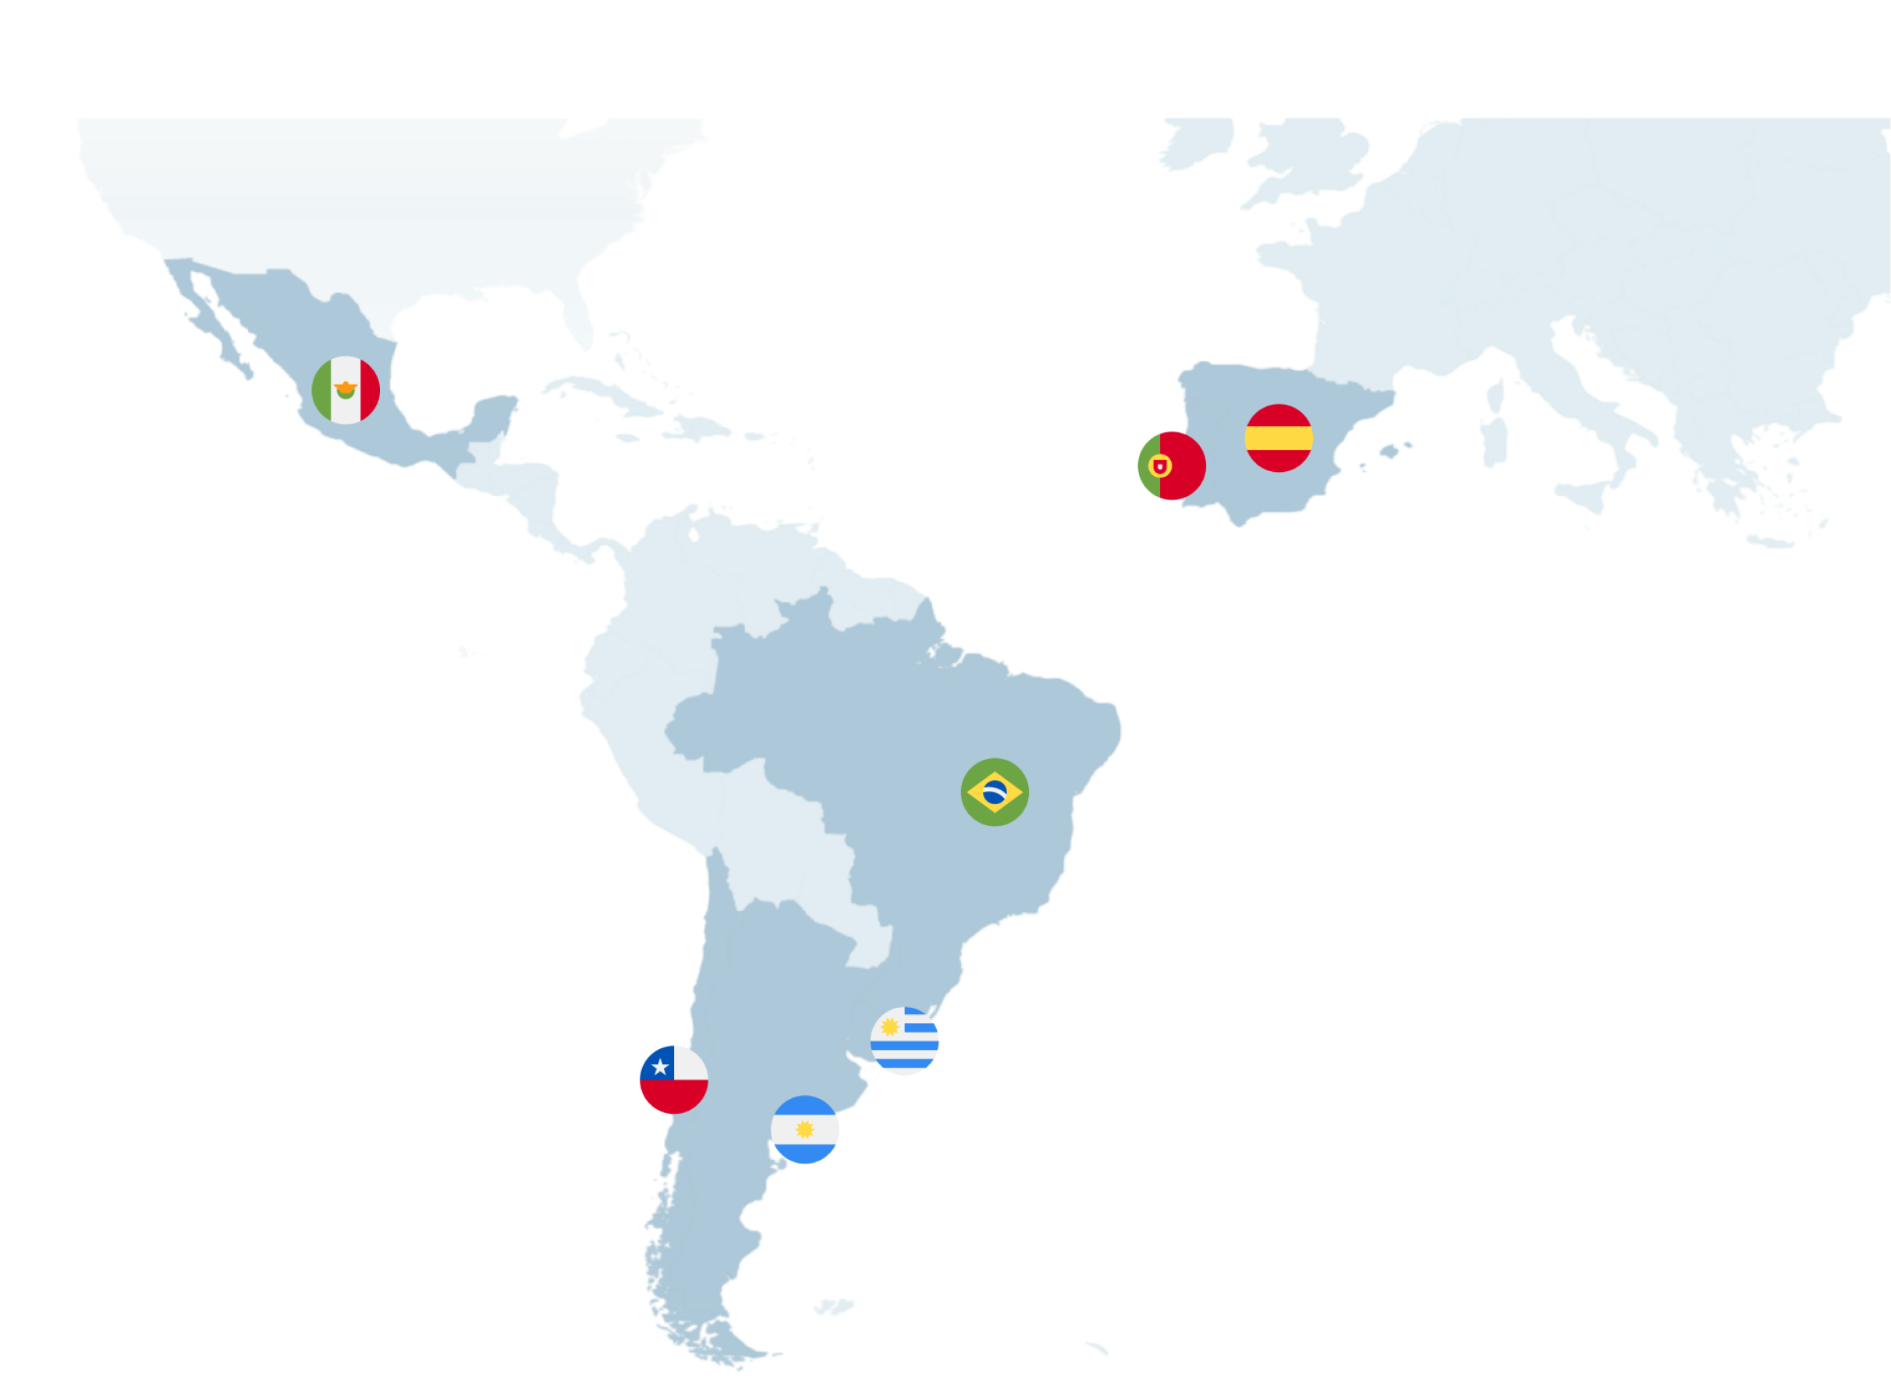
Our History
Banco Santander has historically offered global payment solutions, although the Getnet brand has evolved uniquely in each geography.
Its trajectory combines the integration of previous partnership models with the acquisition of native technology companies according to the needs of each market.
Currently, these trajectories converge into a unified global platform that enhances local agility with the scale of the Group.
2020
2012*
2012*
2003
2022
2021
2020
* Since 2022 under the Getnet brand

Slide 4




Our History
Europa
The acquiring business in Spain began in 2017 after the repurchase of the business that had been operating as a joint venture with Elavon since 2012. This operation allowed Santander to regain direct management of a strategic activity. From then on, an entity was established that operated within Santander Spain until 2022, the year it was integrated into PagoNxt with the aim of driving its expansion throughout the rest of Europe.
2012-2017
2017
2017
JV Elavon
Purchase and New Governance
New Commercial Strategy
Monoliner Vision vs Customer Vision
Non-integrated business with the bank
Loss of efficiency in business management
Negative impact on customer experience
IT platform without evolution
Start of the acquiring business with the repurchase from Elavon and establishment of management, cost, disconnection, and technology committees.
Launch of the new commercial roadmap in October to transform the business vision.
2018
2019
2020
2022
Synergies and Adaptation
Migration
Integration into PagoNxt
Consolidation as Getnet Europe
Integration with the network and central services (SSCC), along with the adaptation of the technological platform.
Completion of the technological migration process to optimize business management.
The entity begins its phase within the global PagoNxt platform.
Transition from Santander Spain to a key part of Getnet's strategic plan to expand throughout the rest of Europe.

Slide 5





Our History
Mexico
Getnet Mexico, launched by Grupo Santander in 2020, is a key acquiring technology platform in the digitalisation of payments for businesses of all sizes, quickly establishing itself as the second most important player in the sector in Mexico. As part of PagoNxt (a Santander fintech), it offers physical and digital solutions including terminals (Smart, Mini, Advance) and contactless payments.
2020
2021
Present Day
Launch
Expansion and Dominance
Continuous Innovation
Introduced in Mexico with a focus on agile payment solutions, including Get Link and Pay during the pandemic.
Acquisition of 70% of MIT, adding 180,000 points of sale. Achieving a 17% market share. Processing over 390 million transactions.
Launch of GTA (Android as a terminal). Strategic partnerships (e.g. Pact) and consolidation as the second largest acquirer in Mexico.

