Slide 1










VAS
Value Added Services
Complementary services designed to extend the core acquiring and payments offering, allowing merchants and partners to extract additional value from payment flows, beyond basic transaction processing.
Main Objectives
Who is it for
Financial Optimization
Customer Experience
Merchants looking to maximize the value of their payment flows
Ecommerce and digital businesses
Improve cash flow and financial efficiency through financing solutions.
Support multi-currency and international payment operations.
Companies operating or selling across borders or currencies
Businesses looking to optimize their liquidity and working capital.
Maximize Revenue
Reduction of Complexity
Increase value per transaction.
Centralize various operational capabilities through a single acquiring partner.
Merchants interested in customer loyalty, rewards, and engagement.
Partners, platforms, and aggregators looking to enhance their acquisition proposition.

Slide 2
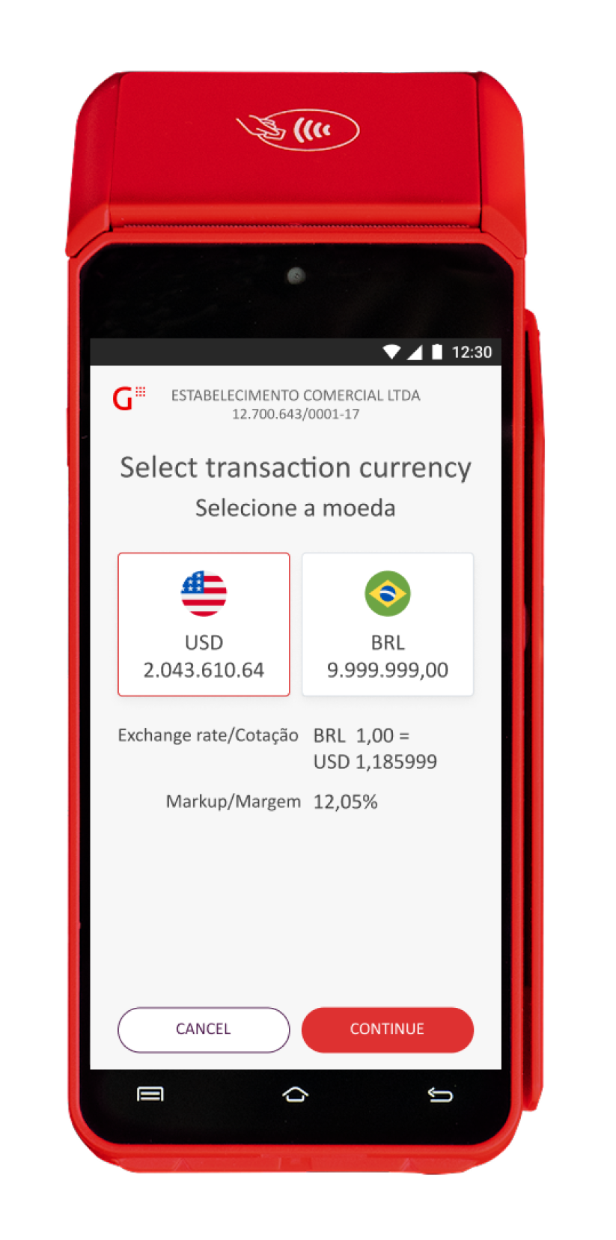





Core Services
These services are delivered as modular capabilities, allowing for flexible adoption according to business needs, geography, and operational maturity.
We combine our expertise and resources with specialized partners to enhance our value proposition.
Dynamic Currency Conversion
Financing Solutions
Whether at a physical or virtual POS terminal, it allows foreign cardholders to pay in their local currency.
Financial management through our Prepayment and DWC (Dynamic Working Capital) solutions.
Antifraud Tools
Broad list of Specialized Partners
Fraud detection through a single API PCI certified platform with less friction for the customer.
We combine our expertise and resources with specialized partners to enhance our value proposition.

Slide 3




























Service Categories | Availability by Country
Products
Argentina
Brasil
Chile
México
Uruguay
España
Portugal
AUTTAR
Not available
Available
Not available
Not available
Not available
Not available
Not available
Benefit Cards
Not available
Not available
Not available
Roadmap
Not available
Not available
Not available
Bill Payments
Not available
Available
Available
Available
Not available
Not available
Not available
Chatbot
Not available
Not available
Not available
Available
Not available
Not available
Not available
Cross Border Payments (FX)
Not available
Available
Roadmap
Roadmap
Not available
Not available
Not available
Dynamic Currency Conversion (DCC)
Not available
Available
Roadmap
Available
Available
Available
Available
Get Conta
Not available
Available
Not available
Not available
Not available
Not available
Not available
Dynamic Working Capital (DWC)
Not available
Available
Roadmap
Available
Not available
Roadmap
Not available
Gas Station Solution
Not available
Not available
Available
Available
Available
Available
Not available
GStore
Available
Available
Available
Available
Available
Available
Available
Insurance
Not available
Not available
Available
Roadmap
Not available
Not available
Not available
Loyalty & Rewards
Not available
Not available
Not available
Roadmap
Not available
Not available
Not available
Continue to the next slide

Slide 4











Products
Argentina
Brasil
Chile
México
Uruguay
España
Portugal
Mobile Top-Up
Not available
Available
Not available
Available
Not available
Not available
Not available
Multi-Currency Pricing (MCP)
Not available
Not available
Not available
Not available
Not available
Not available
Not available
Restaurant Solutions
Not available
Available
Available
Available
Not available
Available
Not available
Sales Advance
Available
Available
Not available
Roadmap
Available
Not available
Not available
Smart Routing
Not available
Not available
Not available
Not available
Not available
Not available
Not available
TaFace
Not available
Not available
Not available
Not available
Available
Not available
Not available

