Slide 1













PIX
Brazil's instant payment system enabling 24/7 immediate transfers and payments. It has become the fastest-growing payment method in recent years, utilizing QR codes or keys for seamless transactions.
Santander
Centralized
Have a registered and active Pix key at Santander.
Have a bank address different from Santander or do not have a registered and active Pix key at Santander.
Have registration with a legal representative PF (Individual).
Eligibility Criteria
Have registration with a legal representative PF (Individual).
Have a product from the Digital Platform enabled that is not the payment Split.
Self-service: Via the Getnet app or My Account Portal
Self-service: Via Getnet app or My Account Portal
Mass Enablement
Mass Enablement
Customer Service Center
*Technical note: Register the SS (Service Request) as: INFORMATION | ENABLEMENT | PIX.
Enablement Channels
*Technical note: Register the SS (Service Request) as: REQUEST | ENABLEMENT | PIX.
The Pix has two settlement times that vary according to the sales time. The customer receives in the account registered in Getnet within up to 30 minutes after the settlement time:
Instantaneous, the Pix is credited within up to 10 seconds after payment confirmation in the customer's Santander account.
Sales made between:
Are settled starting from:
When You Receive the Money
07:30 and 15:30
16:00
15:30 and 07:30
08:00

Slide 2






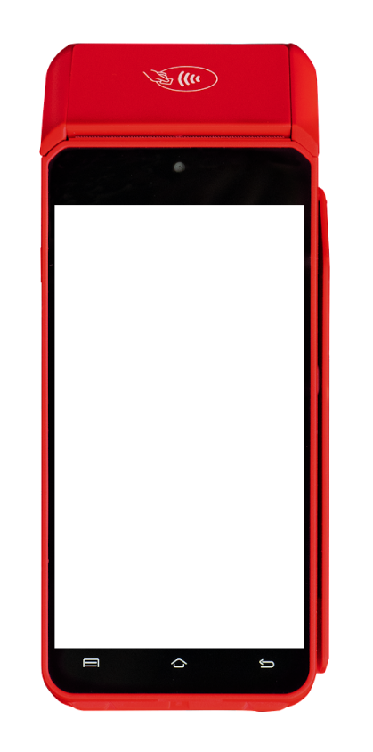












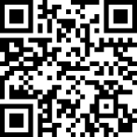






Payment Flow | Pix
01
02
03
04
How it works
Payment Flow
The customer wishes to make the payment via Pix.
The merchant displays the QR code generated by Getnet at the terminal.
The customer accesses their device and makes the payment by scanning the QR Code or bringing their phone close with Google Wallet.
Transaction completion and printing of the receipt.
ESTABELECIMENTO COMERCIAL LTDA
12:30
Pagamento
12:30
Pagamento
12:30
ESTABELECIMENTO COMERCIAL LTDA
12:30
ESTABELECIMENTO COMERCIAL LTDA
12:30
ESTABELECIMENTO COMERCIAL LTDA
12:30
12.700.643/0001-17
Pagamento
12.700.643/0001-17
12.700.643/0001-17
12.700.643/0001-17
Pagamento
Pix
Transação Pix aprovada
Informe abaixo o valor
Selecione a forma de pagamento
R$ 100,00
R$ 100,00
R$ 100,00
R$ 100,00
ID/Transação
Terça, 01 de Setembro de 2020 - 12:10
Aproxime seu dispositivo para realizar o pagamento
88554477411225838855447741122583345
Crédito
Dados do Estabelecimento
1
2
3
Sucesso!
Padaria e Confeitaria Cruzeiro
00.000.000/0000-00
Pagamento
Pré-autorização
Antecipação
4
5
6
Débito
Transação aprovada!
Banco Santander
Dados do Cliente
7
8
9
Rafael Silva dos Santos
Reimpressão
Fechamento
Estorno
Voucher
000.***.***-00
0
Banco ABC
Últimas vendas
CONTINUAR
Pix
ou faça a leitura do QR Code
Inicial
Pagamento
Configurações
CANCELAR
CANCELAR
FECHAR
VIA DO CLIENTE
Home
Enter Amount
Select 'Pix'
Scan QR Code
Operation approved
Receipt

