Slide 1
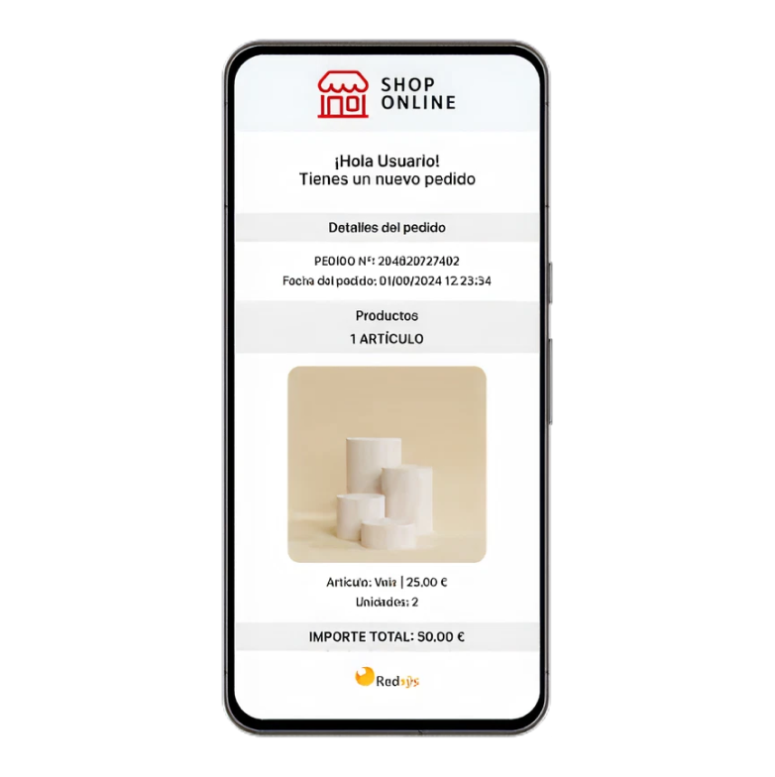

Get Social Selling
Online sales solution without the need for an independent eCommerce site
#digital #individuals #allsegments #allinsdustries
Availability
Current:

Slide 2





Product
Get Social Selling
Value proposition main atributes
Direct Sales without an eCommerce requirement
Payment Flexibility
Boost your sales by accepting the market’s most popular payment methods with simple, competitive rates that scale alongside your business growth.
Empower businesses to start selling online instantly, without the need to set up or maintain complex online stores or proprietary websites.
Financial Integration
Simplified Online Selling
Efficiently manage your cash flow by performing reconciliations, settlements, and personalized reporting directly through your Santander Bank Online Banking app.
Create your own storefront and add products directly from the platform to start selling immediately.

