Slide 1
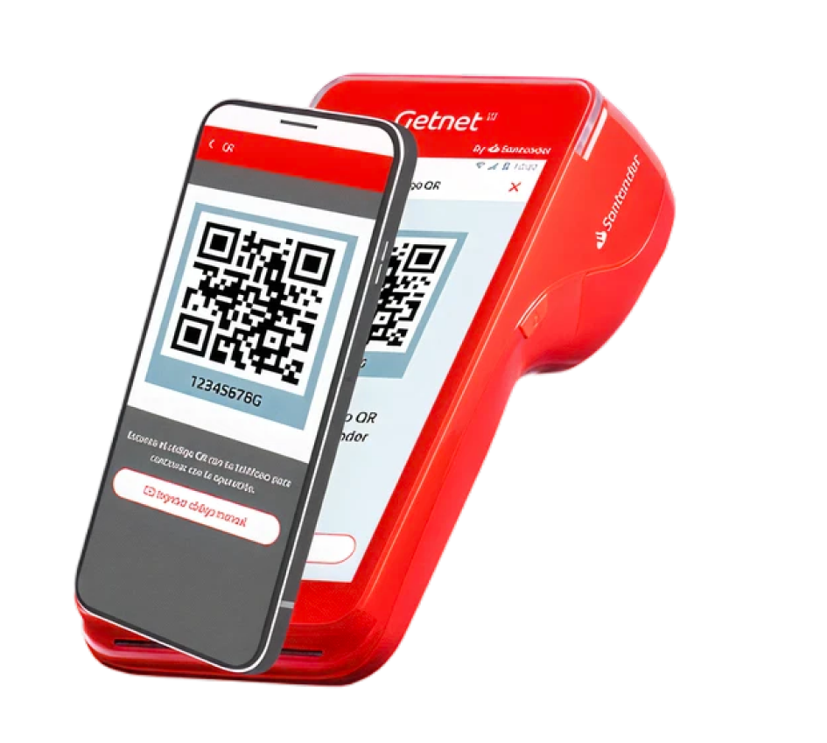

Get QR
Payment solution for processing transactions by scanning QR codes with mobile devices
#mobile #allsegments #allindustries #retail
Availability
Current:

Slide 2



Product
Get QR
Value proposition main atributes
Payment Flexibility
Universal QR Compatibility
Security and Professional Support
Your customer chooses how to pay, as you can accept all virtual wallets and banking apps.
Accept payments from any virtual wallet or banking app. Your customers simply scan and pay using their preferred method, ensuring you never miss a sale.
Guarantee protected transactions under PCI standards and rely on specialized support from 6:00 AM to midnight every day.
Integrated Management Ecosystem
Direct and Transparent Settlement
Manage your business, generate payment links, perform daily closings, and view detailed reports from a unified Dashboard.
Receive your sales revenue directly into your bank account or preferred virtual wallet with constantly updated rates and commissions.

