Slide 1
























Product
Get Mini
Country capabilities
Features
Argentina
Brasil
Chile
México
Uruguay
España
Portugal
Sales / Purchase
Available
Available
Available
Not Available
In Roadmap
Available
Available
Cancellation / void
Not Available
Available
Available
Not Available
Not Available
Available
Available
Partial cancellation / void
Not Available
Not Available
Not Available
Not Available
Not Available
Not Available
Not Available
Refund (total)
Not Available
Available
Not Available
Not Available
Not Available
Not Available
Not Available
Partial linked refund
Not Available
Not Available
Not Available
Not Available
Not Available
Not Available
Not Available
Standalone refund
Not Available
Not Available
Not Available
Not Available
Not Available
Not Available
Not Available
Installments
Not Available
Available
Available
Not Available
Not Available
Not Available
Not Available
Pre-authorization (authorization hold)
Not Available
Available
Not Available
Not Available
Not Available
Not Available
Not Available
Re-authorization (Pre-auth adjustments up / incremental)
Not Available
Available
Not Available
Not Available
Not Available
Not Available
Not Available
Partial capture (Pre-auth adjustments down / decrease)
Not Available
Available
Not Available
Not Available
Not Available
Not Available
Not Available
Deferred authorization
Not Available
Available
Not Available
Not Available
Not Available
Not Available
Not Available
Table continues in next slide

Slide 2








Product
Get Mini
Features
Argentina
Brasil
Chile
México
Uruguay
España
Portugal
Forced post (straight to settlement)
Not Available
Not Available
Not Available
Not Available
Not Available
Not Available
Not Available
Manual and automatic cut-over
Available
Available
Not Available
Not Available
Not Available
Not Available
Not Available
Payouts
Not Available
Not Available
Not Available
Not Available
Not Available
Not Available
Not Available
Check-in/Check-out Cancel I Capture I Increment/Decrement
Not Available
Not Available
Not Available
Not Available
Not Available
Not Available
Not Available
Dynamic Billing Descriptor
Not Available
Not Available
Not Available
Not Available
Not Available
Not Available
Not Available
Soft Descriptor
Not Available
Not Available
Not Available
Not Available
Not Available
Not Available
Not Available
BIN lookup
Not Available
Not Available
Not Available
Not Available
In Roadmap
Not Available
Not Available
Client originated additional ID transaction
Not Available
Not Available
Not Available
Not Available
Not Available
Not Available
Not Available
Antifraud
Not Available
Available
Available
Not Available
Not Available
Not Available
Not Available
Purchase with tip
Not Available
Not Available
Not Available
Not Available
Not Available
Not Available
Not Available
Purchase with donation
Not Available
Not Available
Not Available
Not Available
Not Available
Not Available
Not Available
Cashback with purchase
Not Available
Not Available
Not Available
Not Available
Not Available
Not Available
Not Available
Cashback without purchase
Not Available
Not Available
Not Available
Not Available
Not Available
Not Available
Not Available
Table continues in next slide

Slide 3



Product
Get Mini
Features
Argentina
Brasil
Chile
México
Uruguay
España
Portugal
Receipt Paper
Not Available
Not Available
Not Available
Not Available
Not Available
Not Available
Not Available
Receipt Digital
Available
Not Available
Not Available
Not Available
Not Available
Available
Available
Receipt QR
Not Available
Not Available
Not Available
Not Available
Not Available
Available
Available
Offline transactions
Not Available
Not Available
Not Available
Not Available
Not Available
Not Available
Not Available
Multiple Users ID
Not Available
Not Available
Not Available
Not Available
Not Available
Not Available
Not Available
App Store
Not Available
Not Available
Not Available
Not Available
Not Available
Not Available
Not Available

Slide 4






Product
Get Mini
VAS
Argentina
Brasil
Chile
México
Uruguay
España
Portugal
Auttar
Not Available
Not Available
Not Available
Not Available
Not Available
Not Available
Not Available
Bill Payments
Not Available
Not Available
Not Available
Not Available
Not Available
Not Available
Not Available
Benefit Cards
Not Available
Not Available
Not Available
Not Available
Not Available
Not Available
Not Available
Chatbot
Not Available
Not Available
Not Available
Not Available
Not Available
Not Available
Not Available
Crediário
Not Available
Not Available
Not Available
Not Available
Not Available
Not Available
Not Available
Cross Border Payments FX
Not Available
Not Available
Not Available
Not Available
Not Available
Not Available
Not Available
Digital Account Services
Not Available
Not Available
Not Available
Not Available
Not Available
Not Available
Not Available
Dynamic Currency Conversion (DCC)
Not Available
Not Available
Not Available
Not Available
Not Available
Not Available
Not Available
Dynamic Working Capital (DWC SCD)
Not Available
Not Available
Not Available
Available
Not Available
Not Available
Not Available
Gas Station Solution
Not Available
Not Available
Not Available
Not Available
Not Available
Not Available
Not Available
GStore
Not Available
Not Available
Not Available
Not Available
Not Available
Not Available
Not Available
Last Level
Not Available
Not Available
Not Available
Not Available
Not Available
Not Available
Not Available
Table continues in next slide

Slide 5


Product
Get Mini
VAS
Argentina
Brasil
Chile
México
Uruguay
España
Portugal
Loyalty Rewards
Not Available
Not Available
Not Available
Not Available
Not Available
Not Available
Not Available
Mobile Top-Up
Not Available
Not Available
Not Available
Not Available
Not Available
Not Available
Not Available
Multi-Currency Pricing Multi-Currency Conversion (MCP, MCC)
Not Available
Not Available
Not Available
Not Available
Not Available
Not Available
Not Available
Restaurant Solution
Not Available
Not Available
Not Available
Not Available
Not Available
Not Available
Not Available
Sales Advance
Not Available
Not Available
Not Available
Not Available
Not Available
Not Available
Not Available
Smart Rating
Not Available
Not Available
Not Available
Not Available
Not Available
Not Available
Not Available
TaFace
Not Available
Not Available
Not Available
Not Available
Not Available
Not Available
Not Available

Slide 6

Product
Get Mini
Payment Methods
Argentina
Brasil
Chile
México
Uruguay
España
Portugal
Visa
Available
Available
Available
Available
In Roadmap
Available
Available
Mastercard
Available
Available
Available
Available
In Roadmap
Available
Available
Maestro
Available
Available
Available
Available
Not Available
Available
Available
American Express
Available
Available
Available
Available
In Roadmap
Available
Available
Discover
Not Available
Available
Not Available
Available
Not Available
Available
Available
Diners Club
Not Available
Available
Not Available
Available
Not Available
Available
Available
China UnionPay
Not Available
In Roadmap
Not Available
Available
Not Available
Available
Available
Japanese Credit Bureau
Not Available
Available
Not Available
Not Available
Not Available
Available
Not Available

Slide 7


















Product
Get Mini
Payment Methods / Local Schemes & APM
Argentina
Brasil
Chile
Colombia
México
Uruguay
España
Portugal
SISCARD
Cabal
Naranja
BOLETO
ELo
Hipercard
Cabal
OCA
Local Schemes
Carnet
Banco Santander (App)
PiX (Roadmap)
PiX (Third Party - Plexo)
Toke
QR Payments
MODO
PIX
CoDi
Apple Pay
Google Pay
Samsung Pay
Apple Pay
Google Pay
Samsung Pay
Apple Pay
Google Pay
Mercado Pago (Roadmap)
Apple Pay
Google Pay
Samsung Pay
Pay Pal
Apple Pay
Google Pay
Samsung Pay
Wallets
Apple Pay
Google Pay
Sodexo
Alelo
Ticket VR Beneficios Pluxee
Voucher

Slide 8
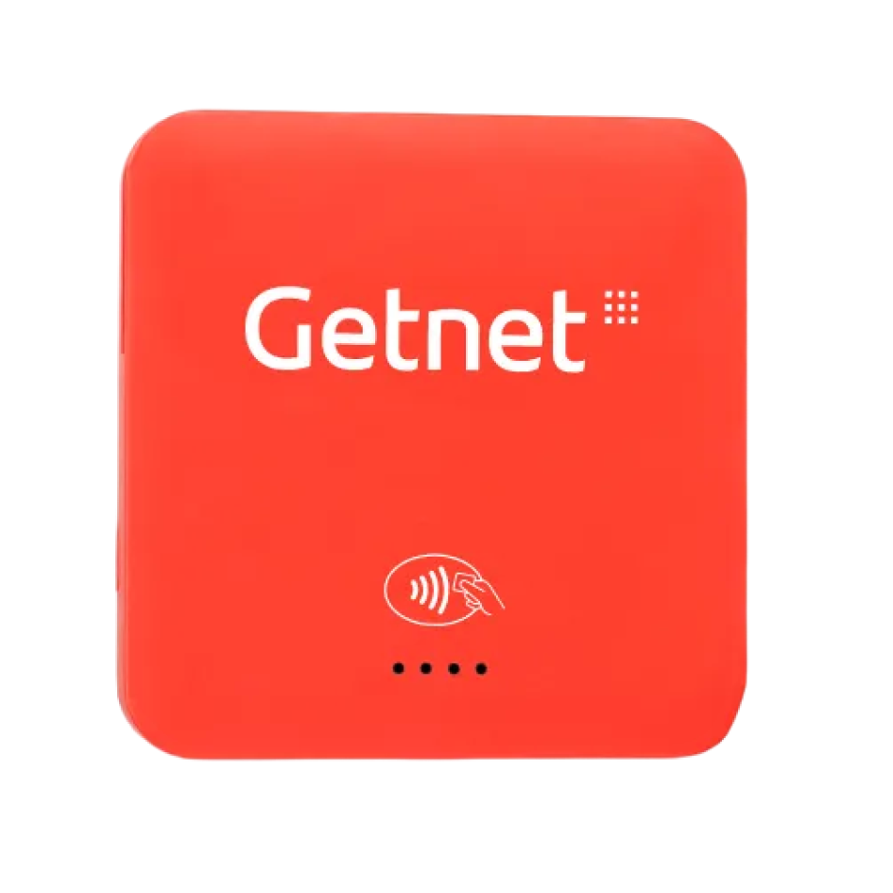

Get Mini
Argentina: Get Aparatito Chile: mPOS
Compact card reader and mini-terminal designed to accept in-person card payments anywhere
#instore #mobile #individuals #sme #retail #allindustries
Availability
Current:

Slide 9




Product
Get Mini
Value proposition main atributes
Connectivity and Mobility
Payment flexibility
Accept all credit, debit, and prepaid cards (Visa, Mastercard, Amex) using Contactless technology, chip, and magnetic stripe, all under the highest security standards.
A compact, wireless device that fits in your pocket. Connect it via Bluetooth to your phone or tablet and turn your business into a mobile point of sale, allowing you to sell wherever you are.
Real-Time Sales Management
Direct Settlement
Receive the money from your sales quickly and directly into your bank account. A simple "pay-per-use" model where you only pay a commission per transaction, with no fixed maintenance costs.
Control your business from the Getnet App. Access your full transaction history, send digital receipts to your customers, and monitor your performance in real time.

