Slide 1

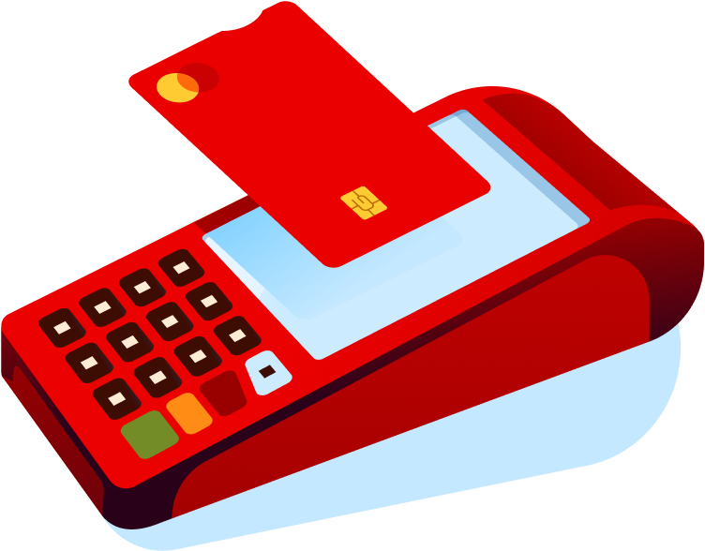

Integrated POS (Android)
Chile: POS integrado
España, Portugal: Get Central
Integrated POS (Android) unifies sales management and payment processing into a single, all-in-one device.
#instore #sme #allsegments #allindustries
Availability
Current:

Slide 2



Product
Integrated POS (Android)
Value proposition main atributes
Seamless Checkout Integration
Automated Operational Efficiency
Easily integrates with your existing cash register system, unifying your sales process. This versatility ensures a smooth payment experience without changing how you manage your store’s workflow.
Minimize manual tasks and eliminate human typing errors. By automating your sales control, you reduce the effort required for daily operations, ensuring accuracy even during high-demand peak seasons.
High-Speed Performance & Versatility
Real-Time Business Intelligence
A fast and elegant terminal designed to handle high transaction volumes effortlessly. Offer your customers a reliable, contactless, and agile payment experience that keeps your checkout line moving.
Gain full control with 24/7 access to your Merchant Portal. Monitor sales in real-time, access detailed reports, and perform online cancellations or exports from a single, unified dashboard.

Slide 3


























Product
Integrated POS (Android)
Country capabilities
Features
Argentina
Brasil
Chile
México
Uruguay
España
Portugal
Sales Purchase
In Roadmap
Not Available
Available
Available
Available
Available
Not Available
Cancellation void
Not Available
Not Available
Not Available
Not Available
Available
Not Available
Not Available
Partial cancellation void
Not Available
Not Available
Not Available
Not Available
Available
Not Available
Not Available
Refund (total)
Not Available
Not Available
Available
Not Available
Available
Not Available
Not Available
Partial linked refund
Not Available
Not Available
Available
Not Available
Available
Not Available
Not Available
Standalone refund
Available
Not Available
Not Available
Not Available
Available
Not Available
Not Available
Installments
Available
Not Available
Available
Not Available
Available
Not Available
Not Available
Pre-authorization (authorization hold)
In Roadmap
Not Available
In Roadmap
Not Available
Available
Not Available
Not Available
Re-authorization (Pre-auth adjustments up incremental)
In Roadmap
Not Available
In Roadmap
Not Available
Available
Not Available
Not Available
Partial capture (Pre-auth adjustments down decrease)
In Roadmap
Not Available
In Roadmap
Not Available
Available
Not Available
Not Available
Deferred authorization
Not Available
Not Available
Not Available
Not Available
Available
Not Available
Not Available
Table continues in next slide

Slide 4




Product
Integrated POS (Android)
Features
Argentina
Brasil
Chile
México
Uruguay
España
Portugal
Forced post (straight to settlement)
Not Available
Not Available
Not Available
Not Available
Not Available
Not Available
Not Available
Manual and automatic cut-over
Available
Not Available
Available
Available
Available
Available
Not Available
Payouts
Not Available
Not Available
Not Available
Not Available
Not Available
Not Available
Not Available
Check-in/Check-out Cancel Capture Increment/Decrement
Not Available
Not Available
In Roadmap
Not Available
Available
Not Available
Not Available
Dynamic Billing Descriptor
Not Available
Not Available
Not Available
Not Available
Not Available
Not Available
Not Available
Soft Descriptor
Not Available
Not Available
Not Available
Not Available
Not Available
Not Available
Not Available
BIN lookup
Available
Not Available
Not Available
Not Available
Available
Not Available
Not Available
Client originated additional ID transaction
Available
Not Available
Available
Available
Available
Available
Not Available
Antifraud
Not Available
Not Available
Available
Not Available
Not Available
Not Available
Not Available
Purchase with tip
Available
Not Available
Available
Not Available
Available
Not Available
Not Available
Purchase with donation
Not Available
Not Available
Not Available
Not Available
Not Available
Not Available
Not Available
Cashback with purchase
In Roadmap
Not Available
Available
Not Available
Available
Not Available
Not Available
Cashback without purchase
Not Available
Not Available
Not Available
Not Available
Not Available
Not Available
Not Available
Table continues in next slide

Slide 5



Product
Integrated POS (Android)
Features
Argentina
Brasil
Chile
México
Uruguay
España
Portugal
Receipt Paper
Not Available
Not Available
Available
Not Available
Available
Not Available
Not Available
Receipt Digital
Available
Not Available
Not Available
Available
Available
Available
Not Available
Receipt QR
Not Available
Not Available
Not Available
Not Available
Not Available
Not Available
Not Available
Offline transactions
Not Available
Not Available
Not Available
Not Available
Not Available
Not Available
Not Available
Multiple Users ID
Not Available
Not Available
Not Available
Not Available
Not Available
Not Available
Not Available
APP Store
Not Available
Not Available
Available
Not Available
Not Available
Not Available
Not Available

Slide 6






Product
Integrated POS (Android)
VAS
Argentina
Brasil
Chile
México
Uruguay
España
Portugal
Auttar
Not Available
Not Available
Not Available
Not Available
Not Available
Not Available
Not Available
Benefit Cards
Not Available
Not Available
Not Available
Not Available
Not Available
Not Available
Not Available
Bill Payments
Not Available
Not Available
Available
Not Available
Not Available
Not Available
Not Available
Chatbot
Not Available
Not Available
Not Available
Not Available
Not Available
Not Available
Not Available
Crediário
Not Available
Not Available
Not Available
Not Available
Not Available
Not Available
Not Available
Cross Border Payments EX
Not Available
Not Available
Not Available
Not Available
Not Available
Not Available
Not Available
Digital Account Services
Not Available
Not Available
Not Available
Not Available
Not Available
Not Available
Not Available
Dynamic Currency Conversion (DCC)
Not Available
Not Available
In Roadmap
Not Available
Available
Not Available
Not Available
Dynamic Working Capital (DWC SCD)
Not Available
Not Available
In Roadmap
Available
Not Available
Not Available
Not Available
Gas Station Solution
Not Available
Not Available
Not Available
Not Available
Available
Not Available
Not Available
GStore
Not Available
Not Available
Not Available
Not Available
Not Available
Not Available
Not Available
Insurance
Not Available
Not Available
Not Available
Not Available
Available
Not Available
Not Available
Last Level
Not Available
Not Available
Available
Not Available
Not Available
Not Available
Not Available
Table continues in next slide

Slide 7



Product
Integrated POS (Android)
VAS
Argentina
Brasil
Chile
México
Uruguay
España
Portugal
Loyalty Rewards
Not Available
Not Available
Not Available
Not Available
Not Available
Not Available
Not Available
Mobile Top-Up
Not Available
Not Available
Not Available
Not Available
Not Available
Not Available
Not Available
Multi-Currency Pricing Multi-Currency Conversion (MCP MCC)
Not Available
Not Available
In Roadmap
Not Available
Not Available
Not Available
Not Available
Restaurant Solution
Not Available
Not Available
Not Available
Not Available
Available
Not Available
Not Available
Sales Advance
Not Available
Not Available
Not Available
Not Available
Available
Not Available
Not Available
Smart Rating_
Not Available
Not Available
Not Available
Not Available
Not Available
Not Available
Not Available
TaFace
Not Available
Not Available
Not Available
Not Available
Available
Not Available
Not Available

Slide 8

Product
Integrated POS (Android)
Payment Methods
Argentina
Brasil
Chile
México
Uruguay
España
Portugal
Visa
In Roadmap
Not Available
Available
Available
Available
Available
Not Available
Mastercard
In Roadmap
Not Available
Available
Available
Available
Available
Not Available
Maestro
In Roadmap
Not Available
Available
Available
Not Available
Available
Not Available
American Express
In Roadmap
Not Available
Available
Available
Available
Available
Not Available
Discover
Not Available
Not Available
Not Available
Available
Not Available
Available
Not Available
Diners Club
Not Available
Not Available
Not Available
Available
Not Available
Available
Not Available
China UnionPay
Not Available
Not Available
Not Available
Available
Not Available
Available
Not Available
Japanese Credit Bureau
Not Available
Not Available
Not Available
Not Available
Available
Not Available

Slide 9




















Product
Integrated POS (Android)
Payment Methods / Local Schemes & APM
Argentina
Brasil
Chile
Colombia
México
Uruguay
España
Portugal
SISCARD (Roadmap)
Cabal (Roadmap)
Naranja (Roadmap)
Local Schemes
Carnet
Cabal
OCA
MODO (Roadmap)
Banco Santander (App)
PiX (Roadmap)
PiX (Third Party - Plexo)
Toke
QR Payments
CoDi
Bizum
Apple Pay
Google Pay
Samsung Pay
Apple Pay
Google Pay
Mercado Pago (Roadmap)
Apple Pay
Google Pay
Samsung Pay
Pay Pal
Wallets
Apple Pay
Google Pay
Sodexo
Alelo
Ticket VR Beneficios Pluxee
Voucher

