Slide 1



Crediário
Merchant-financed installments offering higher conversion, ticket uplift, and full credit control.
Availability
Current:

Slide 2


Product
Crediário
Value proposition main atributes
Merchant-Focused Installments
Higher Tickets, Zero Risk
Allow cardholders to split purchases into up to 48 installments directly at your POS, boosting your sales while you receive the full payment upfront in just 2 days.
Make high-value products accessible to your customers' budgets, increasing your average ticket size without taking on any default or credit risk.
Flat-Rate Cost Control
Drive Retention & Loyalty
Maintain total predictability over your margins with a single, flat fee per sale, regardless of the number of installments chosen by the cardholder.
Offering flexible, on-the-spot financing creates a frictionless checkout that brings customers back, driving long-term repeat business for your store.

Slide 3

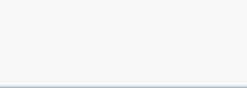
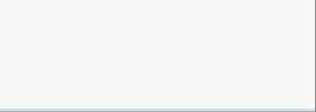














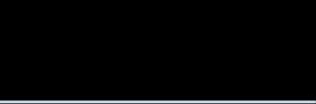


Product
Crediário
Country capabilities
Availability by product
Argentina
Brasil
Chile
México
Uruguay
España
Portugal
Get Classic (Linux based POS)
Not Available
Available
Not Available
Not Available
Not Available
Not Available
Not Available
Get Smart (Android based POS)
Not Available
Available
Not Available
Not Available
Not Available
Not Available
Not Available
Tap on Phone (Smartphone)
Not Available
Not Available
Not Available
Not Available
Not Available
Not Available
Not Available
Get Mini (mPOS de Linux)
Not Available
Not Available
Not Available
Not Available
Not Available
Not Available
Not Available
Integrated POS (Android POS)
Not Available
Not Available
Not Available
Not Available
Not Available
Not Available
Not Available
Pinpad TEF (Linux or Android terminal)
Not Available
Available
Not Available
Not Available
Not Available
Not Available
Not Available
SEP Regional API
Not Available
Not Available
Not Available
Not Available
Not Available
Not Available
Not Available
Web Checkout iFrame
Not Available
Not Available
Not Available
Not Available
Not Available
Not Available
Not Available
Web Checkout Redirect
Not Available
Not Available
Not Available
Not Available
Not Available
Not Available
Not Available
Web Checkout LightBox
Not Available
Not Available
Not Available
Not Available
Not Available
Not Available
Not Available
Web Checkout API
Not Available
Not Available
Not Available
Not Available
Not Available
Not Available
Not Available
Table continues in next slide

Slide 4


Product
Crediário
Availability by product
Argentina
Brasil
Chile
México
Uruguay
España
Portugal
Get Link & Pay
Not Available
Not Available
Not Available
Not Available
Not Available
Not Available
Not Available
Get Link & Pay API
Not Available
Not Available
Not Available
Not Available
Not Available
Not Available
Not Available
SEP Direct API
Not Available
Not Available
Not Available
Not Available
Not Available
Not Available
Not Available
Recurrent Payments
Not Available
Not Available
Not Available
Not Available
Not Available
Not Available
Not Available
GCommerce
Not Available
Not Available
Not Available
Not Available
Not Available
Not Available
Not Available
MOTO (Virtual Terminal)
Not Available
Not Available
Not Available
Not Available
Not Available
Not Available
Not Available

