Slide 1
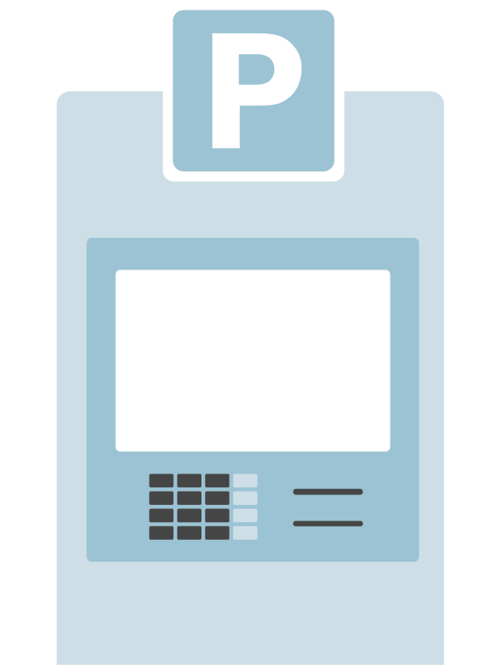


Get Automatic
Chile: Auto atendido
Unattended payment solution for self-service points, enabling secure and continuous staff-free operations
#instore #largecorps #allsegments #allindustries
Availability
Current:
Upcoming:

Slide 2




Product
Get Automatic
Value proposition main atributes
Uninterrupted Availability
Operations Control
Manage all your self-checkout POS operations centrally from your management software or the Getnet platform.
Self-checkout system designed to operate without staff or time limits, increasing business sales opportunities.
Autonomy and Speed
Point of Service Integration
Provides an intuitive user experience that eliminates waiting times and streamlines every payment process.
Versatile solution located directly at pumps, machines, or lockers.

