Slide 1



GetBot
Get Bot provides instant, self-service support for paper roll requests, billing inquiries, case tracking, and technical terminal checks, all in real time without an agent
#digital #midmarket #allindustries
Availability
Current:

Slide 2


Product
GetBot
Value proposition main atributes
Global Conversational Automation
Scalable Customer Self-Service
Enables your users to resolve inquiries independently. This allows your business to easily handle higher support volumes without increasing operational headcount or costs.
A secure, global service that automates customer interactions for payments and service requests, streamlining your daily operations through structured digital journeys.
Payment & Collection Orchestration
Multi-Channel Availability
Coordinates and manages transactions and customer support seamlessly across multiple digital channels, keeping your business active and ready to collect payments 24/7.
Unifies payments, collections, and recurring financial processes within the chat flow, speeding up conversion and ensuring a smooth checkout experience.

Slide 3

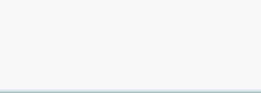
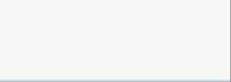


















Product
GetBot
Country capabilities
Availability by product
Argentina
Brasil
Chile
México
Uruguay
España
Portugal
Get Classic (Linux based POS)
Not Available
Not Available
Not Available
Not Available
Not Available
Get Smart (Android based POS)
Not Available
Not Available
Not Available
Not Available
Not Available
Tap on Phone (Smartphone)
Not Available
Not Available
Not Available
Not Available
Not Available
Get Mini (mPOS de Linux)
Not Available
Not Available
Not Available
Not Available
Not Available
Integrated POS (Android POS)
Not Available
Not Available
Not Available
Not Available
Not Available
Not Available
Pinpad / TEF (Linux or Android terminal)
Not Available
Not Available
Not Available
Not Available
Not Available
SEP Regional API
Not Available
Not Available
Not Available
Not Available
Not Available
Web Checkout iFrame
Not Available
Not Available
Not Available
Available
Not Available
Web Checkout Redirect
Not Available
Not Available
Not Available
Available
Not Available
Web Checkout LightBox
Not Available
Not Available
Not Available
Available
Not Available
Web Checkout API
Not Available
Not Available
Not Available
Not Available
Not Available
Table continues in next slide

Slide 4








Product
GetBot
Argentina
Brasil
Chile
México
Uruguay
España
Portugal
Get Link & Pay
Not Available
Not Available
Not Available
Available
Not Available
Get Link & Pay API
Not Available
Not Available
Not Available
Available
Not Available
SEP Direct API
Not Available
Not Available
Not Available
Not Available
Not Available
GCommerce
Not Available
Not Available
Not Available
Not Available
Not Available
MOTO (Virtual Terminal)
Not Available
Not Available
Not Available
Not Available
Not Available

