Slide 1

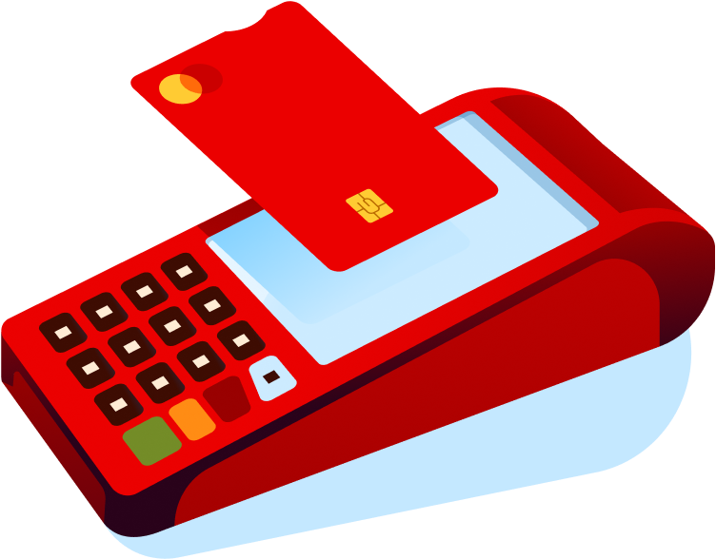

Get Classic
Chile: POS Brasil: Get Clássica
POS terminal for physical stores, providing a secure way to accept card and digital wallet payments
#instore #sme #allsegments #allindustries
Availability
Current:

Slide 2



Product
Get Classic
Value proposition main atributes
Operational Independence
Tailored for you
A flexible solution that evolves with the size of your business
Robust terminal for physical stores that operates without relying on a phone or external app.
Centralized Control
Stability and Security
Comprehensive management via the Getnet Portal for reports, voids, and refund management.
Linux-based system ensuring high performance and compliance with global security standards.

Slide 3





















Product
Get Classic
Country capabilities
Features
Argentina
Brasil
Chile
México
Uruguay
España
Portugal
Sales / Purchase
Available
Available
Available
Available
Available
Available
Available
Cancellation / void
Available
Available
Available
Available
Available
Available
Available
Partial cancellation / void
Not Available
Not Available
Available
Not Available
Available
Not Available
Not Available
Refund (total)
Available
Available
Available
Available
Available
Available
Available
Partial linked refund
Available
Available
Available
Available
Available
Available
Available
Standalone refund
Available
Not Available
Not Available
Not Available
Available
Not Available
Not Available
Installments
Available
Not Available
Available
Available
Available
Not Available
Not Available
Pre-authorization (authorization hold)
Not Available
Available
Not Available
Available
Not Available
Available
Available
Re-authorization (Pre-auth adjustments up / incremental)
Not Available
Available
Not Available
Available
Not Available
Not Available
Not Available
Partial capture (Pre-auth adjustments down / decrease)
Not Available
Available
Not Available
Not Available
Not Available
Not Available
Not Available
Deferred authorization
Not Available
Not Available
Not Available
Not Available
Not Available
Not Available
Not Available
Table continues in next slide

Slide 4








Product
Get Classic
Argentina
Brasil
Chile
México
Uruguay
España
Portugal
Forced post (straight to settlement)
Not Available
Not Available
Not Available
Available
Not Available
Not Available
Not Available
Manual and automatic cut-over
Not Available
Not Available
Available
Available
Available
Available
Available
Payouts
Not Available
Not Available
Not Available
Not Available
Not Available
Not Available
Not Available
Check-in/Check-out Cancel | Capture | Increment/Decrement
Not Available
Available
Not Available
Available
Not Available
Not Available
Not Available
Dynamic Billing Descriptor
Not Available
Not Available
Not Available
Not Available
Not Available
Not Available
Not Available
Soft Descriptor
Not Available
Not Available
Not Available
Not Available
Not Available
Not Available
Not Available
BIN lookup
Available
Available
Not Available
Not Available
Available
Not Available
Not Available
Client originated additional ID transaction
Not Available
Not Available
Not Available
Not Available
Not Available
Not Available
Antifraud
Available
Available
Available
Available
Not Available
Not Available
Not Available
Purchase with tip
Available
Not Available
Available
Available
Available
Not Available
Available
Purchase with donation
Not Available
Available
Not Available
Not Available
Not Available
Not Available
Not Available
Cashback with purchase
Not Available
Not Available
Available
Available
Available
Not Available
Not Available
Cashback without purchase
Not Available
Not Available
Not Available
Not Available
Not Available
Not Available
Not Available
Receipt Paper
Available
Available
Available
Available
Available
Available
Available
Table continues in next slide

Slide 5



Product
Get Classic
Argentina
Brasil
Chile
México
Uruguay
España
Portugal
Receipt Digital
Not Available
Not Available
Not Available
Not Available
Not Available
Not Available
Not Available
Receipt QR
Not Available
Not Available
Not Available
Not Available
Not Available
Not Available
Not Available
Offline transactions
Not Available
Not Available
Not Available
Not Available
Not Available
Not Available
Not Available
Multiple Users ID
Not Available
Not Available
Not Available
Not Available
Not Available
Not Available
Not Available
APP Store
Not Available
Not Available
Not Available
Not Available
Not Available
Not Available
Not Available

Slide 6






Product
Get Classic
VAS
Argentina
Brasil
Chile
México
Uruguay
España
Portugal
Auttar
Not Available
Not Available
Not Available
Not Available
Not Available
Not Available
Not Available
Benefit Cards
Not Available
Not Available
Not Available
Not Available
Not Available
Not Available
Not Available
Bill Payments
Not Available
Not Available
Not Available
Not Available
Not Available
Not Available
Not Available
Chatbot
Not Available
Not Available
Not Available
Not Available
Not Available
Not Available
Not Available
Crediário
Not Available
Available
Not Available
Not Available
Not Available
Not Available
Not Available
Cross Border Payments - FX
Not Available
Not Available
Not Available
Not Available
Not Available
Not Available
Not Available
Digital Account Services
Not Available
Not Available
Not Available
Not Available
Not Available
Not Available
Not Available
Dynamic Currency Conversion (DCC)
Not Available
Available
Not Available
Available
Not Available
Available
Available
Dynamic Working Capital (DWC / SCD)
Not Available
Available
Not Available
Available
Not Available
Not Available
Not Available
Gas Station Solution
Not Available
Not Available
Not Available
Not Available
Available
Not Available
Not Available
GStore
Not Available
Available
Not Available
Not Available
Not Available
Not Available
Not Available
Insurance
Not Available
Not Available
Not Available
Not Available
Not Available
Not Available
Not Available
Last Level
Not Available
Available
Not Available
Not Available
Not Available
Not Available
Not Available
Table continues in next slide

Slide 7



Product
Get Classic
Argentina
Brasil
Chile
México
Uruguay
España
Portugal
Loyalty & Rewards
Not Available
Available
Not Available
Not Available
Not Available
Not Available
Not Available
Mobile Top-Up
Not Available
Not Available
Not Available
Not Available
Not Available
Not Available
Not Available
Multi-Currency Pricing / Multi-Currency Conversion (MCP / MCC)
Not Available
Not Available
Not Available
Not Available
Not Available
Not Available
Not Available
Restaurant Solution
Not Available
Not Available
Not Available
Not Available
Available
Not Available
Not Available
Sales Advance
Not Available
Available
Not Available
Not Available
Available
Not Available
Not Available
Smart Rating
Not Available
Not Available
Not Available
Not Available
Not Available
Not Available
Not Available
TaFace
Not Available
Not Available
Not Available
Not Available
Available
Not Available
Not Available

Slide 8
















Product
Get Classic
Payment Methods
Argentina
Brasil
Chile
México
Uruguay
España
Portugal
Visa
Available
Available
Available
Available
Available
Available
Available
Mastercard
Available
Available
Available
Available
Available
Available
Available
American Express
Available
Available
Available
Available
Available
Available
Available
Discover
Not Available
Available
Not Available
Available
In Roadmap
Available
Available
Diners Club
Not Available
Available
Not Available
Available
In Roadmap
Available
Available
China UnionPay
Not Available
Not Available
Not Available
Available
Not Available
Available
Available
Japanese Credit Bureau
Not Available
Not Available
Not Available
Not Available
Not Available
Available
Not Available

Slide 9





















Product
Get Classic
Payment Methods / Local Schemes & APM
Argentina
Brasil
Chile
México
Uruguay
España
Portugal
Local Schemes
Cabal / Naranja / SISCARD
Boleto / Elo / Hipercard
Carnet / OxxO / OptBLUE AMEX
Cabal / OCA
Banco Santander (App) / PiX (Roadmap)
Pix (Third Party - Plexo) / Toke
QR Payments
Apple Pay / Google Pay / Samsung Pay
Apple Pay / Google Pay / Samsung Pay
Apple Pay / Google Pay / Samsung Pay / PayPal
Apple Pay / Google Pay / Samsung Pay
Wallets
Apple Pay / Google Pay
Apple Pay / Google Pay
Apple Pay / Google Pay
Sodexo / Alelo / Ticket / VR Beneficios / Pluxee
Voucher
Sodexo / Edenred

