Slide 1




Card Not Present - Regional Solutions
SEP Regional Card-Not-Present (CNP) is Getnet’s unified digital payments platform that enables online and remote commerce across multiple countries via a single integration, eliminating the need for separate local connections, contracts, or operational models through three complementary solutions, all delivered from a centralized regional platform: API, Web Checkout & Pay by Link.
API
One platform - Multiple merchants needs
SEP enables merchants to select the integration model that best fits their business, technical capabilities, and compliance requirements.
All solutions share a common operating model, regional coverage, centralized management, standardized reporting, and a consistent payment processing experience, providing a scalable foundation for growth across markets.
Web Checkout
Pay by Link

Slide 2



Card Not Present
In Card Not Present transactions the card is not physically presented or read by a POS terminal, but occur remotely and are processed through digital or back-office channels.
E-commerce websites and mobile sites.
In-app Payments
Mail Order / Telephone Order (MOTO)
Processing payments within merchant or marketplace applications.
Implementation of payment gateways on web platforms and mobile sites, enabling secure transactions.
Solutions for mail or telephone orders, managed through call centers and virtual terminals.
Subscriptions, recurring and merchant-initiated payments
Digital wallets and "one-click" checkouts
Management of automated and merchant-initiated charges through the use of stored credentials.
Fast payment experiences where credentials are stored in the cloud, allowing checkout with a single click.

Slide 3


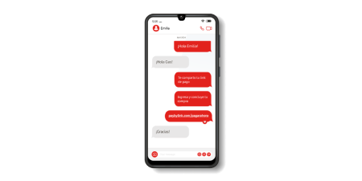







Card Not Present - Regional Solutions Products
SEP Direct API CNP
Global Pay by Link
Single PCI-compliant API for processing CNP payments across multiple countries through single technical entry point.
Accept online payments by sending secure payment links, with no physical POS or e-commerce required.
Regional Web Checkout
Recurring Payments SEP
A hosted e-commerce solution that enables online payments without managing card-entry pages, providing an integration model across multiple countries.
Automates recurring card payments using a secure, tokenized billing model.

Slide 4

































Card Not Present - Regional Solutions Products | Availability by Country
Products
Argentina
Brasil
Chile
Colombia
México
Uruguay
España
Portugal
SEP Direct API CNP
Available
Available
Available
Available
Available
Available
Available
Available
Regional Web Checkout
Available
Available
Available
In Roadmap
Available
Available
Available
Available
Global Pay by Link
Available
Available
Available
Not Available
In Roadmap
Not Available
Not Available
Not Available
Recurring Payments SEP
Available
Available
Available
Not Available
Available
Available
Not Available
Not Available

