Slide 1

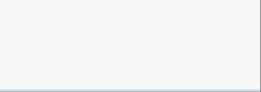















Card Not Present - Local solutions
Local Solutions are online payment products delivered through local acquiring platforms in each country. The underlying platform varies by geography: each country´s Local Solutions are powered by a different provider.
Platform
Argentina
Brasil
Chile
México
Uruguay
España
Portugal
Get Tech
Available
Get BR
Available
Evertec
Available
Available
MIT
Available
Redsys
Available
SIBS
Available

Slide 2


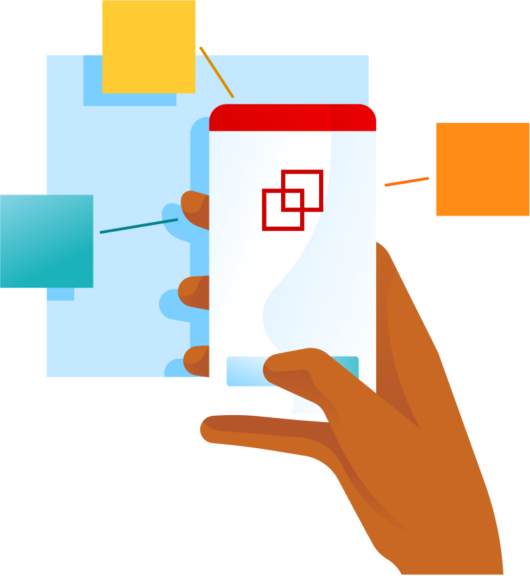
Card Not Present
In Card Not Present transactions the card is not physically presented or read by a POS terminal, but occur remotely and are processed through digital or back-office channels.
E-commerce websites and mobile sites.
In-app Payments
Mail Order / Telephone Order (MOTO)
Processing payments within merchant or marketplace applications.
Implementation of payment gateways on web platforms and mobile sites, enabling secure transactions.
Solutions for mail or telephone orders, managed through call centers and virtual terminals.
Subscriptions, recurring and merchant-initiated payments
Digital wallets and "one-click" checkouts
Management of automated and merchant-initiated charges through the use of stored credentials.
Fast payment experiences where credentials are stored in the cloud, allowing checkout with a single click.

Slide 3


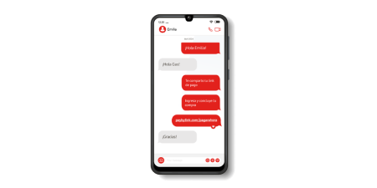
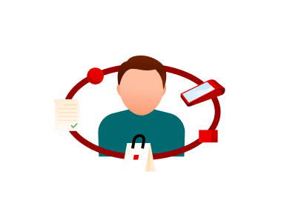


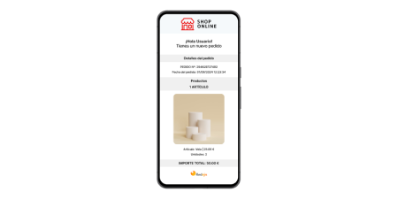



Card Not Present - Local solutions Products
Get Checkout
Get Link & Pay
Recurring Payments
Low-code payment solution that embeds a secure, hosted e-commerce checkout across three delivery options: iFrame, Lightbox, and Redirect
Muulti-country remote payment solution that enables online sales via payment links or a single API without a physical POS.
Automates recurring card payments through a secure, tokenized billing model with a single integration, adapting to local market rules.
Get Social Selling
Getnet Click
Sell online without the need for a website by sharing products on social media with full PCI compliance.
Portable pocket mPOS solution for quick card payments.

Slide 4













Card Not Present - Local solutions Products | Availability by Country
Products
Argentina
Brasil
Chile
México
Uruguay
España
Portugal
Get Checkout
Available
Available
Available
Available
Available
Available
Available
Get Link & Pay
Available
Available
Available
Available
Available
Available
Available
Recurring Payments
Available
Available
Available
Available
Available
Available
Available
Get Social Selling
Not Available
Not Available
Not Available
Not Available
Not Available
Available
Available
Getnet Click
Not Available
Not Available
Available
Not Available
Not Available
Not Available
Not Available

