Slide 1

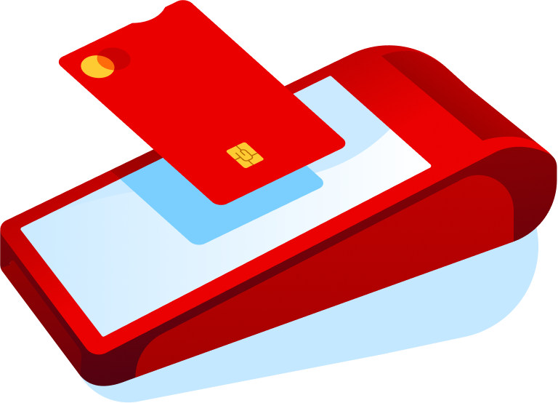

Card Present Solutions
Transactions where the customer and the payment device are in the same location, and the card (or NFC device) is read directly by a certified terminal.
Types of solutions
Attended POS
Semi-Attended POS
Unattended POS
It is the classic point of sale where a cashier operates the terminal and guides the customer during payment.
Self-service terminals where the customer initiates and completes the payment, but staff are nearby to assist if needed.
Fully autonomous devices with no staff in inmediate proximity.
Mobile POS & SPoC
SoftPOS
Centralized CP Platforms / Architectures
Portable POS devices or solutions where a smartphone or tablet plus a secure card reader is used to accept payments on the move.
Allows converting a common commercial device (like an Android phone) into a payment terminal through software.
Architectures that connect and manage different terminal types through a single platform.

Slide 2





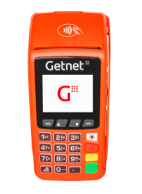

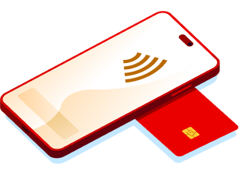
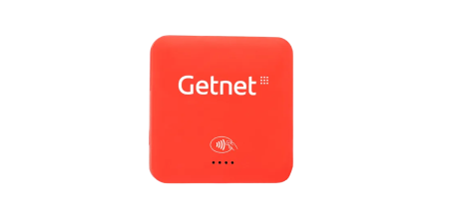
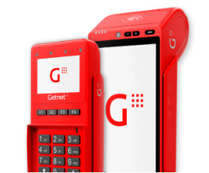







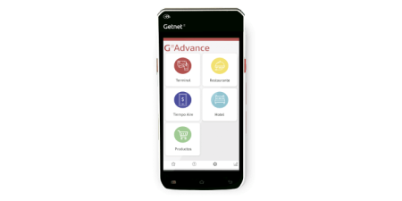
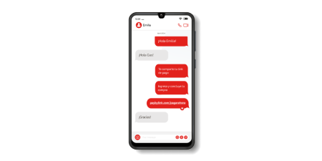




Card Present - Local Solutions Products
Get Classic
Get Smart
Tap on Phone
Get Mini
PinPad / TEF
POS terminal for physical stores, providing a secure way to accept card payments and digital wallets.
A smart Android POS for in-store payments and business management.
Turn your Android phone into a POS to accept contactless payments without a physical terminal.
Compact card reader and mini-terminal designed to accept in-person card payments anywhere.
Integrated payment solution that connects a merchant's POS with a secure PIN pad to streamline card transactions.
Get Central
Get Automatic
Get Advance
Get QR
Integrated POS (Android) unifies sales management and payment processing into a single, all-in-one device.
Unattended payment solution for self-service points, allowing secure and continuous operations without staff.
Compact and lightweight mobile terminal with unlimited connectivity, designed to optimize operations and take your business anywhere.
Payment solution for processing transactions by scanning QR codes with mobile devices.

Slide 3
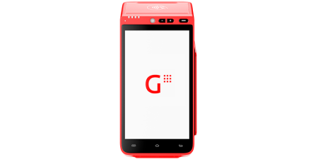

Card Present - Regional Solutions Products
SEP Regional API Card Present
Enables in-store card payments via a single SEP Direct API, providing a standardized entry point for consistent integration across markets.

Slide 4























Card Present - Local and Regional Solutions Products | Availability by Country
Products
Argentina
Brasil
Chile
México
Uruguay
España
Portugal
Getnet Classic
Available
Available
Available
Available
Available
Available
Available
Get Smart
Available
Available
Available
Available
Available
Available
Available
Tap on Phone
Available
Available
In Roadmap
Available
In Roadmap
Available
Available
Get Mini
Available
Available
Available
Available
Not Available
Available
Available
PinPad / Tef (terminal Linux or Android)
In Roadmap
Available
Available
Available
Available
Available
Available
Get Central
In Roadmap
Not Available
Available
Available
Available
Available
Not Available
Get Automatic
Not Available
Not Available
Available
Available
In Roadmap
Available
Not Available
Get Advance
Not Available
Not Available
Not Available
Available
Not Available
Not Available
Not Available
Get QR
Available
Available
Available
Not Available
Not Available
Not Available
Not Available
SEP Regional API Card Present
Available
In Roadmap
Available
Available
In Roadmap
In Roadmap
In Roadmap

