Slide 1



Bill payments
Chile: Get servicios
México: Pagos de servicios
An enterprise-grade, country-aware payment solution that scales global collections and centralizes financial reconciliation
#portals #largecorps #allindustries
Availability
Current:

Slide 2

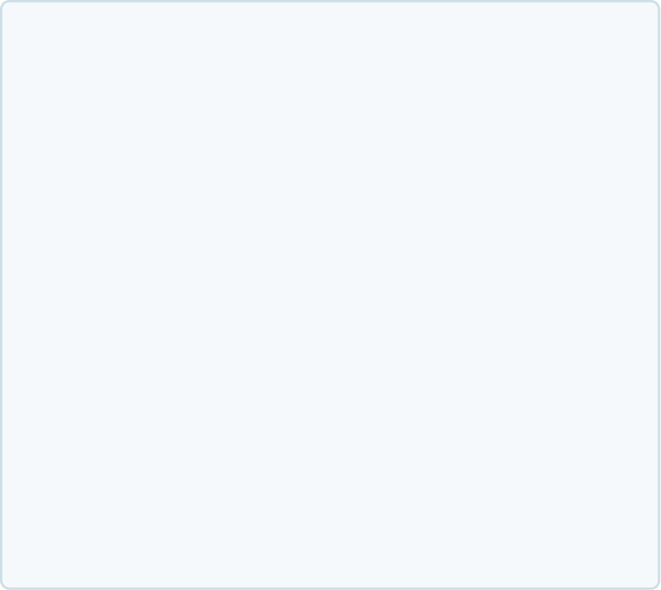
Product
Bill Payments
Value proposition main atributes
Expanded Customer Services
Additional Revenue Stream
Enable merchants to offer utility and service bill payments directly through their existing POS, increasing the value provided to customers.
Generate incremental income through commissions earned on every bill payment transaction, without additional payment infrastructure.
Increased Customer Footfall
Seamless POS Experience
Attract repeat customer visits by providing convenient access to everyday payment services in a trusted local location.
Process bill payments through the existing POS environment with a simple, familiar workflow and minimal operational impact.

Slide 3

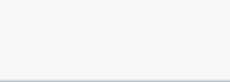
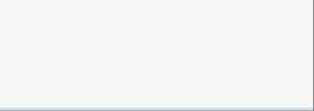






















Product
Bill Payments
Country capabilities
Availability by product
Argentina
Brasil
Chile
México
Uruguay
España
Portugal
Get Classic (Linux based POS)
Not Available
Not Available
Not Available
Not Available
Not Available
Get Smart (Android based POS)
Not Available
Not Available
Available
Not Available
Not Available
Tap on Phone (Smartphone)
Not Available
Not Available
Not Available
Not Available
Not Available
Get Mini (mPOS de Linux)
Not Available
Not Available
Not Available
Not Available
Not Available
Integrated POS (Android POS)
Not Available
Not Available
Available
Not Available
Not Available
Not Available
Pinpad / TEF (Linux or Android terminal)
Not Available
Not Available
Not Available
Not Available
Not Available
SEP Regional API
Not Available
Not Available
Not Available
Not Available
Not Available
Web Checkout iFrame
Not Available
Not Available
Not Available
Not Available
Not Available
Web Checkout Redirect
Not Available
Not Available
Not Available
Not Available
Not Available
Web Checkout LightBox
Not Available
Not Available
Not Available
Not Available
Not Available
Web Checkout API
Not Available
Not Available
Not Available
Not Available
Not Available
Table continues in next slide

Slide 4










Product
Bill Payments
Argentina
Brasil
Chile
México
Uruguay
España
Portugal
Get Link & Pay
Not Available
Not Available
Not Available
Not Available
Not Available
Get Link & Pay API
Not Available
Not Available
Not Available
Not Available
Not Available
SEP Direct API
Not Available
Not Available
Not Available
Not Available
Not Available
Recurrent Payments
Not Available
Not Available
Not Available
Not Available
Not Available
GCommerce
Not Available
Not Available
Not Available
Not Available
Not Available
MOTO (Virtual Terminal)
Not Available
Not Available
Not Available
Not Available
Not Available

