Slide 1



COMPANY PROFILE
ATM, Self-Service & E-Payment Solutions
www.finway-eg.com
Cairo, Egypt

Slide 2
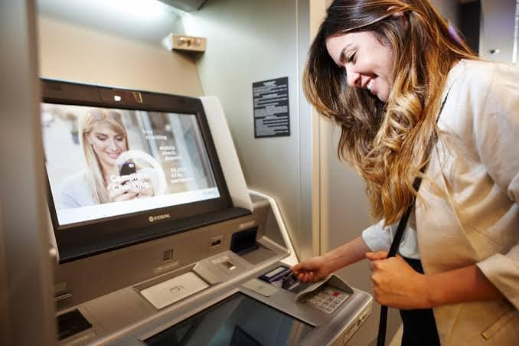

About FINWAY
Finway goal is to provide innovative, efficient solution, and trustworthy services in banking, non-banking and e-payment segments. Our consultants are armed with tools, knowledge, experience, and strategies to address the global security needs throughout a comprehensive portfolio.
Finway exclusively represents Hyosung ATMs in Egypt, Middle East & Africa, Hyosung offers a variety of hardware products to ensure that we have the solutions you need. With machines built specifically for Banking, Retail, and Business.

Slide 3
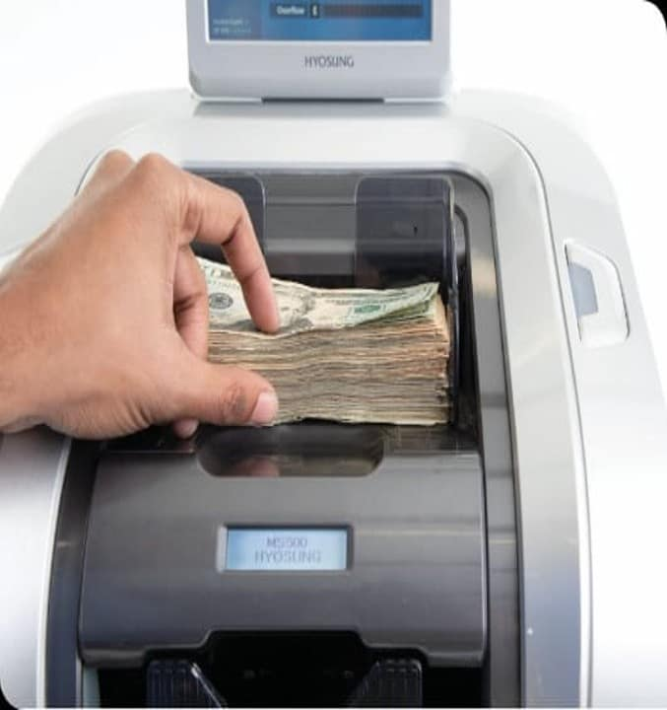






Finway TECH Services vary between
FinTech | Branch Transformation
Security | ATM Business
AI | Managed services

Slide 4


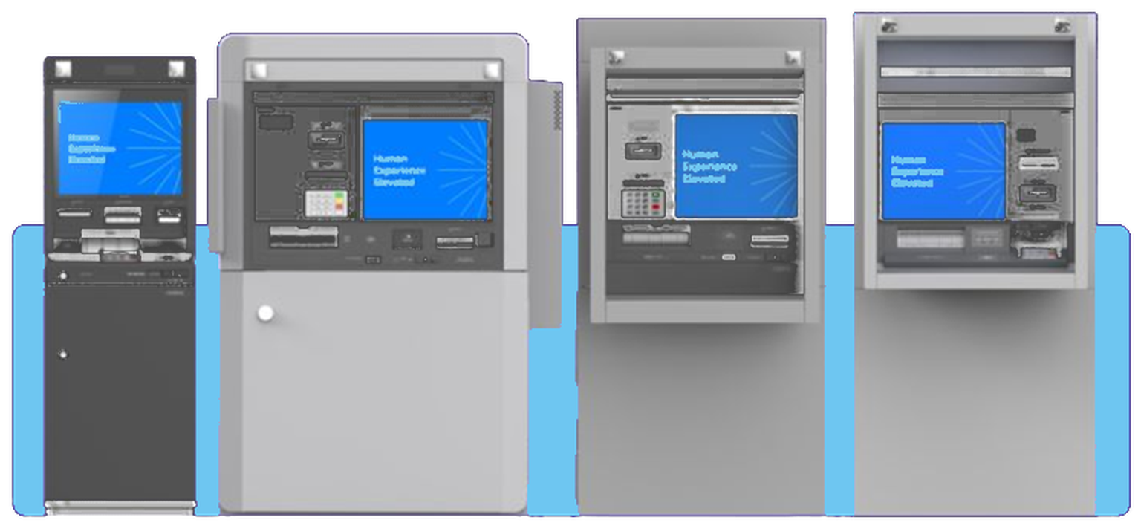

Solutions for Banks
A complete portfolio of cash and self-service banking solutions, powered by HYOSUNG technology.
Cash Recycling & Dispensing ATMs
Accept deposits, detect counterfeit notes and dispense cash — all from one recycling ATM.
TECHNOLOGY PARTNER
Hyosung
Proven banking hardware and software, delivered and integrated by Finway.
Cash Management (TCR)
Teller cash recyclers that store cash securely, backed by accurate accounting software.
Interactive Teller Machines (ITM)
Full self-service banking, with live video-teller assistance whenever customers need it.
Notes:
Banking portfolio: recycling and dispensing ATMs, TCR cash management, and ITMs with video-teller support.

Slide 5

FINWAY also provides solutions for
Self-servicing Kiosks: Finway Offers a variety of Self-Serving Kiosks like Payment Kiosks, Document handling kiosks, Ticketing kiosks, and many other types Automated kiosk solutions Finway act as a one-stop shop for all your self-service needs. We engineer, build and assemble quality self- service kiosks. incorporate powerful software applications and remote monitoring system and offer complete self-service.
E-Payments: As a means of achieving the government’s goal of financial inclusion, Finway is providing Payment Applications, Solutions, and Services for all market segments either banking or non-banking sectors.

Slide 6






Hyosung Corporation
Established in 1966
Total 135 business site in 30 countries
“New challenges bring future changes”
Global Technology Leading New Changes
36
Manufacturing Entities
39
Trading Entities/ Branches
The Hyosung Corporation serves as the holding company with three independent entities –
Hyosung TNC, Hyosung Heavy Industries, and Hyosung Chemical.
34
Trading Offices/ Sales Offices
Holding Company
  Information &
  Communication
Textile / Trading
  Power & Industrial Systems / Construction
  Chemicals
Hyosung ITX
Galaxia Electronics
Galaxia Moneytree
Galaxia Metaverse
Galaxia Device
Spandex
Nylon Polyester Fiber
Fabric Dyeing
Steel & Metal Product
Chemical Products
LED Business
Sebitseom Business
Power Systems
Industrial Machinery
Wind Energy Business
Construction
Hyosung GOODSPRINGS
Chinhung International
PP/DH
TPA
POK Business
Neochem
Film
Optical Film

Slide 7
Business Performance
“Solid Foundation as a Global Company”
We are financially strong and stable
Total Revenue
USD Million
(KRW Billion)
USD $16.5B Revenue
17,957
(21,280)
18,589
(22,667)
16,486
(21,258)
14,729
(17,806)
13,052
(15,140)
Holding Company
Operating Profit
USD Million
(KRW Billion)
USD $426M Operating Profit
2,338
(2,770)
1,137
(1,319)
852
(988)
548
(668)
426
(550)
(as of 2023)
ⓒ Hyosung TNS 2026 | Confidential, and/or proprietary information. Distribution or copying of this information is strictly prohibited
Notes:
그룹(지주사 및 4개 사업회사) 매출 금액 출처: IR 자료 (적용 환율: 1185원, 21년 12월31일 환율)
1219.3원, 22년 12월31일
1289.4원 23년 12월29일

Slide 8

Who is Hyosung TNS?
Since its establishment in 1979, Hyosung TNS has been committed to becoming a global financial IT leader by delivering innovative solutions that create exceptional banking experiences for our customers worldwide.
Establishment
1979
GLOBAL HUMAN EXPERIENCE MAKER
Improving life’s day-to-day interactions for everyone
CEO
Bryan Choi
Financial Performance
Revenue : 938M USD
(Consolidated, 2024)
‘Global Top 3’ FASTEST GROWING
ATM company in the world
Employees
3,400 (worldwide)
(600 in headquarters)
MARKET LEADER in
Production Capacity
150,000 units / year
(12,500 per month)
Recycling ATMs in US, Korea, Russia
Branch Transformation Solutions
Subsidiaries & Affiliates
14 in Overseas markets
(US, Mexico, China, Russia, Germany, UK, Spain, Poland, Italy, Türkiye, India, Indonesia, Taiwan, Vietnam)
WORLDWIDE, about 60,000 ATMs shipped annually
4 in Domestic market
(NHT, NHCMS, FMS, ATMPlus)
Notes:
22년 연결 매출 (9,950억) 환율 1219.3원 기준으로 산정 = $816,041,991
(참고: 단독 매출 7,177억원)
23년 연결 매출 (11,043억) 환율 1289.4원 기준으로 산정 = $856,444,858
(참조: 단독 매출 6,581억원)
24년 연결 매출 (13,787억) 환율 1470.0원 기준으로 산정 = $937,891,156
(참조: 단독 매출 7,548억원)

Slide 10
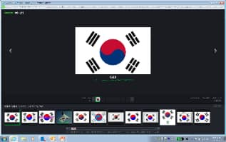
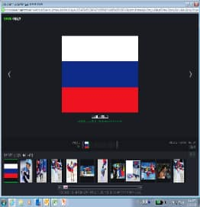

Market Position
Hyosung TNS is rapidly expanding its market presence by securing a solid business base and core competitiveness such as agility and customer-driven innovation.
Fastest Growing ATM Company In the World
True Market Leader
Global No. 3
US No. 1
No. 1 Market Share in
Rank
Manufacturer
Rank
Manufacturer
South Korea
Avg.60%
Russia
Avg.70%
66
70
76
1
“D” Company
1
Hyosung
57
63
●
57
●
●
2
“N” Company
2
“N” Company
●
●
●
3
Hyosung
3
“D” Company
2021
2022
2023
2021
2022
2023
2021
2023
Industry Leading Mover of Fintech
The United States
Avg.54%
Indonesia
Avg.44%
Branch transformation technology launched
Recycling
ATM-compatible teller cash recycler
launched
53
59
51
53
WORLD’s
Hyosung in-house developed recycling technology launched
Cloud-based MVS Platform Launched
Digital Desk™ Launched
●
49
1
●
●
31
●
ST
●
●
2023
2009
2010
2013
2017
2020
2021
2022
2023
2021
2022
2021
(Market share by annual shipment)

Slide 11



























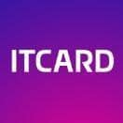




















Major Clients
Hyosung TNS has been a leading provider of financial and retail ATM solutions for over four decades. Hyosung TNS has built many successful relationships with customers around the world.

Slide 12








Research & Development
Hyosung core competencies stem from R&D capabilities that allow for ‘Agility and Flexibility’, which enables to rapidly adapt to new customer requirements and the ability to implement new innovations.
R&D Center
Own our core technologies to enable continuous innovation
R&D Expertise
Mechatronics (Media Handling Source Technology)
Recognition Tech (Computer Vision Based on AI)
System Integration (Unit & Module Layout Optimization)
Software (Application Program & Device Platform)
Fundamental
Technology
9%
Leading to
Total 360 ¹⁾
46% Software Experts
3,267
Design & Technology Patents
System Experts
45%
Self-Service
Experiences
Emerging
Experiences
Green
Technology
¹⁾ Total 360 professional engineers - manpower across all development fields

Slide 13




Core Competencies
Hyosung invent and apply real solutions that work, and focus on Innovation, Engineering, and Superior Customer Service.
Customer Centricity
Deliver customer centric solutions to meet our clients’ specific requirements
Offer branch transformation solutions to reduce the TCO to customers
01
Customer
Centricity
In-House Core Modules
Develop key modules based on our own capabilities (including BRM, CCIM, BCA, CDU)
Ensure high quality, speed to market, and easy to fix problems
R&D
capability
Vertical Integration
Provide a full range of technical services
Firmware/mechanic modules to hardware/system
Provide ATM related software and outsourcing services
In-House
02 Core Modules
Vertical Integration 03

Slide 14
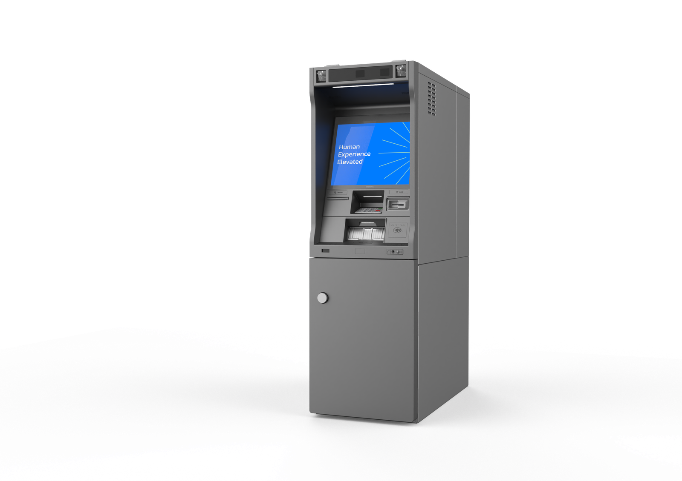
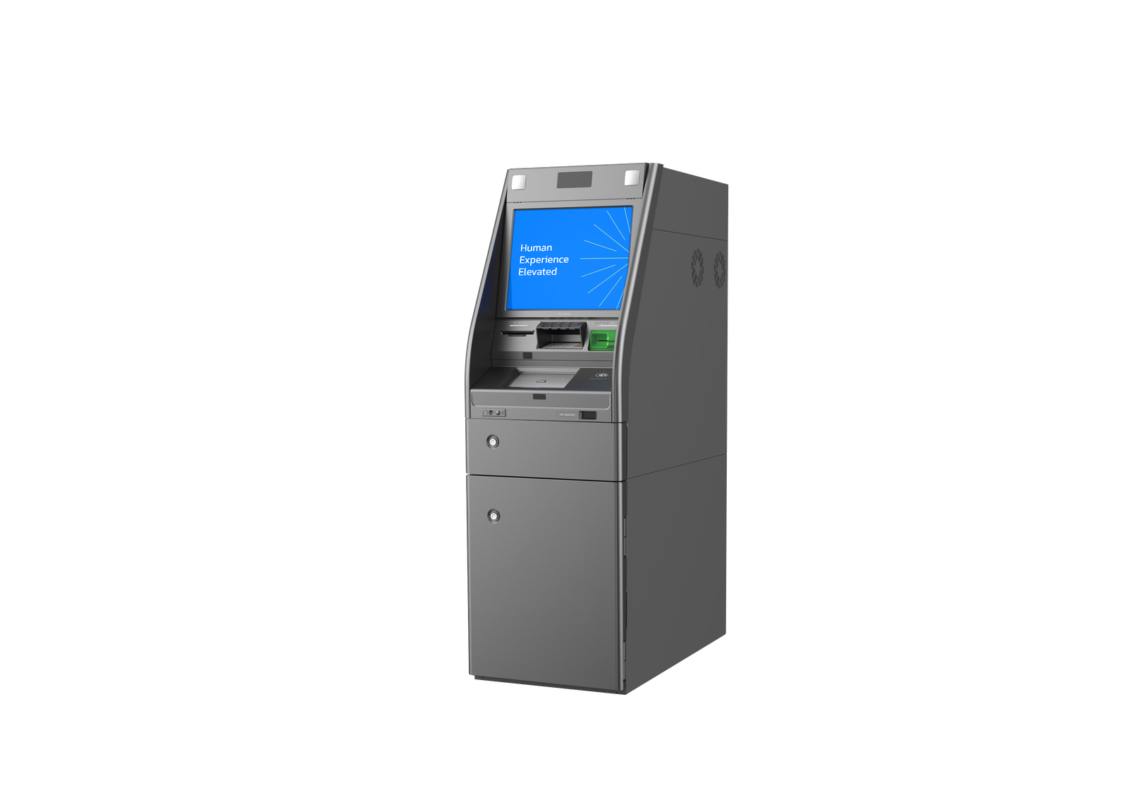
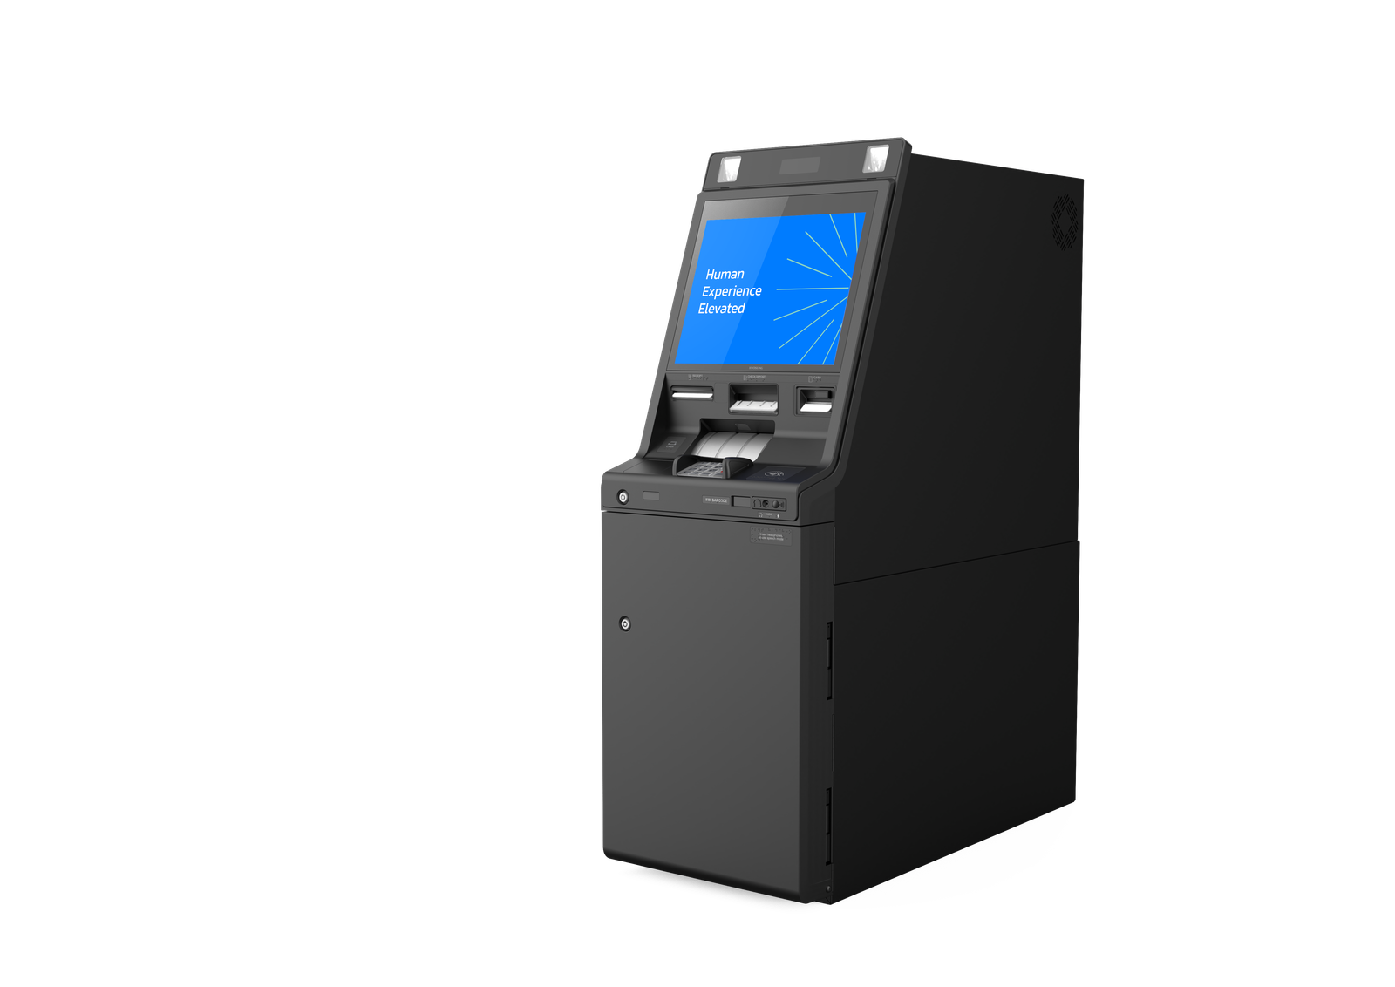
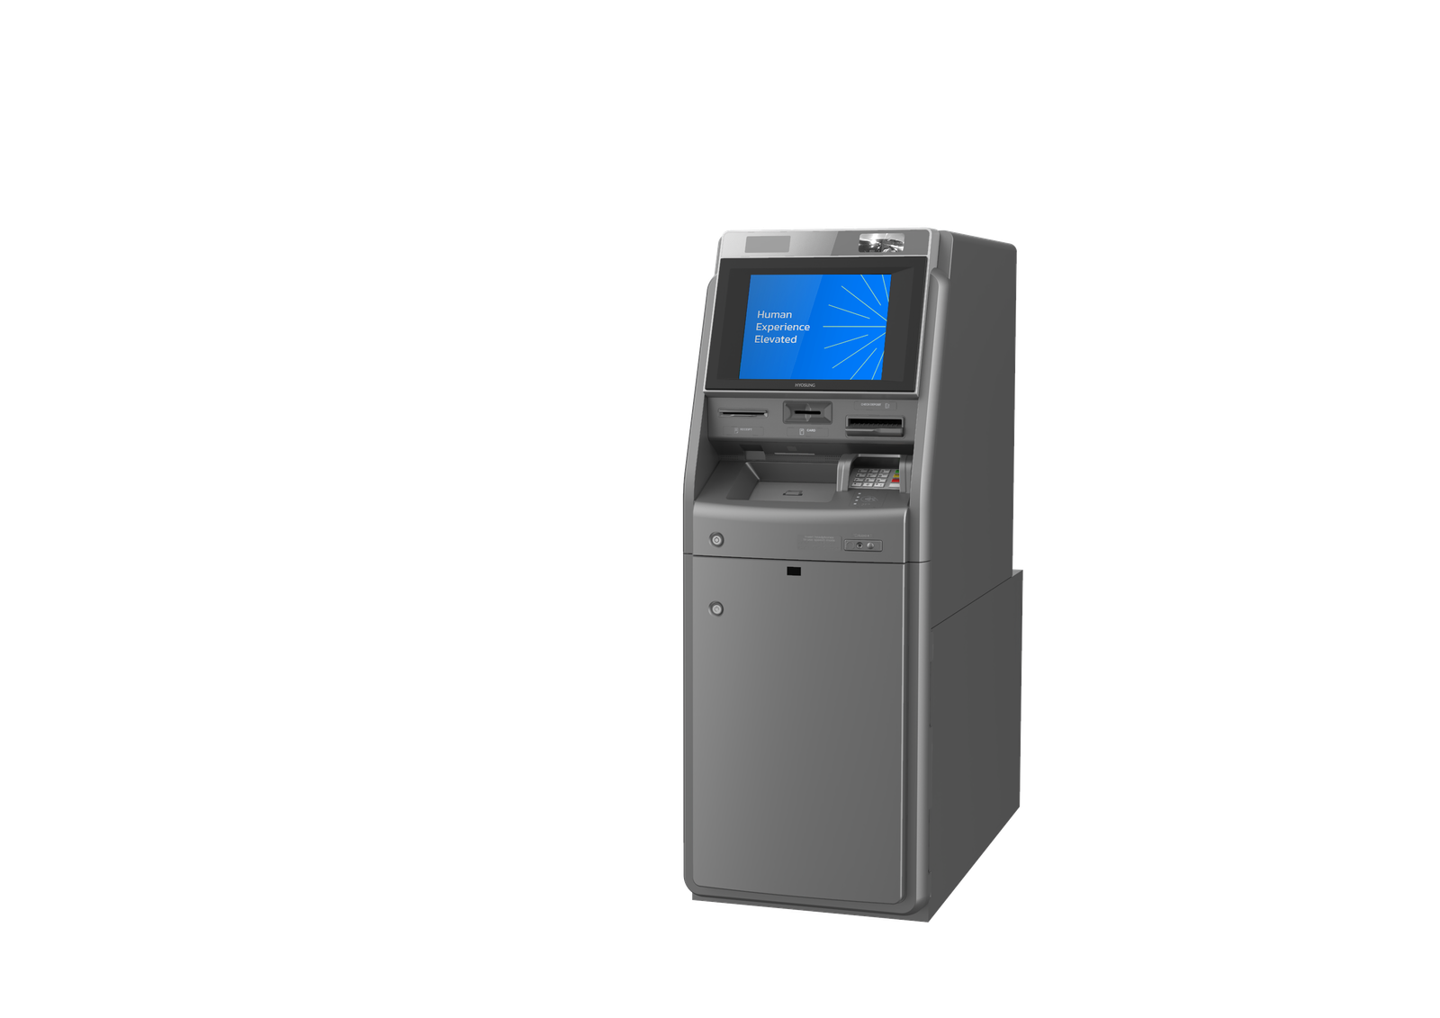
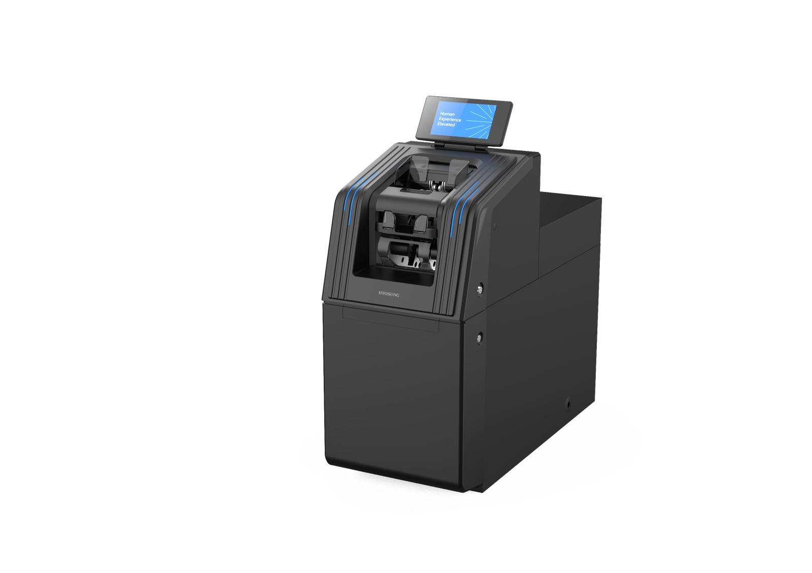
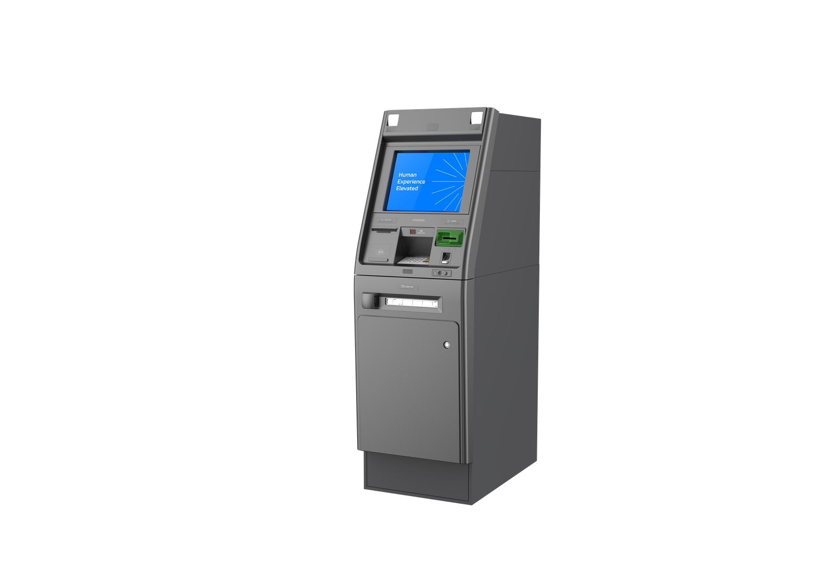
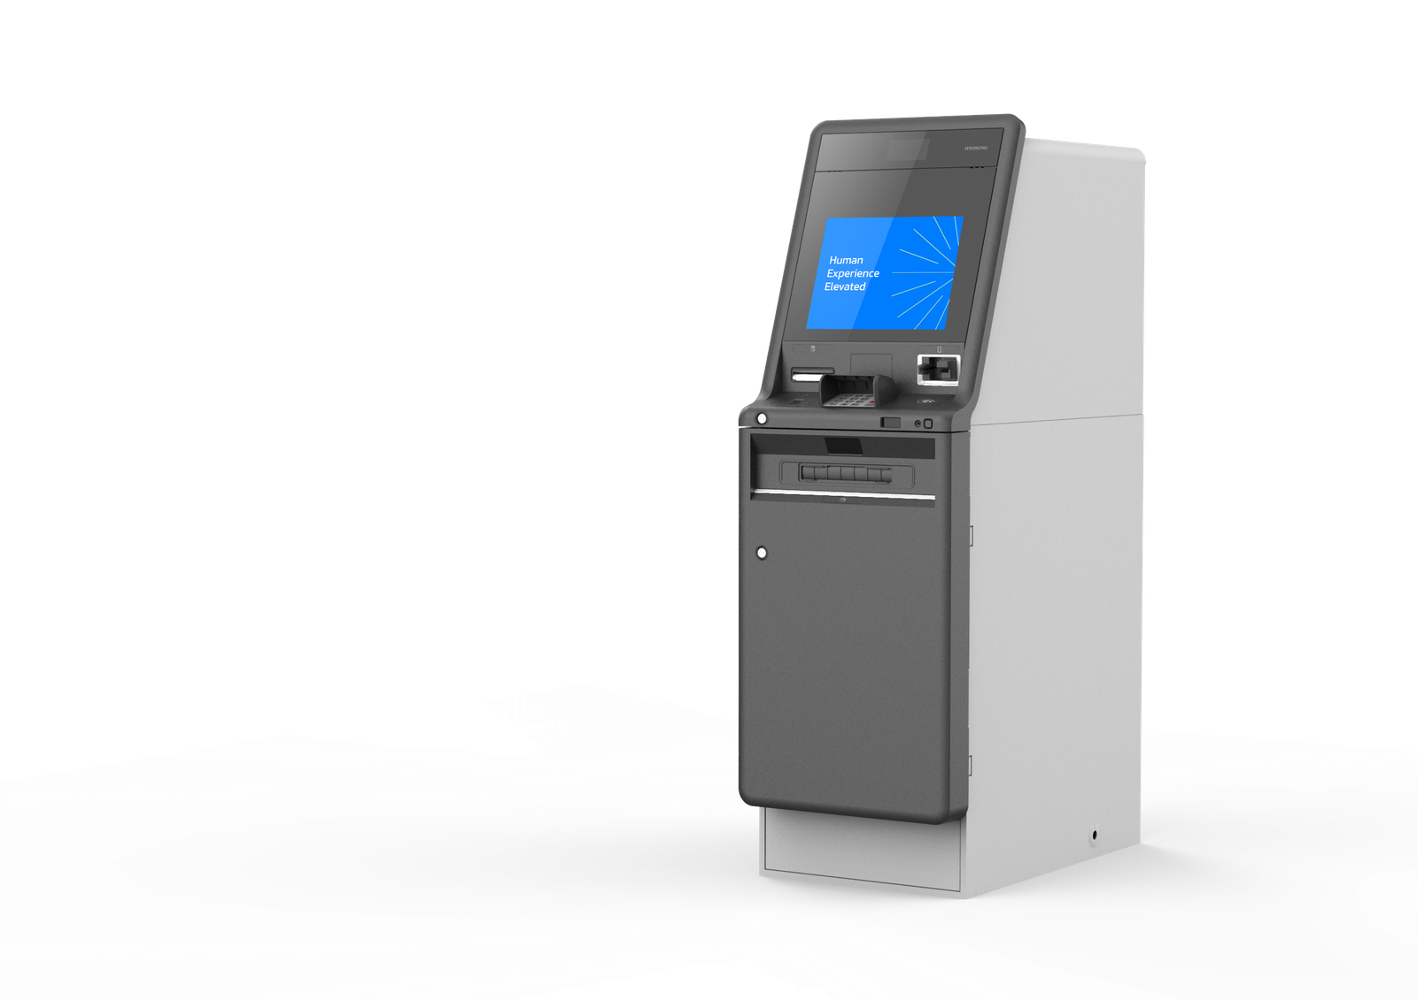
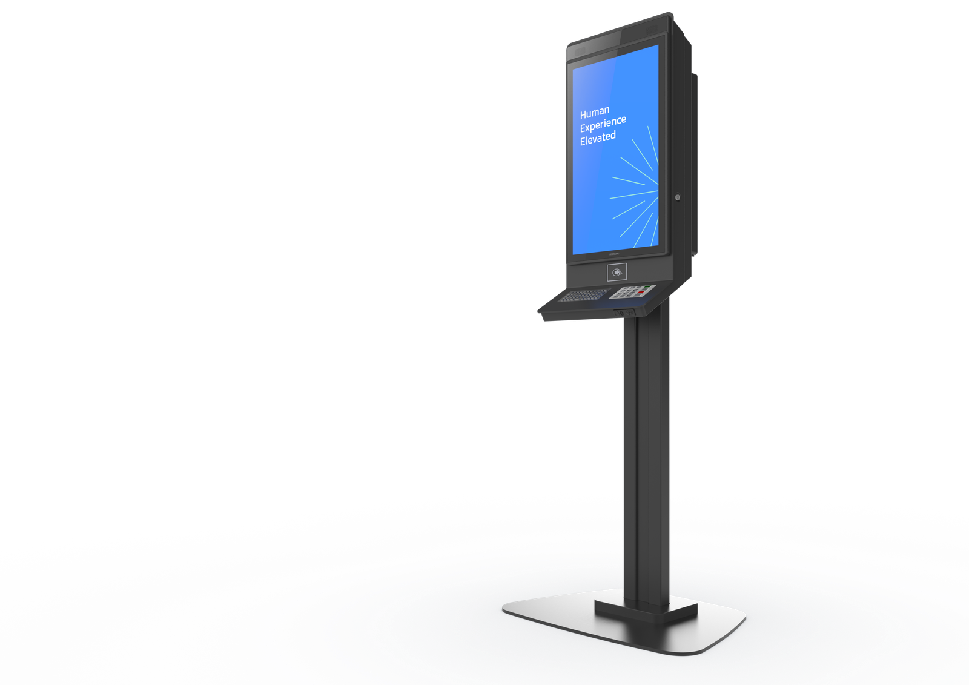
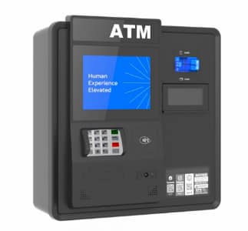
Hardware Lineup
Cash Recyclers
TCR
2026 New
Superior Recycling
Compact Design
Enhanced Cash Management
Latest Recycling
Optimal Cash Mgmt.
Full Denomination Support
Weatherized
Superior Cash Storage
Full Denomination Support
Proven Recycling
Diverse Transactions
Modular Design
Superior Cash Storage
Faster Transactions
Enhanced Security
MX8600S
Hyosung 8LA
Hyosung 9L
Hyosung 8XW
MS500E
(MX8200S)
Cash Dispensers
Non-Cash Terminal
Reliable Cash Dispensing
Superior Cash Storage
Robust Security
Compact Design
Easy Installation
Robust Transaction Set
Sleek Design
MX5600S
Hyosung 5L
Mini ATM
Non-Cash Terminal
(MX5800S)

Slide 15
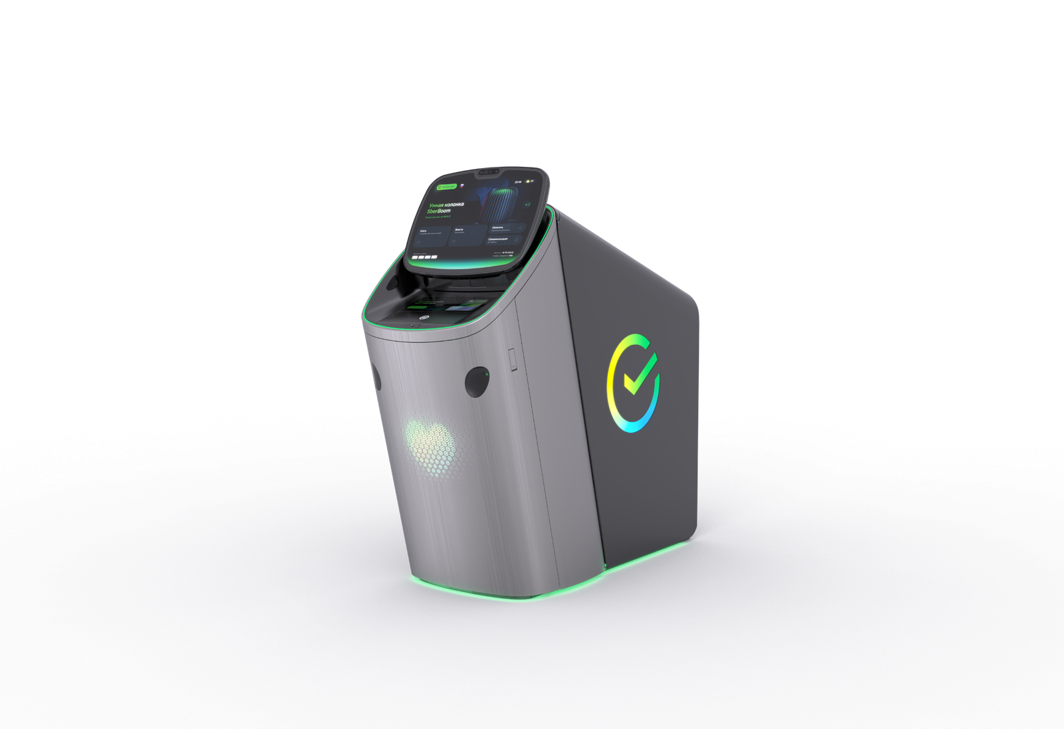
Hyosung 8LSE System Specification
Customer Interface
24.5” Touchscreen
Heart Rate Sensor
Customer Interface
12.3” Touchscreen
with Touch Encrypted PIN Pad PCI 6.0
Contactless Card Reader
NFC reader
Bill Recycling Module
4 recycling cassettes
(314mm note capacity per cassette)
1 deposit + 1 retract/reject Cassette
Max 300 notes per transaction
Beam Projector
ADA Audio Guidance

Slide 16












Software Portfolio
Software Solutions
Hyosung TNS offers powerful homegrown self-service banking software solutions, which are highly optimized by our on-going innovations to bring operational improvements to customers.
ATM and self-service terminal application
A cloud-based ATM software platform
Multivendor ATM software that enables total efficient fleet management with one unified software installed on multivendor ATMs
Web-based omnichannel ATM software platform that allows consistent consumer experiences and greater flexibility in software development
ATM operation management software
Personalization and targeted marketing
Realtime ATM operation and management software that monitors and manages the status of ATM devices
Provides customized services through ATM interface, marketing, campaigns, and frequently used financial transaction items and account information
ATM security software
Assisted teller software
Encryption and firewall, hacking/fraud prevention, and detection software for ATM transactions and customer data
A powerful assisted teller software solution supporting tablet assist, remote video teller control, and other multi-functional kiosks

Slide 17

SELF- SERVICE KIOSKS

Slide 18
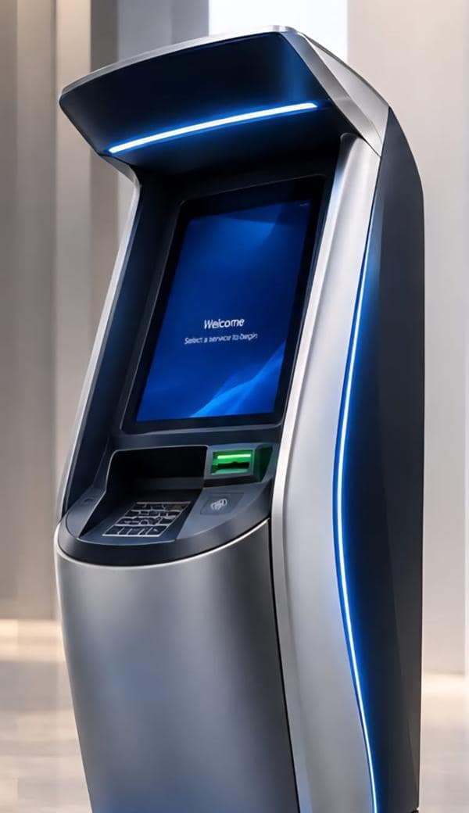
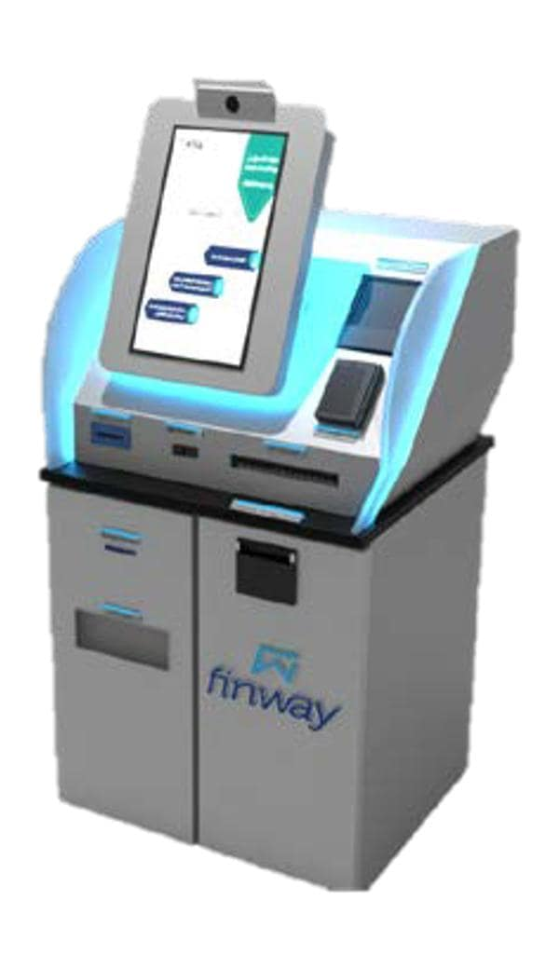
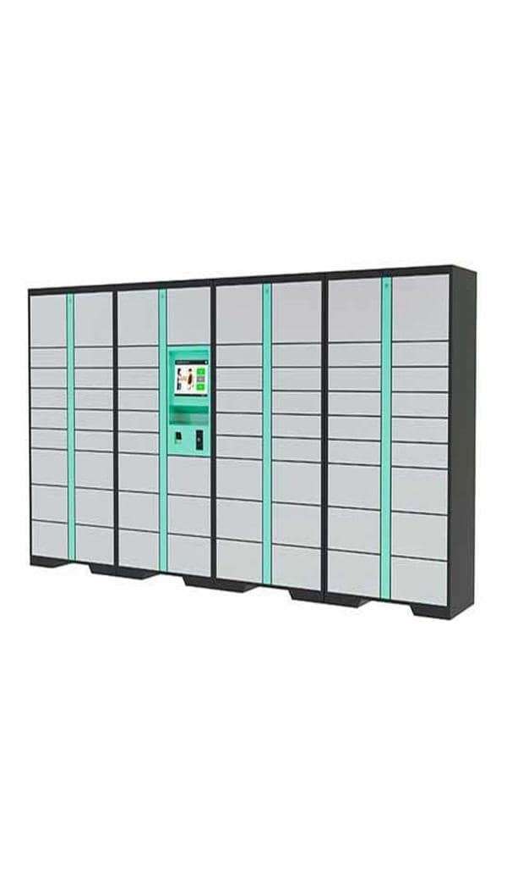
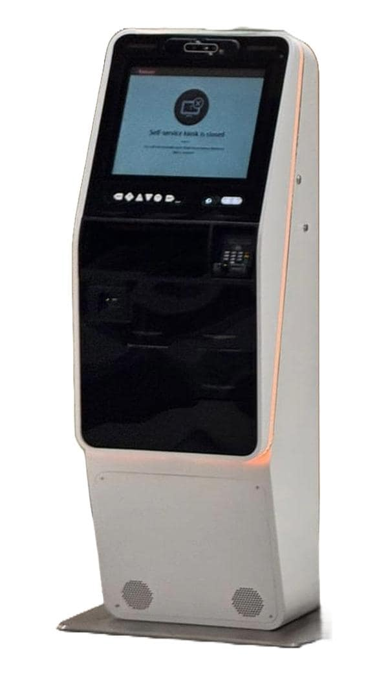
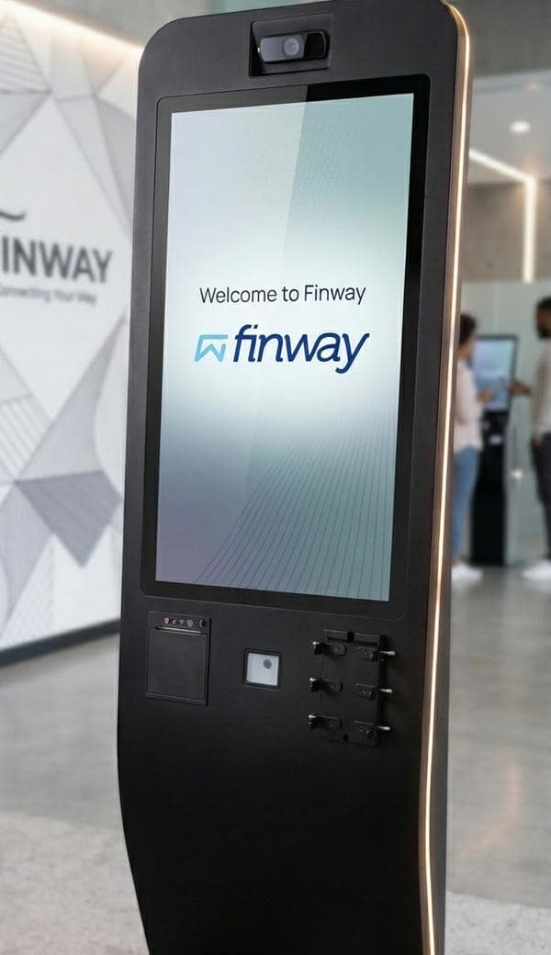
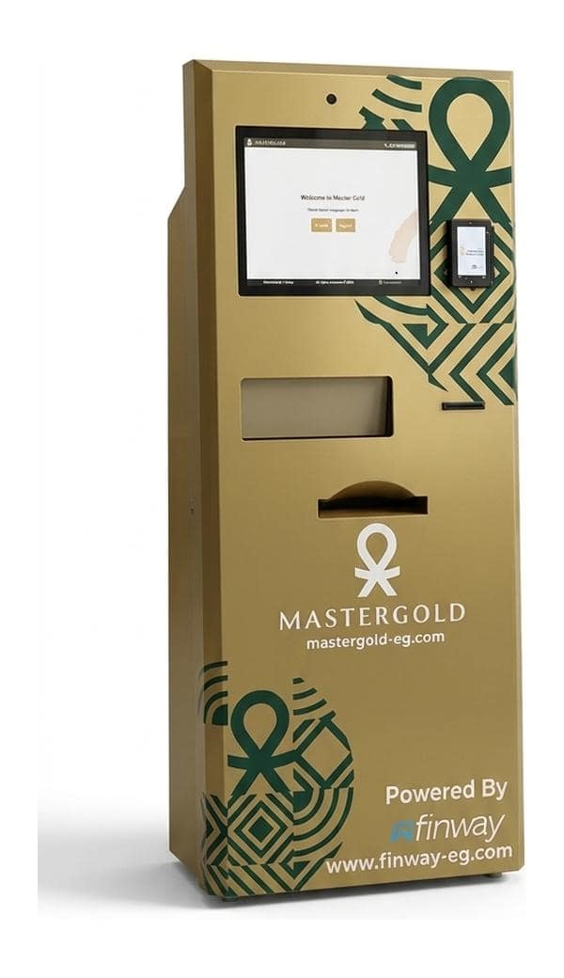

OUR SOLUTIONS
Smart Self-Service Kiosks
Self-service solutions that bring essential services closer to your customers, 24/7.
01
02
03
04
05
06
Ticket Issuance
Queue, event and transport tickets printed in seconds
Document Handling
Scan, submit and collect documents
Smart Lockers
Contactless parcel and document pick-up
Card Issuance
Instant on-site printing of bank and ID cards
Bill Payment
Cashless bill payments and top-ups
Gold Vending
Buy certified gold bars and coins on demand
Notes:
Finway kiosk portfolio: ticket issuance, document handling, smart lockers, card issuance, bill payment and gold vending.

Slide 19






WHY SELF-SERVICE
Benefits of Self-Service Kiosks
01
02
03
Shorter Queues
Customers complete transactions in minutes, without waiting in line.
Always Open
Round-the-clock service, beyond branch working hours.
Multiple Services
Payments, documents, cards and tickets on a single terminal.
Kiosks extend your service network beyond branch walls and working hours, improving the customer experience while lowering the cost of every transaction.
04
05
06
24/7
service availability, 365 days a year
Staff Focused on Value
Teams freed from routine tasks to focus on complex needs.
Flexible Placement
Compact, movable units deploy wherever your customers are.
More Customers Served
Higher daily capacity at a lower cost per transaction.
Notes:
Six core benefits of self-service kiosks for banks, government and retail operators.

Slide 20








KIOSK MANAGEMENT SYSTEM
Remote Monitoring & Management (KMS)
One web-based platform to monitor, control and manage a kiosk network of any size — from anywhere.
Real-Time Status
Live health of every terminal, server and host
Cash & Consumables
Online cash-in/out levels and supplies stock
KMS Dashboard
Live
98.7%
Network uptime
412
Kiosks online
3
Open alerts
Cash Forecasting
Predicts cash outages and refill needs
Remote Troubleshooting
Investigate and resolve issues without a site visit
Instant Alerts
SMS and email notifications on critical events
Automatic Updates
Software distributed and applied over the network
Kiosk 021 · Mall of Egypt
Online
SLA & KPI Reporting
Availability, SLA compliance and business KPIs
Browser-Based Access
Secure access from any location and browser
Kiosk 047 · Head Office
Low paper
Kiosk 113 · Branch 12
Offline
Notes:
KMS capabilities. Dashboard figures on the right are illustrative only.

Slide 21




SOFTWARE SOLUTIONS
Application Development & Backend Integration
Custom kiosk applications, built in-house and fully integrated with your backend systems.
Secure Connectivity
Backend integration through Web APIs, VPN or a hybrid model.
Real-Time Data Exchange
Fetch, validate and update data in your systems directly.
Custom Workflows
Trigger automated processes and third-party integrations from any kiosk activity.
UX & UI Design
Intuitive, on-brand customer journeys designed for self-service.
OUR DELIVERY LIFECYCLE
01
02
03
04
05
06
Planning
Scope, goals and roadmap
Analysis
Requirements and integration needs
Design
UX, UI and system architecture
Development
Build and integrate
Testing
QA and user acceptance
Maintenance
Support and updates
Notes:
Integration capabilities and six-stage software delivery lifecycle.

Slide 22









OUR CLIENTS
Trusted by Leading Institutions
Banks, payment providers, telecom operators and retailers across Egypt rely on Finway to deliver and support their self-service and payment solutions.
www.finway-eg.com
Notes:
Selected Finway clients across banking, payments, telecom and retail.

Slide 23

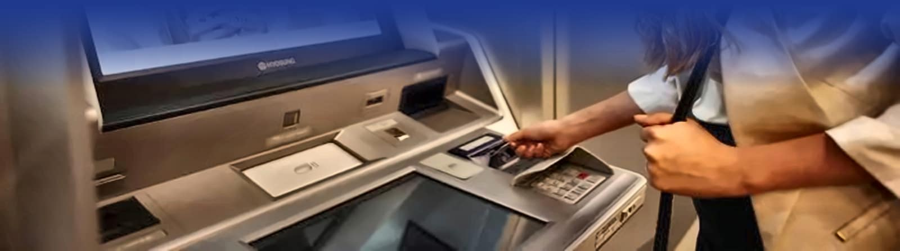
THANK YOU
www.finway-eg.com

