Slide 1


Sourcing and candidate interview prep
Best practice and step-by-step templates to get you started.

Slide 2
TABLE OF CONTENTS
O1
02
03
PREPARATION
SOURCING
What you need to do before the search.
Step by step process and tech used.
INTERVIEW & TEMPLATES
Candidate questions, assessment, submitting candidates and feedback.

Slide 3

01
Preparation
What to do before starting to actively search for candidates

Slide 4

1. Preparation
Assuming you already have an established focus discipline (e.g Tech & Finance USA/ UK ), these are the steps you need to take before starting to search for candidates.
Create/ learn from the team the ideal candidate persona (location, years of experience, career journey, current job, etc.)
Prepare messaging for sourcing in your LinkedIn account, personalised and with our usual clients' EVP in mind
Fill in any other person that helps you source in Charlotte's/ Dualta's accounts (e.g.: Gen/Jan/ Tina)
Create a LinkedIn post about the position + send job to marketing to promote it on top of your post.

Slide 5
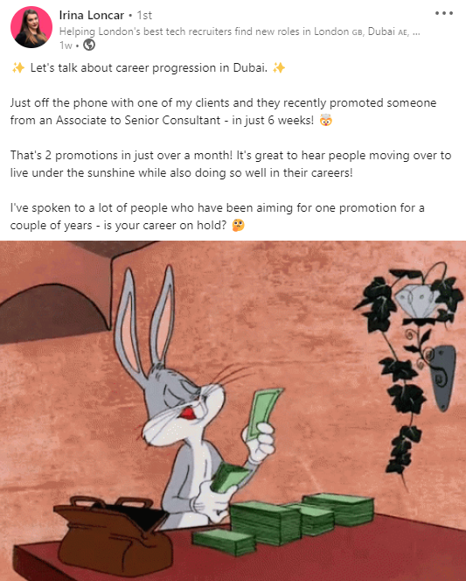
LinkedIn post example
Sell the job focusing on current pain points in the market – career progression, salary, benefits, location, urgency on losing out, etc.

Slide 6

02
Sourcing
Step by step process and tech used.

Slide 7




1. Sourcing – Tech we use
This is the main tech we use in our sourcing process besides LinkedIn & Paiger:
Dripify – Connecting and nurturing
SourceWhale – Automated email sequencing and
InMail / Call tasks tracking
Calendly – Custom meeting scheduler
Loxo - ATS/ CRM and Deal tracker

Slide 8

STEP BY STEP
Best practices & winning formulas:
Identify competitor companies of our client and target that list of companies first
Source daily, but also look into our talent pools database – check who have we placed, cross reference if they're still at their job – ask for referral and explain our referral scheme.
Use a sequence of actions and follow ups that's at least 5-6 steps long (applicable to leads that didn't express unavailability)

Slide 9

03
Interview & Templates
Candidate questions, assessment, submitting
candidates and feedback.

Slide 10

BEFORE THE CALL:
Check their LinkedIn
Get to know details of their work history and/or things they post about - a general assessment.
Check the size of the company they are working for
  See if they were professionally trained (MP, RW, Premier, s3)
  If they survived over 18 months they would be great
START OF THE CALL
Start with a general chat, build a rapport – how's your day been etc.
Ask how’s the job going?

Slide 11
INTERVIEW: Set the agenda for the call
Mention we have 200+ clients in our portfolio
We have done this for years
Mention you would like to get more details and a better understanding of their background so you would understand how to best help them today/tomorrow
What you want to do - long term/short term
  Ask about their aspirations – move to a larger/smaller company; relocate; make more money; get promoted etc
  If they are looking for an internal role send to Charlotte
Dive into their Aspiration / Pain points
  What would you like that you’re not getting in your current job?
    money
    boss
    WFH
    better discipline
    better location
    lack of progression
    Etc – these are the usual pain points

Slide 12
BILLINGS: Perm
    What are their billings year on year
    Ask for a breakdown – what's their avg fee, how many placements a month
      If they don’t know what the fees are they most likely didn’t win the client – so they are doing acc management/delivery (180/270 - they are likely not a 360 consultant, ask them about winning new business)
    Have they won any new business?
      If yes, how much of the business was won by them
      How much were company accounts
    Ask if majority of their work is contingent/retained

Slide 13
BILLINGS: Temp/Contract/Interim
    Ask for their figures
    Typically these consultants will be massive billers
    They will be after big base salaries/guarantee
    They are around 7x more valuable than perm consultants
    Ask them how many clients have they billed with/ how many clients they won
      How much have they billed with any client
      Goal here is to figure out if they are placing a lot of candidates with one client that keeps coming back, or they are just filling roles as they go

Slide 14

ASPIRATIONS
LET'S TALK MONEY
    How much are you making?
    How much do you want to make ?
COMMS STRUCTURE
    How much did you make last year?
3 MOST IMPORTANT THINGS TO YOU FOR YOUR NEXT JOB:
    Managerial path
    Money
    WFH/ Fully remote
    They will have a lot of different answers, figure out what motivates them

Slide 15
Is there anything that’s going to stop you doing this process once we’ve started?
  Realistically what is your timeline?
  Explain that you will be there to help any step of the way, prep for interviews and give more details on the companies.
  Make sure they understand they can be in touch anytime
EXPLAIN CANDIDATE JOURNEY
STEP 1
STEP 2
STEP 3
    You will chat with Dualta/come up with a list of companies
    Give them the list
    They will decide who they want to speak with
    You will present
    You will coordinate
    Hopefully they will have competing offers in a matter of weeks

Slide 16

LOCK IT IN
Try to get them locked in for one client – that you think would be a best fit on what they described they are after: ''Let’s just get you locked in for one and we can easily expand''.
COMMIT TO ACTION
Before I give you the list of all of our clients, I will need some more details from you:
  In a WhatsApp group ask them for the following details in case you didn’t catch that on the call:
  Billings – best to break down by years
  Avg number of placements/ avg fee
  Examples of roles worked on
  Any key achievements that you’d like me to add to the profile

