Slide 1




Women and Girls’ Transport Safety
Active Travel, Travel Hubs and Bus Travel

Slide 2
Throughout 2024 and 2025, the Greater Cambridge Partnership (GCP), England’s Economic Heartlands, and the Cambridgeshire and Peterborough Combined Authority (CPCA) commissioned two studies investigating women and girls’ transport safety in the Greater Cambridge area, and how it can be improved.
Phase 1 investigated perceptions of safety for women and girls in the context of two of GCP's transport schemes: Cambridge South West Travel Hub and Cambridge Eastern Access. The aim of this phase was to develop practical design solutions to improve perceptions of safety for women and girls travelling in and around Greater Cambridge.
Phase 2 was commissioned by the CPCA and grant funded by the Rees Jeffreys Road Fund. This phase built on findings from phase 1 to investigate perceptions of safety for women and girls travelling on buses in Cambridgeshire and Peterborough and examined both urban and rural routes. The aim of this phase was to improve the sense of security for women and girls travelling on buses in Cambridgeshire and Peterborough, to support greater confidence in using public transport, and to encourage mode shift.

Slide 3
This presentation summarises the key findings and recommendations from both studies and is laid out as follows.
Active Travel and Travel Hubs
Focus Groups
Context
Methodology
Issues and Recommendations
Next Steps
Bus Travel
Context
Focus Groups
Methodology
Issues and Recommendations
Next Steps

Slide 4
Phase 1: Active Travel and Travel Hubs – Context
The scope of this phase of work considered two key project sites of different typologies, so that any design findings, principles and solutions could be applied to other projects in the GCP programme.
Newmarket Road, part of the Cambridge Eastern Access (CEA) programme
Cambridge South West Travel Hub
During the ‘Making Connections’ public consultation, many participants raised concerns about safety and security on public transport, affecting women, minority groups and younger or older people travelling alone. Similar concerns have emerged in other consultations, underscoring that women and girls often lack representation in the design and planning processes.
By focusing transport design on the needs of the most vulnerable groups, a more inclusive transport system can be developed which benefits everyone.
The study focused on the safety of women and girls and aimed to address the issue of Violence Against Women and Girls (VAWG).

Slide 5
Methodology
The study on active travel and travel hubs looked at two transport scheme typologies. The methodology for each scheme had three elements.
Safety Inclusion Assessments (SIAs)
Focus groups
Literature review

Slide 6
Focus Groups
Two focus groups were undertaken as part of this study and followed the process below.
1 | Stakeholder research Identifying local community groups for people from minority groups, prioritising engagement with the most vulnerable current and intended users of each scheme.
2 | Approaching identified stakeholders After mapping stakeholders, two focus groups were identified: hospital shift workers and active travel users.
3 | Focus group sessions Exploring safety perceptions and pain points for local women and girls and discussing potential interventions and improvements that participants would like to see.
4 | Analysis Thematic content analysis was undertaken to identify key themes from focus group discussions to identify main sources of discomfort or risk.
5 | Formulating recommendations Focus group discussions were fed into design recommendations.

Slide 7
Safety Inclusion Assessments (SIAs)
Safety Inclusion Assessments were undertaken to review the existing sites and design proposals for Newmarket Road and Cambridge South West Travel Hub, using WSP’s Safety Inclusion Assessment (SIA) tool.
The SIA was designed to assess safety issues in public spaces, with a particular emphasis on safety issues experienced by women, girls and other marginalised groups. It provides context specific design solutions which help reduce personal safety risks. The SIA is based on three core criteria:
The SIA assigns a score 0-2 depending on how design aspects of a space contribute to or compromise perceptions of safety against each core criteria and sub-criteria.
Freedom of Use | Assesses the accessibility of a space for all users.
Useability | Assesses the ease with which people can navigate the space.
A Sense of Belonging | Assesses the aspects of a space which make users feel welcome.
0 | Significant issues identified
1 | Adequate design consideration required
2 | Meets SIA criteria

Slide 8
Active Travel and Travel Hubs – Methodology (cont.)
A literature review was undertaken to summarise research on women’s safety in the context of sustainable transport across the UK.
Key findings included:
Women, girls and other vulnerable users feel more at risk after dark with 81.3% of women in the UK reporting that they feel unsafe in parks and open spaces after dark (Armstrong, 2021)
Rural areas often lack infrastructure which improves overall perceptions of safety including reliable and frequent bus services, bus shelters with live information and street lighting (Scottish Women's Budget Group, 2023; Peña-García, Hurtado, Aguilar-Luzón, 2015)
Feeling unsafe can result in altered travel patterns, resulting in avoidance strategies including taking alternative routes, altering modal choice or not travelling altogether. (Foster et al, 2012; Stark and Meschik, 2018).
Integrating gender-inclusive interventions into transport scheme designs is essential to ensure GCP schemes are accessible and safe for all.

Slide 9
Active Travel and Travel Hubs – Focus Groups
Lighting
“low level lighting- You're going to get weird shadows which would freak me out. You can't see what's around the corner.”
“Good, bright lights that actually turn on when they are supposed to would be good.”
The presence of sufficient lighting is seen to improve perceptions and feelings of safety.
A lack of lighting makes the participants feel less safe, and in some cases, causes them to choose other transport options even if it costs more money.
Participants suggested that lighting contributes to them feel safer depending on time of day, with a heightened sense of unsafety late in the evening at 8pm, compared to earlier at 4:30pm.
These issues are particularly problematic for night shift workers who do not have a choice about the timings of their shifts.
Coping Strategies
“I hold my breath so I can listen for other people.”
"You either pay lots to feel safe, or you save money and feel uncomfortable. I’d rather pay if I was alone.”
The women reported that they often modify their walking behaviour and adopt coping strategies to make them feel safer.
Examples listed by participants include holding their breath, walking with someone else when it is dark, holding keys in their hands, taking alternative, more expensive transport modes, sharing their locations with loved ones or being on the phone to someone whilst they are walking.
One woman said that she paid £24 to park in the hospital car park at night so they feel safe.
Bus Reliability
"I would feel better if I knew the buses were going to be regular".
“I feel like [the bus driver is] just suddenly going to have an angry outburst - he's making gestures at the drivers going past because the lights haven't changed.”
There was a consensus amongst participants that the bus timetables are unreliable and do not align well with their shift patterns. This means they are likely to be waiting at bus stops for extended periods of time.
Additionally, participants described the buses as being “overcrowded” and exclaimed the bus drivers “are stressed which can make you feel anxious”.
These findings point towards the idea that some buses are operating above capacity. This contributes to negative experiences on buses and the shared notion that bus travel is not perceived by participants as a safe public transport option.
Information Aids
“Signage is useful too so you know you’re headed in the right direction… if you don’t know where you’re going you would feel a bit unsure and vulnerable.”
Participants suggested that it was important for them to feel confident in the information available.
The participants discussed the importance of having signage at deviation points of routes to reassure them they are travelling in the right direction.
At bus stops, real-time digital information is seen as a positive feature because it enables the participants to see how long they will be waiting at the stop.
Presence of others
“sometimes you do a late shift and we finish at 8 in the evening. Suddenly, there's no one around…on that part, and it does feel really isolated."
Participants feel more unsafe when they are alone than when they are with others.
Presence of other members of the public or shops being open after dark can also contribute to improved safety perceptions.
Vegetation
“I had seen something like a man in the bushes, which I thought was a bit weird, but I thought, who knows what he’s doing? Yeah it could be anything.”
“There's all bushes on one side that would be easy for someone to hide in and jump out at you.”
Participants described excessive vegetation as being “disconcerting”, because it provides opportunities for people to conceal themselves.
Overgrown vegetation also indicates a lack of maintenance which also exacerbates the sense of unsafety.

Slide 10
Active Travel and Travel Hubs – Focus Groups (cont.)
Bus timetables/reliability
“Once I had to wait so long for the bus I gave up and walked home alone.”
There is a consensus that local bus services are unreliable, particularly at night-time.
Another woman described being stranded at 10pm because the bus was too full to board. She felt so unsafe that night that she now avoids using public transport at night-time altogether.
Cycling
“It is quite scary to travel on foot or bike down the busway in the dark… I know there have been attacks there in the past.”
Participants recognise that it is quicker to cycle, but highlighted several factors which make them feel less safe including:
Lack of, or existing but disjointed cycle infrastructure in the city
Cycle infrastructure installed without sufficient lighting, and where routes end, participants feel unsafe to continue cycling after dark.
Shared cycle spaces are perceived as unsafe particularly at night with limited visibility.
Presence of others
“[A rural shared cycle route feels] very isolating at night as it is so dark. You are too far from any other person that could help in any situation."
Many of the women in this focus group cited “isolation” as a factor that made them feel uncomfortable and less safe than they would like.
General active travel suggestions
The participants from the Active Travel focus group suggested several changes that could be made to active travel infrastructure to improve the perceptions of safety.
These include:
  Mirrors on sharp corners or entrance/exits of tunnels
  CCTV cameras on isolated routes
  High quality lighting
  Improved visibility of movement paths and surroundings
  Regular vegetation maintenance
Many participants also reported that they do not feel safe using underpasses and avoid them where possible.
Summary
The focus groups provided useful insight into the walking behaviour and safety concerns of local women and girls. The key safety concerns which were conveyed throughout the conversations correspond with and verify the findings from SIA undertaken on site visits to the two transport scheme typologies. The remainder of the report discusses these findings. Gender-inclusive design recommendations have been suggested to improve the perceptions of safety for local women and girls and address some of the key themes from the focus groups.
The findings of the SIA assessments are outlined in the following slides.
Lighting
“Lighting is the thing that would make the biggest difference [to my feelings of safety]”
Lighting was the most frequently cited potential physical feature that might improves women’s perceptions of safety.
Information/Education
The participants felt that men do not understand the extent of the safety concerns women go through and highlighted that boys should be educated on anti-harassment from a young age.

Slide 11
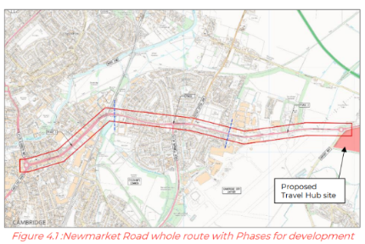
Scheme Overview – Newmarket Road
Newmarket Road is one of the schemes being delivered under the Cambridge Eastern Access programme. The proposals include improving Newmarket Road (from Elizabeth Way to Airport Way) to enable more people to travel by active modes and provide public transport priority where space allows.
The proposals also include a new travel hub to replace the existing Newmarket Road Park and Ride.

Slide 12

Existing Site Issues – Newmarket Road
A lack of active frontage on the approach to the underpass, creating a feeling of isolation.
Overgrown vegetation in the middle section of the underpass creating entrapment points.
Bright lights from tunnels create dark spots immediately outside the tunnels.
Limited infrastructure in the underpass to facilitate passive surveillance (e.g., convex mirrors).
No mobile phone signal in the middle section of the underpass.
Steep ramps providing access to the underpass which were not well-maintained.
Existing artwork defaced with graffiti, creating an uneasy atmosphere.
Insufficient waiting space on the Northern side of the toucan crossing on Newmarket Road.
Abandoned buildings along the route contribute to low levels of perceived safety.
Land use which consists of largely retail and hotels limits activity outside of daytime hours.
A lack of pedestrian crossing points over Newmarket Road from the Travelodge to Cambridge retail park.
The section of Newmarket Road along the perimeter of Cambridge Retail Park is dominated by motor vehicles.
Entrapment points along Newmarket Road.
Street-lighting blocked by overgrowing vegetation.
Bus stops lack electronic live information about arrival times.
Lack of space for people waiting at Malden Close bus stop.
Movement paths blocked by footway parking.

Slide 13
Newmarket Road Lighting Review
A review of existing lighting infrastructure was undertaken as part of the site visit, which found that:
There is inadequate provision of existing lighting for the intended use of the eastern extent of Newmarket Road. Proposed lighting should aim to enable movements by active travel.
Research indicated that when street lighting is implemented sensitively, it can lead to reductions in crime and improved safety perceptions, contributing to increased use of cycling and walking routes after dark.
When streetlights are placed too far apart or are obstructed by vegetation, dark spots and entrapment points can be produced on the surrounding footway.
Overgrown vegetation and a lack of passive surveillance combined with ineffectively placed streetlights were key issues observed to exacerbate personal safety concerns for vulnerable road users.

Slide 14
Newmarket Road Lighting Review (cont.)
Key lighting considerations for Newmarket Road specifically include:
Providing a mixture of multi-layered lighting to ensure users do not rely on overhead light poles as their only source of light.
Clearing the vegetation overgrowth around existing streetlights.
Putting in place regular vegetation management plans.
Placing new lighting infrastructure where it is unlikely to be substantially obstructed by vegetation in future.
More consistent and reduced spacing of streetlights or use of higher lux are recommended at the eastern extent of the Newmarket Road scheme.

Slide 15
Proposed Design Review – Newmarket Road
The proposed designs for Newmarket Road addresses several safety issues identified during the SIA.
The proposed CYCLOPS junction at Elizabeth Way / Newmarket Road and Wadloes Road / Newmarket Road / Barnwell Road junction will remove the safety issues at the Elizabeth Way underpass and maximise opportunities for safe walking, wheeling and cycling.
Improved active travel and public transport infrastructure along Newmarket Road is expected to significantly increase the number of users, improving passive surveillance and space activation.
Soft landscaping and footway / public realm treatments will improve accessibility of the street.
Continuous footway treatments and additional formal crossing facilities will reduce existing accessibility issues.
New puffin and toucan crossings at junctions will improve pedestrian desire lines.

Slide 16
Potential Issues and Outstanding Concerns
Maintenance constraints, particularly concerning vegetation clearance around lighting and signage pose challenges.
Removal of the toucan crossing at Abbey Street – a crossing which is currently very well used – may displace people from their desire line.
At entrapment points, multi-layered lighting should be installed to illuminate the path ahead.
New lighting poles proposed for the extent of the City Cemetery along Newmarket Road will not be effective if the vegetation is not regularly maintained.
Providing CCTV on movement paths between the City Cemetery and the Park and Ride would improve perceptions of safety.

Slide 17
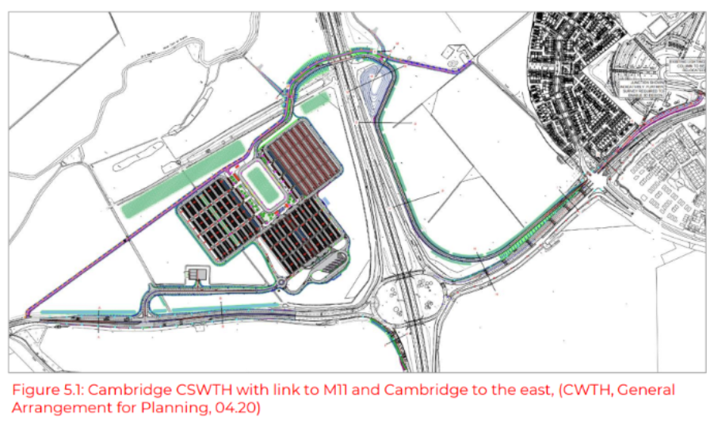
Scheme Overview – Cambridge South West Travel Hub
CSWTH will be a large mobility hub located west of a key entry point into Cambridge: Junction 11 of the M11 motorway. Key features include:
Over 2,000 new parking spaces
Coach and cycle parking
A new dedicated bus route into Cambridge
A new footbridge over the M11
Capacity improvements at Junction 11
Public transport priority measures along the A1309 Hauxton Road / High Street / Trumpington Road corridor

Slide 18
Existing Site Issues – Cambridge South West Travel Hub
A lack of rest areas or signage.
Vegetation overgrowth outside of Trumpington Road Park & Ride.
Narrow shared use path of the northbound side of the carriageway outside of Trumpington Park & Ride creates pinch points for pedestrians and cyclists.
Lack of CCTV, passive surveillance and wayfinding for pedestrians and cyclists.
Sections of route are largely inaccessible for wheelchair and pushchair users. Widths are restrained by overgrown vegetation.
Yellow-coloured lighting on the shared-use path along the A10 could create darkspots and shadows, which may impact perceptions of safety.
Limited mobile service at points creates a significant personal safety concern.

Slide 19
Proposed Design Review – Cambridge South West Travel Hub
Removing the shared-use path along the A10 to extend the carriageway will shift users to the rural off-road path. This would reduce traffic exposure and enhance traffic safety, although it may compromise personal safety due to the isolated nature of the route. This should be monitored.
Install illuminated wayfinding signage that remains visible during darkness.
Convex mirrors should be installed on bends / where there are blind spots for better forward visibility.
CCTV should be installed along the route.
The width of the off-road path should be consistently over 2 metres along its entire length.
Vegetation should be maintained and tree cover should be limited.

Slide 20
Potential issues and outstanding concerns
CSWTH provides alternative transport links integrated into its design (coach, taxi and bus). The inclusion of sheltered waiting areas, integration of vegetation and provision of secure cycle parking and accessible vehicle spaces improve comfort, user experience and accessibility.
Crossflows between road users should be monitored.
A lighting strategy should be prepared for the proposed off-road path to consider human-centric lighting options.
Lighting options and sightlines under large solar canopies should be considered.
Seamless transfer options should be provided to improve pedestrian space between the travel hub and blue badge parking.
A wayfinding strategy should be developed.
Future monitoring of use of the site to determine need for additional facilities such as accessible toilets, waiting areas, and areas for specific needs - noting this would require a planning application.

Slide 21
Lessons for Other GCP Active Travel Schemes
Feature | Description
Passive surveillance and CCTV | Designs should maximise opportunities for passive surveillance to reduce feelings of isolation. For example, convex mirrors should be provided in underpasses or tunnels. Where this is not possible, installation of CCTV should provide greater visibility in areas with less activation.
Digital connectivity | Mobile phone signal should be available to users along the length of an active travel route to minimise feelings of isolation and unsafety, and to allow access to real-time travel information and use of personal safety apps and location sharing.
Movement paths. | Pathways should be wide enough to accommodate all types of users and to minimise the risk of collision between cyclists and pedestrians. Consideration should be given to sections of movement paths where overgrown vegetation or pavement parking creates blocks.
Pedestrian crossings. | Formal crossing points with dropped kerbs and tactile paving should be provided to allow easy crossing for road users with mobility impairments or who are travelling with children in pushchairs.
Vegetation. | Where feasible, and subject to land ownership, regular vegetation maintenance plans should be put in place to prevent vegetation from encroaching on movement paths and obscuring street lighting and natural lighting. Where regular vegetation maintenance plans are unfeasible, consideration should be given to the placement of artificial lighting away from vegetation.
Lighting and visibility. | Perceived safety for women and girls and other vulnerable users should be considered when deciding on the appropriate lighting for a project. Lighting should minimise entrapment points and improve wayfinding where possible.
Street furniture. | Street furniture such as benches should be provided to offer resting points in areas of low actual and perceived safety risk (well-lit, high-visibility areas). The placement of street furniture should be considered so it does not impede pedestrian paths or desire lines.

Slide 22
Lessons for Other GCP Travel Hubs
Feature | Description
Lighting and passive surveillance. | Cycle parking areas, bus stops, car parking spaces, and EV charging points should be well-lit to increase visibility. EV charging points should be positioned close to main footpaths to ensure passive surveillance for users, and to allow users easy access to other facilities.
Facilities. | Consideration should be given to the provision of services at travel hubs to increase opportunities for passive surveillance around the travel hub.
Reserved parking. | Parking spaces near entrances should be reserved for pregnant users and users with mobility impairments to increase accessibility. Pedestrian space between these parking spaces and entrances should offer a seamless transfer.
Wayfinding. | Clear, visible signage should be provided to guide users to areas such as cycle parking, bus stops, and car parking spaces. Signage should include real-time transport information to aid with journey planning, onward transport options and alternative routes where possible.
Digital connectivity. | Free public WiFi should be provided at travel hub sites where possible, to allow for access to real-time travel information and use of personal safety apps and location sharing.
Provision of bins. | Adequate waste disposal options should be provided to help maintain a clean and inviting environment.
CCTV. | Where possible, CCTV should be installed at key areas of the travel hub to enhance security. The provision of emergency call stations at strategic locations should be considered.
Toilet facilities. | Well-maintained, clean public toilets should be provided, with additional space allocated to female toilets to account for the higher proportion of women travelling with children. Appropriate, secure baby changing facilities should be provided.
Waiting facilities. | Secure and well-lit waiting facilities should be provided at bus stops, with adequate seating and visibility. Where possible, shelter from rain and sun should be provided.
Movement paths. | Movement paths between key locations at the travel hub should be wide enough to accommodate all types of users. Movement paths should be well-lit, with lighting strategically placed to minimise the impacts of overgrowing vegetation on visibility. Resting points should be provided to maximise accessibility.

Slide 23
Next Steps – Greater Cambridge Partnership
Cambridge Eastern Access | Cambridge South West Travel Hub
The GCP's Cambridge Eastern Access scheme is currently on hold, pending outputs from the upcoming Greater Cambridge Transport Strategy (GCTS). The GCTS will provide a long-term, strategic level direction for transport across the Greater Cambridge sub-region. Once a decision has been made to move forward with the scheme, the scheme-specific recommendations from the Safety Inclusion Assessments (SIAs) which were undertaken on the proposals will be reviewed, and, where possible, changes will be made to the designs to ensure that key recommendations are integrated. Many of the recommendations from the report are more general and can be applied across GCP's wider active travel programme. Issues around lighting and vegetation maintenance, for instance, will be taken up at a programme-wide level. | By the stage at which recommendations from the Safety Inclusion Assessments (SIAs) were received, the GCP's Cambridge South West Travel Hub (CSWTH) project had already received planning permission. This limited the extent to which designs could be altered. That said, the project team is incorporating recommendations wherever possible, as they approach construction. Where a recommendation cannot be taken forward due to planning constraints, monitoring will be put in place and further proposals brought forward if needed. Importantly, the assessment undertaken on CSWTH raised useful design considerations that will influence other GCP travel hub schemes. For example, the relocated Newmarket Road Park & Ride is at an earlier stage in the design process, and therefore presents opportunities for the more general recommendations around travel hub design to be taken forward.

Slide 24
Bus Travel – Context
Building on the first phase of work, in 2025 the CPCA directed a further study investigating women and girls’ safety on buses.
Consultants undertook desktop reviews of bus routes in the Cambridgeshire and Peterborough Combined Authority area, covering inter-urban, city and town, and rural routes.
The aim of this phase of work was to improve the sense of security for women and girls in Cambridgeshire and Peterborough, to support greater confidence in using public transport and encourage mode shift.

Slide 25

Bus Travel – Methodology
To ensure that this assessment understood the specific context that relates to bus services, including bus stop infrastructure, an additional criterion was created.
SIA Core Criteria
Freedom of Use: This criterion assesses the accessibility of the space for all users. The criteria include assessing movement paths, traffic exposure, visibility from natural and artificial lighting, and active and passive surveillance.
Useability: This criterion assesses the ease with which people can navigate the space. It includes a review of the movement paths and the amenities with how people are expected to navigate through them including wayfinding, maintenance and access to alternative transport options.
A Sense of Belonging: This criterion has a focus on the aspects of a space which make users feel welcome and that they have a place within it. Intended Use and Activity focuses on having a clear primary function to foster inclusivity, activity and encourage participation. A space with street furniture, landmarks, landscaping and a variation of land-uses are attributes which provide a sense of place and feeling of safety.
SIA Additional Criteria
Bus Stop Review: This criterion assesses the accessibility of bus stops, their infrastructure, and their environment. It reviews the footway space around bus stops, looking at drainage and interactions with pedestrians and cyclists. The levels, function and quality of infrastructure is reviewed, including bus stop shelters, seating and cages, the type of information available, and its accessibility. A bus stop with seating, a well-maintained shelter, real-time information and up-to-date route timetables contributes to creating a safe and accessible space that increases the appeal of public transport.

Slide 26
Bus travel – Methodology (cont.)
Two routes in Cambridgeshire were chosen to undergo the SIA. They were chosen to reflect a range of contexts.
A desktop assessment of each route was carried out using the most up-to-date Google Street View data.
There are limitations of this methodology, including that street lighting and mobile phone signal cannot be fully assessed. The study assumed that street lighting was in good working order and that internet connectivity was more reliable in urban sections than in rural sections.
From the desktop assessments, site specific and general recommendations were developed.

Slide 27
Bus Travel – Focus Groups
The focus group explored safety perceptions and barriers to bus travel for local women and girls.
Participants discussed infrequent bus use, often due to convenience, reliability, and safety concerns, especially at night or in rural areas.
Key issues included anxiety about overcrowding, unpredictability of bus arrivals, feeling vulnerable at isolated bus stops, and negative experiences with other passengers. All participants could provide examples of situations where they felt unsafe.
Suggestions for improvement included better real-time information, clearer signposting about what to do if feeling unsafe, more visible CCTV on buses and at stops, having midway entrance/exits on buses and greater clarity on the bus driver’s role.

Slide 28
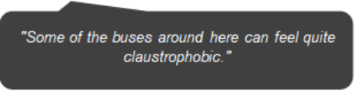
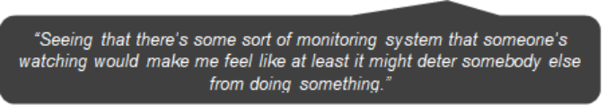
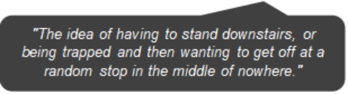
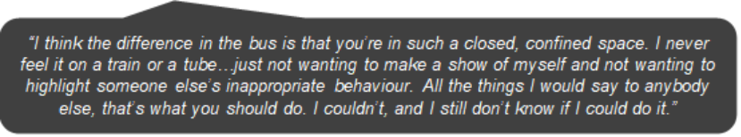
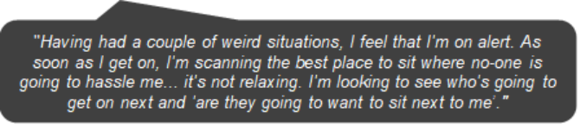
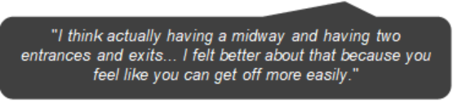
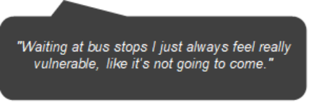
Bus Travel – Focus Groups

Slide 29
Existing Bus Stop Review
During the desktop reviews of both bus routes, the following were identified as working well:
Movement paths are accessible and legible in some of the more built-up areas, with formal crossing points that account for pedestrian desire lines, wide footways and smooth surfacing.
The quantity of overhead street lighting along most of the movement paths in the more urban areas appeared sufficient and likely to contribute to a sense of security through increased visibility.
At several of the stops along each route, the provision of infrastructure at bus stops is accessible and contributes to the perceived safety for users.
Good wayfinding was observed at some key transport hubs.
Several stops in urban areas were identified as having additional artificial lighting which seemed unobstructed and well-positioned.
Infrastructure in proximity to one of the routes, including secure cycle parking, Sheffield stands and Park & Ride sites, encourages multi-modal journeys.

Slide 30
Issues
During the desktop reviews of both bus routes, the following issues were identified:
Movement paths to and from bus stops can be poorly defined, with widths often falling below 2m.
High vegetation coverage along movement paths reduces natural lighting, which may create dark spots and impact visibility.
Street lighting is not multi-layered, which may pose issues along shared use paths. Vegetation coverage sometimes obstructs street lighting.
There is no / limited CCTV or security personnel found along each route.
Large sections along each route have no active frontage, high vegetation coverage / overgrown vegetation, and / or limited infrastructure.
Mobile service may be unreliable in rural areas along each route.

Slide 31
Issues (cont.)
Maintenance of pedestrian routes along each route is insufficient.
Particularly along the rural sections of each route, although also an issue within the urban centres, footways are in poor condition, with narrow widths and cracks in the surfacing which leads to pooling.
A number of points along the route, where it is expected that footfall is relatively high, lack adequate crossing facilities, with either absent or insufficient dropped kerbs and tactile paving.
There is very limited street furniture provision along each of the routes. This impacts the inclusivity of the routes, as it limits the number of resting points that may be needed by certain users.
There are few landmarks and pieces of public artwork along each route.
There is a significant range in shelter provision.
Particularly in the more rural sections along each route, the narrow footways can create conflict between bus users and pedestrians.
There are several instances along the route where bus stop information is inaccessible. There is an absence of real-time information at the majority of stops along each route.

Slide 32
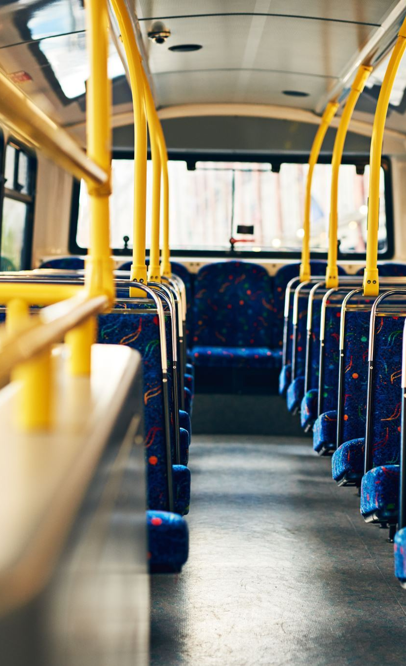
Recommendations
From the outputs of the desktop SIAs and focus groups, the following recommendations were developed:
Engage with wider groups to understand the spectrum of lived experience (e.g., users with visible disabilities).
Explore different methods of gathering feedback to monitor and assess progress and address incidents promptly.
Engage with all bus operators in the region to ensure their websites and apps include clear, accessible information on how to report incidents, seek assistance, or raise safety concerns, including guidance for responding to safety issues.
Implement education and awareness campaigns to provide:
  Information on reporting (i.e. what should be reported / how to report / where to get support)
  Behaviour change campaigns.

Slide 33
Recommendations (cont.)
Implement Safe Haven schemes in bus stations to provide designated areas where passengers can seek refuge and assistance in times of need. Provide relevant training for staff and engage with local authorities to incorporate lessons learned from previous schemes.
Develop a policy allowing passengers to safely disembark outside designated bus stops during late-night hours, where appropriate, to enhance personal safety. Include guidance for drivers on assessing safe locations.
Introduce ‘Help Points’ at bus stops at busy inner city bus stops and isolated suburban/rural areas.
Establish a dedicated team of Transport Safety Officers to patrol Cambridgeshire’s bus network. Engage with other UK authorities, such as Transport for West Midlands, West Yorkshire Combined Authority, and Stoke-on-Trent, to learn from existing schemes.
Implement multiple door boarding and alighting on bus routes (as in London). This reduces fear of being in a closed, confined space for passengers.

Slide 34
Recommendations (cont.)
Implement digital platforms, such as mobile apps or online reporting forms, to allow passengers to report safety concerns. Provide clear instructions on how to use these platforms, ensuring they are user-friendly. Integrate reporting with ticketing where possible to simplify the process.
Implement audio announcements on buses and at bus stops to indicate the next stop and when the bus will stop. Test these announcements with users who have visual impairments. At bus stops along shared-use paths (e.g., near Hinchingbrooke Hospital), include signage and announcements to alert passengers to potential cyclists when alighting.
Clear and maintain vegetation along movement paths to support accessibility and visibility. Focus on footways, lighting, wayfinding, bus flags, and routes with high vegetation coverage, isolated areas, green spaces, and where houses are set back from footways. Include maintenance budgets in all infrastructure projects to allow for ongoing upkeep.

Slide 35
Recommendations (cont.)
Provide wayfinding along routes, including public maps and clear signage. Where possible, include walking and cycling distances to key destinations.
Produce a comprehensive lighting strategy, including a review of existing street lighting. Focus on providing clear visibility of paths and surroundings, taking into account the safety needs of users and the ecological impact of artificial lighting. Include a plan for regular maintenance to keep lighting effective over time
Install CCTV along routes, particularly in obstructed or quieter areas around bus stations. Include regular maintenance and checks to ensure cameras are operational.
Where space allows, provide dedicated rest areas for pedestrians and cyclists, equipped with seating, shelter from the elements, and clear signage. Place strategically at regular intervals and in well-lit, visible locations. Incorporate amenities such as waste bins, bike racks, and accessible space for wheelchair and buggy users to support all users’ needs.
Bus stops should have a flag at a minimum to indicate the stop location and display information on the routes serving the stop and the timetable. While timetables provide essential information, it is recommended that real-time information is made available at all bus stops, particularly those with seating and shelters.

Slide 36
Next Steps – CPCA
As the second phase of work investigated women and girls' safety on buses, the next steps for the project's findings are being taken forward by the Cambridgeshire and Peterborough Combined Authority (as strategic transport authority). These are being developed but may include:
Developing an educational, behavioural change campaign to address how to report incidents, what is unacceptable behaviour and anti-harassment awareness.
Implementing a plan for maintenance and long-term upkeep in relation to vegetation management, lighting, footway surfacing, drainage, and overall accessibility. An initial bus network accessibility plan will be published by 1 April 2027.
Delivering on the recommendations around bus stops, through an approved Bus Stop/Shelter Infrastructure Improvements project, which will deliver targeted improvements to enhance passenger experience, accessibility, and real-time information provision. This will help support increased and more inclusive bus use.
Developing a monitoring and evaluation framework to establish KPIs for lighting, vegetation, CCTV, bus reliability, and user perceptions.

