Slide 1

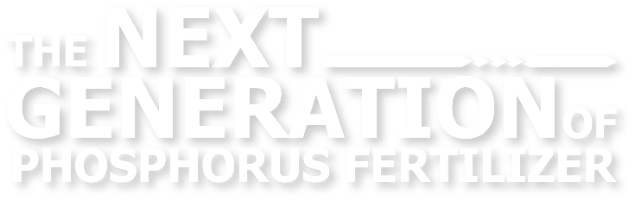

Agronomy Overview
Updated April 2026

Slide 2
The Phosphorus Efficiency Problem
P
Current Options
P
P
Traditional Fertilizers
Require increased application rates to compensate for soil fixation
Added cost to overcome inefficiency
P
Soil
P
P
P
The majority of applied phosphorus gets fixated in the soil, leaving it unavailable to crops in the year of application.
Additive Products & Biologicals
Attempt to prevent soil fixation or loosen P from the soil
Often requires behavior and equipment change; additional cost
10%
Soil - Bound
Plant-Delivered Phosphorus
Plant-Unavailable Phosphorus

Slide 3

RhizoSorb Offers a New Solution
Improved Phosphorus Uptake
P
P
P
Soil
P
Phosphorus is pre-bound to RhizoSorb® during manufacturing, creating a more efficient dry fertilizer granule
RhizoSorb® enables twice the applied phosphorus to be used by the crop as needed throughout the growing season
Far less is bound to the soil, leading to improved availability and uptake
Notes:
The solution is RhizoSorb®. Through extensive research, testing and trialing, Rhizosorb® was brought to market in 2023.
In the manufacturing process, phosphorus is pre-bound to the RhizoSorb, which significantly reduces the reactivity to soil properties, like Ca, Fe, Al, OM & many other factors that adversely affect phosphate. This leads to greater availability and improved plant uptake
RhizoSorb enables twice the applied phosphorus to be used by the crop.

Slide 4
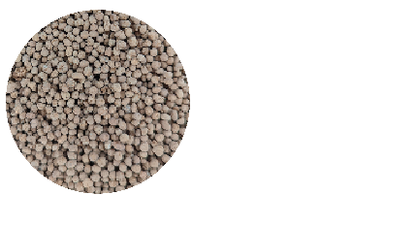
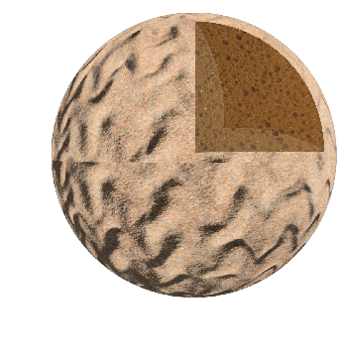
1. Replaces Conventional Phosphates
RhizoSorb is a patented technology integrated into dry-granule phosphate production to improve nutrient use efficiency.
RhizoSorb® 8-39-0 is sold as a direct replacement to monoammonium (MAP) and diammonium (DAP) phosphate fertilizer.
2. Novel Active Ingredient
RhizoSorb is composed of a blend of metal oxides with phosphorus adhered to the surface during production to increase phosphorus availability and uptake throughout the growing season.
P
P
P
3. Soil Chemistry Approach
P
P
Surface interactions between RhizoSorb and phosphorus ensure plant availability by preventing soil tie-up and loss to the environment.
P
P
4. Optimal Nutrient Delivery
RhizoSorb’s plant-driven release controls the delivery of nutrients based on a chemical gradient established between the product surface and the soil-water solution where plant available nutrients are absorbed by the roots.
P
P
Notes:
(BR)---maybe shorten this explanation?
RhizoSorb is a patented and proprietary technology that is changing the way we use and view phosphate fertilizer.
This active ingredient, when integrated into the manufacturing process increases efficiency throughout the mining & production to our fields.
With the nutrient delivery system, it functions in the soil, as a controlled release over the course of the growing season to feed the crop. MAP/DAP do not function this way.
RhizoSorb is a soil chemistry approach that improves plant use efficiency and reduces soil interaction affecting phosphate and reduces off site movement into rivers, lakes and streams
RhizoSorb is not a biological material.
There is nothing like RhizoSorb in the market today for dry phosphate fertilizer. RhizoSorb 8-39-0 is a stand-alone fertilizer and is sold a direct replacement to MAP & DAP.
This is some exciting stuff!! Finally, some advancements in dry phosphate!

Slide 5
RhizoSorb® Maintains Granule Quality
 | RhizoSorb 8-39-0 | MAP | DAP
Crush Strength (lbF) | 7.90 | 8.10 | 8.67
Angle of Repose | 31° | 31° | 36°
Size Guide Number (SGN) | 260-340 | 250-350 | 250-350
Uniformity Index | 40-60 | 40-60 | 40-60
Salt Index | 16.3 | 26.7 | 29.2
Bulk Density (lb/ft³) | 65.1 | 63.0 | 67.0
pH | 4.8-5.4 | 3.9-4.1 | 7.3-7.8
Moisture Content | 3.0 | >1.0 | >2.0
Attrition | 0.3% | 1-2% | 1-2%
RhizoSorb granule characteristics are comparable or better than MAP/DAP
RhizoSorb exhibits a significantly lower salt index
Notes:
Since RhizoSorb is made in the same large scale fertilizer plants, it is virtually identical to MAP/DAP , but with a 38% lower salt index.
When you consider the lower use rate, this equates to approx. 70% reduction in salt index.
Perfect for strip tillers or seed row placement.
It has the same spreading, handling and storages characteristics as MAP/DAP, making it a simple change.

Slide 6





RhizoSorb Development History
1991
2016
2018
2021
2023
Initial technology developed by Penn State researchers
Phospholutions
founded, IP licensed
RhizoSorb® studied
in small plot trials
RhizoSorb® performance + on-farm trials conducted across US
Commercial launch through Ag retail
Notes:
The concept for Rhizosorb was developed and proven out by Dr. Jonathon Lynch of Penn State University in the early 1990’s.
Our Founder and CEO Hunter Swisher, licensed the initial technology from the University as an undergrad and it began its pathway to market in 2016 .
RhizoSorb is our patented phosphate efficiency technology that has been extensively studied for commercial use since 2018.
Over the last 7 years with nearly 600 small plot replicated and on-farm trials, our team of scientists have thoroughly vetted RhizoSorb’s performance in row crops, like corn, soybeans and wheat.
In 2023 we launched RhizoSorb 8-39-0 to the industry. <Next slide>

Slide 7
Proven Across Hundreds of Field Trials
Small Plot Trials
  Small plot trials have been conducted with 12+ research partners at 25+ locations.
  161 cumulative trial site years of testing.
Land Grant University Endorsed
  5+ years of Plot-on-Plot trials with Penn State.
  Penn State research faculty has endorsed RhizoSorb as an EEF (Enhanced Efficiency Fertilizer).
On-Farm Trials
  5 years of on-farm trials conducted on a minimum of 20-acre, side-by-side plots.
Hundreds of small plot, university, and on-farm trials have proven that RhizoSorb® 8-39-0 maintains yields with a 50% reduction in P₂O₅ application rates compared to grower standard practice (GSP) with 100% P₂O₅

Slide 8
Effective Across Soil Textures, Corn
Soil texture does not impact performance of RhizoSorb
All treatments represent RhizoSorb applied at 50% P compared to grower standard practice (GSP) 100% P
184 unique soil textures assessed across small plot & on-farm trials
N = 184

Slide 9
Effective Across Soil Phosphorus Levels, Corn
RhizoSorb maintains yields at low, medium, and high soil test phosphorus (STP) levels with 50% less applied phosphate.
Soil test phosphorus levels do not impact RhizoSorb performance
Data from 60 on-farm trials.
<20 ppm P: 11 trials
20-40 ppm P: 35 trials
>40 ppm P: 14 trials
y = -0.0006x + 1.0359, R² = 0.0394
Bray-2 Reported to provide a more accurate long-term
assessment of phosphorus sufficiency is soils over time.
Dots represent RhizoSorb® applied at 50% P of GSP
Not all growers have reported STP values

Slide 10
RhizoSorb Performance Across pH Ranges, Corn
Data represents RhizoSorb applied at 50% P₂O₅ against grower standard practice (GSP) 100% P₂O₅
pH is not a significant driver of product performance
(n=95 unique test points)
Data reported from on-farm trials
y = 0.0035x + 0.9897
R² = 0.0027

Slide 11
Soil Test Phosphorus Drawdown Study
Plot-on-Plot Trials Overview
Data Validation
RhizoSorb has been trialed year over year on the same plots, proving that a 50% P₂O₅ reduction does not impact soil test phosphorus values or crop yields.
Trial Selection
P-responsive sites with low soil-test phosphorus (STP <25ppm) were selected for evaluation.
Trial Setup
Small plot studies, 6 replications per treatment, 8 locations, 32 site years.
Results
RhizoSorb plots continue to maintain STP and crop yields year after year.

Slide 12
RhizoSorb® Maintains STP with 50% Phosphorus
Soil tests are performed prior to phosphate application every year.
RhizoSorb efficiently delivers phosphate to crops and overcomes the need to build soil phosphate reserves.
After 5 years of trialing at 50% P2O5, in low phosphate soils, soil test phosphorus is maintained.
Year
Bray-2 is reported to provide a more accurate long-term assessment of phosphorus sufficiency in soils over time.
Notes:
Based upon current conventional approaches to phosphate and soil fertility, we have been taught to apply enough material all “build soil test phosphorus levels”, and many are working to maintain high testing P soils.
Application recommendations for RhizoSorb® are at a 50% reduction in comparison with grower standard practice for phosphate applications.
Example: if you are applying 80#’s/ac of P2O5 through MAP/DAP, RhizoSorb® would be applied at 40#’s/acre of P2O5.
One of the biggest concerns among growers and agronomists have with applying less fertilizer is “what will happen to my soil test P values”.
This has been a concern of ours as well and has been a component of our extensive trial work over the years. We have studied the long term affects of continued use of RhizoSorb® year over year and it has determined that after 4 years of plot-on-plot applications has statistically maintained soil test phosphorus with 50% less P2O5 year after year. This is an on-going study both in small plots and field scale on-farm use of RhizoSorb®
These trials show that we are not mining the soil with RhizoSorb®. You can apply less phosphate while maintaining soil test P levels and meet crop demand for P. <next slide>
Over the last 4 years we have conducted replicated year over year, plot on plot trials looking at RhizoSorb as applied at 50% less P compared to a standard application.

Slide 13
RhizoSorb® Maintains Yield with 50% Phosphorus
RhizoSorb year over year on the same plot, at 50% P, maintained the same or better yields as 100% P plots
Small plot studies, 6 reps per treatment, 8 locations, 32 site years. Rates:
  - Control: 80lbs/ac P₂O₅
  - RhizoSorb: 40lbs/ac P₂O₅
RhizoSorb and Control rates remained the same year over year
Notes:
An additional component of these year over year, plot on plot trials, crop yield are maintained and slightly ahead of grower standard phosphate fertilizer applications.
RhizoSorb can maintain or increase yields year over year with lower application rates compared to MAP/DAP <next slide>

Slide 14
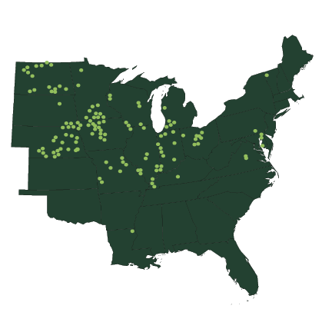
Same or Greater Yields with Less P
50% Phosphorus Applied
50% Phosphorus Applied
50% Phosphorus Applied
50% Phosphorus Applied
50% Phosphorus Applied
195 on-farm trials in 22 states spanning 5 years
Notes:
195 trials in 5 years in 22 states
Since 2021 we’ve conducted more than 190+ On Farm field scale trails of at least 20 acres or larger in 22 states.
Our success rate averages 83% when comparing Rhizosorb to a growers’ standard practice for dry phosphate applications.
When we combine these on farm results with our small plot replicated results, we now have over 700 data points that have collected, through 2025 growing season.
Collectively our testing and trialing programs has been in place now for over 9 years.

Slide 15
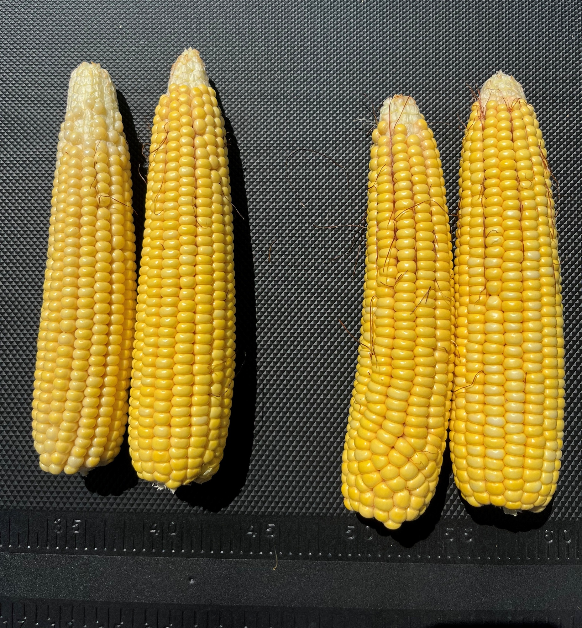
Results Across Crops
50% Phosphorus Applied
50% Phosphorus Applied
50% Phosphorus Applied
50% Phosphorus Applied
Grower Standard Practice
RhizoSorb
50% Phosphorus Applied
Notes:
And we’re seeing these results across crops. We’ve also tested on Soybean, Wheat, Canola, and Potatoes – all showing strong performance. We have enough data on soybeans and wheat to share those results statistically.

Slide 16
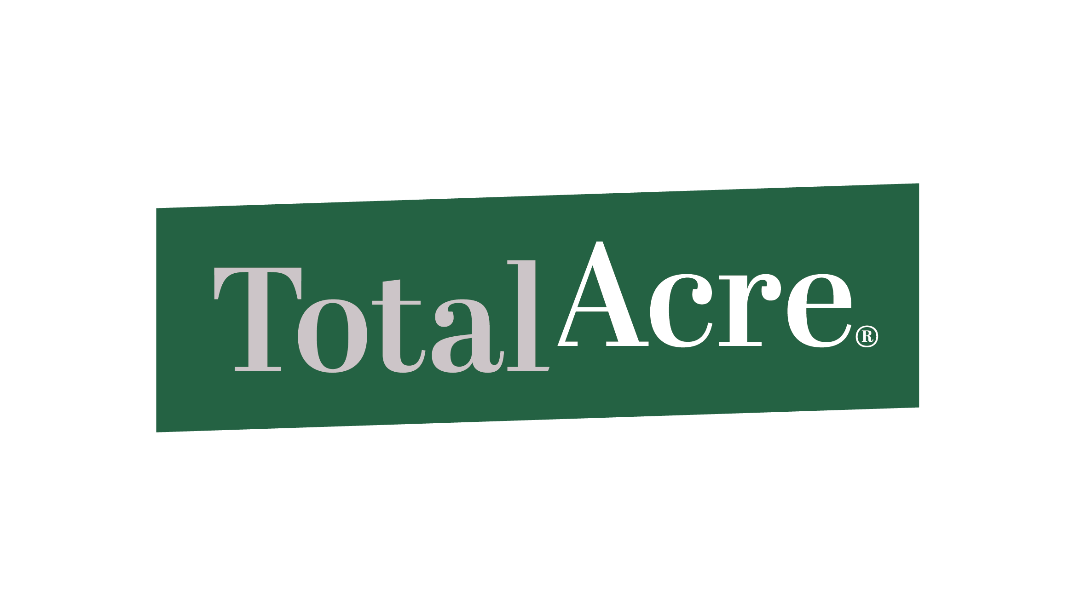
Corn, On-Farm 2024 Tissue P Levels
50% Phosphorus Applied
50% Phosphorus Applied
50% Phosphorus Applied
50% Phosphorus Applied
Data Collected by
RhizoSorb
Grower Standard Practice
n=27
Notes:
184 trials in 4 years in 18 states

Slide 17

P
P
P
P
P
Soil
P
P
P
70-90% of MAP/DAP is Tied-up in Soil
RhizoSorb Enables 2x More Applied Phosphorus Uptake
Proven Across
Hundreds of Trials
$$$
No Impact to Soil Test Phosphorus Levels
Reduced Application Cost, Not Nutrition
Sustainability Without Cost or Yield Impact

Slide 18
Reasons Retail Locations Are Switching
Market Differentiation
Better Fertilizer Utilization
Operational
Value
Start selling agronomics and greater value, instead of fighting on MAP pricing alone.
Better margins per pound of P in the plant: more per ton for retailers; savings per acre for growers.
Serve more acres with every ton of fertilizer, optimizing storage, transportation, and handling.
Notes:
Differentiation in the Market
Stop trying to fight National Retail on price with MAP;
Sell agronomics and value
Phosphorous in the Plant vs Phosphorous in the Soil
Because our Rhizosorb’s plant availability, growers are paying less per pound of P IN THE PLANT.
Better utilization of every fertilizer dollar
33% reduction in volume needed to maintain yield and soil test levels compared to equivalent MAP Rate
Reduced Fuel, Trucking, Loading time, Handling, Storage
These things add up and deliver value above and beyond the 10% savings.
Big advantage for Strip Till/dry 2x2 applications

Slide 19
Retail Agronomist FAQ
What is RhizoSorb and how is it made?
How is RhizoSorb priced?
Patented metal oxide technology embedded in MAP that improves plant uptake and reduces costs. RhizoSorb is a more efficient and cost-effective phosphate fertilizer.
The technology improving phosphate use efficiency is embedded directly inside the granule during production of common fertilizers like Monoammonium Phosphate (MAP).
RhizoSorb is priced so it is always cheaper compared to MAP/DAP.
Due to the increase in efficiency, the product is positioned to have both a lower carrying cost to the retailer and to be cheaper per acre for the grower.
How does RhizoSorb work?
Why should I switch?
The technology controls the release of phosphorus from inside the fertilizer granule, preventing phosphate from binding to the soil.
RhizoSorb feeds the plant, not the soil – so more is used by the plant during the year of application. The result is higher efficiency and lower fertilizer cost per acre.
RhizoSorb’s increased efficiency over conventional phosphates offers more value to both retailers and growers.
Doing more with less means retailers can make more margin selling a differentiated product that growers see an immediate return on investment from.

Slide 20

We are Enhancing Global Phosphorus Use
Taylor Strehl
Technical Agronomist
tstrehl@phospholutions.com

