Slide 1
COASTAL WEALTH
How to Build Your
Optimal Financial
Freedom Plan
CRN202903-10605327
01 / 11

Slide 2

WELCOME
Todays Meeting Agenda
Our Firm and Services
CW
Understanding Financial Planning
Coastal's Process
Ongoing Model
Tax Control Triangle and Retirement Income
Next steps
CRN202903-10605327
02 / 11

Slide 3






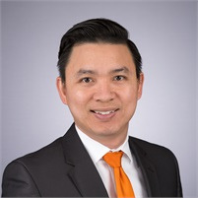




OUR TEAM
200+ Years of Experience
JH
AC
MD
RS
Dr. Jason E. Heller, CFP
Reed Willett
Nick Tranghese
Avery Chartier
Marcia Dryjowicz, CLU, ChFC
Ryan Solle
Senior Executive VP — Head of Planning Solutions Group
VP — Planning Solutions Group / Investment Specialist
Advanced Markets Manager
Planning Director
Life Specialist
Business Market Specialist
AN
MF
EB
NK
Anh Nguyen, CFA, CFP, MBA
Michele Friedlander, RHU, REBC
Sam Eppy
Elliot Barry
Noah Kahn
Certified Financial Planner / Wealth Management Advisor
DI/LTC Specialist
Head of Financial Planning Sales
Financial Planner
Financial Planner
CRN202903-10605327
03 / 11

Slide 4
WHAT WE DO
Our Services
Understanding what the prospective client has going on personally, financially and professionally comes first before any recommendations
Investment Strategies
Short Term Investments — Money Market Accounts
Mid Term Investments — 529 Plans
Long Term Investments — Retirement Plans
Insurance Strategies
Life Insurance
Disability Insurance
Long Term Care Insurance
Ongoing Financial Planning
Cash flow analysis
Savings & Investment Review
Liquidity review
Retirement planning
Tax planning
Insurance planning
Estate planning
04 / 11

Slide 5
FINANCIAL PLANNING
Six Areas of Financial Planning
Financial Position
Protection Planning
Investment Planning
Retirement Planning
Tax Planning*
Estate Planning*
• Cash reserve levels
• Cash reserve strategies
• Debt management
• Cash flow management
• Net Worth
• Discretionary Income
• Expected inflow/outflow
• Lines of credit
• Disability options
• Long-term care
• Umbrella liability
• Life insurance
• Medical/Health
• Property & Casualty
• Deductibles vs cash reserves
• Policy status
• Policy loans
• Beneficiary designations
• Special needs situations
• Alternate/add'l coverage
• Asset allocation
• Education planning
• Lump-sum accumulation
• Options/restricted stock/NQDC
• Ongoing investment fees
• Risk tolerance
• Tax implications
• Cost basis
• Time frames
• Diversification strategies
• Dollar-cost averaging
• Market timing issues
• Minimum distributions
• Pre-59½ strategies
• 401(k)s
• IRAs
• Medicare/Medigap
• Social Security
• Roth conversions
• Income streams
• Health care
• Tax transitions
• Risk tolerance transition
• Timing issues
• Retirement Income Projections
• Business Succession
• Tax reduction
• Tax deferral
• Tax avoidance
• Future taxes due
• Withholding
• Tax diversification
• Qualified investments
• Non-qualified investments
• Effects of liquidation
• Filing status
• Business ownership
• Non traditional ownership
• Asset Protection Strategies
• Estate balancing
• Capital transfer
• Asset ownership
• Trusts
• Wills
• Trust funding
• IRD
• Succession planning
• Special needs independents
• Minor children
• Generation skipping
• Short-term life expectancies
• Estate liquidity
CRN202903-10605327
05 / 11

Slide 6
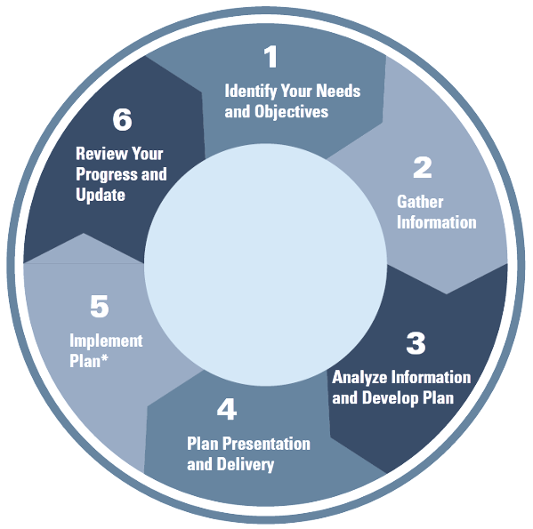

PHASE 1 & 2
OUR APPROACH
Initial Consultation (1 hour meeting)
Receive and Sign Fee Agreement
Your unique vision with our systematic approach
Receive and Pay Invoice
Receive and Complete/Return Fact Finder and Goal Development
PHASE 3
Meeting with Planner to review (30 min)
Steps to the process — Goal is to be 100% complete in 60 days.
a. Goals and Facts (Net Worth and Cash Flow)
b. Immediate Questions (Preliminary Analysis)
PHASE 4 & 5
Meeting for delivery of the formal financial plan (1 hr)
Meeting for implementation and next steps (1 hr)
Impromptu or scheduled meetings as needed
PHASE 6
Establish annual review to discuss Year 2+ changes and new goals
CRN202903-10605327
06 / 11

Slide 7
ANNUAL CYCLE
Ongoing Planning Model
Q1. Financial Planning Topics
Q2. Investment Planning
Accumulators: Identify savings opportunities and vehicles
Accumulators: Growth
Pre-Retirees: Expand the margin of safety & identify catch-up opportunities
Pre-Retirees: Position assets for future needs
Retirees: Identify income needs & resources
Retirees: Distribution strategy
GENERAL CONCEPTS
GENERAL CONCEPTS
• Tax strategies for the year
• Risk tolerance review tied to goals
• Cash flow
• Review overall investment strategy & holdings
• Net worth
• Account review and maintenance
• Goals review
Q4. Year End Tax Planning
Q3. Protection Planning
Accumulators: Time, tax, diversification
Accumulators: Employee benefits review; ensure protection needs are met
Pre-Retirees: Marry current tax needs with future tax planning
Pre-Retirees: Utilize current cash flow to ensure retirement benefits are adequate
Retirees: RMD planning, gifting, & tax distribution planning
Retirees: Review short- and long-term needs (Health, Chronic Care, Legacy)
GENERAL CONCEPTS
GENERAL CONCEPTS
• Year end tax planning
• Full protection review
• Tax loss harvesting
• Estate Planning
• Future taxes
• Beneficiary designation
07 / 11
CRN202903-10605327
• Summary of annual accomplishments
• Begin planning for the following year

Slide 8
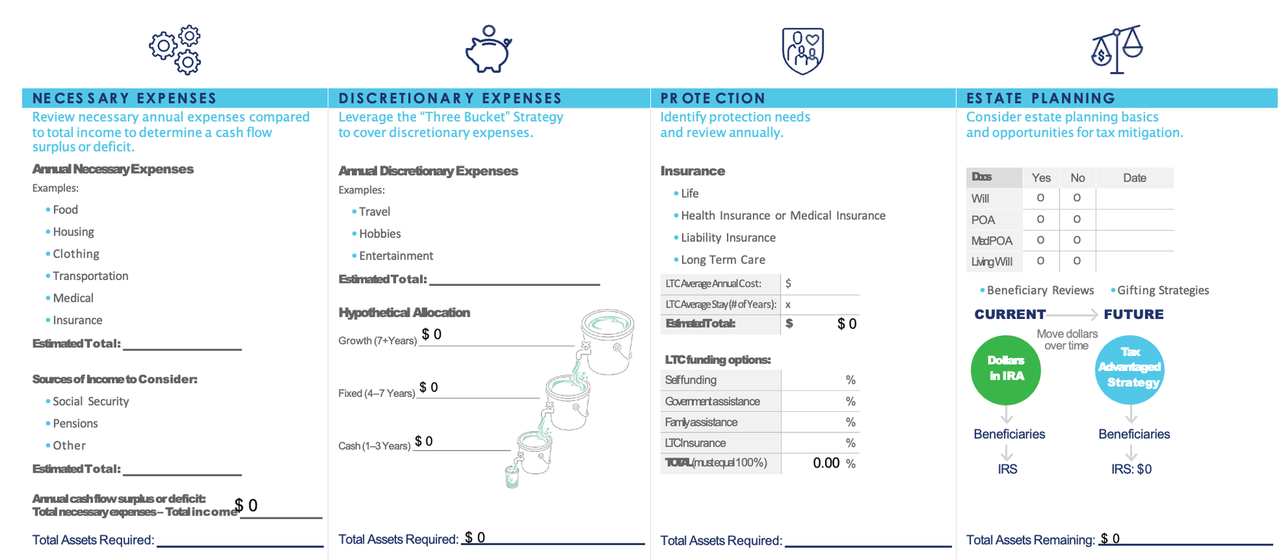
Financial Planning Services
Retirement Income
Framework
CRN202903-10605327
08 / 11

Slide 9
FINANCIAL PLANNING SERVICES
After tax
$ IN
Potential for tax free OUT
Tax Control Triangle
TA X
ADVANTAGED
Tailoring a strategy that's right for you
Because different types of accounts and investments offer specific tax advantages, you can gain more control over your future taxes by placing money in a variety of assets. Taxation is just one consideration when making investment decisions.
After tax $in
TAXABLE
TA X
DEFERRED
Before tax or after tax
$ IN
Let's take a look at your current portfolio and tax diversification opportunities for your situation.
Taxable OUT
(Capital gains or Dividends and Interest)
Taxable OUT
(Ordinary income)
CRN202903-10605327

Slide 10
TAX DIVERSIFICATION
Tax Control Worksheet
Please only fill out the rows and fields that start with orange text. | Tax-Advantaged | Taxable | Tax-Deferred
Current asset level: | $ 15,000.00 | $ 125,000.00 | $ 325,000.00
Current asset %: | 3% | 27% | 70%
Recommended asset level: | $ 186,000.00 | $ 139,500.00 | $ 139,500.00
Recommended asset % (must total 100%): | 40 % | 30 % | 30 %
Future Need Scenarios
Annual Income Need (Investable Assets) | $ 300,000.00
Assumed Capital Gains Tax Rate: | 20 %
Assumed Ordinary Income Tax Rate (Federal & State): | 30 %
Annual Asset Need | Current Scenario | Recommended Scenario
Tax-Advantaged: | $ 9,677.42 | $ 120,000.00
Taxable: Need ÷ (1-Capital Gains Tax) | $ 100,806.45 | $ 112,500.00
Tax-Deferred: Need ÷ (1-Ordinary Income Tax) | $ 299,539.17 | $ 128,571.43
Assets Needed For One Year: | $ 410,023.04 | $ 361,071.43
Difference (tax savings per year): |  | $ 48,951.61
# of Years in Retirement |  | 35
Potential Tax Savings in Retirement |  | $ 1,713,306.45
CRN202903-10605327
10 / 11

Slide 11
SERVICE TIERS
Our Planning Structure
Essential
Foundational Planning
Financial Planning
• Review of Financial Position
• In-Depth Review of 1-5 Key Areas
• In-Depth Review of 6+ Key Areas
— Emergency Fund & Liquidity
— Financial Position
— Financial Position
— Basics of Wealth Accumulation
— Investment Planning
— Investment Planning
— Insurance Products
— Education Planning
— Education/Protection Planning
• Summary of Recommendations
— Protection Planning
— Retirement/Business Planning
• Annual Touch Point
— Retirement Snapshot
— Tax & Estate Planning
• Reports from each area
• Reports from each area
• Summary of Recommendations
• Summary of Recommendations
• Access to Investor360
• Access to Investor360
• Financial Professional Access
• Access to PFV by Emoney/Right Capital
• Semi-Annual Plan Reviews
• Financial Professional Access
• Quarterly Plan Reviews
No Cost
1% of Household Income
$6,000 Minimum
$3,000 Minimum
OR $500 Per Month
CRN202903-10605327
11 / 11

