Slide 1



Sri Lankan - Australian Lawyers Association
CPD CONFERENCE
Mulgrave Country Club
Trust Accounting, Ethics & AML
10 Oct 2026
Aruna Colombathantri CA (ANZ),FIPA (Aus), FFA (UK), FCA (SL), LL.B (SL), Lawyer (Aus & SL)
Managing Partner
Australian Public Accountants

Slide 2

The regulatory framework
Related Act + Rules
Part 4.2 of the Legal Profession Uniform Law (LPUL), contained in Schedule 1 of the Legal Profession Uniform Law Application Act 2014 (Vic)
The Legal Profession Uniform General Rules 2015 (Vic) (General Rules 2015)
Legal Profession Uniform Law Australian Solicitors Conduct Rules 2015
Legal Profession Uniform Legal Practice (Solicitors) Rules 2015
Anti‑Money Laundering and Counter‑Terrorism Financing Act 2006
Trust money +
Trust accounts

Slide 3
The regulatory framework
Regulatory Bodies
The Legal Services Council
The Commissioner for Uniform Legal Services Regulation
The Victorian Legal Services Board
The Victorian Legal Services Commissioner
Trust money +
Trust accounts

Slide 4
The regulatory framework
S129 (1) definition of trust money
Trust money is money entrusted to a law practice in the course of or in connection with the provision of legal services by the law practice, and includes
(a) money received by the law practice on account of legal costs in advance of providing the services; and
(b) controlled money received by the law practice; and
(c) transit money received by the law practice; and
(d) money received by the law practice, that is the subject of a power exercisable by the law practice or an associate of the law practice, to deal with the money for or on behalf of another person.
Trust money +
Trust accounts

Slide 5
Trust money
Types of trust money and AML impact
General trust money (S 137)(S 137)(S 137)
Controlled money (((S 139)
Transit money (S 140)
Power money (S 141)
Written direction money (S 142)
Investment money – recorded in the register of investments (Rule 59)
Types of trust money & AML

Slide 6
Trust money
Part 2 of AML & CTF Act 2006—Customer due diligence
A reporting entity must undertake initial customer due diligence before providing a designated service to a customer. However, in special cases, initial customer due diligence may be carried out after the provision of the designated service.
• A reporting entity must undertake ongoing customer due diligence in relation to the provision by the reporting entity of designated services.
• Simplified customer due diligence may be undertaken in certain low risk circumstances as part of initial and ongoing customer due diligence.
• Enhanced customer due diligence must be undertaken in certain circumstances as part of initial and ongoing customer due diligence.
• Certain pre‑commencement customers are subject to modified customer due diligence.
• Exemptions from initial customer due diligence, and ongoing customer due diligence, apply in certain circumstances.
Types of trust money & AML

Slide 7
Trust money
What designated services are relevant for lawyers?
(1) For the purposes of AML & CTF Act 2006 , the following table 6 define:
(a) the provision of a designated service; and
(b) the person (the customer) to whom the designated service is provided.
Credit :The following summary of table 6 from NSW Law Society .
Person means any individual, a company, a trust, a partnership, a corporation, a body politic.
Types of trust money & AML

Slide 8
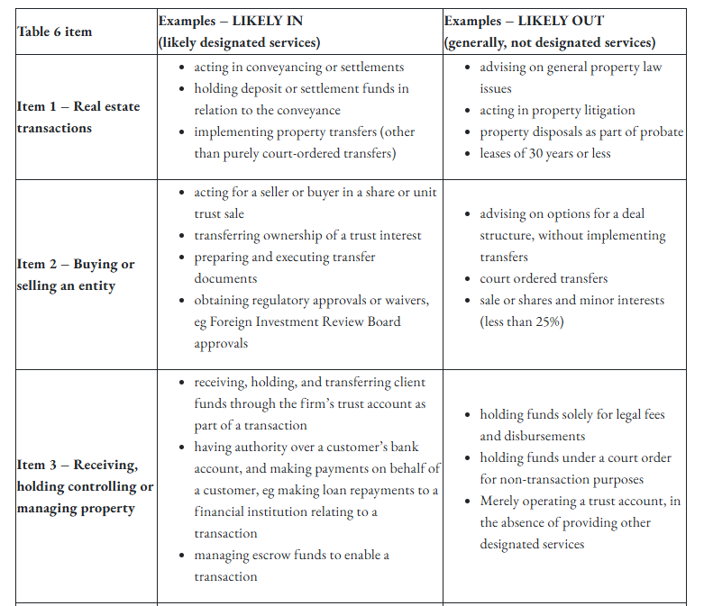
Trust money
Types of trust money & AML

Slide 9
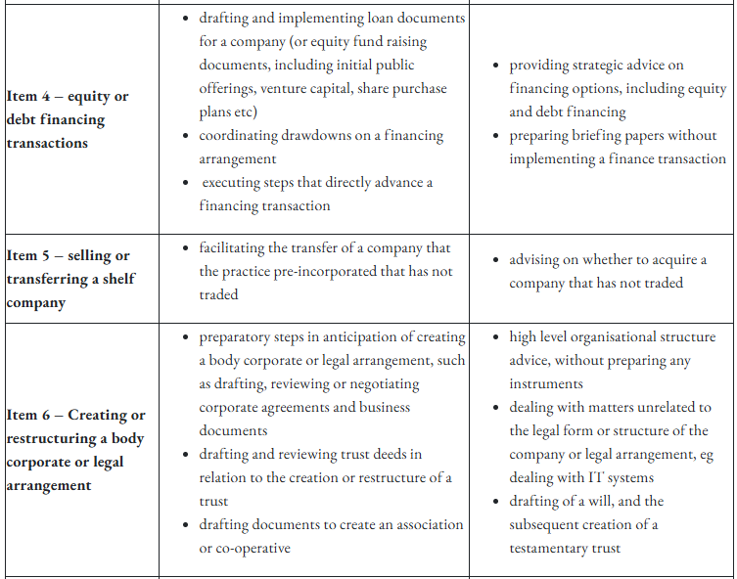
Trust money
Types of trust money & AML

Slide 10
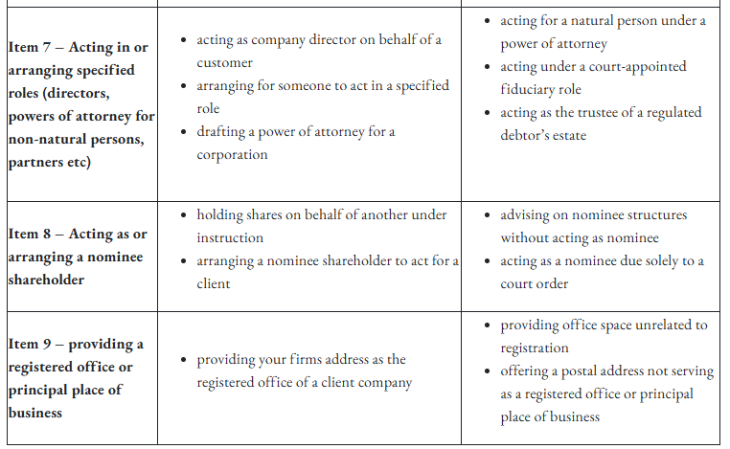
Trust money
Types of trust money & AML

Slide 11
Trust Records
General Discussion - Matter files
What AEE and Investigators expect to review in the Fidelity Fund Claim ?
Property Sale & Purchase files
Estate matter files
POA files
Criminal law files
Family law files
Personal injury law files
Litigation files
Commercial law files
Business law files
Insurance matter files
Migration law files
Others

Slide 12
AML/CTF-related amendments to uniform rules
The implementation of the Tranche 2 AML/CTF reforms introduces a profound shift in the legal profession's ethical landscape. It creates an inherent friction between a lawyer's traditional fiduciary duties to the client (such as absolute confidentiality and undivided loyalty) and their new statutory duties to the state as an AUSTRAC reporting entity.
To manage these ethical conflicts, formal changes were made to the Australian Solicitors' Conduct Rules (ASCR) and the Legal Profession Uniform Rules. The primary ethical changes and dilemmas facing the profession center on four major areas: [1, 2]

Slide 13
AML/CTF-related amendments to uniform rules
1. Confidentiality vs. Statutory Disclosure
A cornerstone of legal ethics is maintaining absolute client confidentiality. However, under the AML/CTF framework, lawyers providing designated services are legally mandated to report suspicious matters (SMRs) to AUSTRAC.
The Ethical Shift: Broad statutory disclosure acts as an explicit exception to the duty of confidentiality. To handle this ethically, Practice Rules require lawyers to explicitly warn clients in their initial retainer agreements that the firm has statutory obligations to disclose certain information and may be forced to terminate the relationship if compliance benchmarks are not met.

Slide 14
AML/CTF-related amendments to uniform rules
2. The "Tipping Off" Dilemma vs. Client Loyalty
Under the AML/CTF Act, it is a criminal offence to "tip off" a client that a Suspicious Matter Report (.SMR) has been or is being filed against them.
The Ethical Shift: This severely tests the ethical duty of undivided loyalty and the obligation to act in the client's best interests. If a lawyer files an SMR, they cannot tell the client why they are suddenly withdrawing from the matter or delaying a transaction. Practitioners must carefully navigate communication to ensure they do not inadvertently commit a tipping-off offence while trying to handle client inquiries ethically.

Slide 15
AML/CTF-related amendments to uniform rules
3. Redefining "Just Cause" for Terminating a Client
Under standard legal ethics, a lawyer cannot simply abandon a client mid-matter without "just cause" (e.g., a breakdown in the relationship or non-payment of fees).
The Ethical Shift: Amendments to Conduct Rule 8 (Client instructions) and Rule 13 (Completion or termination of engagement) explicitly align client instructions with Customer Due Diligence (CDD) compliance. If a client refuses to provide identity documents, hides their ultimate beneficial ownership, or triggers unmitigatable money laundering risks, the rules now legally and ethically define this as "just cause" for immediate termination of the retainer

Slide 16
AML/CTF-related amendments to uniform rules
4. "Wholesome Practice" vs. Turning a Blind Eye
Failing to identify money laundering risks is no longer treated merely as a regulatory oversight—it is now an ethical breach of integrity under Rule 5 of the ASCR.
The Ethical Shift: "Turning a blind eye" to obvious red flags, or wittingly structuring a transaction to help a client avoid AUSTRAC's $10,000 cash threshold, directly violates a lawyer's paramount duty to the administration of justice. Ethical compliance now requires active, risk-based vetting ("know your customer") rather than passive execution of a client's instructions.

Slide 17
AML/CTF-related amendments to uniform rules
“Rule 5 of ASCR - Standard of conduct—dishonest or disreputable conduct
5.1 A solicitor must not engage in conduct, in the course of legal practice or otherwise, which—
5.1.1 demonstrates that the solicitor is not a fit and proper person to practise law, or
5.1.2 is likely to a material degree to—
(i) be prejudicial to, or diminish the public confidence in, the administration of justice, or
(ii) bring the profession into disrepute.

Slide 18
Trust Records
General Discussion - Matter files
What AEE and Investigators expect to review in the Fidelity Fund Claim ?
Property Sale & Purchase files
Estate matter files
POA files
Criminal law files
Family law files
Personal injury law files
Litigation files
Commercial law files
Business law files
Insurance matter files
Migration law files
Others

Slide 19

General trust obligations and principles
S 148 Deficiency in trust account
A law practice, an Australian legal practitioner or any other person must not, without reasonable excuse, cause—
  (a) a deficiency in any trust account or trust ledger account; or
  (b) a failure to pay or deliver any trust money.
  Penalty: 500 penalty units or imprisonment for 5 years, or both.
  What is the deficiency ?
"deficiency" in a trust account or trust ledger account includes the non-inclusion or exclusion of the whole or any
part of an amount that is required to be included in the account. (S3.3.21 of LPA – Old Act)
How to avoid common deficiencies ?
  Check the ledger balance
  Check the bank account balance
  Check the transferee two – three times (Eg: Payments to local builder (Northern Firm) and transfer to overseas client St Kilda firm)
The key law practice obligations contained in the LPUL include:
Wellington - - Capital of New Zealand

Slide 20

General trust obligations and principles
S 154 Reporting irregularities and suspected irregularities
(1) As soon as practicable after a legal practitioner associate of a law practice becomes aware that there is an irregularity in any of the law practice's trust accounts or trust ledger accounts, the associate or entity must give written notice of the irregularity to the LSB. (Eg : City Law firm / Regional law firm)
In addition AEE (Eg: Northern Suburbs Lawyer) – ADI (Eg: Regional Lawyer ) must give written notice
(2) If an Australian legal practitioner believes on reasonable grounds that there is an irregularity in connection with the receipt, recording or disbursement of any trust money received by a law practice of which the practitioner is not a legal practitioner associate, the practitioner must, as soon as practicable after forming the belief, give written notice of it to the LSB.
Eg : Common in property, family law and estate as well as at the time of changeover the clients
The key law practice obligations contained in the LPUL include:
London - Capital of England

Slide 21
Discussion
External examinations of trust records - S 155
External investigations – S 163
External intervention (S 326) means the appointment of, and the exercise of the functions of, a supervisor, manager or receiver under Chapter 6.
Trust Account related cases
Regional lawyer - $800k – 1000k deficiency / family law / on going ,
City lawyer – struct off matter/ trust money allegation withdrawn/
Regional lawyer – External Intervention matter on going – probate
AML- funds move to trust account - suspects of robbery - long-term matter

Slide 22




Any Questions?
New York - USA
Toronto - Canada
San Francisco - USA
Singapore
22

Slide 23

Thank You!!!
ARUNA COLOMBATHANTRI
0439 630 358
Level 40, 140 Williams St, Melbourne VIC 3000
aruna@australianpublicaccountants.com.au
www.australianpublicaccountants.com.au

Slide 24


Slide 26
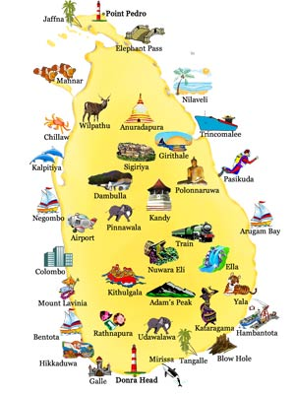


Large image
Sydney - Australia
26

