Slide 1

Managing Practice Risk: Conflicts, Conveyancing, and independent advice for BFAs
PRESENTED BY:
Jamie McCallum
Prevention & Risk Manager
& LIV Accredited Property Law Specialist

Slide 2
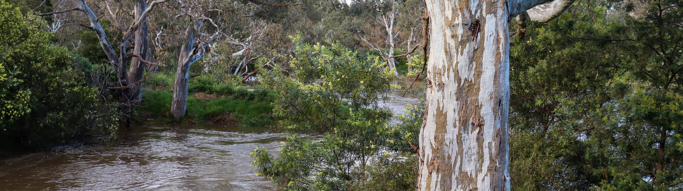

Acknowledgement
of traditional owners and country
I acknowledge the Wurundjeri Woi Wurrung and Bunurong People of the Kulin Nation as the Traditional Owners of the land on which we meet today. I pay my respects to their Elders past and present, and extend that respect to all Aboriginal and Torres Strait Islander peoples.

Slide 3
Why do mistakes matter to solicitors?
Client claims against you
Stress
Reputational damage
Financial costs
Time spent dealing with a mistake or claim

Slide 4
Combined claims data | 2025 - 2026

Slide 5
Work Intake and Clients -
Can I act, and should I act?

Slide 6

QR code to access SLIDO

Slide 7
Question 1 – Guarantee advice
You are approached by long standing clients to provide guarantee advice and solicitors’ certificates.
The clients are a husband and wife.
The husband is the sole director and shareholder of a company that operates a small business.
The company needs a loan from a private lender, and the lender will only provide the loan, if the husband and wife provide guarantees in favour of the lender.
The clients want you to provide the advice, because they have dealt with you before (particularly for the husband’s company) and you have acted on the purchase of the family home (which is in the name of the wife).
The clients are happy to be seen by you separately, so that ‘they get independent advice’.
You have not provided guarantee advice before, but you are not busy and have the time to take on the matter.

Slide 8
Do not edit
How to change the design
Question 1 - Guarantee advice - Do you?
The Slido app must be installed on every computer you’re presenting from

Slide 9

Acting for multiple parties – conflict of interests
Acting for multiple parties is high risk
  Who is your client?
  Did a party feel pressured to sign by the other party?
  Was your advice objective?
  Your duties as a lawyer under the Legal Profession Uniform Law Australian Solicitors’ Conduct Rules 2015, and the duty to avoid conflicts for:
  Former clients (rule 10) and,
  Current clients (rule 11)
  If you act for multiple parties in a transaction, how would you defend your actions in Court?

Slide 10
Double trouble – double excess
Clause 5 of the LPLC 2026-2027 (defence costs exclusive excess) policy states:
5. Deterrent excess
  The Insured will bear (in addition to any part of the loss which is excluded from cover under this contract) the first amount of each and every loss up to twice the specified amount, arising from any of the following. The deterrent excess does not apply to defence costs.
5.2 Multiple parties or interests
  Any matter or transaction in respect of which the Firm acted for or represented more than one party or interest.

Slide 11

Dabbling
Providing advice outside of your area of expertise, increases the chance of a mistake occurring or the client receiving incorrect advice, and is like playing with...

Slide 12
Work Intake & Retainer Management
Right Client
Right Matter
Right Time
Who is the client? – corporate, individual, trust, couple, joint venture
Do they have capacity, authority, right to deal?
Any conflicts?
Within firm’s area of expertise/business strategy?
Do we have the
resources
time
staff
to do this matter well?

Slide 13
You provide BFA advice, what are good risk management practices?

Slide 14
Question 2 – Family Law BFA
You are approached by a couple who are about to get married, and they want you to prepare a binding financial agreement.
You have previously acted for both of them in various matters.
The couple tell you that they have agreement on all of the key terms, and just need the BFA documented and signed.
They don't want to see other lawyers because they trust you, and your fees are more reasonable than your competitors.

Slide 15
Do not edit
How to change the design
Question 2 - Family Law BFA - Do you?
The Slido app must be installed on every computer you’re presenting from

Slide 16
Suggested steps when dealing with high-risk BFA’s
Know the law and only act for one party
Have client intake forms to obtain key information, such as assets
Review the documents in advance of the client meeting
Assess whether there is sufficient disclosure of assets. Is there missing information? Do further enquiries need to be made?

Slide 17
Suggested steps when dealing with high-risk solicitors’ BFA’s (continued)
Consider any amendments that may need to be made to the BFA (e.g. insufficient disclosure of assets, unfair terms)
Provide the client with written advice in advance of the meeting (see sections 90G and 90UJ of the Family Law Act 1975 (Cth))
Discuss your written advice with the client at the meeting (see sections 90G and 90UJ of the Family Law Act 1975 (Cth))
Ask the client to explain in their own words what are the consequences of the BFA that they are going to sign

Slide 18
Suggested steps when dealing with high-risk solicitors’ BFA’s (continued)
Take detailed notes of the clients understanding and responses
If the client appears to not understand, is rushing to sign, is being pressured to sign or further amendments need to be made to the BFA, it is recommended that the client does not sign the BFA until they have had further time to consider or the required amendments have been made to the BFA
Provide a post meeting letter of advice confirming what was discussed at the meeting, including any key information, such as why the client wanted to sign the BFA, the client’s understanding of the BFA or any amendments that you recommended
Refer to the case of Thorne v Kennedy [2017] HCA 49

Slide 19
You provide guarantee and solicitor’s certificate advice, what are good risk management practices?

Slide 20
Suggested steps when dealing with high-risk guarantee advice and solicitors’ certificates
Know the law and only act for one party
Have client intake forms to obtain key information
Review the guarantee documents in advance of the client meeting

Slide 21
Suggested steps when dealing with high-risk guarantee advice and solicitors’ certificates (continued)
Provide the client with written advice in advance of the meeting
Perform the Verification of Identity on the client in person and face to face. NO REMOTE VOI
Discuss your written advice with the client at the meeting
Ask the client to explain in their own words what are the consequences of the guarantee (and any security) that they are going to sign?

Slide 22
Suggested steps when dealing with high-risk guarantee advice and solicitors’ certificates (continued)
Take detailed notes of the client’s understanding and responses
If the client appears to not understand or is being pressured to sign, it is recommended that the client does not sign the guarantee documents, until after they have had further time to consider
Provide a post meeting letter of advice confirming what was discussed at the meeting, including any key information, such as why the client wanted to provide the guarantee, and the client’s understanding of the guarantee

Slide 23
Conveyancing risks

Slide 24
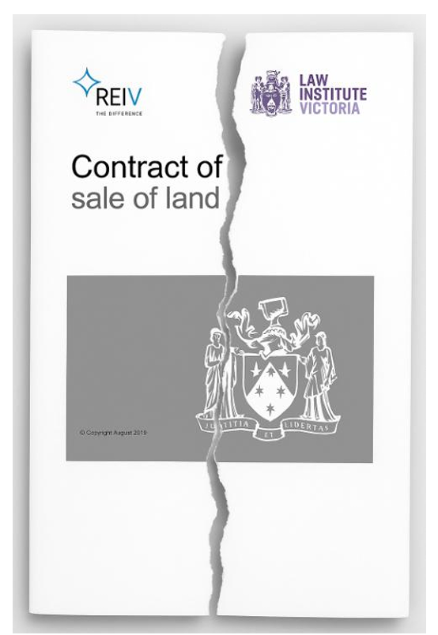

Common vendor claims
Defective section 32 statements
Owner-builder issues

Slide 25
Do not edit
How to change the design
Which certificates do you obtain when preparing a section 32 statement?
The Slido app must be installed on every computer you’re presenting from

Slide 26
A certificate could have helped…
A common scenario….
Solicitor acts for the vendor on the sale of a property in an older Melbourne Suburb, the property is worth $1.2 million, and a 10% deposit of $120,000 is payable by the purchaser upon signing.
Prior to settlement the purchaser realises that there is an unregistered sewer easement located within the property and not shown on the title diagram included in the section 32 statement.
The purchaser then terminates the contract and demands a full refund of the deposit.
The vendor has lost a sale, and now has to pay commission to the selling agent.
Vendor has to re-sell in a declining market?
The potential loss suffered by the vendor client is huge.

Slide 27
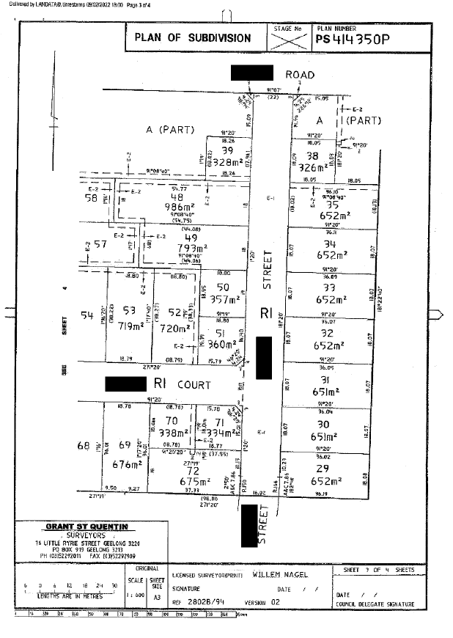
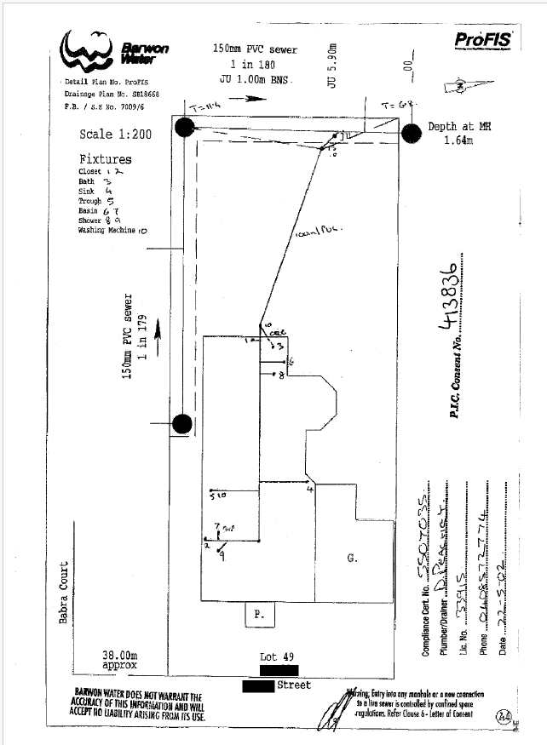
A certificate could have helped…
A common scenario….
In many cases if the vendor solicitor had obtained a water information certificate with the asset plan attached or a sewers and drain map, and annexed it to the section 32 statement, then this issue could have been avoided.

Slide 28

Owner-builder
Owner-builder also applies to building works that are not structural, can include:
    Installing a new kitchen or bathroom
    Enclosing a veranda with fly screens
    Moving an internal door including plastering and painting the walls
Need to be able to ask the client the right questions and then assess whether owner-builder applies.
Owner-builder issues matter, if section 137B of the Building Act 1993 (Vic) applies, and is not complied with before the contract signing, then the consequences can be brutal.
Purchaser may terminate any time prior to settlement.
Drop dead, no vendor defence mechanism like section 32 of the Sale of Land Act 1962 (Vic).

Slide 29
Resources

Slide 30
LPLC Free Risk Management Resources
Checklists:
Sale of land - questions for the vendor
Vendor practitioner section 32 statement and contract checklist
Purchase of land – questions for the purchaser
Webinars:
  Owner-builders and the section 32: How the law changed on 1 July 2026
  Solicitors’ Certificates and Guarantee Advice
  Tech Solutions for Risk Reduction in Property Law
  GST in property transactions
  Sale of real estate — Acting for vendors
  Sale of real estate — acting for a purchaser
LPLC landing pages:
  Family Law
  Securities (mortgages, and guarantees)
  Property

Slide 31

Get the latest LPLC news and alerts
Subscribe to the latest risk management updates, events, news and alerts by visiting:
lplc.com.au/subscribe
If you have a specific risk management question or need some help finding resources, you can contact us by phone on 03 9672 3800 during business hours, or via email at:
lawyersrisk@lplc.com.au

Slide 32
Questions?

