Slide 1

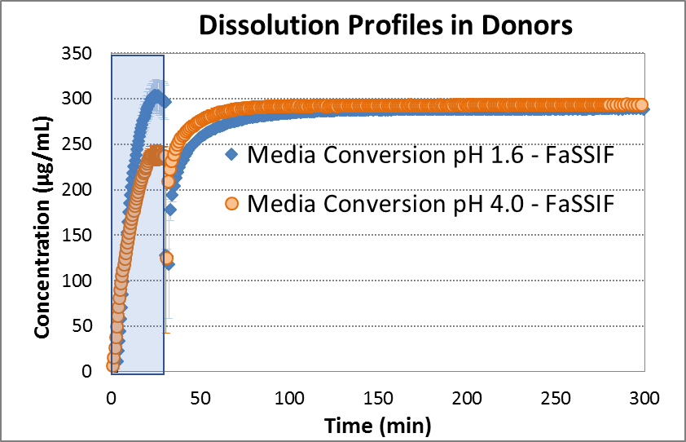
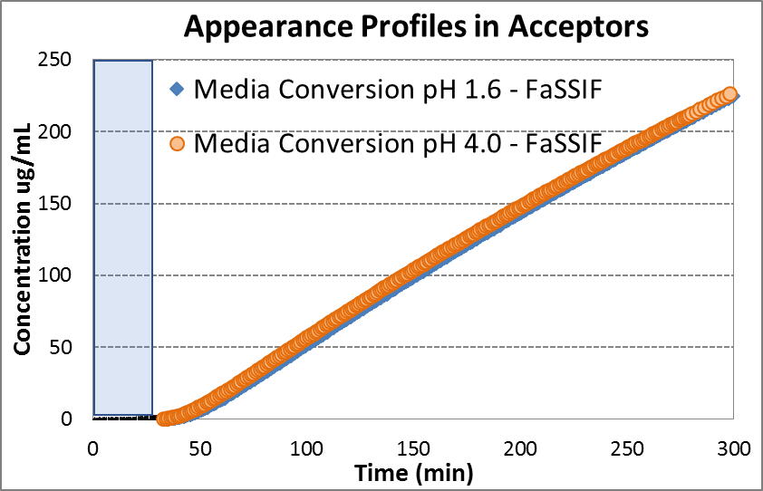
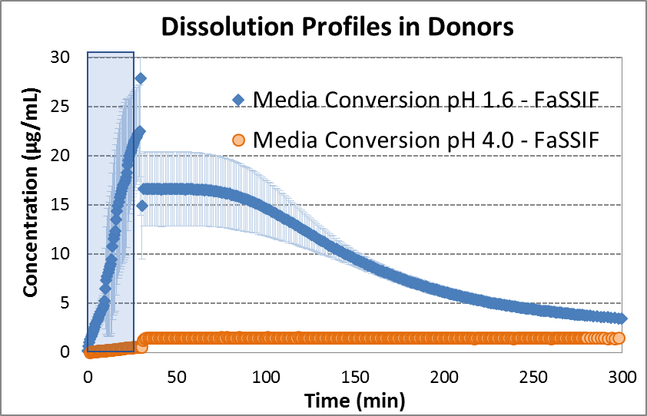
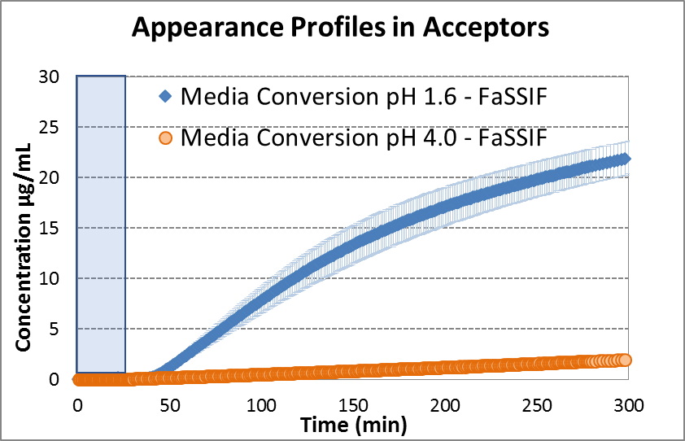
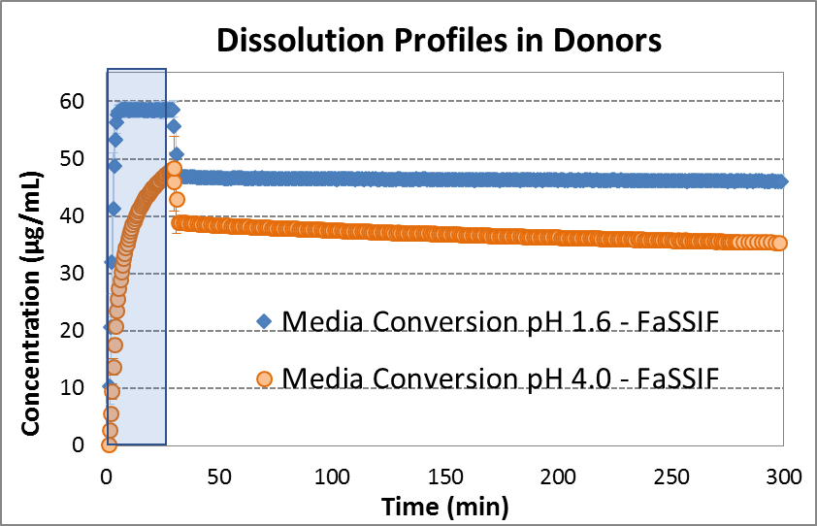
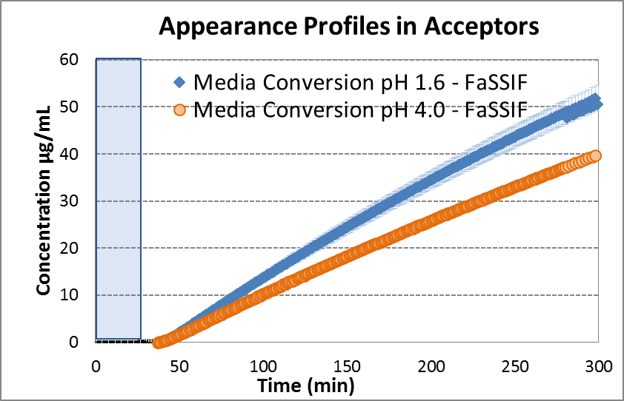
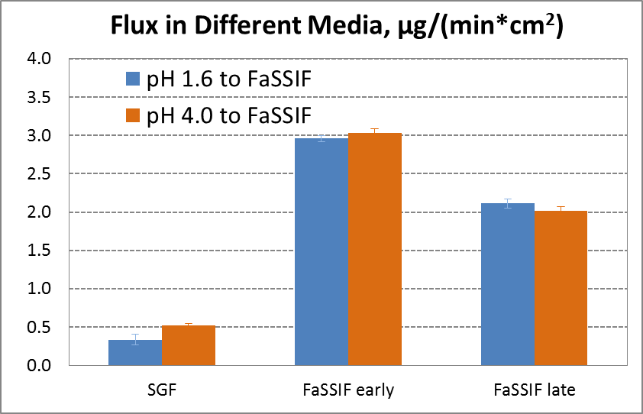
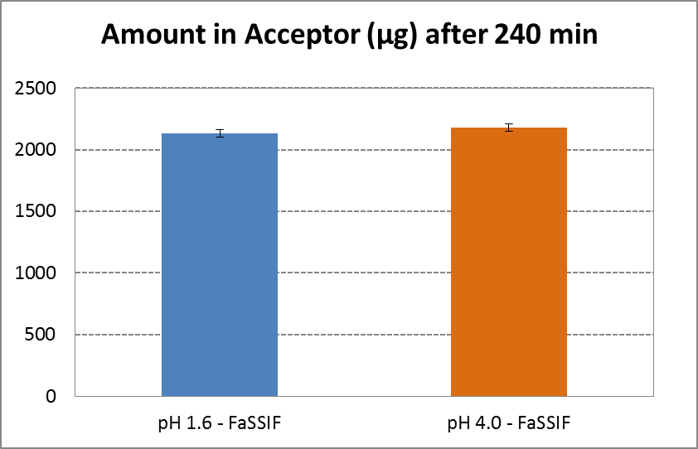
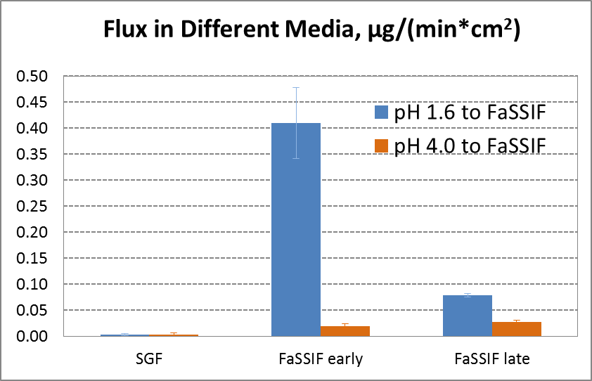
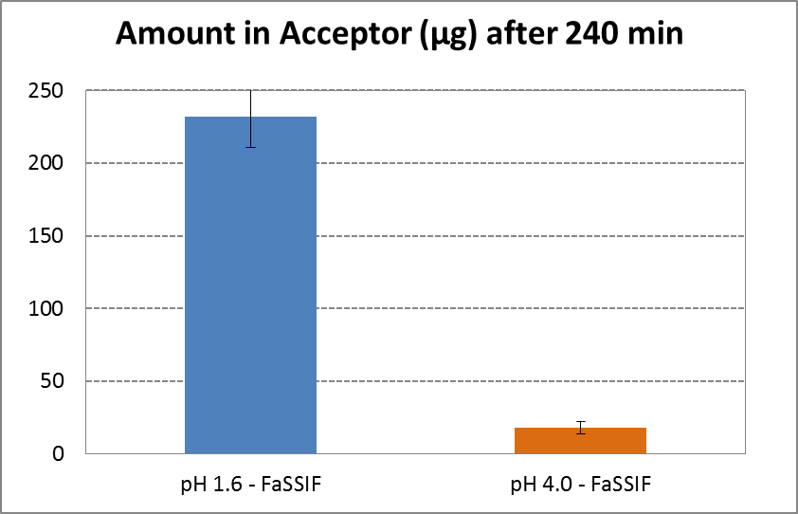
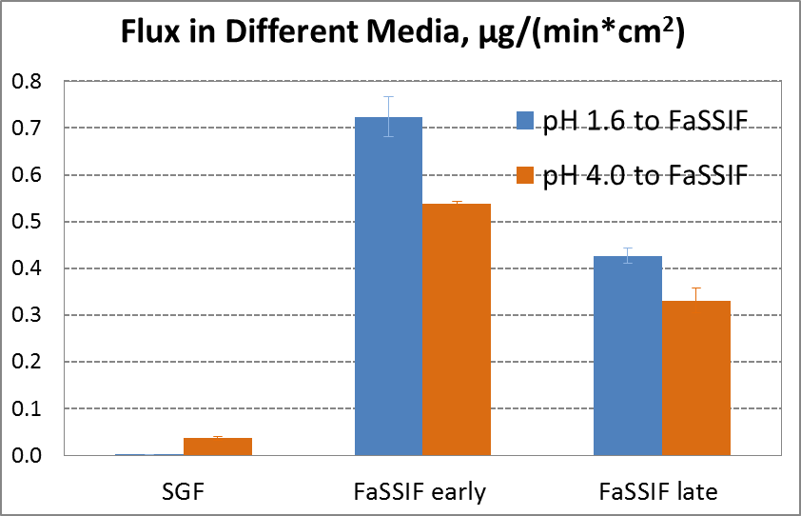
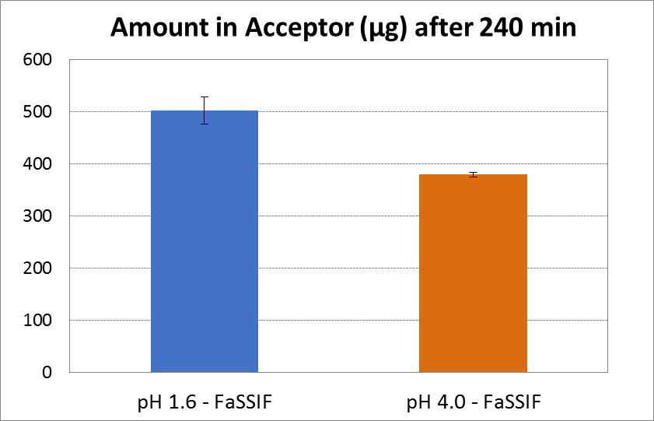
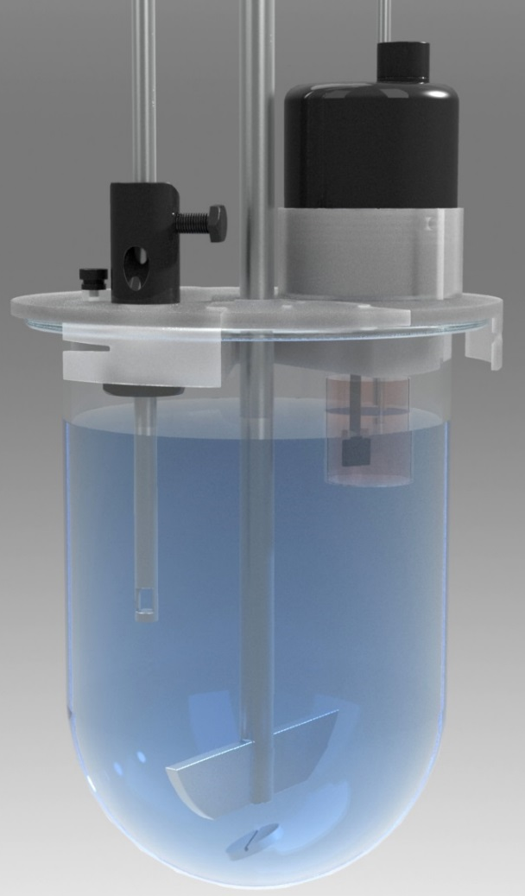
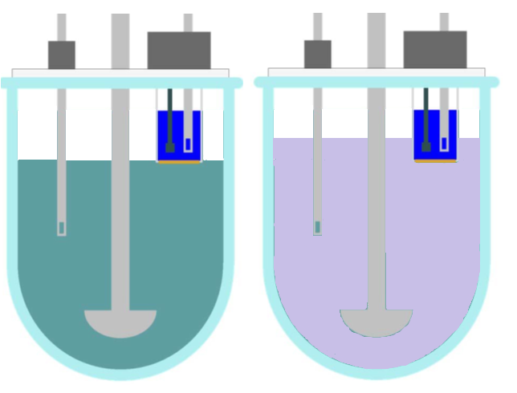
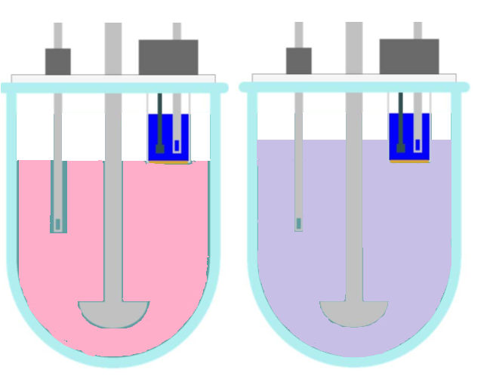

In Vivo Predictability of Flux Measurements for Assessment of Bioavailability Reduction due to Drug–Drug Interactions with Acid Reducing Agents
Oksana Tsinman¹, Konstantin Tsinman^{1*}, Ram Lingamaneni¹, Jane Li², Dawen Kou², Mark Ragains², and Larry Wigman²
¹Pion Inc., Billerica, Ma 01821, USA; ²Genentech, South San Francisco, CA 94080, USA
QR Code
*CONTACT INFORMATION: ktsinman@pion-inc.com
PURPOSE
The challenge of developing poorly soluble drugs continues to grow as more and more new chemical entities (NCEs) are poorly soluble. Formulation strategies often rely on maintaining a supersaturated state for poorly soluble drugs. A large portion of modern patients are medicated to reduce stomach acidity, and Drug–Drug Interactions (DDI) with Acid Reducing Agents (ARAs) can dramatically increase pharmacokinetic variability and decrease bioavailability—especially for weak bases. This study evaluated pH-shift flux measurements as in vivo predictive tool for DDI assessment.
RESULTS
Compound A (BCS Class IIa)
No DDI Expected in Clinic Studies
Compound B (GDC-0941¹, BCS Class IIb)
Strong DDI Expected in Clinic Studies
Compound C (BCS Class IIb)
Product Formulated to Minimize DDI from ARA
Method(s)
Three research drug products were received from Genentech and used as model formulations:
Compound A: BCS Class IIa Salt
Formulated Tablet, 200 mg of API;
pK_{a} 4.3 (monoprotic acid)
logP 6.18
Solubility:
- 0.1 µg/mL at pH 1.0
- 3.18 mg/mL in FaSSIF
Compound B: BCS Class IIb
Formulated Tablet, 20 mg of API
pK_{a} 1.53, 4.3 (di-protic base)
logP 2.1
Solubility:
- 0.75 mg/mL at pH 1.0
- < 1 µg/mL in FaSSIF
Compound C: BCS Class IIb
Formulated Tablet, 50 mg of API
pK_{a} 1.1, 3.3, 5.0 (tri-protic base)
logP 3.3
Solubility:
- > 100 mg/mL at pH 1.0
- ~1 µg/mL in FaSSIF
Figure 3. Dissolution profile (top left); appearance profile (top right); flux values (bottom left) were calculated by fitting concentration-time profile in the receiver with straight line ((15 – 30 min for SGF, 40 – 100 min for FaSSIF early and 300 – 360 min for FaSSIF late) and multiplying by a ratio of receiver volume to the area of the membrane; accumulated amount of Compound A in the receiver chamber (bottom right).
Figure 4. Same as Figure 3, but for Compound B
Figure 5. Same as Figure 3, but for Compound C
Figure 6. AUC in dog PK study for GDC-0941 reported in Ref. 1
Table 1. C_{max} and AUC reduction due to ARA in dog studies.
MacroFLUX™ Apparatus
Figure 1. A MacroFLUX™ device (Pion Inc.) consisted of absorption chambers inserted into modified vessel covers of the USP apparatus II dissolution bath. In situ concentration monitoring in both dissolution and absorption chambers was enabled through fiber optic UV probes connected to the Rainbow instrument (Pion Inc.).
Donor FO Probe connected to Rainbow instrument
Absorption Chamber
13 mL of Acceptor Sink Buffer (pH 7.4, Pion).
Separating lipophilic
membrane (3.88 cm², GIT lipid)
Receiver FO Probe connected to Rainbow instrument
No difference in flux or absorbed amount in vitro
No DDI of ARA in human studies
>90% reduction in flux and absorbed amount in vitro
~80% reduction in AUC due to DDI of ARA in dog PK studies
~25% reduction in flux and absorbed amount in vitro
Correlated with dog PK results
USP Vessel
Overhead stirrer
“Normal Stomach” SGF to FaSSIF
“Hypochlorhydric” SGF to FaSSIF
Figure 2. Schematic of the experimental setup to study DDI of ARAs.
Conclusion(s)
MacroFLUX™ can be used for assessing the risk factors associated with DDI caused by ARAs.
In vitro data correlated well with PK data (animal and human) and correctly rank-ordered formulations designed to minimize DDI in hypochlorhydric patients.
Membrane is stable to pH change, formulations and biorelevant media.
Use of FO eliminated need for the sampling.
REFERENCES
1. Pang J, Dalziel G, Dean B, Ware JA, Salphati L. Pharmacokinetics and absorption of the anticancer agents dasatinib and GDC-0941 under various gastric conditions in dogs - Reversing the effect of elevated gastric pH with betaine HCl. Mol Pharm. 2013;10(11):4024–31.
pH 1.6 – pH 6.5
pH 4.0 – pH 6.5
800 mL SGF to 1000 mL FaSSIF after 30 min in the same vessel
Continuous monitoring dissolution and flux for 6 hours
Full size formulated products in USP apparatus II

