Slide 1

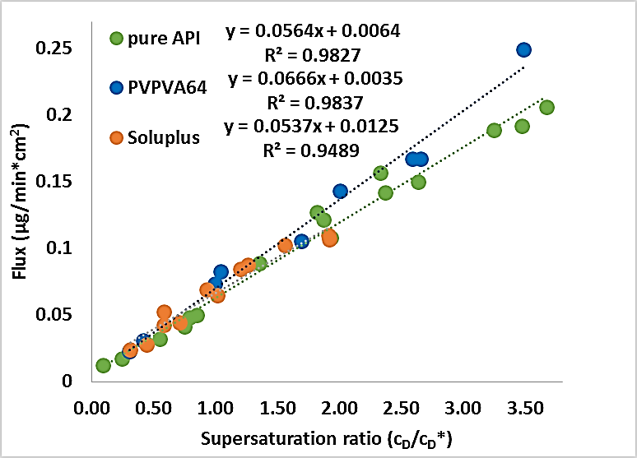
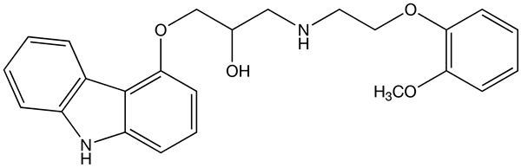
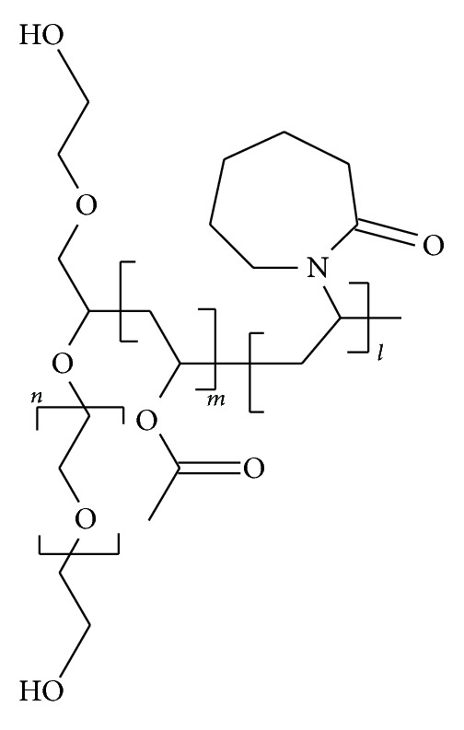
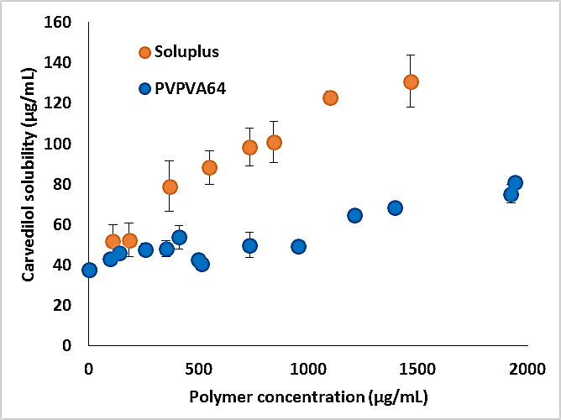
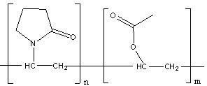
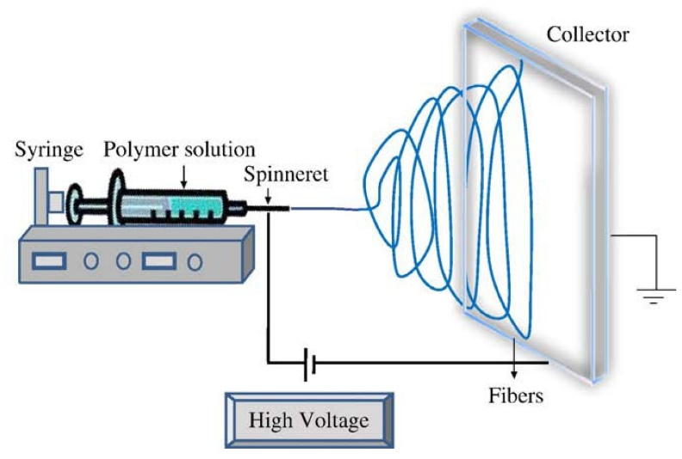
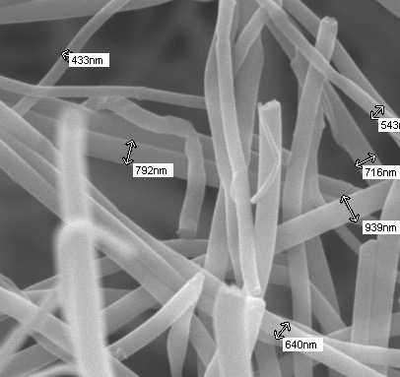
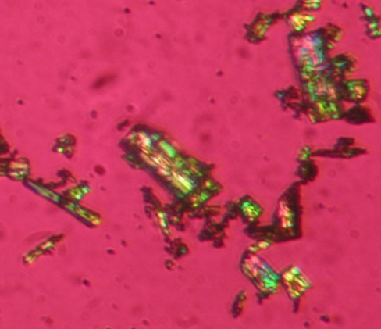
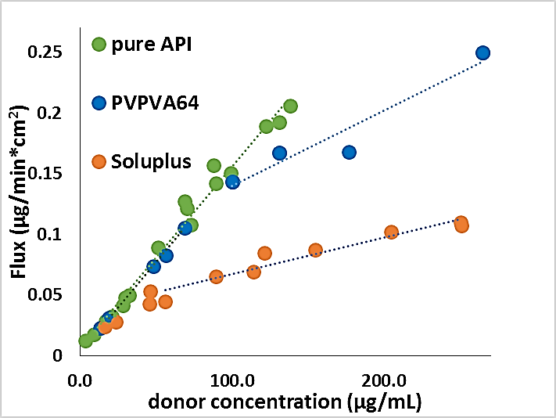
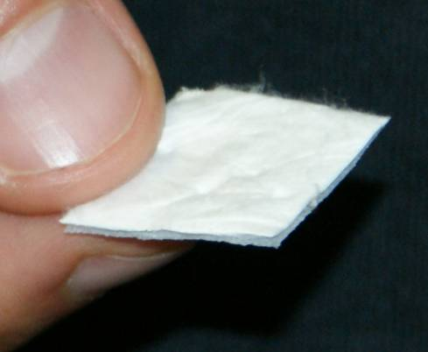
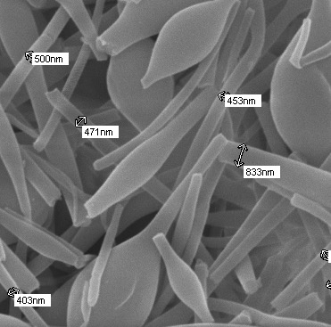
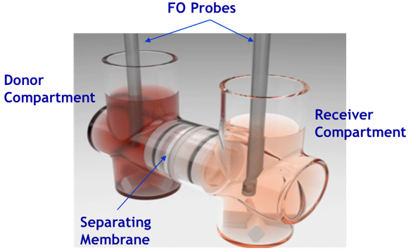
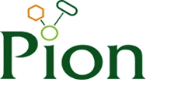

Investigating the Driving Force of Membrane Transport of Carvedilol from Supersaturated Solutions Achieved by Electrospun Formulations
Enikő Borbás¹, Konstantin Tsinman ², Oksana Tsinman ², György Marosi ¹, Zsombor K. Nagy ¹, Bálint Sinkó ²
¹ Budapest University of Technology and Economics, ² Pion Inc.
T1024
QR Code
CONTACT INFORMATION: ktsinman@pion-inc.com
PURPOSE
When a poorly water-soluble active pharmaceutical ingredient (API) is formulated to enhance its dissolution, additives, such as surfactants, polymers and cyclodextrins have an effect not only on dissolution profile, but also on flux through the membrane. In order to fully understand these effects on flux, the driving force of membrane transport cannot be simplified to the total concentration gradient.
Result(s)
III. What is the real driving force of membrane transport?
I. Results of thermodynamic solubility measurement of pure API in the presence of different amount of additives
Which polymer is the better solubilizing agent?
a)
b)
Objective(s)
The aim of this study was to investigate the impact of formulation excipients, solubilizing additives on dissolution, supersaturation and membrane transport of an API.
Carvedilol
Method(s)
Carvedilol (CAR), an anti-hypertensive drug was chosen as a poorly water-soluble model drug and formulated in order to enhance its bioavailability using solvent-based electrospinning. A polyvinylpyrrolidone (PVP) derivative (VA64) and Soluplus® were used to create two different amorphous solid dispersions (ASD) of the API.
PVP VA 64
Soluplus
Figure 5. Flux as a function of supersaturation ratio defined as the ratio of the donor concentration and the thermodynamic solubility of the API in the same media
Figure 3. a) Structure of the API and polymer additives; b)Carvedilol solubility as a function of the amount of polymer additive
II. Results of flux experiments of electrospun formulations and the pure API
Conclusion(s)
Although the solubility assays showed that Soluplus® was a more powerful solubilizing agent for the poorly water-soluble Carvedilol than the PVP derivatives, the amount of drug absorbed through the artificial membrane was found to be significantly smaller in case of Soluplus® containing formulations. These results clearly indicated that the driving force of membrane transport could not be simplified to the concentration gradient.
Supersaturation ratio (defined as the ratio of dissolved amount of the drug to its thermodynamic solubility in the same media) was found to be the driving force of membrane transport.
The polymer and the API (88:12) were added into ethanol and stirred by a magnetic stirrer at 600 rpm until the dissolution completed. The electrical potential applied on the spinneret electrode was 40 kV . A grounded aluminum plate covered with aluminum foil was used as collector (20 cm from the spinneret). Polymer solutions were dosed with 8-10 mL/h.
Is the membrane transport through size exclusion membranes concentration driven?
a)
b)
Electrospun nabofibers of Soluplus based ASD of Carvedilol
Carvedilol form II crystals
Figure 1. Electrospinning apparatus
Phosphate buffer
pH 6.5
Phosphate buffer
pH 6.5
The load dependent effect of various additives that can influence the characteristics of dissolution and absorption through artificial membrane (cellulose membrane with 1 kDa MWCO) were observed by carrying out a simultaneous dissolution-absorption study with a side-by-side diffusion cell, µFLUXTM. The solubilizing effect of the polymers were studied by carrying out thermodynamic solubility assays in pH 6.5 phosphate buffer (same as the donor media in the dissolution-permeation assays).
Electrospun nanofibers of PVP VA64 based ASD of Carvedilol
Size exclusion membrane (MWCO= 1kDa)
REFERENCEs
Raina et al. Impact of Solubilizing Additives on Supersaturation and Membrane Transport of Drugs. Pharm. Res. 2015, 32, 3350-3364.
Figure 4. a) Schematic of flux setup showing experimental conditions and microscopic images of the electrospun formulations and the pure API; b) flux of pure CAR and CAR containing ASDs at 25°C as a function of concentration in the donor chamber
While the flux was found to be directly proportional to the donor concentration in the concentration range of 0-100 µg/mL in case of the pure API and the PVP VA 64 containing formulation as well, reaching higher concentrations in the donor chamber resulted in lower fluxes than expected in case of PVPVA 64 containing formulations (Figure 4.b). The similar phenomenon happened for Soluplus containing formulation even in the lower concentration region.
Figure 2. A fragment of the µFLUX™ apparatus showing a pair of the donor and receiver chambers

