Slide 1
The Open Source Movement
Information Systems Management (ISYS30261)
Inderjit Sandhu (N0578334)
Emily Gill (N0582908)
Notes:
Indy
Welcome, my name is Indy and this is Emily

Slide 2
Outline
The open source movement
What is open source?
10 principles
Why produce open source?
Advantages
Disadvantages
Open source vs proprietary
Case studies
Should / do companies use open source?
Notes:
Emily
Here’s an outline of what we’ll be talking about, pretty much:
Open source, what it is, examples etc.
Why produce OS and advantages and disadvantages
Case studies
Should / do companies us open source?

Slide 3
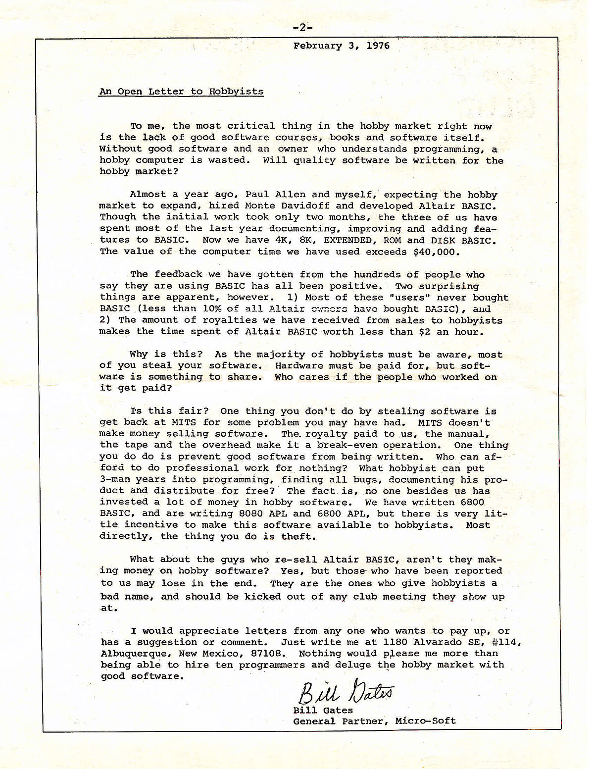


The Open Source Movement
https://goo.gl/FCf8Ff
Open Source Initiative (OSI) is born
Bill Gates’ Open Letter to Hobbyists
1976
https://opensource.org
1998
https://goo.gl/mcp8My
1985
Free Software Foundation (FSF) founded by Richard Stallman
Notes:
Indy
Before Emily explains what Open Source actually is, I’m going to briefly talk about the Open Source Movement, not considering any OS itself, as this was the title of our topic and it’s always good to know about things in context
A movement is a gradual change in the way things are done over a period of time. Looking at the history on a timeline will tell us more about the movement
- Software has been around for quite a while,
1976 - Bill Gates wrote an open letter (Open Letter to Hobbyists – people interested in computing and software)
Expressed dismay at the unfairness of gaining the benefits of software authors’ time, effort and capital without paying them
In response to people doing this to his software
- 1985 – Richard Stallman announces the Free Software Foundation (FSF)
A foundation which support the free software movement
People should be in control of their own computing, not under the powers of the software developer
Non profit – its funds are spent mostly on software developers to write free software
A lot of people supported Stallman, but people believed that the FSF was almost against paid for software, and there was some of tension involved…then…
1998 - OSI is born
Another non-profit organisation dedicated to promoting open source software
Actually started because the founders, Bruce and Eric, disagreed with the confrontational attitude that had been associated with ‘free software’ and its movement
Aimed to promote open source ideas for businesses to use
Essentially, the OSI aims to take the negative attitudes of free software away
Since then – history – Firefox and other OS software, which Emily will talk about, have been released

Slide 4
What is Open Source?
Open source (OS) software - software with its source code viewable/changeable by the public (Midrack, 2017)
Source code = open to public
Proprietary - software owned by an individual/company that has developed it (Linfo, 2005)
Source code = closed to public (kept secret)
Can’t be copied or distributed without complying with licensing agreements
Notes:
Emily
Open Source software is software that has its source code viewable and changeable by the public
Its source code is open to the public
Differs from proprietary software – which is software owned by an individual or company that has developed it
This source code is closed to the public, effectively kept a secret
It can’t be copied or distributed without complying with its licensing agreements
Open Source definition - https://www.lifewire.com/what-is-open-source-software-4147547
Proprietary - http://www.linfo.org/proprietary.html

Slide 5
Open Source Initiative (OSI) 10 principles
OSI promotes open source software
Distribution terms of OS software, outlined by the Open Source Initiative (2007)
Free redistribution
Source code
Derived works
Integrity of the author’s source code
No discrimination against persons or groups
https://opensource.org
Notes:
Although Fumi has explained the 10 principles in the lecture they’re important so we’re going to briefly remind you of them.
- Just to remind you, the Open Source Initiative exists to promote open source software. Website link is on slide and in references – contains a lot of information on OS.
The OSI has outlined distribution terms of open source software – last updated 2007. In order to be officially open source, software must comply with the following 10 principles:
1 Free redistribution
Should be no license fee for distributing software
2 Source code
Program must contain the source code – shouldn’t have been intentionally made unclear
Should be in the preferred form of the programmer – source code and compiled form
3 Derived works
License must allow modifications or derived (work based on preexisting work) work – must allow them to be distributed under the same license as the original software
4 Integrity of the author’s source code
Ensures that different versions of software are secure, and that changes are made on patch files. This way, if there’s an update with bugs, the original code is safe and users can update to a previous version be reverting to a previous patch update
5 No discrimination against persons or groups
License must not discriminate against anybody – everybody should be able to use it

Slide 6
OSI 10 Principles Continued
No discrimination against fields of endeavour
Distribution of licence
Licence must not be specific to a product
Licence must not restrict other software
License must be technology-neutral
https://opensource.org
Notes:
Indy: first 5
Emily: last 5

Slide 7
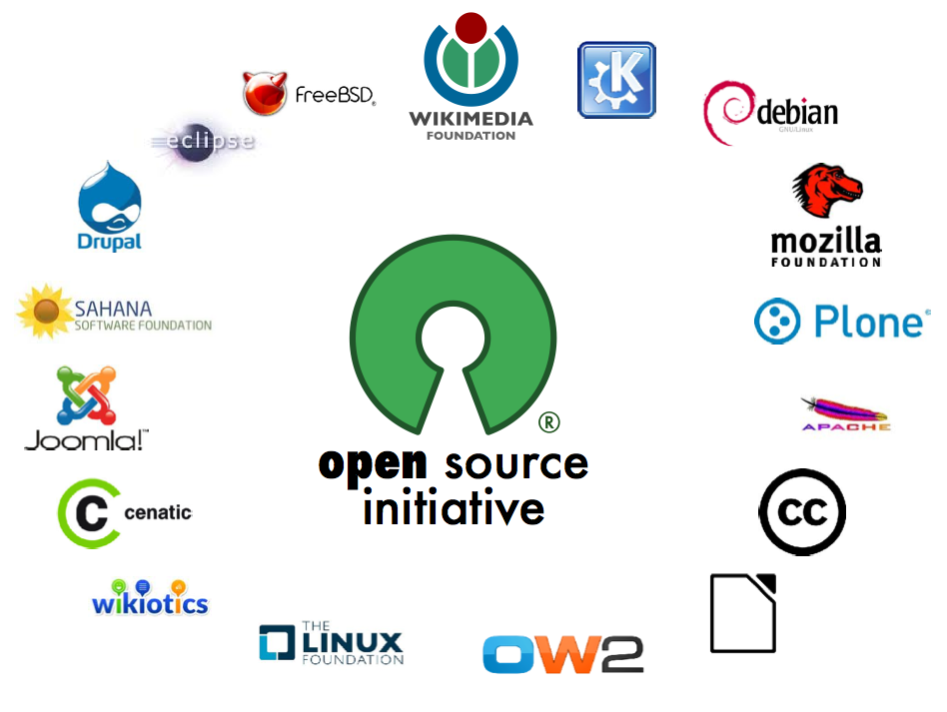
Examples of Open Source
OSI Affiliates, June 2012 (https://goo.gl/aavJkN)
Linux
PHP
Apache Server
MySQL
Open Office
Notes:
Emily
You can see on the image a load of examples of OSI affiliates (group attached to an organisation). Some of these include:
- Explain each a little bit

Slide 8
Advantages of Open Source
Companies:
Free to use
Argued than OS is more reliable than proprietary
OS software ideas can influence proprietary software produced
Form of income (Weiss, 2017)
Saves time and encourages staff to experiment without fear (Allen and Geller, 2012)
Community benefits:
Anyone can fix bugs (Rosenblum, 2012)
Practice & ego (Olajide, 2017)
Better quality – constantly modified and improved (Bridge, 2017)
Cyber security (Nmap, Wireshark,etc) protection (Hackertarget, 2017)
Satisfy your needs
Notes:
Indy
Just to recap, the concept of Open Source is simple – an individual or a group of people develops code, and makes it available to the open source community
What’s the benefit of this? People can make money off software, so why share it for free?
Companies have started to use Open Source software more and more in recent years, mainly since the OSI was launched in 1998. Mainly do due the following reasons.
Free to use – disregarding the hidden costs, which Em will talk about, OS is free to use and implement. Companies can get a good, OS version of software, for free. Depending on the usability of this software and how fit for purpose it is for a business – free software could save huge costs
Argued that OS is more reliable than proprietary software – e.g. as Fumi explained in his presentation, enthusiasts argue that Linx/Apache are more reliable than Windows/Windows Server – reliability may not be an issue for you or me, when, say our server freezer, but for companies, if a server freezez it could have serious consequences
As Fumi mentioned in his lecture, companies can use open source methodologies to develop their own products through using these ideas. You can look at source code to inspire you. For example, if a small company is struggling on how to develop a complicated part of an application (such as a SMS response system), looking at an example of how this has been done can help them out. Similar to stack overflow – you look at examples and learn from it (hopefully not copying and pasting)
Form of income:
Software such as MySQL, WordPress, Magento all make their companies millions of pounds through several ways:
Charging for support in maintaining software – might require specific know-how
Offering extra security and management features
Selling addons – WordPress sells themes
Saves time and encourages staff to experiment – learnt from case study, will explain more later
IT staff wouldn’t be required to spend months on a lengthy requirements investigation, they can start developing quickly.
It can encourage staff to develop without being scared of making a £1million mistake.
Case study mentioned that everybody seems scared to death of trying things, but with OS, it’s a no dollar mistake – true as you’re not working on the actual application.
As I’ll mention in my case study, you can also give a develop a period of time to experiment using OS, and see if he comes up with any useful internal business programs -
Can relate to this on placement – I was working on actual company applications – an internal one, but was still nervous to make a mistake as I knew I could have broke things and it could be expensive – this would only benefit companies developing internal systems as you can’t typically use OS for commercial purpose
- Benefits the community – OS software is effectively run by a community of experts. Everybody involved can share their ideas, which can be a benefit to the community.:
- Everybody can work together to fix bugs or suggest improvements. Rather than a set amount of, say 10 developers in a company, you can have hundreds of people working on a bug as soon as its been identified – people
can then argue that OS is more secure in this aspect
- Practice and ego – As well as this, somebody could create some code that sits hidden and locked away from 20 years that nobody else looks at, but with OS, the whole world can look at it and use it.
- Better quality – People may want an update to improve the quality of their phone, maybe iPhone users want an always on display like Samsung has, if iOS was open source, people could code this. Other than making a dig at iPhone users, the point I’m making is that with open source, people can improve the quality of things when they want and how they want
- Cyber security – obviously there’s a lot of OS software out there for different purposes, but there a lot of well known cyber security software. Nmap, Wireshark etc. If you’re an average user who uses their PC every so often, and don’t want to spend money on complicated cyber security software, this OS could be the right choice
- Satisfy your needs – Looking for reactions…
- If you are a skilled programmer, or know a skilled programmer, you can adapt source code to suit your particular needs. For example, if you want to move the favourite’s section on Firefox because its really annoying you, you can.
Simple example – there are many more, more useful ways you can customise OS software to your needs

Slide 9
Disadvantages of Open Source
Hidden costs (support, training etc.)
High level of knowledge required
Risk of abandonment
Security risks involved
Legal complications (Ehret, 2014)
Notes:
Emily
References?

Slide 10
Case Study 1 - “Dilemmas within commercial involvement in open source software”- Ciesielska and Westenholz (2016)
6 levels of involvement in open source software:
Levels 1-3 were over 3 year project conducted with open-interviews, observations and documentary material
Level 4 – Even though Nokia were supposedly only a sponsor for Maemo.org, they were only allowing certain developers to work on it
Level 5 – Nokia became a sponsor of GNOME but because of code fork – they were not able to be in charge of it overall – Nokia only create software that benefits themselves
Level 6 – TYPO3 offer software that developers can keep up to date and different customers can use
Notes:
Emily

Slide 11
Case Study 2 – “Open source deployment in local government” – Allen and Geller (2012)
San Francisco (CCSF), California USA, in 2009 over 24-month period
Looked at perceived outcomes of adopting 3 open source projects in local government
Recovery SF website – how federal money was spent in SF – WordPress
Graphics department job tracker – Site for tracking graphics jobs – SugarCRM
Map interface project – new graphic information system interface for city planners
Notes:
Indy
This case study by Allen and Geller was carried out on local government in San Francisco in USA. Carried out in 2009 over 2 years
The mayor of SF had agreed to adopt 3 open source projects
The study looked at the perceived outcomes that these projects had
Recovery SF website – site reporting how federal money was being spent in San Francisco. Uses WordPress as the Open Source Platform
Graphics department job tracker – a site for tracking graphic jobs by ticket and department – essentially a project management tool
Map interface project – creating a new graphic information system interface for city planners

Slide 12
Open source deployment in local government
Aims
Look at perceived organizational outcomes of OS adoption
Challenging IT environment
Time constraint
Shrinking IT resources
IT department poor relationship with rest of organisation
Limitations
Small set of projects in one location
Local government, not other company types
Confidential details
Notes:
Indy
Aims:
Look at perceived organisational outcomes of adopting OS in a challenging IT environment. I’ve underlined perceived because the researchers were interested not in statistics, such as how much money can OS save, but more the noticeable, visible effects of OS on a company
As well as this, the environment was challenging. The challenges faced included:
Time constraint – the mayor of SF, who’s decision it was to agree to use OS, had a time limit for each project
IT resources were shrinking
IT department had a poor relationship with the rest of the organisation
Limitations – I identified:
- Small set of projects in one location – data was limited – 3 projects and one location isn’t a good enough number to determine if all companies can use OS, but, it’s a start
- Because the case study focused on a local government, it’s difficult to compare these effects with normal organisations, that may operate differently
- Due to confidentiality agreements, many details about the project, such as the number of developers used, and results couldn’t be shared

Slide 13
Open source deployment in local government
Findings
3 OS projects generally perceived as successful
IT department wasn’t scared – no $1million mistakes
OS has a useful online community
Perceived positive change of relationship within organization
Difficult to keep staff focused
Disruptive project strategies
“OS gives IT departments freedom to experiment, try new products and find better ways of doing things without the complicated purchasing and management overhead that comes with traditional proprietary software”
Notes:
Indy
Findings – the findings for the study had all been grouped together. Not individual results for each project:
- All 3 projects were generally perceived as successful within 18 months. All are still in operation
- Open source allowed the organisation to react to any business problems quickly by allowing the organization to find solutions much more quickly – could identify a business problem, and quickly use an OS software solution without having to develop their own software
- The study found that developers weren’t scared to develop on OS software – they were free to make mistakes without having to worry about making a one million dollar mistake. Somebody let a developer play around for 6 months, said that the company will probably not use much of what he develops, but anything he develops will be useful. You’re free to use the right technology for you, not what the vendor tells you.
- Experience of this on placement – I was working on actual company system and nervous to make changes as I didn’t want to waste another developer’s time or cost the company money
- The research and development department found that Open source had a useful online community. They found that developers could ask questions, similar to how people post things on stack overflow, and other people were good at responding
- Study found a perceived change of relationship within the organization. Different departments would communicate with each, request improvements, and other departments would respond showing a demo of some OS,
knowing that OS could be quite straight forward to implement. Made the organization happier in general as people felt they could communicate problems more
- Open source provided many benefits but a couple of challenges too:
- The organization found it difficult to keep staff focussed. They had to ensure staff weren’t too distracted by the experimenting side of using OS
- By using OS, the organization’s typical project management strategies and resource allocation varied a lot. These strategies were disrupted.

Slide 14
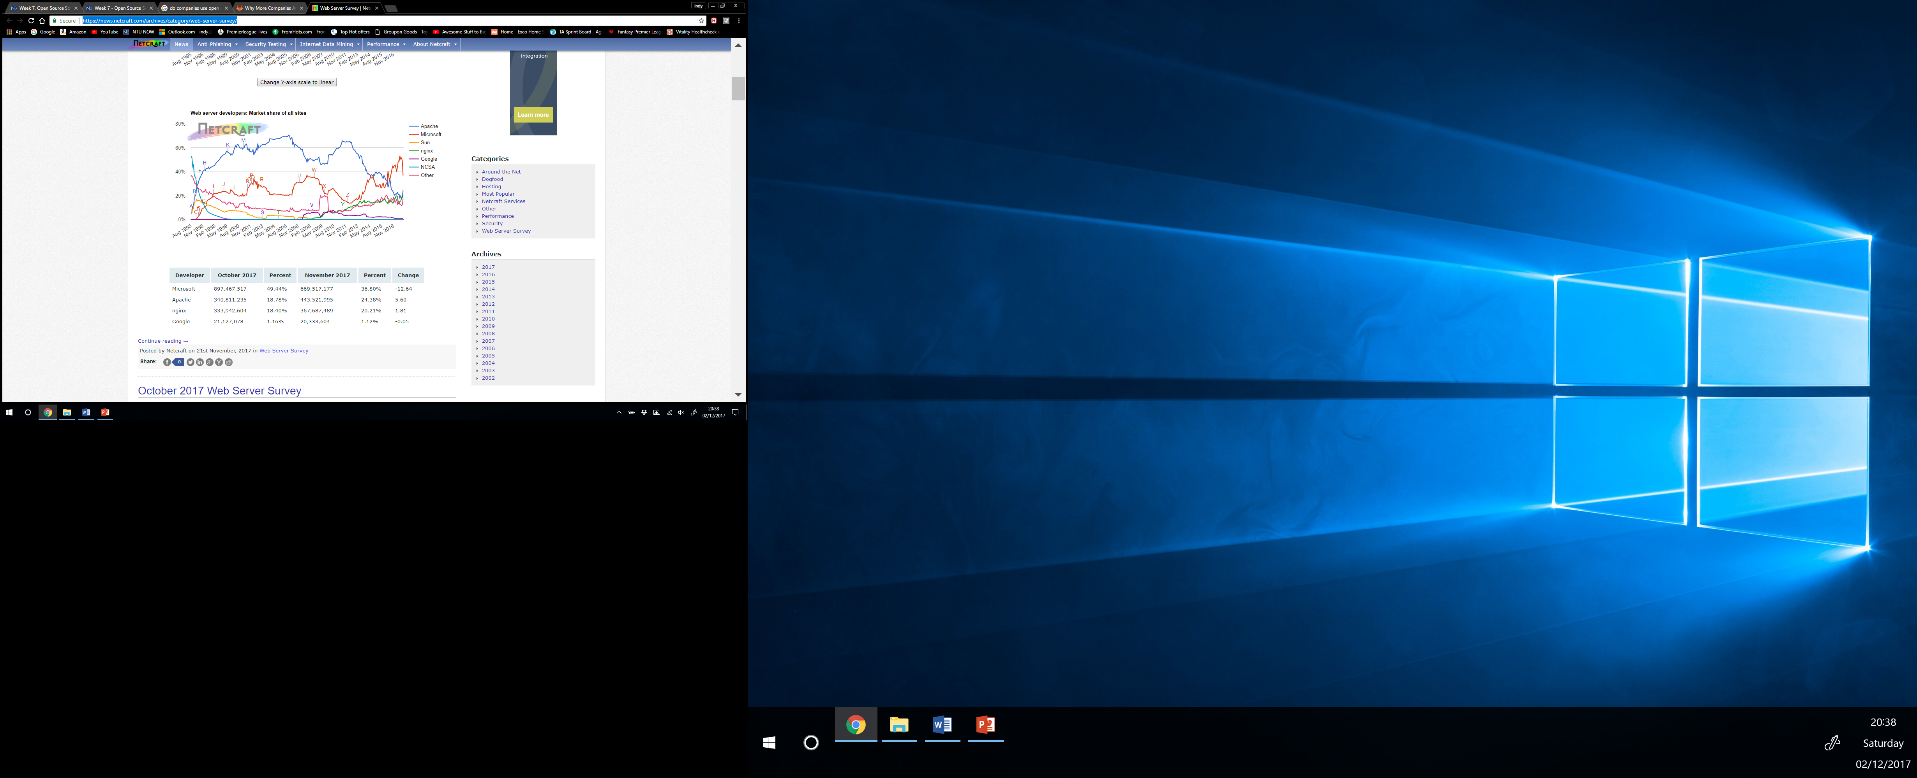
Do companies use open source software?
In 1998, 10% of organisations used open source (Gartner (1998)
Gartner (2008) survey on 274 companies worldwide
85% use open source software
Gitlab (2016) global developer report
98% of developers use open source tools at work
Netcraft (2017) web server survey
Responses from 1.8 billion + sites
Apache dominated market share, dropped and has started to rise again
https://goo.gl/tUagQ8
Notes:
Break it down (e.g. percentages in a certain year)
Updated version of the graph Fumi used in his lecture, I think that was up to 2014, but we can see that there’s been some changes in the last few months / years
In the past 20 years, use of Apache has generally dropped
From 2014, Microsoft Server has overtaken the market share but in the last few months we can wee the gap is again getting narrower
Highest share of Apache was about 70% in 2005
About 37% in 2014 when Microsoft had overtaken them
25% now, gap is closing

Slide 15
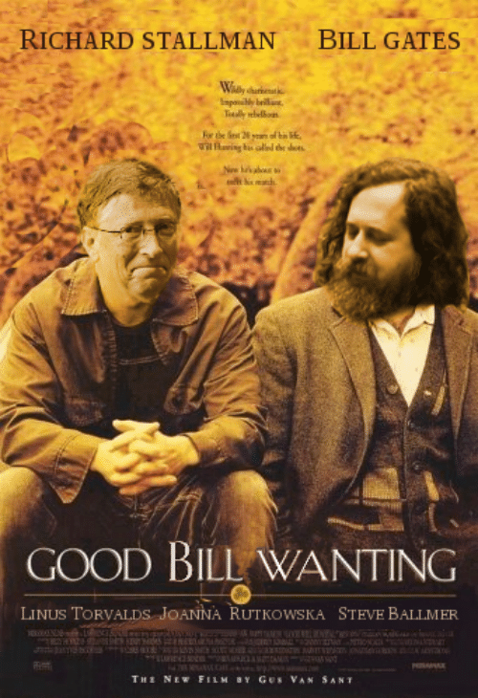
Gates vs Stallman
Bill Gates
Against open source
Unfair for people to gain benefits of software authors’ time, effort and capital without paying them
Richard Stallman
For open source
Software should be free for people to use, study, distribute and modify
https://goo.gl/eb9svP
Conclusion: “makes no difference” – Funminiyi Olajide – 14/11/17
Notes:
Emily introduces - Indy discusses
DISCUSSION
“For me, Open Source is a Moral Thing” – Matt Mullenweg

Slide 16
Should Companies use open source?
Useful for exam - we’ll be required to ‘relate value of OS to specific business cases’
Yes
Free to use
More reliable
OS software ideas on proprietary
Form of income
Good quality
Saves time/encourages staff to experiment
No
Hidden costs (support, training etc.)
High level of knowledge required
Risk of abandonment
Security risks involved
Legal complications
Notes:
Indy & Emily
We’ve went through advantages and disadvantages of Open Source in general
But, I’ve found out that for our exam, we’ll need to ‘relate the value of Open Source to specific business cases’, so to conclude, we’ll recap the main points regarding businesses using OS:
While there are obviously benefits of using OS, some companies are suspicious about using OS software:
- OS may be free but there are costs such as training employees or paying for service/support from companies. Companies must work out this cost to see if its worth it.
Does anybody else have any more advantages of negative, regarding using OS in businesses?

Slide 17
References
Bridge, R., 2017. A guide to open source software – advantages and disadvantages [online]. Available at: http://entrepreneurhandbook.co.uk/open-source-software/ [Accessed 26 November 2017]
Ehret, O, 2014. The legal risks when using open source in software [online]. Available at: http://ecija.com/sala-de-prensa/the-legal-risks-when-using-open-source-in-software/ [Accessed 27 November 2017]
Gartner, 2008. Gartner says as number of business processes using open-source software increases, companies must adopt and enforce an OSS policy [online]. Available at: https://www.gartner.com/newsroom/id/801412 [Accessed 30 November 2017]
Gitlab, 2016. 2016 global developer report [online]. Available at: https://page.gitlab.com/2016-developer-survey_2016-developer-survey.html [Accessed 30 November 2017]
Hackertarget, 2017. 15 essential open source security tools [online]. Available at: https://hackertarget.com/10-open-source-security-tools/ [Accessed 29 November 2017]
Jonathan P. Allen, Dave Geller, (2012),"Open source deployment in local government", Information Technology & People, Vol. 25 Iss 2 pp. 136 - 155
Linfo, 2005. Proprietary software definition [online]. Available at: http://www.linfo.org/proprietary.html [Accessed 28 November 2017]
Malgorzata Ciesielska, Ann Westenholz , (2016),"Dilemmas within commercial involvement in open source software", Journal of Organizational Change Management, Vol. 29 Iss 3 pp. 344 – 360
Midrack, R.L., 2017. What is open source software? [online]. Available at: https://www.lifewire.com/what-is-open-source-software-4147547 [Accessed 25 November 2017]
Netcraft, 2017. November 2017 web server survey [online]. Available at: https://news.netcraft.com/archives/category/web-server-survey/ [Accessed 25 November 2017]
Olajide, F., 2017. Funminiyi’s lecture on open source software [online]. Available at: https://now.ntu.ac.uk/d2l/le/content/483647/viewContent/2444343/View [Accessed 28 November 2017]
Open Source Initiative, 2007. The open source definition [online]. Available at: https://opensource.org/osd [Accessed 27 November 2017]
Rosenblum, J., 2012. Advantages of open source software [online]. Available at: https://cloudtweaks.com/2012/08/advantages-and-disadvantages-of-open-source/ [Accessed 25 November 2017]
Weiss, A, 2017. 5 ways to make money with open source [online]. Available at: https://www.thoughtco.com/ways-to-make-money-with-open-source-software-2532836 [Accessed 26 November 2017]

Slide 18
Questions?
Thank you.
Inderjit (Indy) Sandhu: N0578334@my.ntu.ac.uk
Emily Gill: N0582908@my.ntu.ac.uk
Notes:
If anybody would like this PowerPoint, Email either of us. There’s a lot of useful links to research so I’d recommend it.
You mentioned you can simple develop code and make it available to the open source community. How do you do this? Or how do you find code?
https://opensource.org/faq#restrict

