Slide 1
Assignment 3
Inderjit Sandhu N0578334

Slide 2
Contents
Description / PACT
My screens / interface in practice
Feedback
Changes / improvements
References

Slide 3
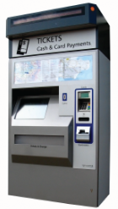
Description
Train ticket booking system
  Search for destination
  Choose destination
  Choose ticket options
  Confirm & pay
  Receive tickets
Screens – mid 1st
Report – high 1st
http://goo.gl/yo9Oay

Slide 4

Potential user profile (people)
Users:
  General public (primary) / ticket inspectors (secondary)
Varying age
Varying visual acuity – detail avoided
Dyslexia – explained soon
Mixed handedness – all areas accessible for both hands
Varying technical experience – simple steps
Based in UK – English default – multiple languages
Unusable for blind users / no audio
http://goo.gl/lY2kNb
People
Activities
Context
Technology

Slide 5
Key activities
Welcome/choose activity screen
View train times screen
A-Z ticket destination finder screen
Collect prepaid tickets screen
Search / select destination
  User searches for destination
  User touches their destination
  Chooses ticket options
  Pays / receives printed tickets
View train times
Collect prepaid tickets
  Entering a code and receiving tickets
Choose ticket options screen
Change destination screen
Choose ticket type screen
Choose route
Pay for tickets screen
Printing tickets screen
People
Activities
Context
Technology

Slide 6

Context
Physical environment
  Indoors / outdoors
  Roofed corners – screen glare - privacy - concentration
  Though trains are noisy, no sound needed
Social and organisational context
  Public areas (train stations)
  Single users
  Noise may distract during busy train periods
https://goo.gl/kXynfb
People
Activities
Context
Technology

Slide 7
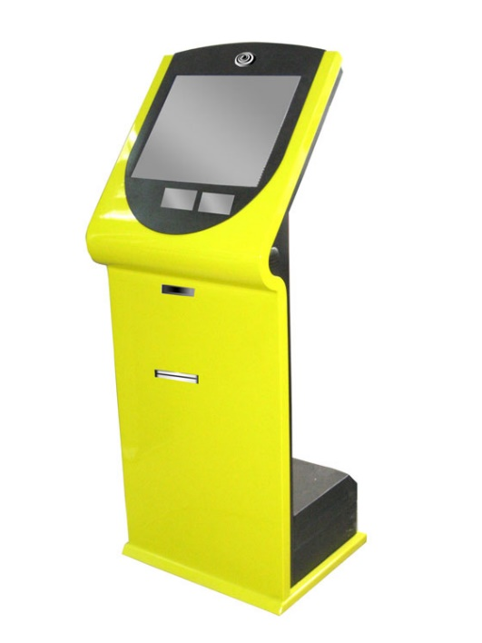
Technology
http://goo.gl/HJvpKf
Basic desktop computer – basic tasks
LCD capacitive touchscreen monitor
  12 inch (30cm by 24cm)
  800 x 600 resolution
  Anti-glare technology
Till system (with card reader)
Printer for tickets
Mounted on stand – 86cm / 110cm off ground
  Less than 120cm recommended by ADA Standards (2010)
  Wheel chair user friendly
People
Activities
Context
Technology

Slide 8
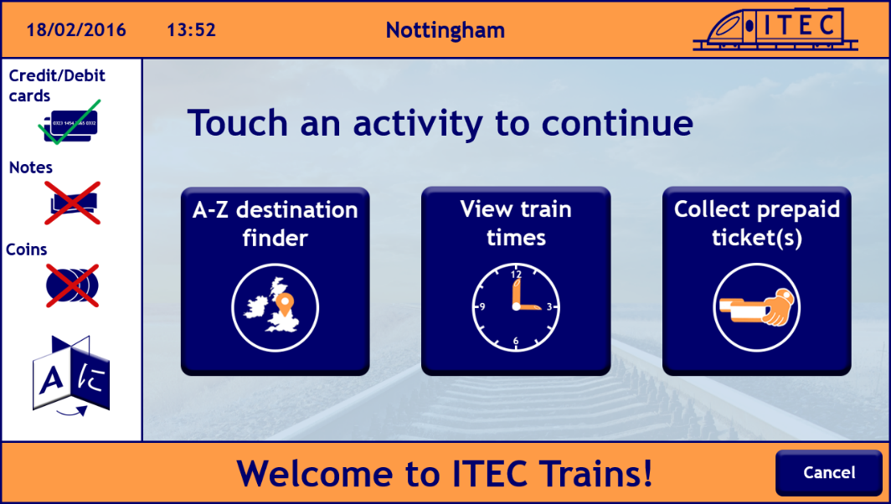
Screens / the interface in practice
Choose activity screen
Trebuchet font (sans serif) – easier for dyslexic users says BDA (2015)
Logo – relevant & simple – made on Photoshop
Sticks to 4 sizes of text as Smith (2014) recommends
Concepts of images familiar and have clear meaning
Image sets – Mullet & Sano’s (1995) principles (immediacy, generality, cohesiveness & communicate effectively)
Consistent characteristics – size, orientation, colours, weighting & white circles to achieve effective image coordination as Smith (2016) explains

Slide 9
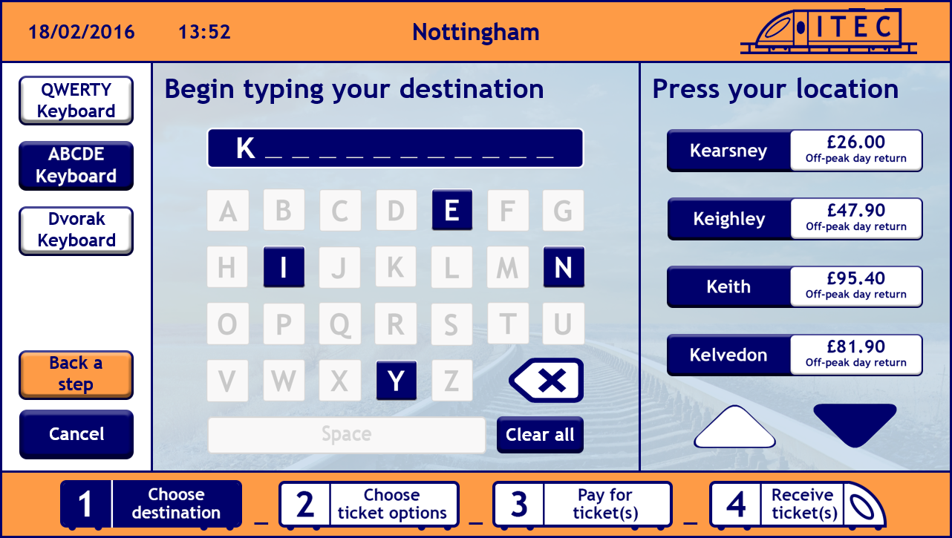
Screens / the interface in practice
Search for destination screen
Sentence case – left aligned – humans read left aligned text easier concludes Anthony (2011), as were used to it
Greyed out buttons – clear to users button won’t do anything
Clear screen layout – information/options down the left, keyboard in middle, destinations down the right, progress bar along the bottom
Finger friendly – comfortable size – even spacing
Minimal text – as Fadeyev (2009) explains, keep things concise to save time
Artistic images / screen elements – making experience memorable and satisfying – Fadeyev (2009)

Slide 10
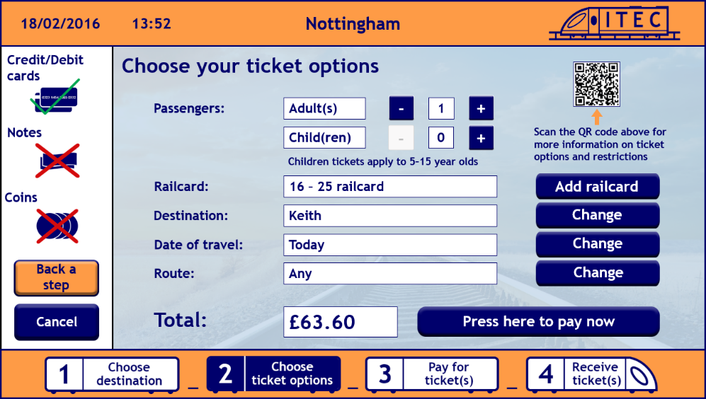
Screens / the interface in practice
Choose ticket options screen
Instructional headings – Smith (2016) explains user should be guided to their goal
Bevel effect – makes buttons appear touchable
Consistent layout, screen elements and colour means users can use the system again with ease, as Sollenberger (2013) explains
Kiosk terminology – ‘Press’, ‘touch’ & ‘back a step’
Transparent background & negative contrast help appearance of display against finger marks and glare
Progress bar – user knows where they are and what remains

Slide 11






Feedback
‘Requires multi-touch screen’
  Typing and touching destination
Obvious and intuitive
No/minimal text entry
  Filtering system
  ‘Continue typing to see more destinations’
K e a

Slide 12

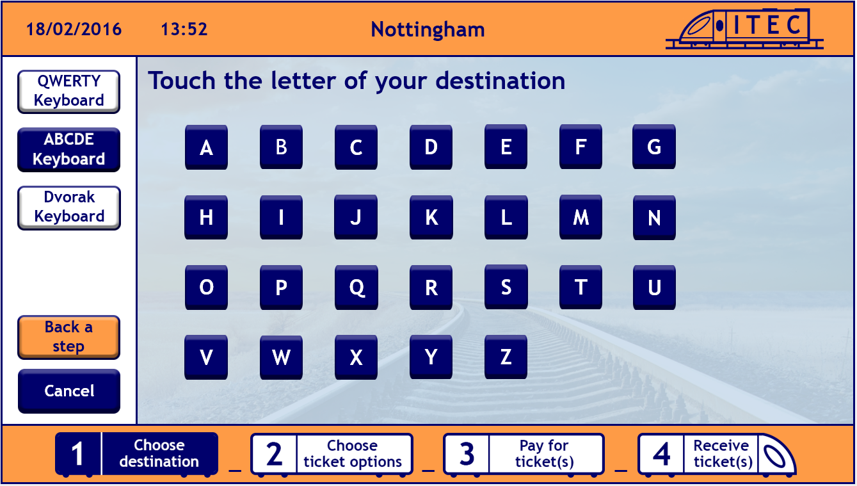
Changes
‘Requires multi-touch screen’
  A – Z letter buttons
    One touch – no typing - more spacious
Obvious and intuitive
  A – Z destination buttons – break down tasks
No text entry
(old)
(new)

Slide 13
References
ADA, 2010. ADA Standards for Accessible Design [online]. Available at: http://www.ada.gov/2010ADAstandards_index.htm [Accessed 3 February 2016]
Anthony, 2011. Why you should never centre align paragraph text [online]. Available at: http://uxmovement.com/content/why-you-should-never-center-align-paragraph-text [Accessed 27 February 2016]
BDA New Technologies Committee, 2015. Typefaces for dyslexia [online]. Available at: http://bdatech.org/what-technology/typefaces-for-dyslexia/ [Accessed 16 February 2016]
Dmitry Fadeyev, 2009. Characteristics of successful user interfaces [online]. Available at: http://usabilitypost.com/2009/04/15/8-characteristics-of-successful-user-interfaces/ [Accessed 3 March 2016]
Gary Heiting, 2016. How Your Vision Changes as You Age [online]. Available at: http://www.allaboutvision.com/over60/vision-changes.htm [Accessed 2 February 2016]
Kevin Mullet and Darrell Sano, 1995. Communication oriented techniques. Upper Saddle River, NJ, USA: Prentice-Hall
Kyle Sollenberger, 2013. User Interface design fundamentals [online]. Available at: (http://blog.teamtreehouse.com/10-user-interface-design-fundamentals) [Accessed 4 March 2016]

Slide 14
References continued
Pauline Smith, 2014. Pauline’s lecture on screen design [online]. Available at: https://now.ntu.ac.uk/d2l/le/content/360283/viewContent/1660408/View [Accessed 25 February 2016]
Pauline Smith, 2016. Pauline’s lecture on Kiosks [online]. Available at: https://now.ntu.ac.uk/d2l/le/content/360283/viewContent/1660401/View [Accessed 26 February 2016]
Pauline Smith, 2016. Pauline’s lecture on text and other screen elements [online]. Available at: https://now.ntu.ac.uk/d2l/le/content/360283/viewContent/1660406/View [Accessed 25 February 2016]
Scott Ambler, 2014. User Interface Design Tips, Techniques, and Principles [online]. Available at: http://www.ambysoft.com/essays/userInterfaceDesign.html [Accessed 2 March 2016]
Scribe Consulting, 2016. Serif and sans-serif fonts [online]. Available at: http://www.scribe.com.au/tip-w017.html [Accessed 2 February 2016]
Sticky Content, 2016. Are you Team Title Case or Team sentence case? [Online]. Available at: http://www.stickycontent.com/blog/are-you-team-title-case-or-team-sentence-case [Accessed 28 February 2016]

Slide 15
Thank you

