Slide 1
spring 2023 July 10, 2023
Taking Stock
With Teens
®
22+ Years Of Researching U.S. Teens
GenZ Insights

Slide 2
DISCLOSURES
Disclosures for universe of: Ed Yruma, Abbie Zvejnieks
1. I or a household member has a financial interest in the securities of the following companies: none
2. I or a household member is an officer, director, or advisory board member of the following companies: none
3. I have received compensation within the past 12 months from the following companies: none
4. Piper Sandler or its affiliates beneficially own 1% or more of any class of common equities of the following companies: none
5. Piper Sandler has received compensation for investment banking services from or has had a client relationship with the following companies within the past 12 months: none
6. Piper Sandler expects to receive or intends to seek compensation for investment banking services from the following companies in the next 3 months: none
7. Within the past 12 months Piper Sandler was a managing underwriter of a public offering of, or dealer manager of a tender offer for, the securities of the following companies: none
8. Piper Sandler has received compensation for non-investment banking services from or has had a client relationship with the following companies within the past 12 months: WWW
9. Piper Sandler makes a market in the securities of the following companies, and will buy and sell the securities of these companies on a principal basis: none
10. Piper Sandler usually provides bids and offers for the securities of the following companies and will, from time to time, buy and sell the securities of these companies on a principal basis: AKA, BIRD, BRLT, FIGS, LVLU, RENT, TDUP
11. Piper Sandler will buy and sell securities on a principal basis for the following companies: BURL, CAL, COLM, CROX, DECK, ETSY, FTCH, GIII, JWN, LULU, NKE, ONON, OXM, PTON, PVH, REAL, ROST, RVLV, SFIX, SKX, TGT, TJX, UAA, WMT, WRBY, VFC, WWW

Slide 3
Investment Risks
  Risks to achievement of investment objectives include, but are not limited to, the following:
    Reliance on key top management
    Changing consumer preferences
    Changes in input costs and raw materials
    Markdown risks
    Product flow and inventory disruptions
    Competition
    Lack of pricing power
    Deleveraging of fixed expenses
    Foreign exchange rate risk
    General macroeconomic uncertainty

Slide 4
Fall 2022: 44th Semi-Annual Proprietary GenZ Research Project
14,500
15.8
TEENS SURVEYED
AVERAGE AGE
52%
46%
47
2%
U.S.
STATES
$66,497
20%
AVERAGE HOUSEHOLD INCOME
41%
32%
39%
7%
TEENS CURRENTLY
PART-TIME EMPLOYED
Survey is executed in partnership with DECA.
The source for all charts/tables within this report is Piper Sandler.

Slide 5
Spring 2023: 45th Semi-Annual Proprietary GenZ Research Project
5,690
16.2
TEENS SURVEYED
AVERAGE AGE
53%
45%
47
2%
U.S.
STATES
$67,691
22%
AVERAGE HOUSEHOLD INCOME
43%
26%
40%
9%
TEENS CURRENTLY
PART-TIME EMPLOYED
Survey is executed in partnership with DECA.
The source for all charts/tables within this report is Piper Sandler.

Slide 6



Teen Behavior & Habits
E-Commerce
Social Media & Content
Key Themes, Trends & Takeaways
Food & Snacks
Payment & Crypto
Fashion & Beauty
Video Games
Executive Summary
Teen Behavior & Habits
Teen Brand Preferences
Demographics & Appendices

Slide 7
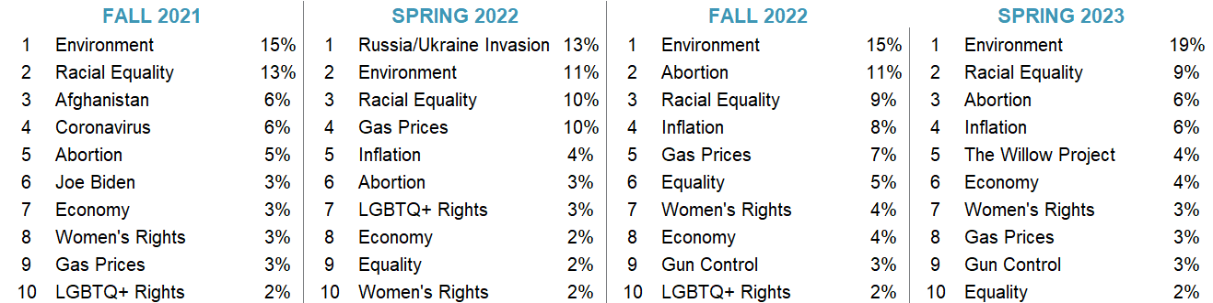
GenZ Insights: They Actually Care About The World
Most Important Political & Social Issues
We started asking teens to “name a political or social issue that is important” to them for the first time in Fall 2019
GenZ is unique in that they appear to care more about social justice & the environment versus former generations
The Willow Project has overtaken Gen Z mindshare, ranking No. 5 as the most important social/political issue in Spring 2023, with 4% mindshare, falling just below inflation (6%) and roughly in line with the economy (4%)
The Environment ranked No. 1 with 19% mindshare this Spring, up 400 bps vs Fall 2022, and up 800 bps Y/Y
Racial equality (9% mindshare), abortion (6%), and inflation (6%) remain consistently prominent issues, while LGBTQ+ rights fell out of the top 10
Executive Summary
Teen Behavior & Habits
Teen Brand Preferences
Demographics & Appendices

Slide 8
GenZ Insights...The Who’s Who?
Who They Like & Who They Follow
Favorite Celebrities
Favorite Social Media Personalities
Taylor Swift
Ryan Reynolds
Selena Gomez
Adam Sandler
Kevin Hart
Zendaya
Dwayne “The Rock” Johnson
Kanye West
LeBron James
Drake
Alix Earle
Andrew Tate
Selena Gomez
Emma Chamberlain
Mr. Beast
Dwayne “The Rock” Johnson
CoryxKenshin
Markiplier
Kevin Hart
Kanye West
Selena Gomez moved to the No. 3 favorite celebrity spot from No. 43 in the Fall while Taylor Swift claimed the No. 1 favorite celebrity from No. 3 in the Fall. Tom Holland and Harry Styles fell out of the top 10 from No. 8 and No. 9 in the Fall to No. 13 and No. 12, respectively, and Drake moved into the top 10 from No. 12 in the Fall.
Alix Earle claimed the No. 1 social media personality title from being unranked in the Fall. Selena Gomez and Markiplier joined the top 10 while Kylie Jenner, Jidion, and Zendaya fell from the ranking. Notably, Kai Cenat took the No. 11 spot.
Executive Summary
Teen Behavior & Habits
Teen Brand Preferences
Demographics & Appendices

Slide 9
TikTok Widens Lead as Favorite; Instagram Most Used
Favorite Social Media Platform (%)
Highest Social Media Engagement (%)
TikTok (37%) lost ~1% share as favorite while Snapchat (27%) lost 3% share. Instagram (23%) improved 3-points from Fall ’22.
Instagram continues to lead the pack in monthly usage at 80%, followed by Snapchat at 73% and TikTok at 72%.
When asked, the average teen in our survey spends ~4.4 hours per day on social media, in-line with past surveys.
Executive Summary
Teen Behavior & Habits
Teen Brand Preferences
Demographics & Appendices

Slide 10
What’s In Your Wallet? Food, Video Games & Clothing
Upper-Income Teens
Males’ Wallet Share
Females’ Wallet Share
1 | Food | 24%
2 | Clothing | 17%
3 | Video Games/Systems | 12%
1 | Clothing | 28%
2 | Food | 22%
3 | Personal Care | 12%
Food was the most important category for male spending this Fall and increased 100 bps vs last Fall
Video Games/Systems remains the No. 3 wallet choice for males at 12% share, in line with last Fall and down 200 bps Y/Y
Clothing placed No.2 with 17% share for males, up ~100 bps Y/Y and down ~100 bps since Fall 2022
Clothing remains the top-choice within the wallet for females, down ~200 bps from Fall 2022; Food stayed at No. 2
Personal care was the No. 3 wallet choice for females at 12% share, increasing ~100 bps Y/Y and vs last Fall
Executive Summary
Teen Behavior & Habits
Teen Brand Preferences
Demographics & Appendices

Slide 11
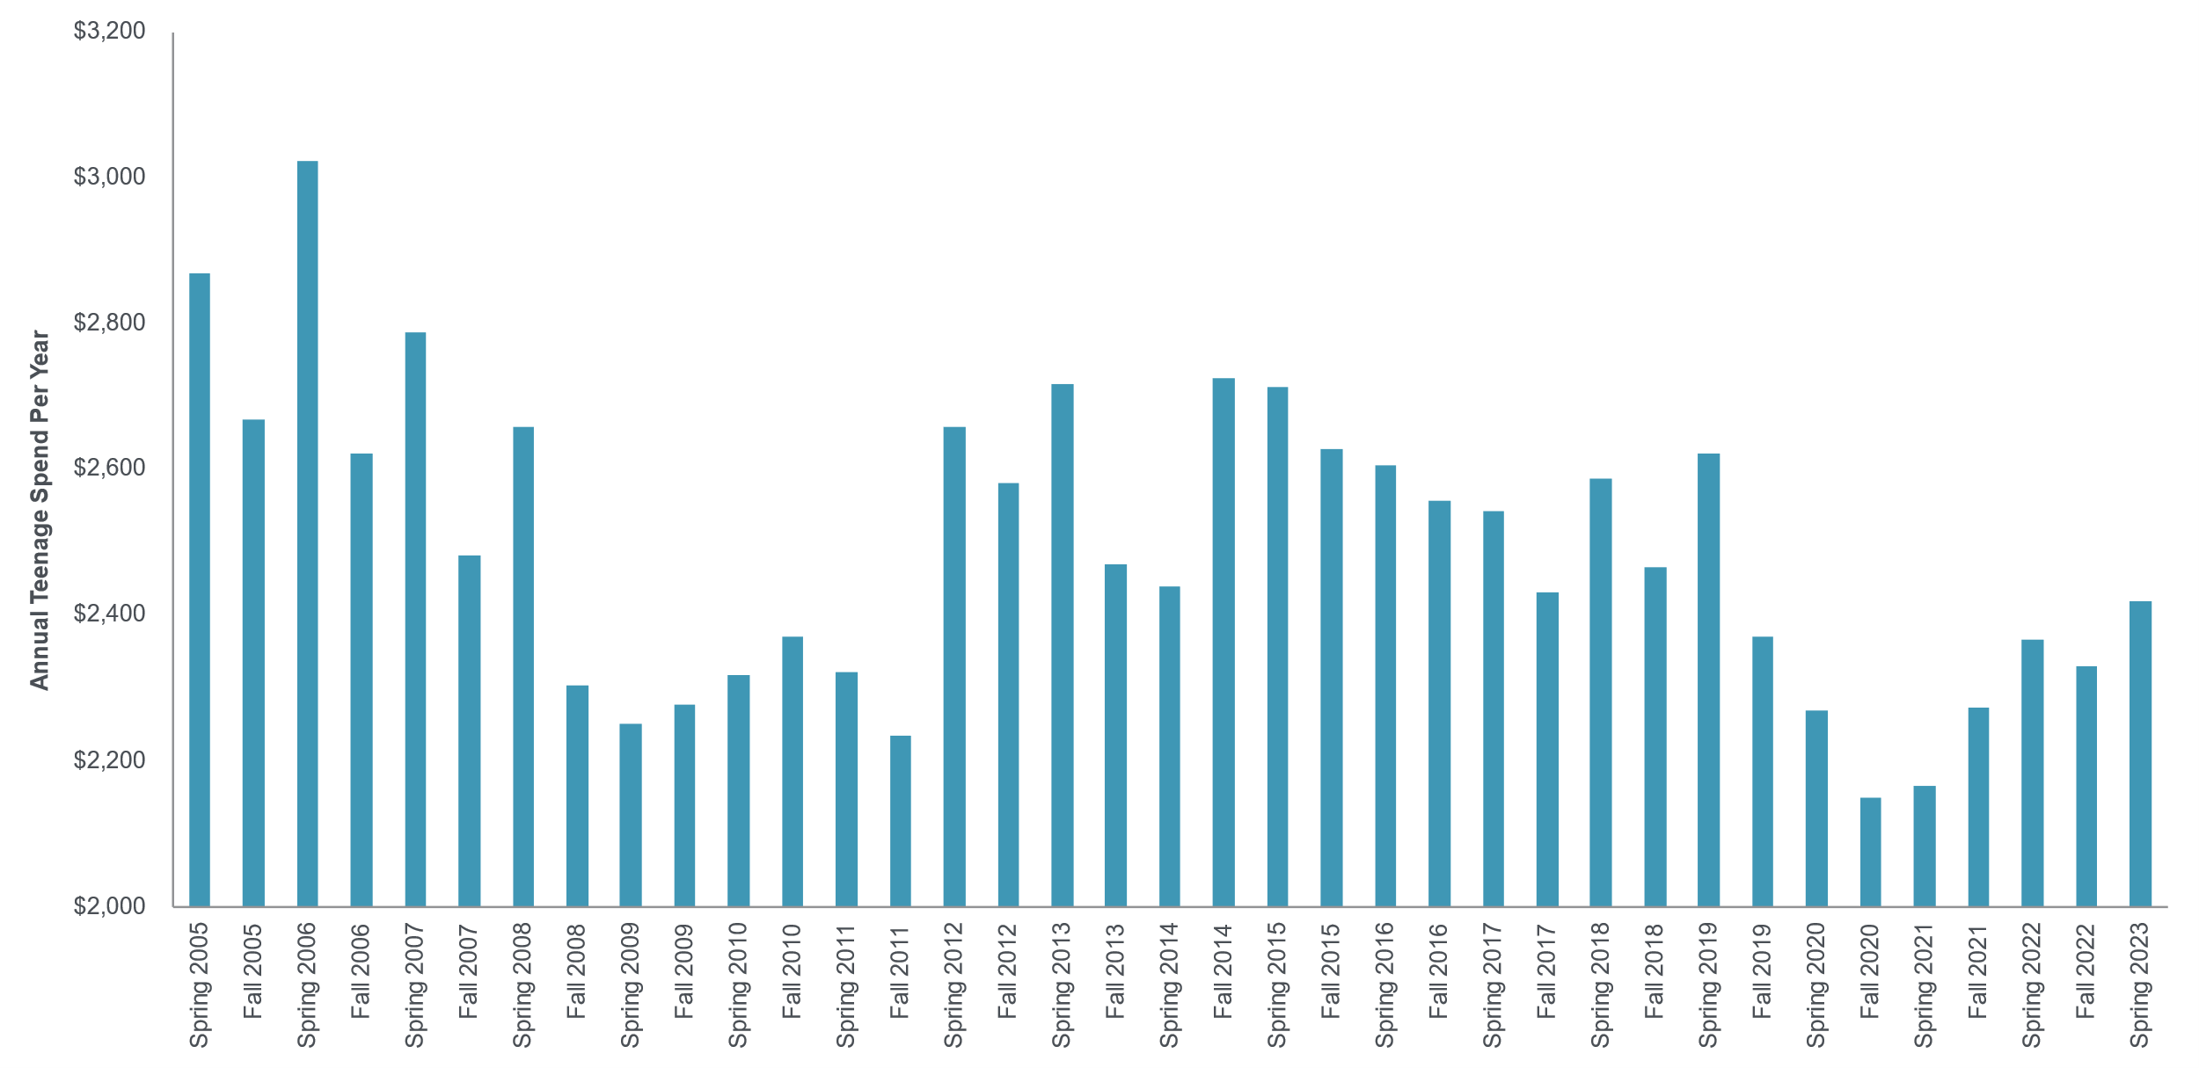
Teen Spending Up 2% Y/Y, Up 4% Vs. Fall 2022
All Teens
Peak Spend
$3,023
$2,419
Trough Spend
$2,150
Teens self-reported spending ~$2,419 per year in our survey, implying total teen spending of ~$67B, assuming 27.7M teens ages 13-19.
Executive Summary
Teen Behavior & Habits
Teen Brand Preferences
Demographics & Appendices

Slide 12
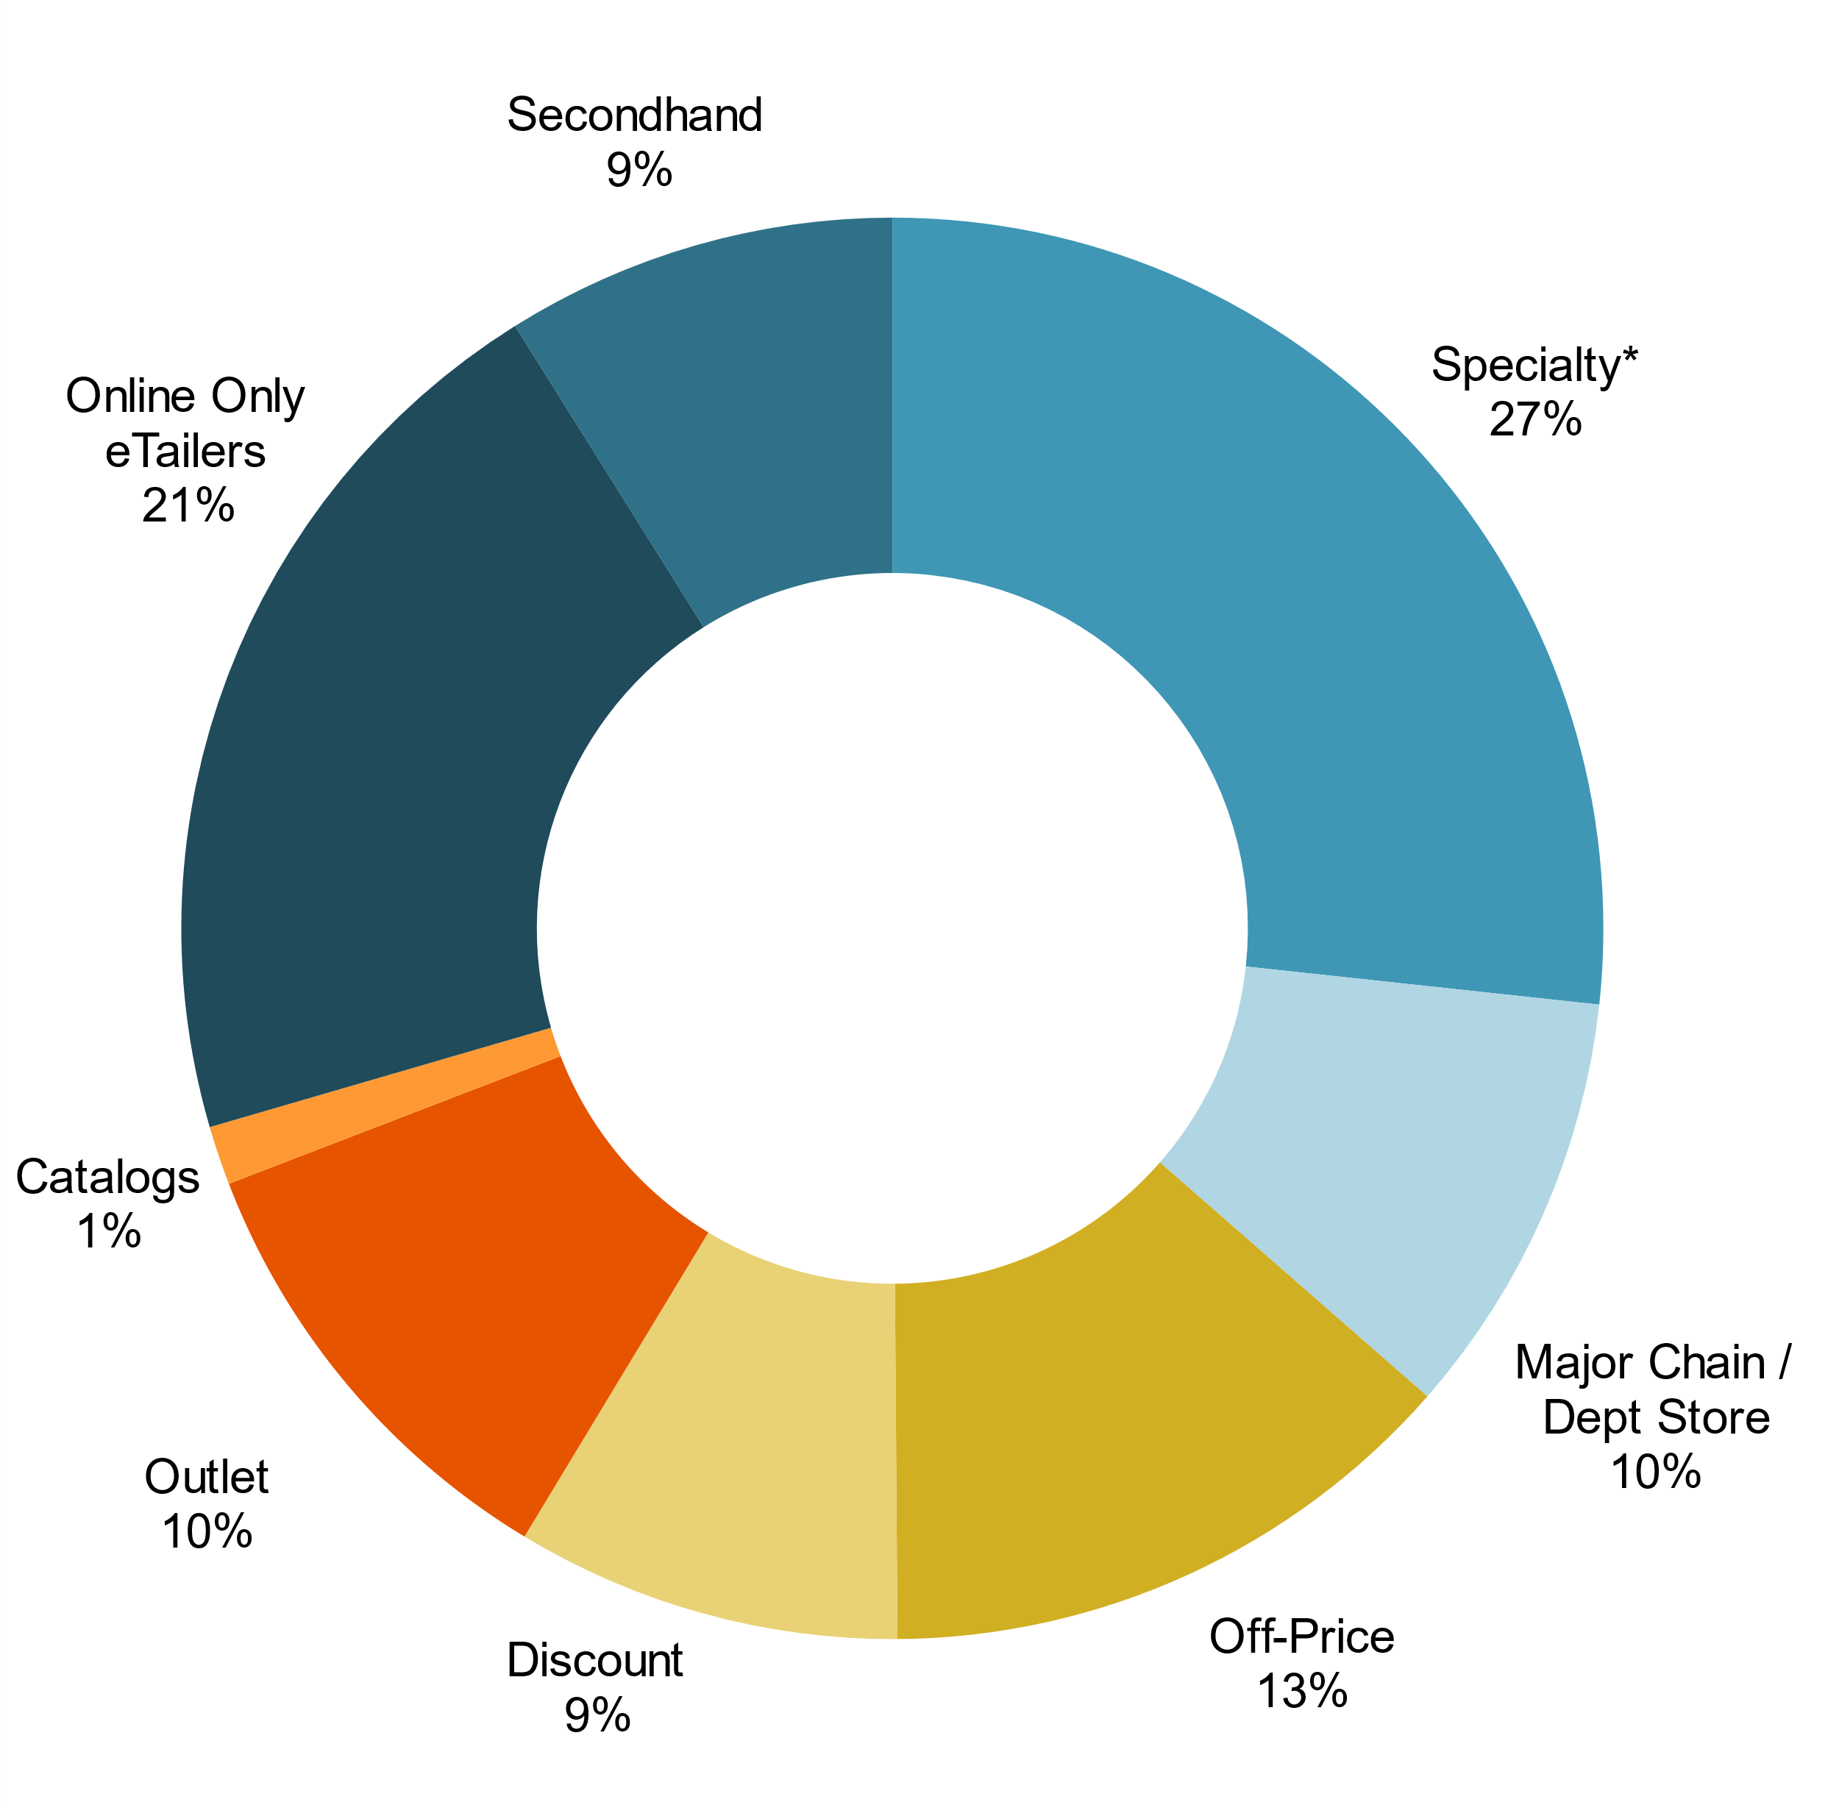
Shopping Channel Preference
Upper-Income Teens
Specialty retail is the most prominent channel for teens—with 27% of their time spent in this channel
Notably, Off-Price as teens’ preferred shopping channel increased 500 bps Y/Y and 400 bps vs last Fall
Secondhand also gained momentum with 9% of teens choosing secondhand as their preferred channel vs 7% LY; males who prefer secondhand shopping increased 300 bps to 9% vs 6% last Fall
Over the last five years, we have seen a significant shift toward online only shopping preferences (21% vs 19% in Spring 2018) and away from catalog (1% vs 6% in Spring 2018)
Executive Summary
Teen Behavior & Habits
Teen Brand Preferences
Demographics & Appendices

Slide 13
Netflix Still Leads Teens’ Daily Video Consumption
Daily Video Consumption by Platform (%)
On average, teens spend 31% of their daily video consumption on Netflix, down ~100 bps from Fall ‘22.
YouTube is again second at ~28%, also down ~100 bps from Fall 2022.
Cable, Prime Video, Disney & Hulu were roughly flat versus Fall ’22, while HBO Max & Other gained ~100 bps versus Fall ’22.
Executive Summary
Teen Behavior & Habits
Teen Brand Preferences
Demographics & Appendices

Slide 14
Enter the Metaverse: 29% of Teens Own a VR Device
We recently introduced new series of questions around VR device ownership, usage, and the Metaverse. 29% of respondents noted owning a VR device, a 3-point improvement versus the prior two surveys at ~26%.
That said, of those with a VR Device only 4% use it daily and ~14% use it weekly (in-line with Fall ‘22). To us, the lukewarm usage demonstrates that VR remains ‘early days’ and that these devices are less important than smartphones.
Interest in the Metaverse appears mixed: ~52% of teens are either unsure on the Metaverse or not interested / no intentions to purchase a device, up slightly from prior surveys. Just 7% are interested and intend to purchase a VR device.
Of Teens that Own a VR Headset (%)
Of Teens that Do Not Own a VR Headset (%)
Executive Summary
Teen Behavior & Habits
Teen Brand Preferences
Demographics & Appendices
Notes:
\

Slide 15










Top Payment Apps for Teens
Penetration for Payment Apps on Smartphones and Used in Last Month
Cash App ranked #1 for the most preferred peer-to-peer money transfer apps
Other
Apple Pay has the most penetration of users at 39%. (We point out 87% of teens in the survey say they have an iPhone.) SQ’s Cash App had the second most penetration at 25% followed by PYPL’s Venmo at 23%. Payment apps from Zelle and various traditional banks lagged the emerging fintech apps.
Executive Summary
Teen Behavior & Habits
Teen Brand Preferences
Demographics & Appendices

Slide 16
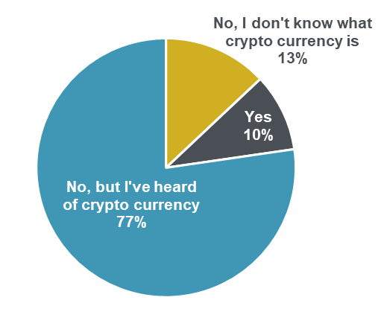
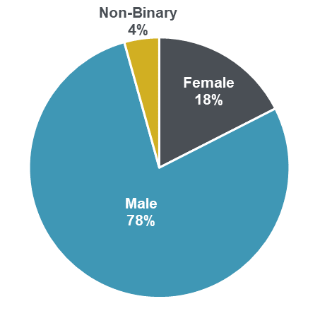
10% Of Teens Have Bought Crypto
Have you ever bought bitcoin or another cryptocurrency?
Gender Makeup of Teen Crypto Traders
Only 10% of teens claim to have traded cryptocurrency, but another 77% are aware of what cryptocurrencies are. Of the crypto traders, a striking 78% are male. Teens who traded crypto also tended to be older and have above-average household incomes relative to the survey average.
Executive Summary
Teen Behavior & Habits
Teen Brand Preferences
Demographics & Appendices

Slide 17
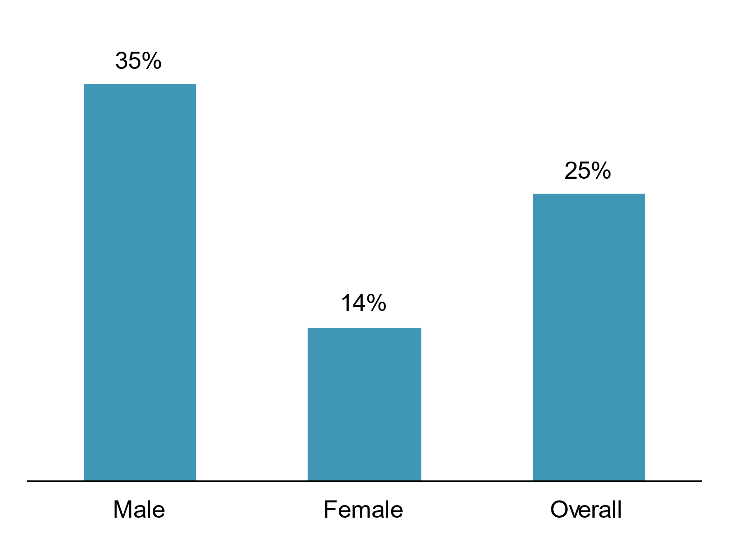
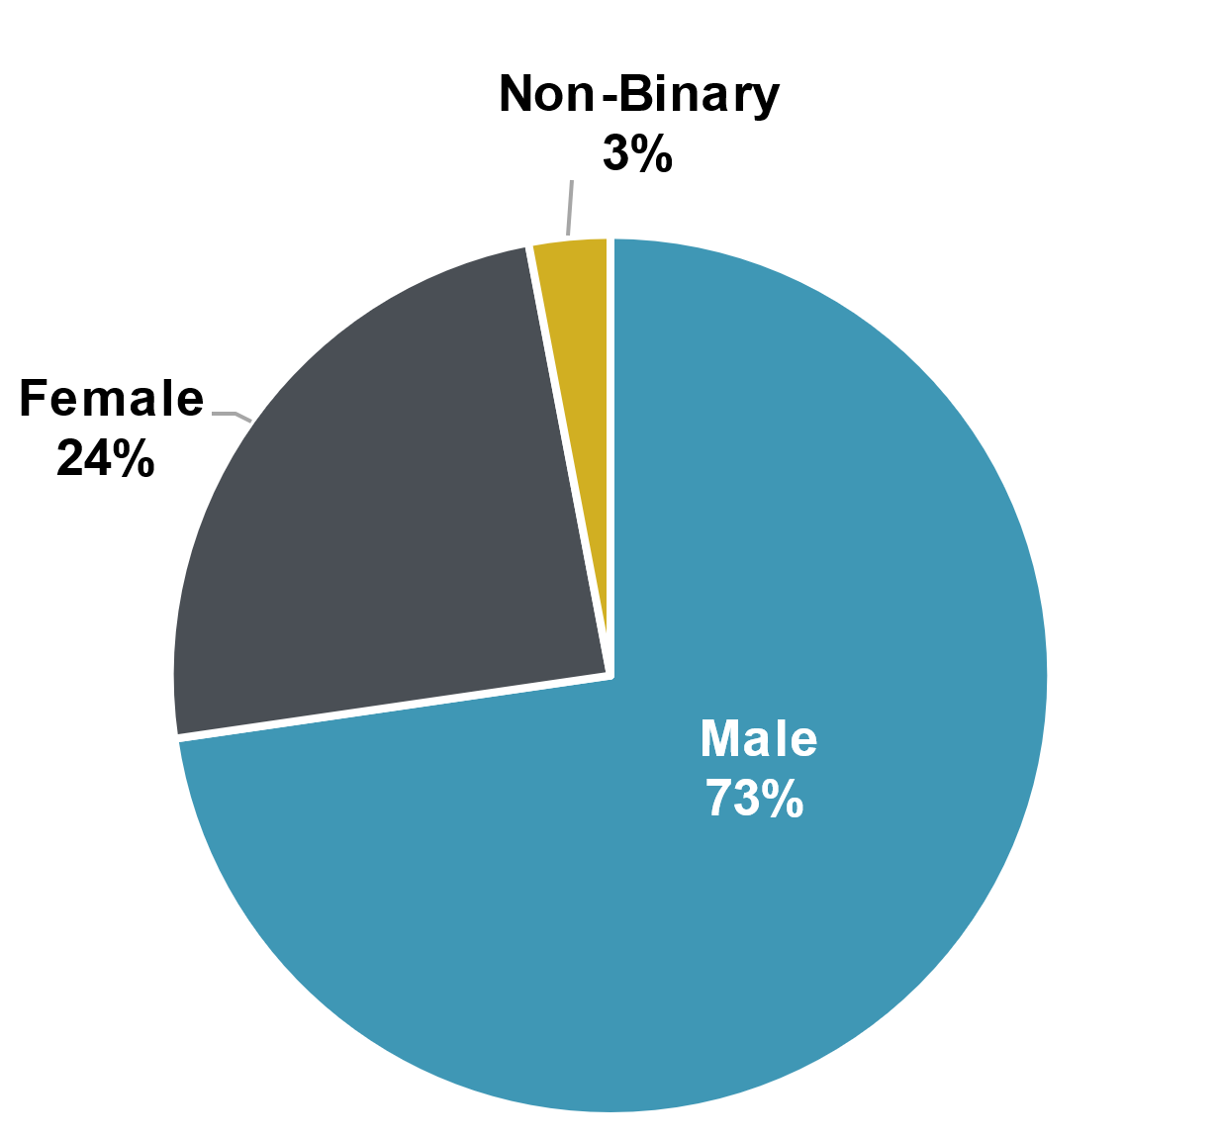
25% of Teens Have Used ChatGPT
Have you used or attempted to use ChatGPT?
Gender Makeup of Teen ChatGPT Users
25% of all teens have used or attempted to use ChatGPT. Notably, 73% of the teens who have used ChatGPT are male, while 24% are female and 3% are non-binary.
Executive Summary
Teen Behavior & Habits
Teen Brand Preferences
Demographics & Appendices

Slide 18
Teen iPhone Ownership Remains Elevated
iPhone ownership remains near record highs at 87%
Intent to purchase an iPhone was also near record highs at 88%
We feel the data remains positive for iPhone adoption given the successful rollout of the latest iPhone models
Executive Summary
Teen Behavior & Habits
Teen Brand Preferences
Demographics & Appendices

Slide 19
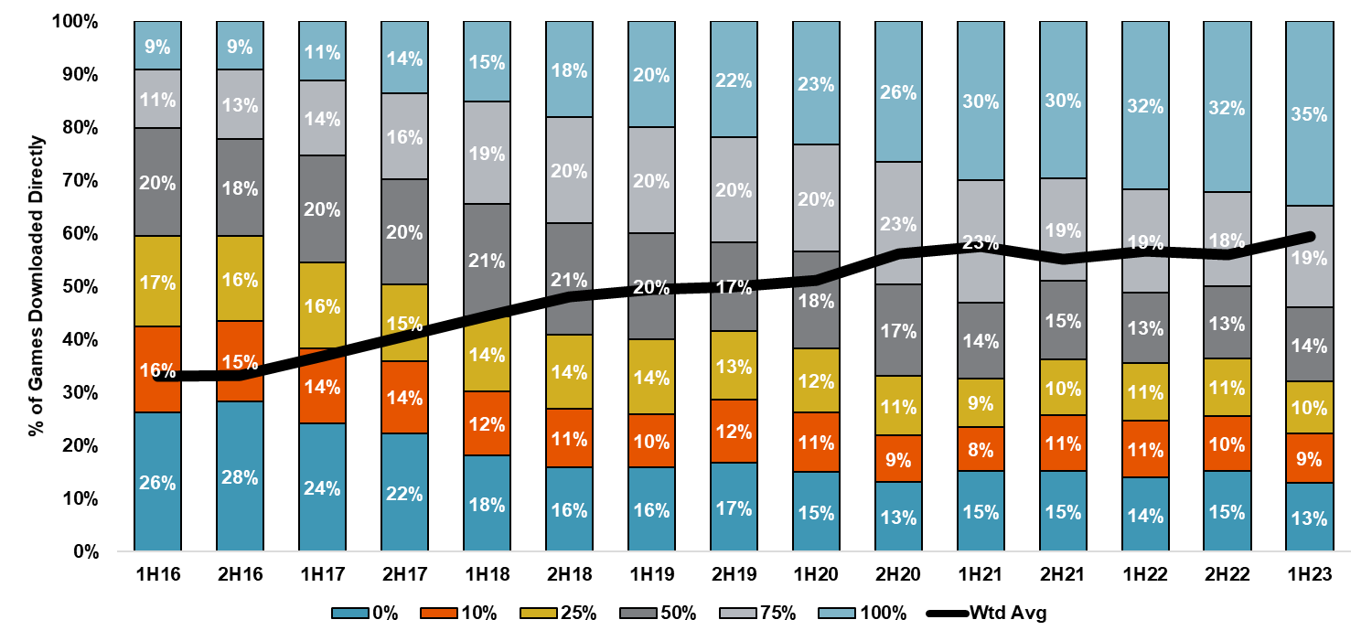
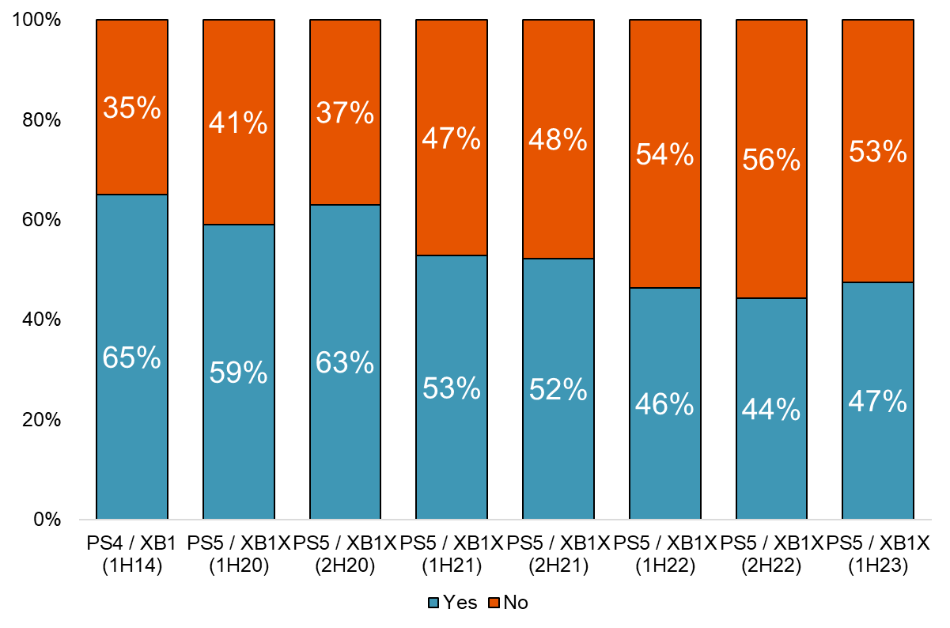
Teen Gaming | Full-Game Downloads & Console Purchases
Full-game downloads were up 3% vs. LY, and broke >60% of weighted avg. games
Purchasing a New Console in the Next 2 Years?
Wtd Avg Games Downloaded
1H23: 60%
2H22: 56%
1H22: 57%
Console Purchasing
1H23: 47%
2H22: 44%
1H22: 46%
Full-game downloads are most important to CDNs in the Gaming vertical, and teens continue to download >50% of their games on a weighted average basis. There was a decent uptick to 60% of games being downloaded on a weighted average basis, which suggests to us a continued multi-year trend higher and direct downloads increasing. Anticipated console purchasing over the next two years did slightly increase, but remains sub-50%.
Executive Summary
Teen Behavior & Habits
Teen Brand Preferences
Demographics & Appendices

Slide 20
Teen Brand Preferences
Executive Summary
Teen Behavior & Habits
Teen Brand Preferences
Demographics & Appendices
Image Source: Brand websites.

Slide 21
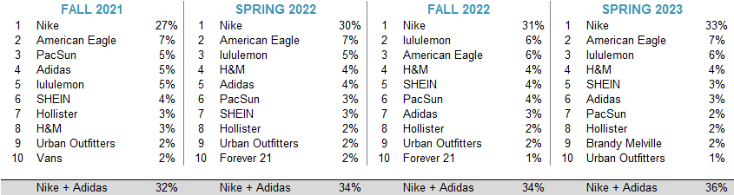
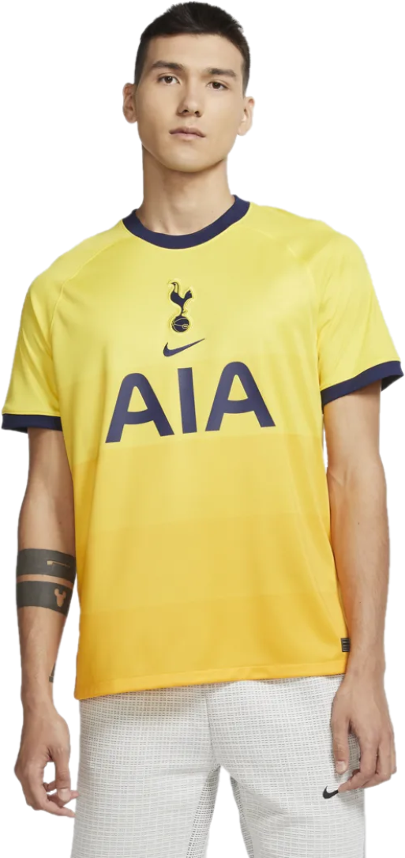
Favorite Apparel Brands
All Teens – See Appendix for more detail broken down by upper vs. average-income teens and male vs. female
Apparel spending was ~$595/year—up 9% Y/Y and up 4% sequentially
Females outspend males by ~$200 vs. $202 last Fall
Nike is the No. 1 brand (>12 years running) at 33% share, +300 bps Y/Y
American Eagle took No. 2 brand spot from lululemon, remaining flat Y/Y and up +100 bps vs Fall 2022
Adidas moved from No. 7 brand in Fall 2022 to No. 6 in Spring 2023, but fell 100 bps Y/Y
SHEIN maintained the No. 5 spot, but lost 100 bps since Fall 2022 (flat Y/Y)
Brandy Melville moved into the top 10 taking the No. 9 spot with 2% mindshare, ahead of Urban Outfitters with 1% mindshare (down 100 bps Y/Y)
Executive Summary
Teen Behavior & Habits
Teen Brand Preferences
Demographics & Appendices
Image Source: Nike.com

Slide 22
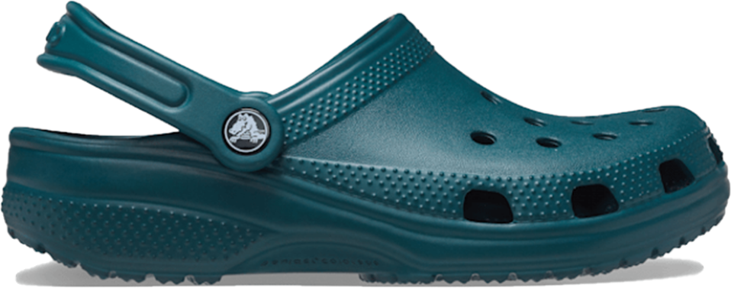
Favorite Footwear Brands
All Teens – See Appendix for more detail broken down by upper vs. average-income teens and male vs. female
Footwear spending was $307/year—up 2% Y/Y with male’s up 6% Y/Y and female’s down -2% Y/Y
Males continue to outspend females on footwear by $75/year for all-income teens, by $47/year for upper-income teens, and by $84/year for average-income teens
Nike remained No. 1, gaining 120 bps of mindshare Y/Y and 150 bps sequentially
adidas remained No. 3 but lost 170 bps of share Y/Y while Converse gained 165 bps Y/Y
New Balance moved back to the No. 5 spot, gaining 100 bps of share Y/Y, while Crocs moved to the No. 6 spot but still gained 25 bps of share Y/Y
UGG emerged in the top 10 taking the No. 7 spot while Hey Dude moved to the No. 8 spot but still gained 25 bps of share Y/Y
Under Armour fell out of the top 10 ranking compared to last Spring
Executive Summary
Teen Behavior & Habits
Teen Brand Preferences
Demographics & Appendices
Image Source: Crocs.com

Slide 23
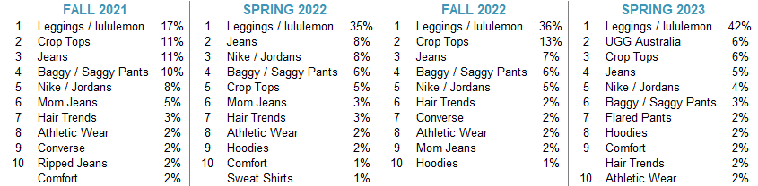
Top Fashion Trends Right Now
Upper-Income Teens, Female
This unaided question goes to all teens to opine on top fashion trends for females in school
Leggings/lululemon is still the No. 1 trend at 42%, gaining +700 bps of mindshare Y/Y and up +600 bps sequentially
UGGs replace Crop Tops as the No. 2 trend with 6% mindshare, after not being in the top 10 for the last few surveys
Crop tops took third with 6% mindshare, reflecting a 700 bps decline vs Fall 2022 yet a 100 bps increase Y/Y
Denim trends have decreased slightly in overall mindshare with jeans down 300 bps Y/Y with baggy pants falling 300 bps Y/Y, flared pants taking the No. 7 spot with 2% mindshare, and mom jeans falling out of the top 10.
Nike/Jordans (4%) and athletic wear (2%) remain relevant—landing in the No. 5 and No. 10 position, while Nike fell 400 bps Y/Y and 100 bps sequentially
Hoodies gained share, moving into the No. 8 spot vs. the No. 10 spot last Fall, and increasing 100 bps sequentially (flat Y/Y)
Hair trends fell to No. 9 vs. No. 6 in the Fall, and Comfort moved back into the top 10 after falling out last Fall
Executive Summary
Teen Behavior & Habits
Teen Brand Preferences
Demographics & Appendices

Slide 24
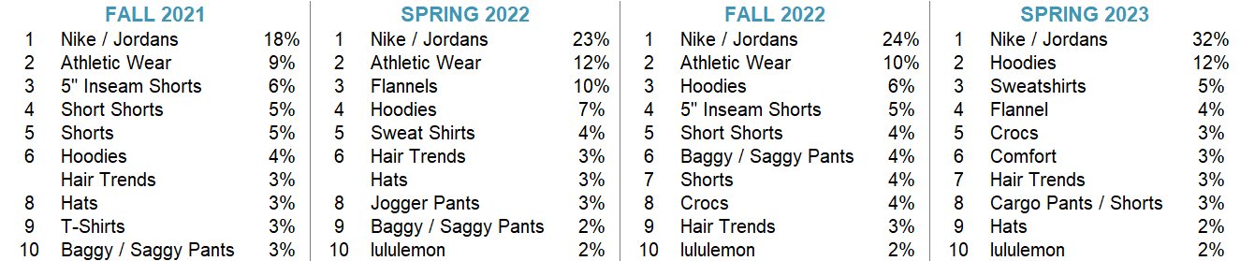
Top Fashion Trends Right Now
Upper-Income Teens, Male
Like the former question, this question goes to all teens to opine (unaided) on top fashion trends for males
Mentions of Nike / Jordans remain No. 1 mindshare and gained 900 bps of mindshare Y/Y, up 800 bps sequentially
Hoodies took the No. 2 spot with 12% mindshare, up 600 bps sequentially and 500 bps Y/Y
Mentions of 5” Inseam Shorts fell out of the top 10, while Flannel entered the top 10, taking spot No. 4 with 4% mindshare
Notably, Crocs moved from the No. 8 spot last Fall to the No. 5 spot, but lost 100 bps sequentially
Leggings / lululemon remain at No. 10 with 2% share, flat Y/Y and in line with last Fall
Comfort (3% share) and Cargo pants / shorts (3% share) entered the top 10 while Shorts and Athletic Wear fell out
Executive Summary
Teen Behavior & Habits
Teen Brand Preferences
Demographics & Appendices

Slide 25
Top Brands Starting To Be Worn
Upper-Income Teens
Male
Female
Executive Summary
Teen Behavior & Habits
Teen Brand Preferences
Demographics & Appendices

Slide 26
Top Brands No Longer Worn
Upper-Income Teens
Male
Female
Executive Summary
Teen Behavior & Habits
Teen Brand Preferences
Demographics & Appendices

Slide 27
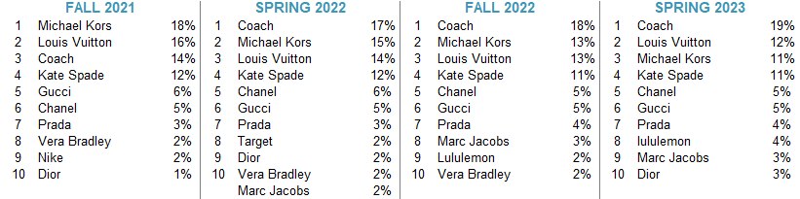
Favorite Handbag Brands
All Female Teens
Handbag spending increased to to $128/year, up 8% Y/Y and up 25% sequentially
Coach maintains No. 1 spot with 19% mindshare, up 100 bps vs the Fall and up 200 bps Y/Y
Kate Spade remains at No. 4 with 11% share, while losing 100 bps, in line with Fall 2022 and down 100 bps Y/Y
Chanel, Gucci, and Prada maintain spots No. 5 through 7 since Fall and all maintained the same level of mindshare since Fall – Chanel (5%), Gucci (5%), Prada (4%)
SHEIN remains out of the top 10 after falling out in Fall 2021; SHEIN was No. 17 brand with <1% share
Lululemon ranked in the top 10 for the second consecutive survey while gaining 200 bps of mindshare and moving from No. 9 to No. 8 for female teens favorite handbag
Marc Jacobs took the No. 9 spot with 3% mindshare, in line with last Fall, and up 100 bps Y/Y
Executive Summary
Teen Behavior & Habits
Teen Brand Preferences
Demographics & Appendices

Slide 28
Beauty: Favorite Cosmetics Brands
All Female Teens
Female spending on cosmetics was $123—up 32% Y/Y, including an impressive +40% Y/Y amongst upper-income females and +26% Y/Y amongst average-income females.
e.l.f. gained an impressive 900 bps of mindshare Y/Y to 22% and maintained its position as the No. 1 makeup brand amongst teens.
Selena Gomez’s Rare Beauty moved up 5 spots from the Fall to #2, bumping Maybelline to #3 for the first time since Spring 2021.
L’Oreal moved back down to #4, followed by LVMH’s Fenty Beauty at #5 (unchanged from the Fall) and Puig’s Charlotte Tilbury at #6, its highest positioning yet.
EL-owned Too Faced and MAC made their way back into the top 10, while L’Oreal’s NYX made it in for the first time, replacing Sephora, Ulta, and Morphe.
Executive Summary
Teen Behavior & Habits
Teen Brand Preferences
Demographics & Appendices

Slide 29
Beauty: Favorite Skincare Brands
All Female Teens
Skincare spending for females was $119/year— +11% Y/Y, and ~12% higher than the multi-year average.
CeraVe (L’Oreal-owned) maintained its lead as the No. 1 skincare brand with 41% mindshare (in line with last year).
The Ordinary (EL-owned) moved into the No. 2 spot for the first time at 7% mindshare compared to 6% last year; it was also No. 2 among average-income females at 8% mindshare.
Cetaphil (owned by privately-held Galderma) moved to No. 3 and Neutrogena continued to slip—now in the No. 6 spot with 4% mindshare vs. 5% in the Fall and 6% last Spring.
Drunk Elephant (owned by Shiseido) moved up 1 spot to No. 4 with 4% mindshare, while La Roche-Posay (L’Oreal-owned) also moved up 1 spot from the Fall to No. 5 at 4% mindshare.
Digitally-native custom skincare brand, Curology, and EL’s Clinique switched spots at No. 8 and No. 7, respectively.
e.l.f.’s skincare brand is continuing to gain traction amongst teens, making its first debut in the top 10 at No. 9, followed by JNJ’s Aveeno at No. 10.
Executive Summary
Teen Behavior & Habits
Teen Brand Preferences
Demographics & Appendices

Slide 30
Beauty: Favorite Haircare Brands
All Female Teens
Annual haircare spend stood at $90 for female teens which was largely in line with last year. Upper-income teens spent $86/year on haircare and average-income teens spent $92/year.
Olaplex made its way back to No. 1, gaining one point of share from the Fall, but still sitting below the 11% mindshare seen in Spring 2022. Olaplex was also the No. 1 hair brand for both upper and average-income teens.
UL’s SheaMoisture dropped to No. 2 again, losing 1 point of mindshare Y/Y. Pantene maintained its spot at No. 3, while Mielle came in at No. 4 for its first time being in the top 10. The brand’s launch in Ulta this past year likely helped here.
Amika beat out Dove and Aussie, coming in at No. 5 for its first top 10 debut. L’Oreal and Dove followed at No. 6 and No. 7, respectively. Garnier and Aussie still ranked in the top 10, but did each lose some share.
Not Your Mother’s also made its first debut in the top 10, coming in at No. 10.
Other brands to call out amongst the upper-income group include P&G-owned Ouai, L’Oreal’s Redken, and privately-held Moroccan Oil.
Executive Summary
Teen Behavior & Habits
Teen Brand Preferences
Demographics & Appendices

Slide 31
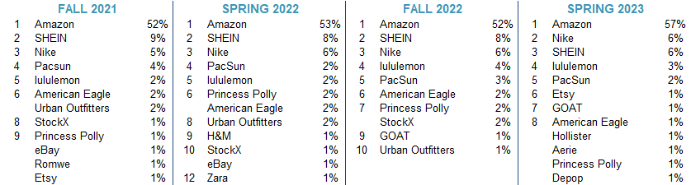
Favorite Websites For Shopping
Upper-Income Teens
94% of females claim to shop online (down from 95% in the Fall) and 92% of males shop online (vs. 90% in the Fall)
Amazon’s dominance continues as 57% of teens say this is their favorite website to shop on
SHEIN lost mindshare, falling from No. 2 favorite website for the last 3 surveys to No. 3 with 6% mindshare (down 200 bps Y/Y and vs Fall 2022)
Nike surpassed SHEIN in terms of favorite shopping website, while total mindshare (6%) remained in line vs last Fall and as well as Y/Y
Princess Polly lost share (-100 bps Y/Y and vs Fall 2022), falling to the No. 8 spot (tied with several other brands), down from the No. 7 last Fall
GOAT moved from the No. 9 spot in Fall 2022 to the No. 7 spot this Spring with 1% mindshare (flat vs last Fall)
Executive Summary
Teen Behavior & Habits
Teen Brand Preferences
Demographics & Appendices

Slide 32
Favorite Restaurant
Executive Summary
Teen Behavior & Habits
Teen Brand Preferences
Demographics & Appendices

Slide 33
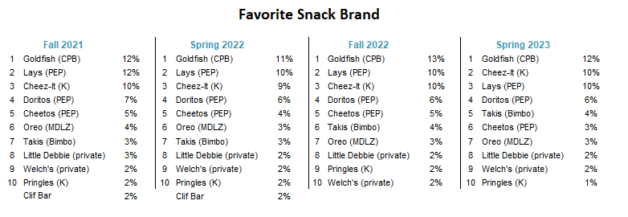
Favorite Snack Brand
Goldfish maintained its position as the number one snack brand, slightly ahead of Lays and Cheez-It
Cheez-It, Lays, Doritos, and Takis complete the top five positions
Cheez-It, Takis and Welch’s moved up one spot, while Lays, Cheetos and Pringles fell one spot
Little Debbie held its position in the top ten
Executive Summary
Teen Behavior & Habits
Teen Brand Preferences
Demographics & Appendices

Slide 34
Non-Binary Preferences
The non-binary cohort ranked Nike as No. 1 for both apparel and footwear brands.
Hot Topic and Goodwill take spots No. 2-3 for favorite apparel brand, while Converse falls second for favorite footwear brand followed by Vans and Dr. Martens, tied for the No. 3 spot.
In-line with the other results of the survey, Amazon is the No. 1 website for the non-binary cohort, followed by SHEIN and Nike.
Executive Summary
Teen Behavior & Habits
Teen Brand Preferences
Demographics & Appendices

Slide 35











Meet Our Senior Research Analyst Team
Abbie Zvejnieks
Global Lifestyle Brands, Athletic & Footwear
Edward Yruma
Global Lifestyle Brands, Retail & Digital Disruptors
Harsh Kumar
Semiconductors
James Fish
Cloud Automation Software
Korinne Wolfmeyer
Beauty & Wellness
Peter Keith
Hardlines & Leisure
Michael Lavery
Consumer Staples
Tom Champion
Internet
Kevin Barker
Financial Technology
Matt Farrell
Vertical Marketplaces
Jason Bednar
Orthodontics
Executive Summary
Teen Behavior & Habits
Teen Brand Preferences
Demographics & Appendices

Slide 36
Important Research Disclosures
Analyst Certification – Ed Yruma, Abbie Zvejnieks, Senior Research Analysts: The views expressed in this report accurately reflect my personal views about the subject company and the subject security. In addition, no part of my compensation was, is, or will be directly or indirectly related to the specific recommendations or views contained in this report.
Piper Sandler research analysts receive compensation that is based, in part, on the firm's overall revenues, which include investment banking revenues.
Affiliate disclosures: Piper Sandler is the trade name and registered trademark under which the corporate and investment banking products and services of Piper Sandler Companies and its subsidiaries Piper Sandler & Co. and Piper Sandler Ltd. are marketed. This report has been prepared by Piper Sandler & Co. Piper Sandler & Co. is regulated by FINRA, NYSE and the United States Securities and Exchange Commission, and its headquarters are located at 800 Nicollet Mall, Minneapolis, MN 55402. Piper Sandler Ltd. is authorised and regulated by the Financial Conduct Authority, and is located at 6th Floor, 2 Gresham Street, London EC2V 7AD. Disclosures in this section and in the Other Important Information section referencing Piper Sandler include all affiliated entities unless otherwise specified.
Ratings and Other Definitions
Stock Ratings: Piper Sandler fundamental ratings are indicators of expected total return (price appreciation plus dividend) within the next 12 months. At times analysts may specify a different investment horizon or may include additional investment time horizons for specific stocks. Stock performance is measured relative to the group of stocks covered by each analyst. Lists of the stocks covered by each are available at www.pipersandler.com/researchdisclosures. Stock ratings and/or stock coverage may be suspended from time to time in the event that there is no active analyst opinion or analyst coverage, but the opinion or coverage is expected to resume. Research reports and ratings should not be relied upon as individual investment advice. As always, an investor’s decision to buy or sell a security must depend on individual circumstances, including existing holdings, time horizons and risk tolerance. Piper Sandler sales and trading personnel may provide written or oral commentary, trade ideas or other information about a particular stock to clients or internal trading desks reflecting different opinions than those expressed by the research analyst. Piper Sandler will buy and sell securities of the subject company on a principal basis, regardless of whether it is a registered market maker in those securities. In addition, Piper Sandler offers technical products that are based on different methodologies, may contradict the opinions contained in fundamental research reports, and could impact the price of the subject security. Recommendations based on technical analysis are intended for the professional trader, while fundamental opinions are typically suited for the longer-term institutional investor.
Overweight (OW): Anticipated to outperform relative to the median of the group of stocks covered by the analyst.
Neutral (N): Anticipated to perform in line relative to the median of the group of stocks covered by the analyst.
Underweight (UW): Anticipated to underperform relative to the median of the group of stocks covered by the analyst.

Slide 37
Important Research Disclosures
Other Important Information
The material regarding the subject company is based on data obtained from sources deemed to be reliable; it is not guaranteed as to accuracy and does not purport to be complete. This report is solely for informational purposes and is not intended to be used as the primary basis of investment decisions. Piper Sandler has not assessed the suitability of the subject company for any person. Because of individual client requirements, it is not, and it should not be construed as, advice designed to meet the particular investment needs of any investor. This report is not an offer or the solicitation of an offer to sell or buy any security. Unless otherwise noted, the price of a security mentioned in this report is the most recently available market closing price. Piper Sandler does not maintain a predetermined schedule for publication of research and will not necessarily update this report. Piper Sandler policy generally prohibits research analysts from sending draft research reports to subject companies; however, it should be presumed that the fundamental equity analyst(s) who authored this report has had discussions with the subject company to ensure factual accuracy prior to publication, and has had assistance from the company in conducting diligence, including visits to company sites and meetings with company management and other representatives.
Notice to customers: This material is not directed to, or intended for distribution to or use by, any person or entity if Piper Sandler is prohibited or restricted by any legislation or regulation in any jurisdiction from making it available to such person or entity. Customers in any of the jurisdictions where Piper Sandler and its affiliates do business who wish to effect a transaction in the securities discussed in this report should contact their local Piper Sandler sales representative, or as otherwise noted below. Canada: Piper Sandler & Co. is not registered as a dealer in Canada and relies on the “international dealer exemption” set forth in National Instrument 31-103 – Registration Requirements, Exemptions and Ongoing Registrant Obligations of the Canadian Securities Administrators. This research report has not been prepared in accordance with the disclosure requirements of Dealer Member Rule 3400 – Research Restrictions and Disclosure Requirements of the Investment Industry Regulatory Organization of Canada.
Europe: This material is for the use of intended recipients only and only for distribution to professional and institutional investors, i.e. persons who are authorised persons or exempted persons within the meaning of the Financial Services and Markets Act 2000 of the United Kingdom, or persons who have been categorised by Piper Sandler Ltd. as professional clients under the rules of the Financial Conduct Authority. United States: This report is distributed in the United States by Piper Sandler & Co., member SIPC, FINRA and NYSE, Inc., which accepts responsibility for its contents. The securities described in this report may not have been registered under the U.S. Securities Act of 1933 and, in such case, may not be offered or sold in the United States or to U.S. persons unless they have been so registered, or an exemption from the registration requirements is available.
This report is produced for the use of Piper Sandler customers and may not be reproduced, re-distributed or passed to any other person or published in whole or in part for any purpose without the written consent of Piper Sandler & Co. Additional information is available upon request.
© 2023 Piper Sandler. All rights reserved.

