Slide 1


The Compliso Toolkit
COMPLISO
Presents

Slide 2

Welcome to the Compliso Toolkit
Hi, I’m Liso – your quality sidekick.
Whether you’re new to ISO or just tired of overcomplicated systems, you’re in the right place.
The Compliso Toolkit gives you:
Everything you need to build a compliant QMS
Templates and guides that actually make sense
No jargon, no filler – just real help.
Welcome. I’m Liso

Slide 3
The Stress of ISO Certification
If you’re a small company trying to get ISO 9001 certified, you’ve probably felt this:
You don’t know where to start
You’re not sure if you’re doing it right
You’ve downloaded “free templates” that just made things worse
You’re spinning your wheels, second-guessing every step
You’re stressing about the audit itself
You don’t have a dedicated quality team.
You don’t have time to read through standards line by line and try to interpret what they actually expect from you.
And you definitely don’t have the budget for an expensive consultant.

Slide 4
Interpreting the Standard is Half the Battle
Trying to interpret the standard?
Good luck with that…
What the standard says
“The organization shall determine external and internal issues that are relevant to its purpose and its strategic direction and that affect its ability to achieve the intended result(s) of its quality management system.
The organization shall monitor and review information about these external and internal issues”
(ISO 9001:2015 Clause 4.1)
What it actually means
Think about what’s going on inside and outside your company
Identify anything that could impact how you meet quality goals
Turn that into a tidy document an auditor will understand
Keep it updated even if you’re a two-person team juggling everything
The Compliso Toolkit explains every clause – in plain English – and shows you how to meet it.

Slide 5

Introducing the Compliso Toolkit
The Compliso Toolkit takes the stress, confusion, and guesswork out of getting certified.
Here’s what you get:
📘 Clause-by-clause guidebooks – each clause broken down into plain English explanations
📂 Editable templates – built to match what auditors actually want to see
📖 Template guidebooks – walkthroughs for each template so you know how to complete them correctly
📝 Completed examples – so you never have to guess what “right” looks like
🎓 Additional training material – to help get your whole team on board
📦 Delivered through a clean, user-friendly app – giving you structured access to everything you need, all in one place.
Everything you need to build your QMS – clearly explained, easy to follow, and ready to go.
All delivered in a way that makes sense.

Slide 6
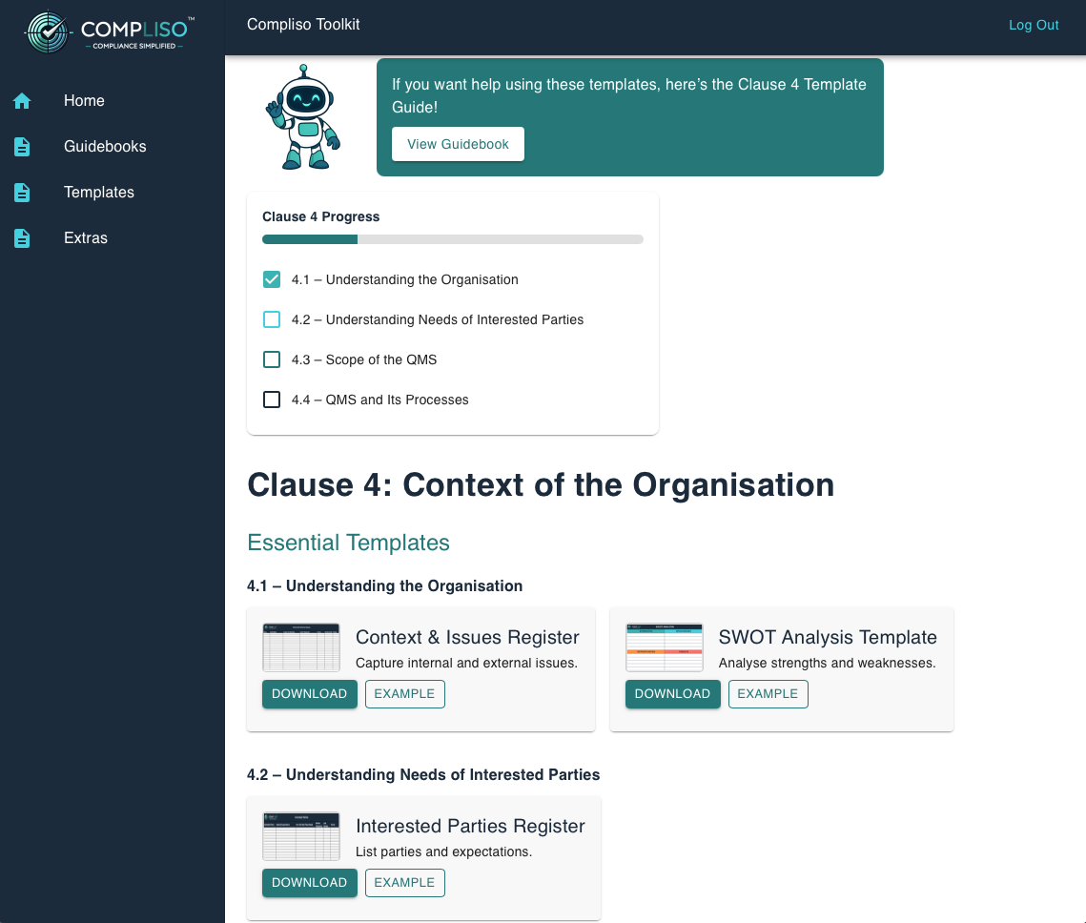
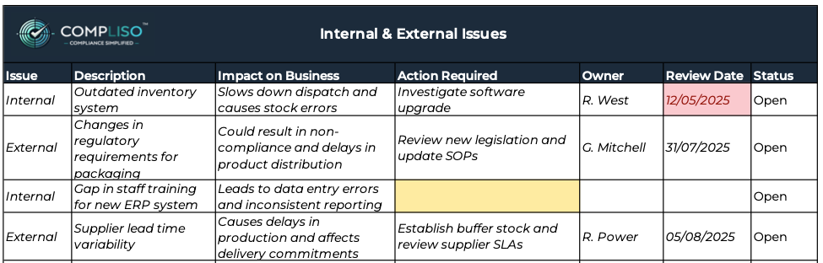
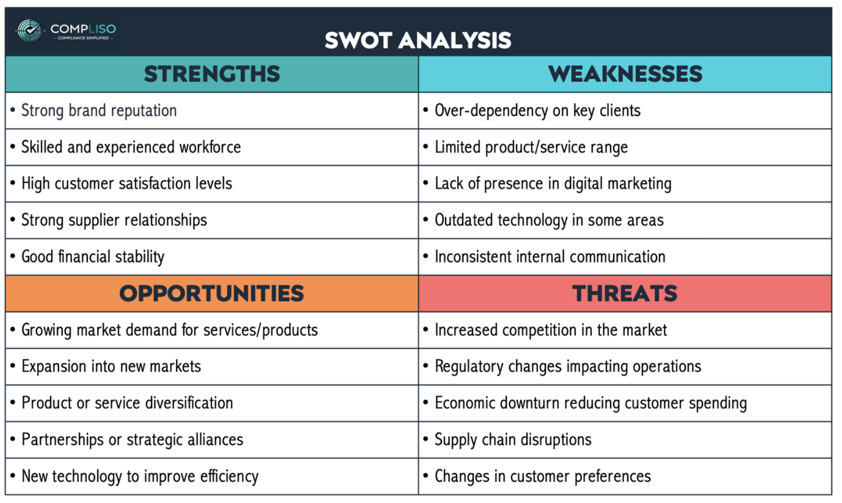
A Peek Inside the Toolkit 👀

Slide 7
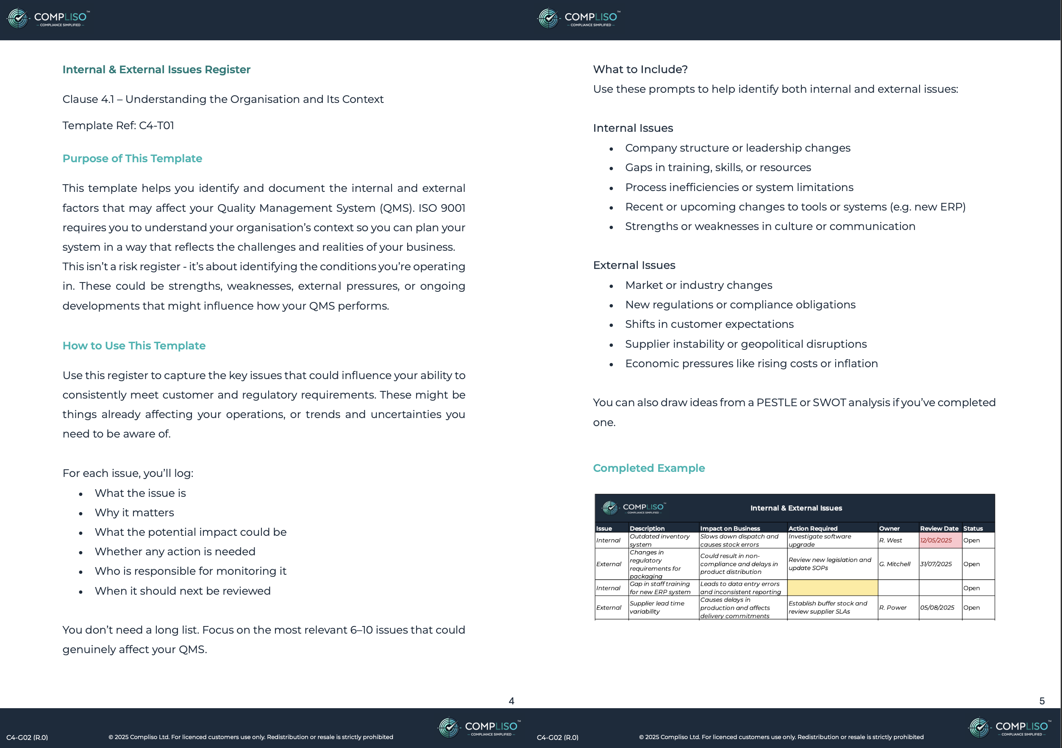
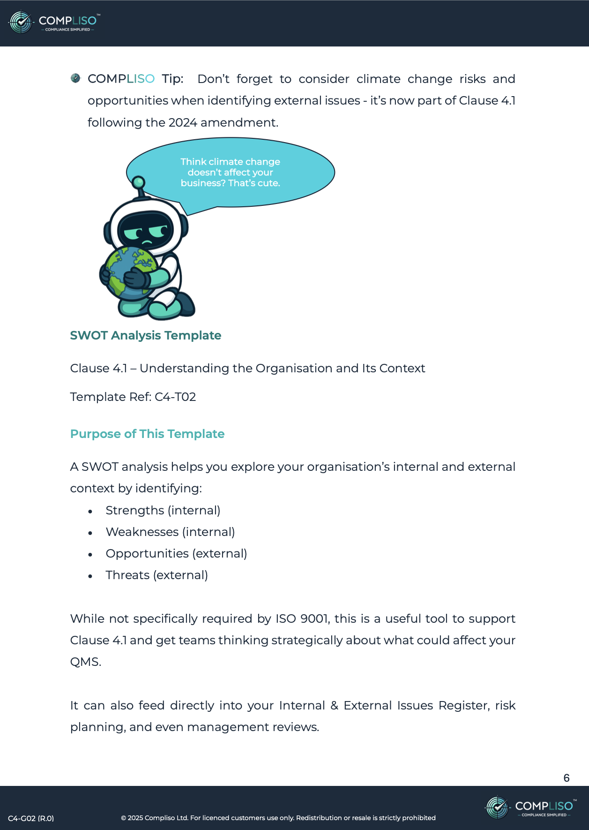
A Peek Inside the Guidebooks 👀

Slide 8
Who’s the Compliso Toolkit For?
This toolkit is perfect for:
Small businesses working towards ISO 9001 for the first time
Quality managers building a system with limited time
Business owners who want to avoid expensive consultants
Teams with no formal quality training but big audit goals
Anyone who just wants ISO to make sense
If ISO feels like a second language – this toolkit was built for you.

Slide 9


Ready to Make ISO Simple?
The Compliso Toolkit was built to take you from
“I have no idea where to start” to “We’re ready for the audit.”
Everything you need – guidebooks, templates, examples, and training – delivered in one tidy, easy-to-use platform.
And this is just the start…there’s much more to come…
Want the Toolkit?
Liso’s ready - just press that Big Red Button
or visit www.compliso.ie
Buy Now

Slide 10
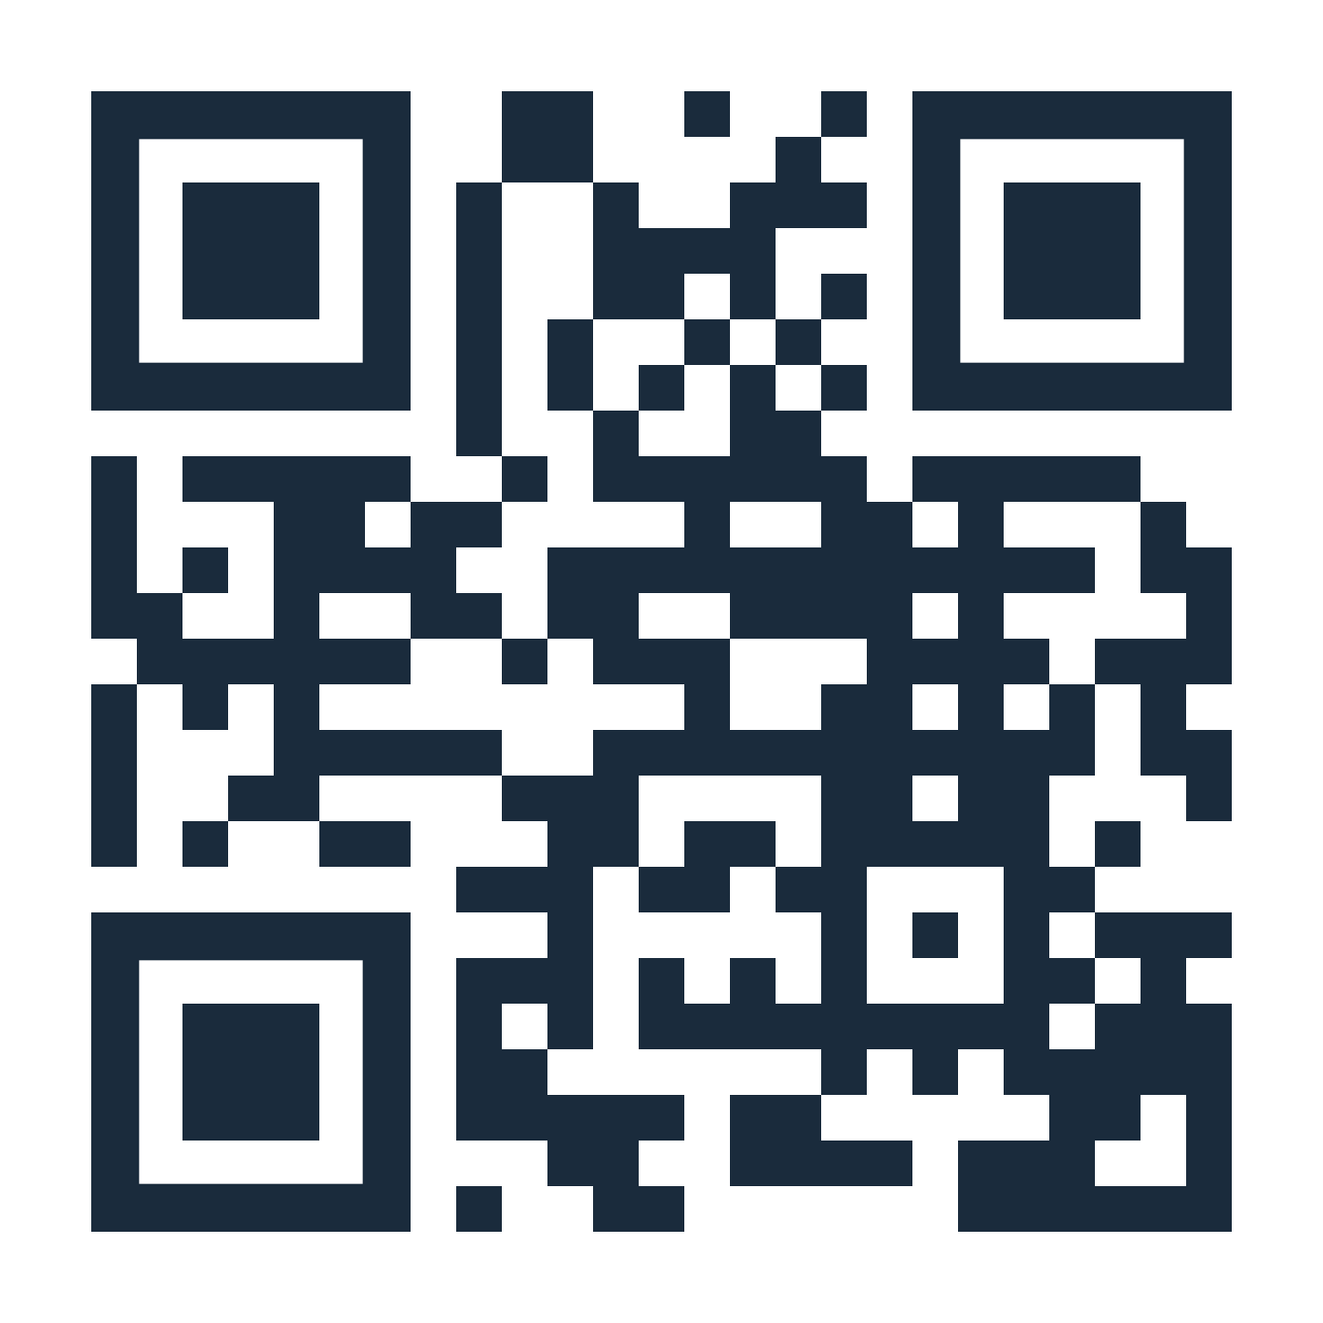
Contact Us
Have a question? Curious about the toolkit?
📧 Email: info@compliso.ie
🌐 Website: www.compliso.ie
📍 Based in Ireland - supporting small businesses everywhere.

